Slide 1
Project Management
US 120388 - Supervise a project team of a small project to deliver project objectives
US 10146 - Supervise a project team of a developmental project to deliver project objectives
28 Credits

Slide 2
Breakdown of 3 days
Day1
  General information on Unit standards / Portfolio Building.
  Study Unit 1 - ORGANISATIONAL STRUCTURES AND KEY STAKEHOLDERS FOR PROJECT MANAGEMENT
  Summarise
Day 2 + Recap
  Study 2 - SUPERVISE A PROJECT TEAM OF A SMALL PROJECT TO DELIVER PROJECT OBJECTIVES
  Study 3 - SUPERVISION AND PROJECT MANAGEMENT
Day 3 + Recap
  Study Unit 4 - REPORT ON PROGRESS
  Study Unit 5 - IDENTIFY AND RECTIFY PROBLEMS

Slide 3
Ground Rules
Days Training, Workshops, and Portfolio building
Breaks
Participation
  Open
  Work experience
  Show of hands
  Chat session
  Park-Slide – noting discussion topics
Portfolio Submission

Slide 4

Section 1 Overview
What Is a Portfolio?
Collection of Evidence that
Lists criteria (a standard or principle for judging, evaluating, or selecting something) for proving competence
  So, what is competence?
    the ability to do something successfully or efficiently
    By applying the related knowledge, skills, and abilities
Provides evidence that you meet criteria
Is organised to enable assessor to evaluate evidence against criteria.

Slide 5
Overview
The Portfolio of Evidence (PoE)
Section 1 – Administrative detail
Section 2 – Assessment planning
Section 3 – Assessment design matrix
Section 4 – Formative assessment activities
Section 5 – Summative assessment
Knowledge questionnaires

Slide 6
Overview
Section 6 – Summative assessment – Workplace assignments
Section 7 – Feedback
Section 8 – 10 Additional Evidence

Slide 7
Categories Of Evidence
Practical Competence
Foundational Competence
Reflective Competence

Slide 8
Overview
Competency
  Against Outcomes in Unit Standard
Interpret
  Outcomes in relation to workplace

Slide 9
Good Evidence
Valid
  Should relate to what is being assessed
Authentic
  Own evidence
Reliable
  Consistency
  Another assessor makes same judgment
Current
  As recent as possible
Sufficient
  Enough evidence

Slide 10
Assessment Brief
Purpose of Unit Standard
120388 Supervise a project team of a small project to deliver project objectives
Learners accessing this standard will be working as a leader in the context of a small project/sub-project involving few resources and having a limited impact on stakeholders and the environment. These projects may be from any economic sector. This standard will also add value to learners who are running their own business and recognise that project management forms an integral component of any business.

Slide 11
Assessment Brief
Purpose of Unit Standard
120388 Supervise a project team of a small project to deliver project objectives
Learners accessing this standard will be working as a leader in the context of a small project/sub-project involving few resources and having a limited impact on stakeholders and the environment. These projects may be from any economic sector. This standard will also add value to learners who are running their own business and recognise that project management forms an integral component of any business.
Page 39 + 43

Slide 12

Assessment Brief
Entry Level Requirements
Refer page number 9 of 155
Communication
Mathematical Literacy
Computer Literacy

Slide 13
Assessment Brief
Credit Value
10 credits = 100 notional hours
Theoretical + Practical + Workplace experience
Submission of Portfolio of Evidence (PoE) - based on Specific Outcomes (SOs) and Assessment Criteria (ACs).
This program credits is 14 each = 28 credits – 280 hours
Comprising of 24 hours theory / 156 hours practical / 100 hours workplace experience

Slide 14
Types of Assessment
Integrated Assessment
Diagnostic
Formative
Summative

Slide 15
Assessment Methods
Assessment Methods
Questioning
Product Evaluation
Observation

Slide 16
Assessment
Assessment
Formative
Summative
Evidence during
facilitation
Self Assessment
Knowledge Assessment
Summative Workplace
Assignments
Formative + Summative = Competent

Slide 17
Competence
Competent
Ability to perform task, action or function successfully
Certificate issued and credits awarded
Not Yet Competent
Not successful yet
Opportunities to remediate to address gaps

Slide 18

Re-Assessment
Specific feedback - focus on not yet competent areas
Re-assessment - same context and same conditions
Only Not Yet Competent specific outcomes - to be re-assessed
ENJO’s policy: - Two (2) re-assessments

Slide 19
Assessment Brief
Credit Accumulation
Credits will be awarded on successful completion of unit standards.
NB: - Quality Assurance Process
Assessment
Moderation
Verification

Slide 20
Assessment Brief
Assessment Tools and Matrix:
  All the specific outcomes
  Associated assessment criteria
  Range statements
  Critical cross-field, development outcomes
  Essential embedded knowledge.

Slide 21
Assessment Brief
ENJO Assessment Process:
  Integrated assessment against current SAQA registered unit standards and qualifications in a fair, valid, reliable and practicable manner.
  Moderation and verification procedures carried as per SAQA requirements.
  Learner competence demonstrated through formative and summative assessments.

Slide 22
Assessment Brief
Learners have the right to:
  Be informed when and how assessments are conducted
  Appeal against an assessment conducted.
  Get interpretation to the numeracy and literacy level of the skills programme, unit standard or qualification.

Slide 23
Assessment Brief
Facilitation and assessments will be conducted in English.
Learners may have an observer present; however observer may not partake, comment or interrupt the assessment process.
Assessment results will be available as soon as possible after the final assessment.
Learners may have access to results within normal working hours.

Slide 24
Assessment Brief
Additional Notes:
  Assessor will maintain telephonic and electronic contact until sufficient evidence has been submitted.
  Additional evidence may be submitted after initial submission.
  If you have a problem which might affect the outcome of assessment(s) you should notify the assessor. Where practicable such needs will be accommodated. (special needs)

Slide 25
Appeals and Disputes
Learner has right to appeal against:
Unfair assessment
Invalid assessment
Unreliable assessment
Unethical practices
Inadequate expertise and experience of the assessor
Appeals have to be submitted in writing to ENJO.

Slide 26


Slide 27
Section 1
Portfolio of Evidence
Section 1 – Administrative Detail

Slide 28

Section 1 - 2 Administrative Detail
Learner Information
ID
CV
Qualifications
Special Instructions
Declaration of Authenticity
Unit Standard
Sign all required documents

Slide 29
Special Instruction
No Tippex
Initial each page
Comments in full
ENJO or own templates to be used to complete portfolio
Use assigned colour unless instructed differently

Slide 30
Unit Standard
Refer pages 39 - 46
SAQA US ID
Unit Standard Title
NQF Level
Credits
Purpose of the Unit Standard
Learning assumed to be in place

Slide 31
Unit Standard
Unit Standard Range
Specific Outcomes
Assessment Criteria
Essential Embedded Knowledge (EEK)
Critical Cross-field Outcomes (CCFOs)
Notes

Slide 32
Study Unit 1
ORGANISATIONAL STRUCTURES AND KEY STAKEHOLDERS FOR PROJECT MANAGEMENT

Slide 33


Let’s know one another?
What is your current role in this organization?
Have you worked on a small/major project as a team member?
Are you currently working on a project?
What are your expectation?

Slide 34
So let’s plan a wedding event
The Objective: is to plan a wedding that will be timely, within budget, memorable and exclusive.
Deliverables of wedding plan : Venue, wedding cake, • Venue selection, , cake design,
the guest list, invitation design, entertainment, hair and make up, wedding speech, vows, ring choice, honeymoon selection
Plan a wedding step by step.
1. Set a Wedding Budget.
2. Start Your Guest List. ...
3. Pick Your Wedding Party. ...
4. Narrow Down the Dates. ...
5. Choose a Venue

Slide 35
So let’s plan a wedding event
Benefits Criteria – success
Everyone being where they should be at the right times
Happy guests
No family conflict (yes, it’s a factor)
(For the bride), feeling beautiful
Having a stress-less wedding planning experience
Choosing wedding suppliers you can trust to deliver
Project team (leader/workers) / Budget / Tolerance / Change control

Slide 36
Learning outcomes Unit 1
& Summative assessments
Undertake the management activities, from start to end, for a small project. Refer page 23
Discuss and explain the appropriateness of the various organisational structures. Refer page 24

Slide 37
What will we cover?
Organisational structures and key stakeholders for project management
:
Alternative organisational structures are identified and how projects operate within each structure are identified. Advantages & disadvantages of all organisational structures are explained. Reasons for choosing particular organisational structures are described. The interface and overlap between general management and project management is explained. Examples of organisational structures are provided.

Slide 38
Introduction to Project Management
Projects differ from other types of work.
  A project is a task that is undertaken temporarily to create a unique product, service, or result.
  A project will always have a final date, and the duration of a project can vary from a number of weeks to several years.
  Its main aim is to complete project with fulfilling requirements of clients or customers on specified time.

Slide 39
Explaining Project Management
Project Management
The application of knowledge, skills, tools, and techniques to project activities to meet project requirements. Project management is accomplished through the correct application and integration of the project management process groups.
Process | One-time
Nature | Non-repetitive and unique
Work location | Within or outside the organizational premises
Set of tasks | Dynamic
Success | Ascertained by the accomplishment of the project within defined criteria.

Slide 40
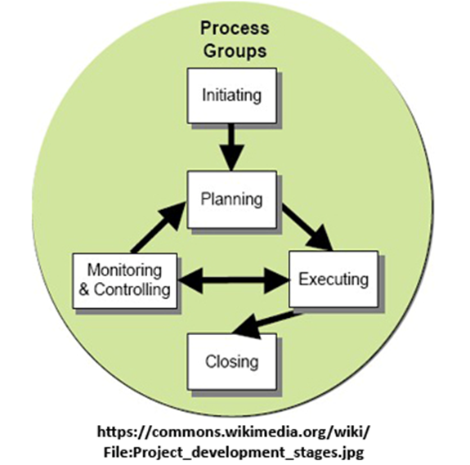
Project Management Stages

Slide 41
Time, Cost, Performance Constraints
Cost
  The specified or allowable budget for the project - the target cost of the work to be done.
Time
  The scheduled period over which the work must be done - the target date for when the project will be completed.
  (Which minimum resources (int/external) are needed)
Performance
  The scheduled period over which the work must be done - the target date for when the project will be completed.

Slide 42
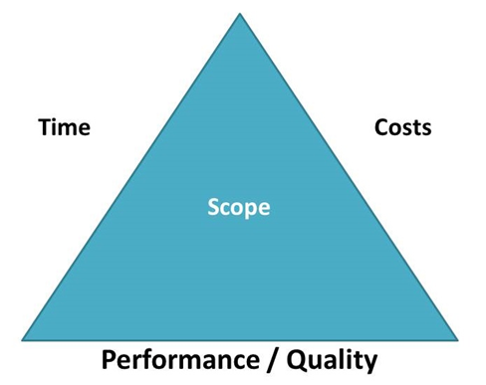
Time, Cost, Performance Constraints

Slide 43
Time, Cost, Performance Constraints
Time Constraint
  The amount of time that is available to complete a project
Cost Constraint
  The budgeted amount that is available for the project
Performance Constraint
  What must be done to produce the project’s end result

Slide 44
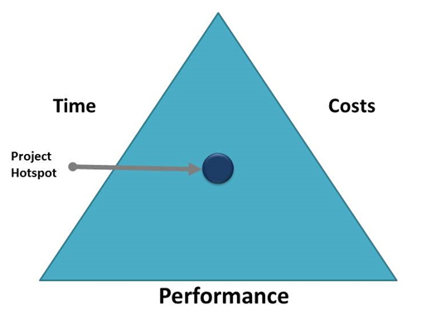
Time, Cost, Performance Constraints

Slide 45

Time to do an activity
Go to page 69 and answer the following questions: 15 minutes
1. How does a project differ from other types of work?
2. List the 5 process group of Project Management?
Briefly explain the 3 constraints of Project?

Slide 46
Understanding Project Management Body of Knowledge (PMBok)
The PMBOK® Guide is the standard used to manage most projects most of the time, and it is used across many types of industries.
This standard describes project management processes, tools, and techniques to use in the management of scope, schedule, quality, and cost, as well as any critical and environment aspects that influence the outcome of the project.

Slide 47
Understanding Project Management Body of Knowledge (PMBok)
The following list contains some of the areas which may overlap or have interdependencies:
  Definition of a project - represents a single, focused endeavour
  Definition of a program - is a collection of projects
  Definition of a portfolio - a collection of projects and/or programmes
  Relationship between project management and program management - A project is a temporary endeavor (such as the creation of a new product, service, or result) A program is a group of projects that are similar or related to one another, and which are often managed and coordinated as a group instead of independently.

Slide 48
Understanding Project Management Body of Knowledge (PMBok)
The following list contains some of the areas which may overlap or have interdependencies:
  Relationship between project management and portfolio management - project management is about executing projects right, portfolio management is about executing the right projects.
  Stakeholder management – is used to gain a mutual understanding of the objectives and expectations of all parties
  Governance - is the framework for how project decisions are made. It tells you what activities the organization does, and who’s responsible.

Slide 49
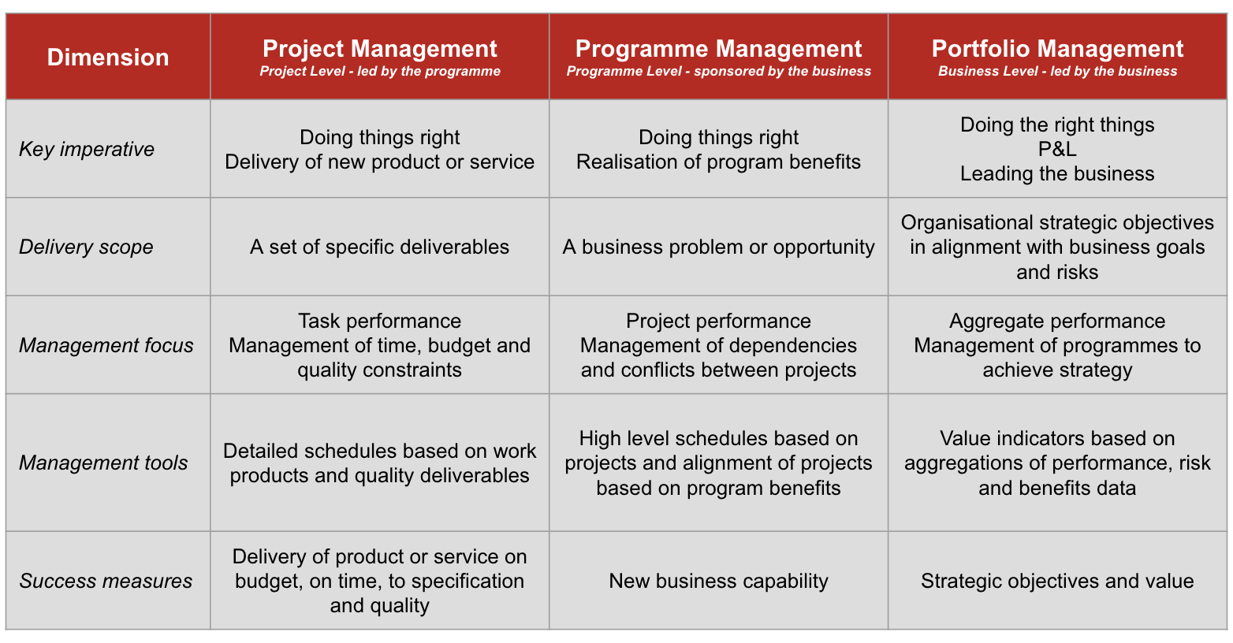
Comparatives and output

Slide 51
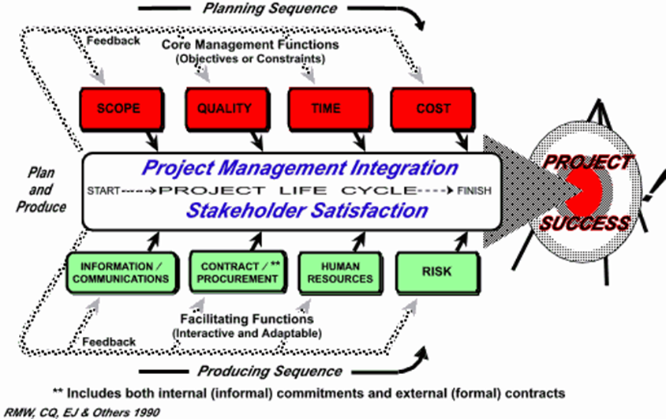
The Project Management Process

Slide 52
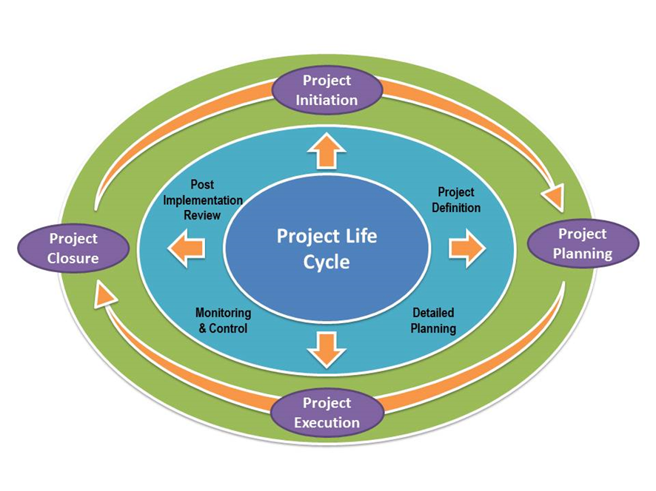
Project Processes and Knowledge areas
(546) The Life Cycle of Project Management – YouTube
https://www.youtube.com/watch?v=POuGKD3xLqs

Slide 53
The nine knowledge areas - Refer page 33
Project Integration Management - is the umbrella that covers all other project management
Project Scope Management - management plan that defines, validates, and controls scope
Project Time Management - timelines and the schedules of resources
Project Cost Management - continuously evaluate your costs to avoid any surprises at the end of a project
Project Quality Management - is to achieve consistency across your projects
Project Human Resource Management - is creating teams that click and helping individual team members grow and learn new tasks.
Project Communications Management - is crucial to identifying who needs to know what and when before your project starts
Project Risk Management - is the process of mitigating the potential negative impact unforeseen events can have on a project's cost, time table, or other resources.
Project Procurement Management - is a term that describes the process of managing and optimizing a project’s budget as it applies to the goods, services, and resources (people, material, ext. vendors, etc) you’ll need to complete your project.

Slide 54
The Appropriateness of Various Organisational Structures
What is organisational structure?
An organizational structure defines activities such as task allocation, coordination and supervision, which are directed towards the achievement of organizational aims
The organizational structure affects organizational action and provides the foundation on which standard operating procedures and routines rest
A project operates in with people, process and technology of an organization. Projects have an impact on the culture, policies, procedures and other aspects of an organization. The organizational structure has a major influence on the execution of the project. The organizational structure decides the resources, communication methods and other aspects of project management.

Slide 55
Different organisational structures
NAME STRUCTURE | DESCRIPTION | PAGE
Functional | This is the most common form of an organization. Organizational departments are grouped by areas of specialization within different functions. | 34
Divisional | Is a company’s divisions have control over their own resources, essentially operating like their own company within the larger organization. Each division can have its own marketing team, sales team, IT team, etc | 35
Project | Is structured in and around the projects themselves | 36
Matrix | Is where employees work across different superiors, divisions, or departments. It shows cross-functional teams that form for special projects. For example, an engineer may regularly belong to the engineering department (led by an engineering director) but work on a temporary project (led by a project manager) | 37

Slide 56
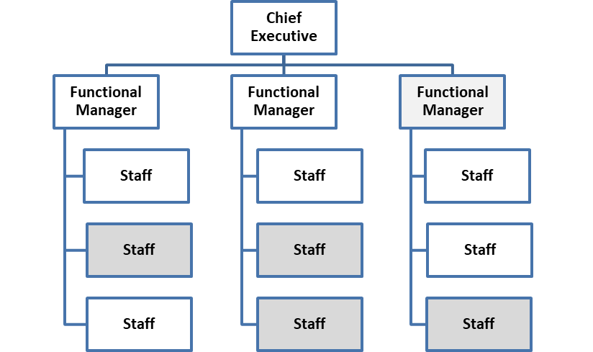
Functional Structure

Slide 57
Divisional Structure
Divisional structure typically is used in larger companies that operate in a wide geographic area or that have separate smaller organizations within the group to cover different types of products or market areas

Slide 58

Matrix Structure

Slide 59
Pure Organisational Structure
In a "pure project organisation" model project managers have total control over the project that they oversee. For this model to work, central control at management level must be weak. A "pure project organisation" can also be called a "task force." In the case of a "pure project," the leader of this task force would have complete authority for a short period to solve a specific problem. In business, it is very scarce to find an example of such purity.

Slide 60

What is the difference between Project Management and General Management?

Slide 61
What is the difference between Project Management and General Management?
BASIS FOR COMPARISON | PROJECT MANAGEMENT | GENERAL MANAGEMENT
Meaning | Project Management refers to the efficient management of the effort of the team for the time-bound and successful accomplishment of the project. Its main aim is to complete project with fulfilling requirements of clients or customers on specified time. | General Management refers to the management of the overall activities and the processes of the organization, to ensure coordination and optimum utilization of resources. Its main aim is to manage all resources of company and oversee daily operations.
Process | One-time | Continuous
Nature | Non-repetitive and unique | Repetitive and regular
Work location | Within or outside the organizational premises | Within the organizational premises
Line of Authority | Blurred | Defined
Set of tasks | Dynamic | Consistent
Success | Ascertained by the accomplishment of the project within defined criteria. | Ascertained by attainment of the defined goals.
Function | planning, executing, monitoring, controlling, and closing out projects. | planning, organizing, staffing, directing and controlling.

Slide 62
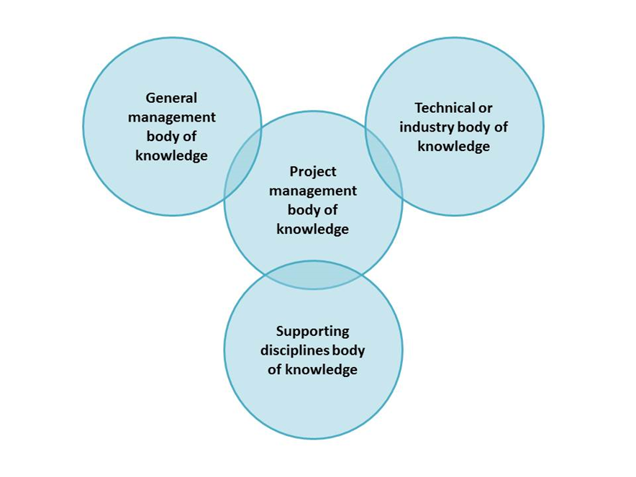
General Management and Project Management

Slide 63
Project Management Skills
Project Management Knowledge Competency.
  What does the project management team know about project management?
Project Management Performance Competency.
What is the project management team able to do or
accomplish while they apply their project management
knowledge?
Personal Competency. How does the project management team behave when they perform the project or activity? Personal competency also involves attitudes and core personality characteristics.

Slide 64
Time to do an activity
Go to page 70 and answer the following questions: 15 minutes
1. What is an organisational structure?
2. Complete a table – benefits, and drawbacks of 2 structures
3. Identify type org. structure used for projects.
4. Open question with motivation - Activity for tonight.
5. BRIEFLY EXPLAIN – Activity for tonight.

Slide 66
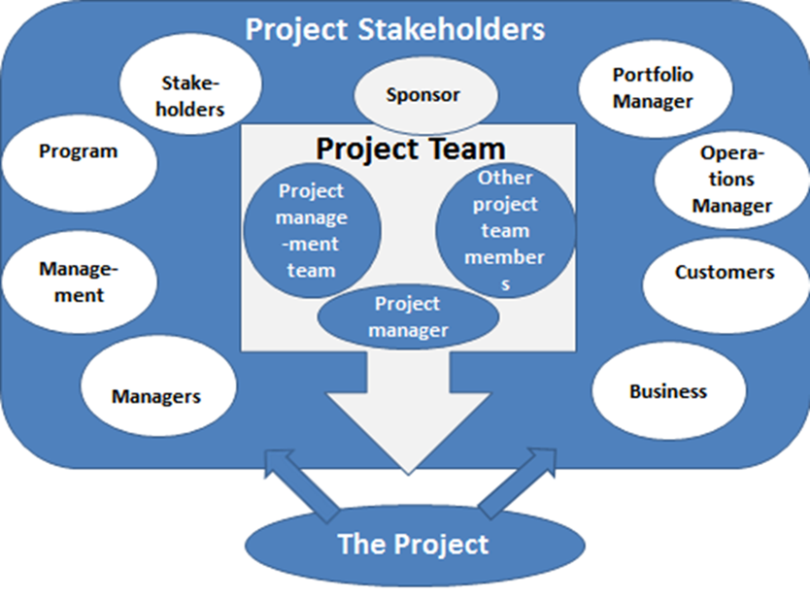
Identify and Communicate with Key Stakeholders

Slide 67
Positive and negative stakeholders
Positive stakeholders are people who would normally reap benefits from the successful outcome of the project,
Help the project management team to complete the project successfully
Negative stakeholders are people for whom outcomes from the project’s success is seen as negative.
Sees the outcome and may be negatively impacted by the project or its outcome.

Slide 68
What do stakeholders bring?
They bring experience to the table
They help identify risks
They help increase the chances of success
Leadership
Look at things in a BIG Picture Format.

Slide 69
Customers
The customers/users are those persons or organisations that will make use of the project’s product, service or result. Customers/users may be internal or external.

Slide 70
Sponsors
The sponsor is the person or group that provides the necessary funds for the project. When a project is first conceived, the person or group acting as the sponsor supports the cause of the project
Role is the person responsible for the overall success of the project, including appointing the project manager and team, defining success criteria, and ensuring the successful delivery of the project. ... The project sponsor sits above the project manager.

Slide 71
Portfolio Managers
Portfolio managers are responsible for the high-level governance of a number of projects or programs.

Slide 72
Project Managers
The project manager is the person that the organisation assigns to achieve the project objectives. This is a challenging, high-profile role with huge responsibility and priorities that are constantly shifting.
Role In the broadest sense, project managers (PMs) are responsible for planning, organizing, and directing the completion of specific projects for an organization while ensuring these projects are on time, on budget, and within scope.

Slide 73
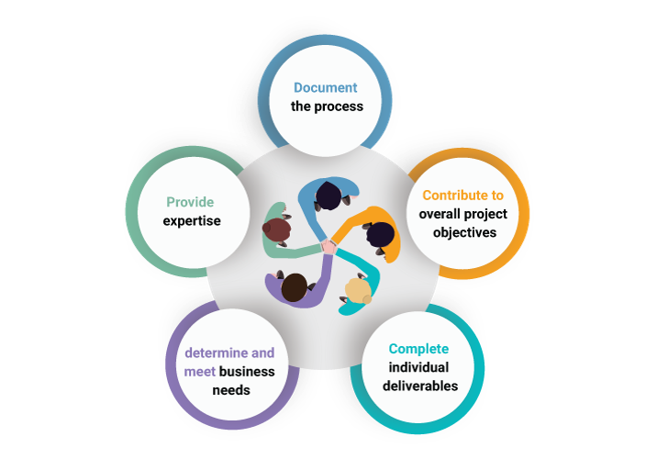
Project Team
A project team consists of the project manager, project management team, and other team members who do the work but who are often not involved with the management of the project.

Slide 74
Functional Managers
Functional managers are employees who are part of management within the administrative or functional area of the business, such as Human Resources, finance, accounting, or procurement

Slide 75
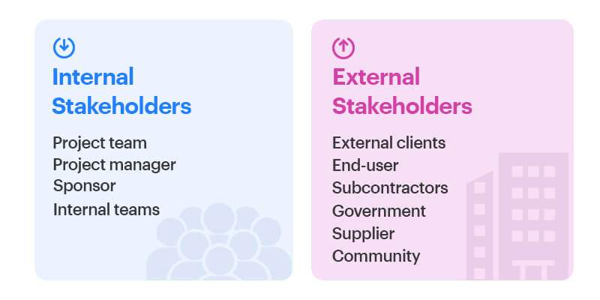
Two types of project stakeholders

Slide 76
Time to do an activity
Go to page 74 and answer the following questions: 15 minutes
1. List 5 Possible stakeholders in a project?
2. Give me an example of a positive and negative of stakeholder
Who is a project sponsor? Why is person important
Name all aspects of a project manager

Slide 77
A-Z ON PROJECT MANAGEMENT
https://www.youtube.com/watch?v=qTQsdJFG4SQ

Slide 78


Slide 79
Study Unit 2
SUPERVISE A PROJECT TEAM OF A SMALL PROJECT TO DELIVER PROJECT OBJECTIVES

Slide 80
Learning outcomes Unit 2
& Summative assessments
Undertake the management activities, from start to end, for a small project. Refer page 53
Set-up, run, and close a developmental project. Refer page 54

Slide 81
What will we cover?
Supervise a project team of a small project to deliver project objectives
SO1 - Undertake the management activities, from start to end, for a small project.
A project management plan is developed, agreed and communicated using agreed procedure. Project operations are established within agreed time frames using identified personnel. Project progress is measured against project scope and requirements. Project work is executed, monitored, evaluated and controlled according to project management plan. Close down procedures are executed according to agreed procedures and project management plan.

Slide 82
What will we cover?
Supervise a project team of a small project to deliver project objectives
SO5 - Set-up, run and close a developmental project
1. Project duration start and end time and tasks are communicated and explained. 2. Project is set up within agreed time frames using identified personnel. 3. Project progress is observed against project scope and requirements. 4. Project work structures are applied and monitored. 5. Closing down procedures are followed.

Slide 83
Introduction
Whether it is called a project plan or a project timeline, it is of vital importance to develop and maintain a document that clearly outlines the project milestones and major activities that are necessary to implement the project.
It is important to document the actual date on which the project activities are completed. If the actual completion date differs from your baseline date at any stage, you must still have on it the date that it was supposed to be completed. This is done for historical purposes.

Slide 84
Develop, agree and communicate a Project management plan
Confirming Project Team Objectives
Statement: A brief narrative description of what you want to achieve
Measures: Indicators you’ll use to assess your achievement
Performance specifications: The value(s) of each measure that define success
The project objective defines the benefits, outcomes, and performance improvements that are expected from the project. The objectives focus on things that are external to the project. The “what” that’s achievable, realistic, and can be completed within the time allowed

Slide 85
SMART is an acronym that stands for:
S = Specific
M = Measurable
A = Achievable (or attainable, actionable, appropriate)
R = Realistic
T = Time-bound (or timely, traceable)

Slide 86
S M A R T
Specific
Make sure your objective is clearly defined. Narrow your scope of the objective so that is has a very tangible and specific outcome. This helps you focus your intent. When writing this part of the objective think of the Who, What, Where, When and Why of it all.
Measurable
Make sure you can actually quantify the objective. If it’s not measurable, you won’t know when the project objective has been met. You want to make sure the objective is trackable to keep you and the team accountable.

Slide 87
S M A R T
Achievable
Make sure you can accomplish the objective. Identify the clear steps that need to happen to make sure the objective is completed. When writing this portion of the objective as yourself how you will accomplish it? What steps need to be taken in order to accomplish the specific objective you’ve defined?
Realistic
This one is really important. Don’t set objectives that can’t be achieved within the constraints of the project. Make sure your objective is practical. Do you have the budget to do this? Is there enough time? Does your team have the right knowledge or do you have time to invest in learning?

Slide 88
S M A R T
Time-Bound
When will this be done by? Having a clear end date defined helps everybody involved. It lets you know when you need to focus on that objective. It also helps you set a relationship between multiple objectives on a project as well

Slide 89
Project Plan
Firstly,
Firstly, a project plan defines project goals and objectives, specifies tasks and how goals will be achieved, identifies what resources will be needed and associated budgets and timelines for completion
A common misconception is that the plan follows the project timeline. The timeline is only one of the components of the plan. The project plan is the major work product from the entire planning process, so it contains all the planning documents.

Slide 90
Project Plan
Is a plan which stipulates the different steps and stages of a project. “ Road trip” – lead to overall success.
Firstly - a project plan is a formal document designed to guide the control and execution of a project. A project plan is the key to a successful project and is the most important document that needs to be created when starting any business project
Secondly, a project plan defines project goals and objectives, specifies tasks and how goals will be achieved, identifies what resources will be needed and associated budgets and timelines for completion

Slide 91

Steps in developing a project plan
Explain the project plan to key stakeholders and discuss its key components – Executive summary, policies and procedures, schedules, timeline plans, budgets
Define role and responsibilities
Develop a scope statement – business need/problem, project objectives, benefits, what deliverables, key milestones
Develop the project baseline
Create baseline management plans – slide to follow
Communicate

Slide 92
Develop a Project Plan/Timeline
A common misconception is that the plan follows the project timeline. The timeline is only one of the components of the plan. The project plan is the major work product from the entire planning process, so it contains all the planning documents.

Slide 93
Develop a scope statement
Business need and business problem
Project objectives, stating what will occur within the project to solve the business problem
Benefits of completing the project, as well as the project justification
Project scope, stated as which deliverables will be included or excluded from the project
Key milestones, the approach and other components as dictated by the size and nature of the project

Slide 94
“ Baseline” within a project
Baselines: These are sometimes called performance measures because the performance of the entire project is measured against them. They are the project's three approved starting points for scope, schedule, and cost. These are used to determine whether or not the project is on track during execution
Baseline management plans: These include documentation about how variances will be handled throughout the project
Other work products from the planning process, which include plans for risk management, quality, procurement, staffing and communications

Slide 95
Develop the project baselines
Identify activities and tasks needed to produce each of the deliverables identified in the scope baseline. How detailed the task list needs to be depends on many factors, including the experience of the team, project risk and uncertainties, ambiguity of specifications, amount of buy-in expected, etc
Identify resources for each task, if known
Estimate how many hours it will take to complete each task
Estimate cost of each task, using an average hourly rate for each resource

Slide 96
Develop the project baselines
Consider resource constraints, or how much time each resource can realistically devote to this one project
Determine which tasks are dependent on other tasks, and develop critical path
Develop schedule, which puts all tasks and estimates in a calendar. It shows by chosen time period (week, month, quarter or year) which resource is doing which tasks, how much time each task is expected to take, and when each task is scheduled to begin and end
Develop the cost baseline, which is a time-phased budget, or cost-by-time period

Slide 97
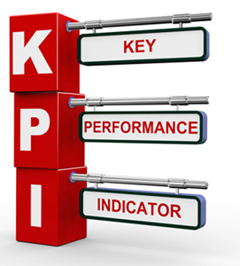
Create baseline management plans

Slide 98
Communicate
Who wants which reports, how often, in what format and using what media
How issues will be escalated and when
Where project information will be stored and who can access it
What new risks have surfaced and what the risk response will include
What metrics will be used to ensure a quality product is built
What reserves have been used for which uncertainties

Slide 99
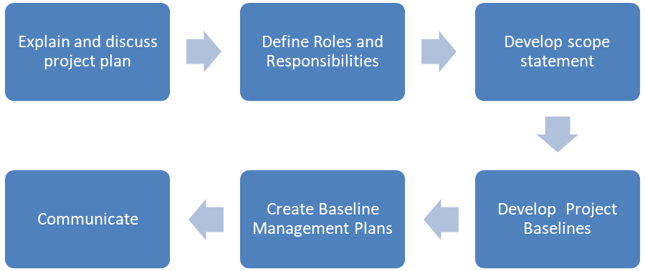
Destination Success
Project success refers to “on time, within budget, to specification” completion;
success of the product produced; or success in achieving the business objectives of the project.

Slide 100
The Plan or Timeline
A unique ID that your team can reference when they are giving an update
The name of the task
When the task should start
When the task should finish
The actual date on which the task was completed
Any tasks that need to be completed before other tasks can begin
The owner of the task
Percent completed of each task

Slide 102
Project Planning Cycle
The Planning Cycle brings together all aspects of planning into a coherent, unified process.
https://www.youtube.com/watch?v=-DqIBgb_fpU

Slide 103
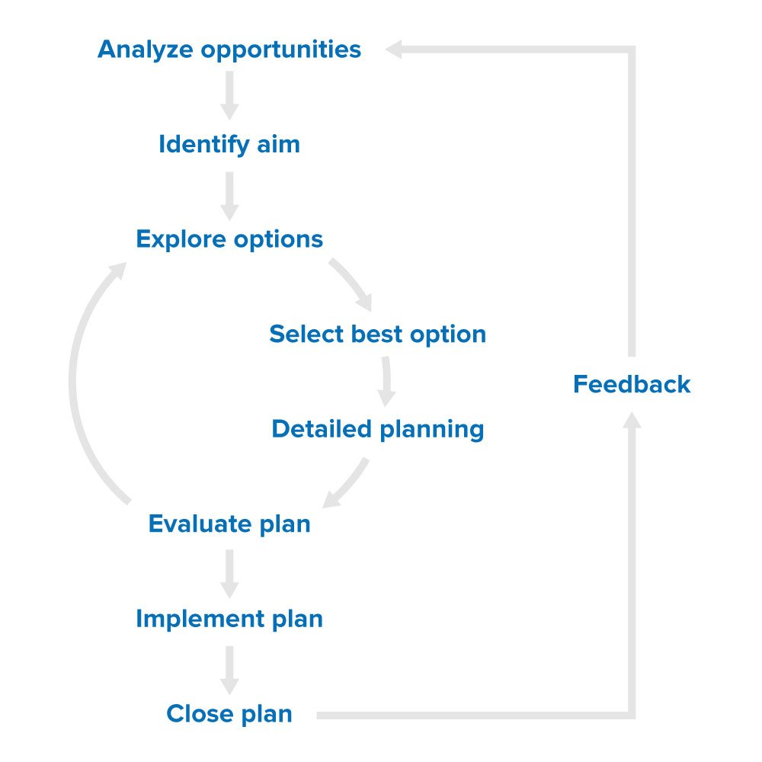
Project Planning Cycle

Slide 104
Implementing the Planning Cycle
Stage 1. Analysis of Opportunities
Stage 2. Identifying the Aim of the Project Management Plan
Stage 3. Exploring Options
Stage 4. Selecting the Best Option
Stage 5. Detailed Planning
Stage 6. Evaluation of the Plan and its Impact
Stage 7. Implementing Change
Stage 8. Closing the Plan

Slide 105
Details of each stage
Analysing - clarify what you need to do - start by examining your current position, and deciding how you can improve it.
  One option is to carry out a SWOT Analysis . This will identify the strengths and weaknesses of your position, and the opportunities and threats that P/M or the team face.
  Another method is Risk Analysis , which will help P/M to spot potential pitfalls and weaknesses in your organization that may affect your plan, and identify any external risks. You can then use your findings to plan how you will neutralize or mitigate those risks.

Slide 106
Details of each stage
Identifying the aim
  When you've completed a realistic analysis of your situation, and the opportunities for change, the next step is to precisely define the aim of your plan.
  Ask questions:
    What do I want the future to be?
    What benefit do I want to give to my customers?
    What returns do I need?
    What standards am I aiming at?
    What values do I and organization believe in?
  You can present this aim as a Vision Statement or Mission Statement

Slide 107
Details of each stage
Exploring options
  By this stage, P/M should have a good understanding of your situation and what you want your project to achieve. The next step is to work out how to do it.
Select the Best Option
  Once the P/M has explored all the options, you need to decide which one to pursue. If you have the necessary time and resources, you might decide to do detailed planning, costing, and risk assessment work for each one. But chances are you won't have this luxury.

Slide 108
Details of each stage
Detailed planning
  With your final decision made, you need to establish the most efficient and effective way to achieve your aim. This determines who will do what, when, where, how, why, and at what cost.
  Techniques like Gantt Charts and Critical Path Analysis can be useful when working out priorities, deadlines, and how to allocate resources.
  A good plan also identifies risks and suggests contingencies. This allows you to respond effectively to setbacks or crises. You should also consider transitional arrangements – how will you keep things going while you implement the plan.

Slide 109
Details of each stage
Evaluate the plan and its impact.
  The next stage is to review your plan and decide whether you should implement it. It’s crucial to be objective here – even if you've done a lot of work to reach this stage, it may still not be worth your while to pursue the project.
Implementing change
  Once P/M has finalized the proposal, and you're confident that it will deliver, it's time to put it into action.
Close the Plan and Review
  All being well, your project is now complete and it was a huge success! Now it's time to close it down and assess what you've learned. Look back over the planning process and assess it carefully to see what could be improved or refined in the future.

Slide 110
The Project Initiation Document
The PID varies from organisation to organisation, but basically it contains the What? Why? Who? How and when? of the project.
The what of the project:
  Purpose: Why are you doing this work? Describe the desired end result of this project.
  Objectives: What specific outcomes will be achieved, and how will you measure these outcomes? Remember to limit the number of objectives for your project – four or five goals are typically enough.
  Scope: What are the boundaries for this project (for example, type of work, type of client, type of problem, geographic area covered)?
  Deliverables: What will the project deliver as outputs? Where you can, describe deliverables as tangible items like reports, products, or services
  Constraints: What things must you take into consideration that will influence your deliverables and schedule? These are external variables that you cannot control but need to manage.
  Assumptions: What assumptions are you making at the start of the project? If necessary, schedule work to confirm these assumptions.

Slide 111
The Project Initiation Document
The PID varies from organisation to organisation, but basically it contains the What? Why? Who? How and when? of the project.
The why of the project: Business Case + Risk Analysis
  Benefits: Why are you carrying out this project, and what benefits do you expect it to deliver? Include information on how these benefits will be measured. For more on benefits management,
  Options: What other courses of action were considered as this project was designed and developed?
  Cost and Timescale: Provide a breakdown of project costs and related financing.
  Cost/Benefit Analysis: How are the costs of the project balanced against the expected returns?
  Risk Identification: Identify the risks within the project, and that you'll either need to manage or accept.
  Risk Prevention: Describe what you are going to do to mitigate or manage risks.
  Risk Management: Where you can't prevent risks, what are your contingency plans for dealing with them? What actions will you take should the risk materialize?
  Risk Monitoring: What processes do you have in place to routinely assess the risks associated with your project?

Slide 112
The Project Initiation Document
The PID varies from organisation to organisation, but basically it contains the What? Why? Who? How and when? of the project.
The who of the project: Roles and Responsibilities
  Project Organization Chart/Structure: Create a diagram that shows the lines of authority and reporting for each project team member.
  Project Sponsor: Who has the ultimate authority and control over the project and its implementation?
  Project Manager: Who is the Project Manager, and what are his or her responsibilities?
  Project Team: Who are the key members of the project team? What are their roles and job descriptions? What are their phone numbers and email addresses? What is their original department or organization? And to whom do they report to on a daily basis?

Slide 113
The Project Initiation Document
The PID varies from organisation to organisation, but basically it contains the What? Why? Who? How and when? of the project.
The who of the project: Provide broad information about how the project will be implemented. Outline how the project will roll out by defining timelines, resources, and management stages.
Assignments: What major tasks (with milestones) will be completed during the project?
Schedule: Provide a report of the estimated time involved for the project. You've probably already prepared a high level Gantt chart or similar schedule, so the PID simply summarizes the anticipated schedule.
Human Resources: How many days of activity will be needed to complete the project? How many support staff will be needed? Will you need to bring more people onto the project team?
Project Control: How will progress be monitored and communicated?
Quality Control: How will the quality of deliverables be evaluated and monitored?

Slide 114
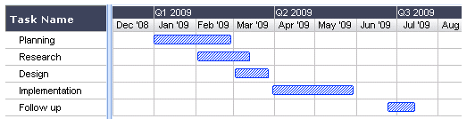
Set Up, Run and Conclude a Project
A Gantt chart, commonly used in project management, is one of the most popular and useful ways of showing tasks displayed against time. On the left of the chart (vertical axis) is a list of the activities and along the top or bottom (horizontal axis) is a suitable time scale

Slide 115
Project Charter
Developing the Project Charter is the process in which a document that formally authorises a project or a phase is developed, and the initial requirements that satisfy the needs and expectations of the stakeholder is documented.
P/C - is to authorize the project manager to start the approved project and allow him to use organizational resources to accomplish the objectives of the project
Inputs | Outputs
Project Statement of work Business case Contract Enterprise environmental factors Organisational Process | Project Charter

Slide 116
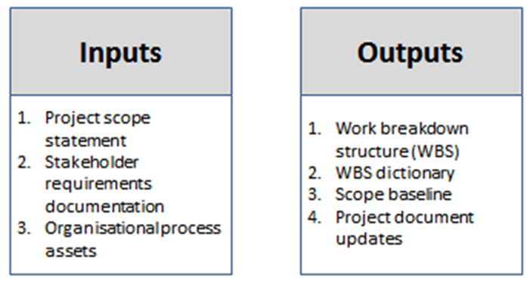
Work Breakdown Structure (WBS)
WBS, is a project management tool that takes a step-by-step approach to complete large projects with several moving pieces. By breaking down the project into smaller components, a WBS can integrate scope, cost and deliverables into a single tool.

Slide 117
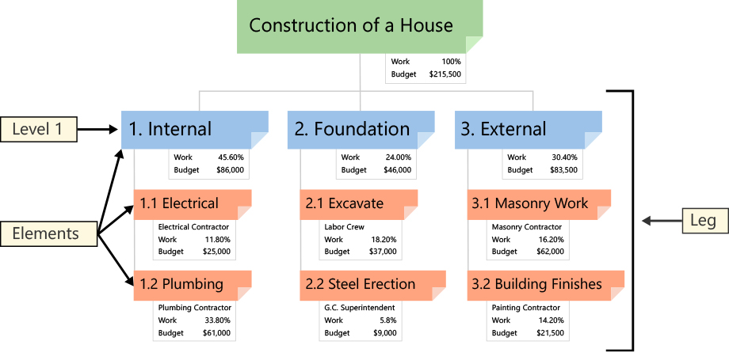
Work Breakdown Structure (WBS)
The Project Management Body of Knowledge (PMBOK) defines the work breakdown structure as a deliverable oriented hierarchical decomposition of the work to be executed by the project team.

Slide 118
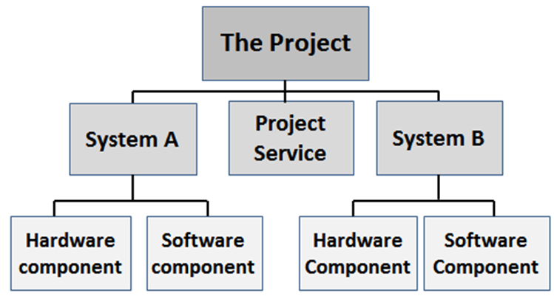
Work Breakdown Structure (WBS)

Slide 119
The 100% Principle
The 100% rule states that the WBS includes 100% of the work defined by the project scope and captures all deliverables – internal, external, and interim – in terms of the work to be completed, including project management.

Slide 121
Project Execution
The execution phase is the most important part of the project. This stage begins with the preparation to do the required tasks as determined in the planning phase, with team members that work towards the desired outcome.

Slide 122
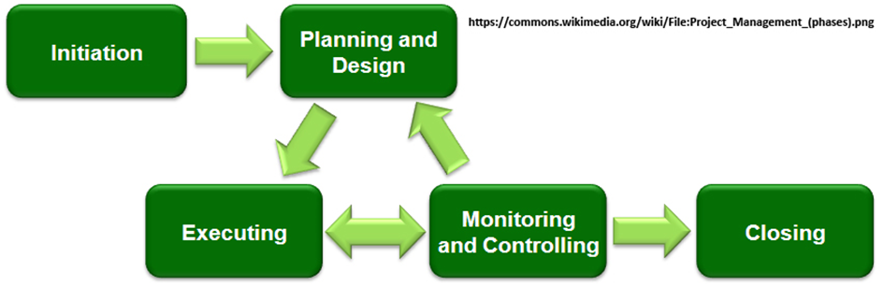
Project Execution

Slide 123
Project Execution Plan
The Project Execution Plan (PEP) is a very important document for the management of a project. It is a statement of policies and procedures that are defined by the project manager for the approval of the project sponsor and/or project director
A typical execution template covers:
Project brief and description | Project scope and milestones
High-level business requirements | Authorities, roles and responsibilities
Project cost plan | Risk and sensitivity analysis
Programme management | Procurement and contracting

Slide 124
Monitor and Control
The monitoring of project activity is an aspect of project management that is performed throughout the project. The aspect wherein corrective and preventive actions are taken is called controlling.
P/M is responsible for executing monitoring and controlling processes effectively and correctly.

Slide 125
Process Integration
The Planning process can be seen as the “plan” component, while the Executing process corresponds is the “do” component.
The “check-act” component corresponds with the Monitoring and Controlling process. The “plan-do-act-check” cycles are started by the Initiating process

Slide 126
Project Progress
Project progress is primarily determined when actual project performance is compared to the schedule and the Work Breakdown Structure (WBS).
Project deviation/variances must be actioned by investigating the root cause but must be quickly remediated and it has a direct impact:
Cost
Time
Quality.

Slide 127
Project Team and Planning
It is often the people who will be doing the work that can best estimate the amount of work that is involved as they often have previous experience.
A project manager can guide them; however, the project team should feel comfortable that the estimates that were arrived at in the project plan are realistic and achievable

Slide 128
Monitoring the Project's Progress
Once there is an agreed project plan, the team can get to work. However, even with the best will in the world chances are excellent that things will not go as anticipated. Projects are done in a changing environment and they must be able to cope and succeed despite unexpected events.
Project team to keep P/M informed, updates on:
    Activities that are completed
    Activities that are expected to be delayed
    Any new activities that could not previously be foreseen
    Any new dependencies that were not previously identified
    Any issues
    Of progress against the plan on a regular basis.
    Identifying unexpected events, such as new activities or incorrect estimates

Slide 129
Change Control Process
It is important that changes or not simply made without careful consideration, therefore the project needs to have good change control procedures in place.
This means that they must:
  Identify all changes asked for
  Conduct an investigation so that they understand why the change is necessary
  Assess the impact of the change (both to the project and people that are external to the project)
  Involve experts who can provide information on the impact of the suggested change
  Determine what the cost of the change will be
  Decide how the change will be funded (the sponsor may have to decide on this)
  Understand the impact of not doing the change

Slide 130
Project Team: Eyes and Ears of the Project
If the project manager and the project team communicate regularly and frequently, the project manager can always be informed and prepared for potential issues.
The project team can also provide regular contributions to:
  Potential project risks
  Potential delays
  Project issues
  Changes that take place outside of the project (such as in the business or other projects)
  Feedback

Slide 131

Closing the Project
Project Closure is more than a milestone, it is a process, with deliverables, to successfully conclude your project
WHEN your customer is pleased with the final product and the sponsor is pleased that you closely managed the project, keeping it on schedule and on budget (within the agreed tolerances and met their acceptance criteria).

Slide 132
“Clean-Up” Activities
These project closure activities are initiated following your meeting with your customer and project sponsor and other primary stakeholders.
During this meeting, the stakeholder has reviewed the end-user acceptance and confirmed that you and your project team have satisfied the project objectives.
You are instructed to close out the project.
Clean-up address:
List all outstanding items | All contract commitments are finalized and closed | Complete a final account - budget vs actual
Prepare a final report | Collate responses to your feedback questionnaires | All documents are collated and stored
Communicate the project closure process to all stakedolders.

Slide 133
Lessons Learned Meeting
Before re-assignment of the project team members, make sure to conduct a formal lesson learned meeting.
Prior to this meeting distribute a brief “lessons learned questionnaire” to all project stakeholders
Ask questions in the following broad categories:
  Management Sponsorship
  Project Objectives & critical success factors
  Project Plan and Schedule
  Project Team
  Client/End User Involvement
  Use of Technology
  Client Acceptance Criteria
  Project Monitoring
  Project Committee

Slide 134
Final Project Report and Last Items
The document should be a recap of the project. Begin with information from the Project Plan document such as:
  Executive Summary
  Project Purpose
  Project Objectives
  Project Organization
  Project Schedule

Slide 136
Study Unit 3
SUPERVISION AND PROJECT MANAGEMENT

Slide 137
What will we cover?
Supervision and Project Management
SO1 - Supervise and monitor a team working on a small project.
The impact of the needs and constraints of the project environment on team work and team composition are explained with examples. Supervisory activities involved with reference to project teams are named with examples. Work is delegated and supervised as per the project plan. The achievement of group objectives and goals are monitored in accordance with agreed plan. Corrective action to sustain team performance is identified as required and implemented according to needs.

Slide 138
What will we cover?
Supervision and Project Management
SO2 - Supervise and monitor a developmental project team
Supervision practices, with reference to project teams are described. Project team objectives are confirmed in accordance with the scope of the project and requirements. Project team progress is monitored and recorded against project plan. Task workflow is organised to achieve minimal waste and delay. Report progress on a developmental project

Slide 139
The Differences between Supervisory and Leadership Practices
Delegates kindly jot down 2 points and send your comments on the chat.
L - directs or determines the vision of a project or company and spearheads the direction.
S - is the management of the resources and people in accordance with the established vision
Internal vs External focus
S – the act of directing, monitoring, or overseeing a task or project to ensure it is done properly
L – the ability to influence others

Slide 140
The Differences between Supervisory and Leadership Practices
Supervisors are used to managing a task and having an extensive amount of control over those processes. However, true leaders realize delegation is essential. You cannot take control over every task -- instead, leaders need to motivate and encourage staff to perform.
Leadership of the team means setting goals for the team and its processes but not micromanaging each task. Instead, the leader must provide the tools, resources and support for the team to succeed.

Slide 141
Definitions and Terminology of Supervision
Supervision is a tool that can be used to educate and support people. It is an opportunity to discuss professional issues and improve on expertise.
Supervision provides an individual the opportunity to learn from his/her own experiences in working with consumers, to review and debrief approaches to support practices, and ensure that service delivery is done according to best practice standards

Slide 142
Line Supervision
This kind of supervision includes operational supervision, which is provided by a line manager.
Line managers have a clear line of accountability. They are responsible for the day-to-day management of practices and service delivery in the workplace and the planning and monitoring of the workload

Slide 143
Managerial Supervision
This is a kind of professional supervision which is done by a professional senior from the same work situation.
Professional supervision from a manager/senior is done to ensure that good governance is being followed and that the organisation is working according to its goals and vision.
Professional supervision could cover some or all the following areas:
  The context of professional practice (competent systems and efficient roles)
  The conceptualisation of strategy (conceptual competence and good, ethical judgment)
  Good response to the needs of clients (technical skills)
  Critical self-awareness (personal development)

Slide 144
Mentoring
Mentoring is either an informal or formal process which can be a very important professional development tool for project team members, as well as for managers.
Informal mentoring happens on its own between the individual member and his/her mentor, and formal mentoring is when a mentor is allocated to a team member

Slide 145

Coaching
Coaching is not simply about showing people, or telling them, how to do something. If one only does that there is no guarantee that any learning will take place, coaching is far more than that.
Coaching puts the emphasis on helping the learner to learn, rather than on getting the teacher to teach.

Slide 146
The Role of the Team Leader/Supervisor
Understand the Role of Team Leader
An effective team leader brings people together to promote creativity, improve performance and support collaboration to deliver consistently strong results and high levels of engagement

Slide 147
The Role of the Team Leader/Supervisor
Understand the Role of Team Leader
An effective team leader brings people together to promote creativity, improve performance and support collaboration to deliver consistently strong results and high levels of engagement

Slide 148
Understand the Role of Team Leader
Remember that all eyes are on you
Accept that you don’t have all the answers
Know when to back off
Get ready to get stuck in
Be prepared to coach your people
Appreciate the responsibility that comes with your role
Communicate in a variety of ways
Reward and recognise your team
Have one eye on the future

Slide 149
Steps to Building an Effective Team
As a team leader, there are ways of dealing with team members in such a way as to ensure that the team is effective and productive.
Remember that each organisation is different and each team dynamic is also different, therefore your techniques must be flexible and easily adjusted to suit your specific team and its function.

Slide 150
Suggestion to Building an Effective Team
Establish your leadership with each team member – Relationships of trust and loyalty.
Consider each employee's ideas as valuable.
Act as a harmonizing influence
Encourage trust and cooperation
Take steps to improve communication, cooperation, trust, and respect
Delegate problem-solving tasks
Facilitate communication.
Establish team values and goals; evaluate team performance.
Set objectives, solve problems, and plan for action
Set ground rules

Slide 151
Encourage Participation in Decision Making
Being a team leader requires a certain amount of decision making and in cases decisions can only be made by the team leader or someone in a position of authority.
However, when it comes to projects and teams, it is often a good idea, depending on the type of decision of course, to include the whole team in the decision-making process.

Slide 152
Encourage Participation in Decision Making
When you bring other people into the decision-making process, you need to approach decisions differently. These approaches vary, depending on a number of different factors, including:
  The type of decision.
  The time and resources available.
  The nature of the task being worked on.
  The environment the group wants to create.
  The amount of buy-in needed.

Slide 153
Delegating Tasks
Team member must know what role they are expected to play
The process can be broken down into the following steps:
  The work plan or task must be analysed and broken down into smaller tasks, programmes, or units of work and a decision taken as to who in the section is best suited to carry them out.
  The delegated tasks must be clearly communicated to members indicating what is expected, how it must be done and where to get help, if necessary.
  Decision-making authority required to execute the task must be indicated to the member so that team members can react to situations immediately and effectively
  A regular feedback and reporting schedule must be agreed upon
  A system to enable the flow of information must be established by the team members
  The successful completion of delegated tasks must be monitored
  Successful achievement of the delegated tasks must be given recognition by the team leader and other stakeholders

Slide 154
What to Delegate
If you try to delegate work that's inappropriate or should be done by you, you'll probably fail – despite your best planning and support recognition by the team leader and other stakeholders
The following points should be considered:
  Time - Do you have enough time to delegate? You must be able to give sufficient instruction and support as necessary.
  Availability – Is someone (expertise or information) available to do the task? You must have people with the necessary skills and expertise to complete the job successfully.
  Criticality – Is the work critical to the success of the project or the organisation? High profile tasks that have a low tolerance for mistakes are often better done yourself

Slide 155
Whom to Delegate
Delegating work to a person or team takes thought and consideration. If you delegate to the wrong person, you may spend too much time instructing and supporting the work. If you delegate too much to one person, you risk incomplete results, and an unhappy, over-stressed individual
Consider:
  Organsational Structure
  Staff buy-in
  Individual vs teams

Slide 156
How to Delegate
A positive outcome can depend on how you actually hand over the task. You need to keep morale high and ensure that your team happily accepts assignments from you.
Consider:
  Clarify your expectations– Tell the person to whom you are delegating what you need accomplished and why it's important. When he or she knows the desired results, it's much easier to see the "big picture" and work accordingly
  Establish checkpoints – Plan how you will ensure the work is being completed according to plan by establishing checkpoints at the end of project stages.
  Focus on the result
  Explain how much support you'll provide
  Talk about consequences – If you allow people to have authority over their work, inform them of the consequences of both successful and unsuccessful results.

Slide 157
Monitor team progress
Team progress is monitored against the team objectives and the project plan that were developed and agreed upon during the planning process

Slide 158
How to Recognise Non-Performance
As the project manager are you obtaining accurate time estimates from your team members?
More common issues:
A team member is consistently missing deadlines: This team member is unable to complete their work on time. They assure you they can complete the work in the time allotted; they commit to the delivery date, and then fail to deliver on the due date.
A team member is consistently delivering poor quality: This team member has been responsible for most of the bugs issued by QA. This team member claims to have fixed a bug and either haven’t fixed it or have fixed it but caused other bugs.
A team member is always asking for help from the team: This team member will always be seen at their co-worker’s desk getting help with their work.

Slide 159
How to Recognise Non-Performance
More common issues: (continue)
The team is constantly complaining about a team member who is interfering with their productivity: The team member they are complaining of is negatively impacting performance of the team because they are always asking for help.
Conflicts on the team: The team member always seems to be involved in some sort of conflict with someone else on the team.
Excessive absenteeism: This team member will be absent for 2 or more days per month. Mondays and Fridays are popular days to call in sick or play hooky as they extend the weekend.

Slide 160
PROJECT MANAGEMENT 101
https://www.youtube.com/watch?v=RT66tw1cKCA

Slide 162
Study Unit 4
REPORT ON PROGRESS

Slide 163
What will we cover?
Report on Progress
SO3 - Report progress for a small project. .
A variety of reporting lines are recognised and explained with examples Report priorities and requirements are agreed and documented in agreed format. Progress is documented and reported in accordance with established procedures. Reports are produced according to client specifications. Progress reports are produced within agreed time frame and format.

Slide 164
What will we cover?
Report on Progress
SO3 - Report progress on a developmental project
A variety of reporting lines are recognised and explained
Report priorities and requirements are described and documented.
Progress is documented and reported in accordance with established procedures.
Reports are produced according to donor specifications.
5. Progress report is produced within agreed time frame and format.

Slide 165
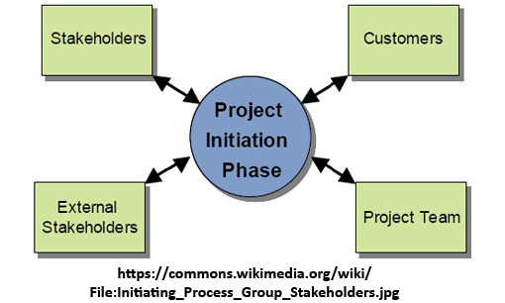
Reporting Progress on a Project
The Importance of Progress Reporting
Progress reporting is a very important activity of project management. The project manager issues regular progress reports against budget, schedule and scope.
The following people must be included on the circulation list:
  Project Sponsor
  Budget Holder
  Senior Users
  Team Members

Slide 166
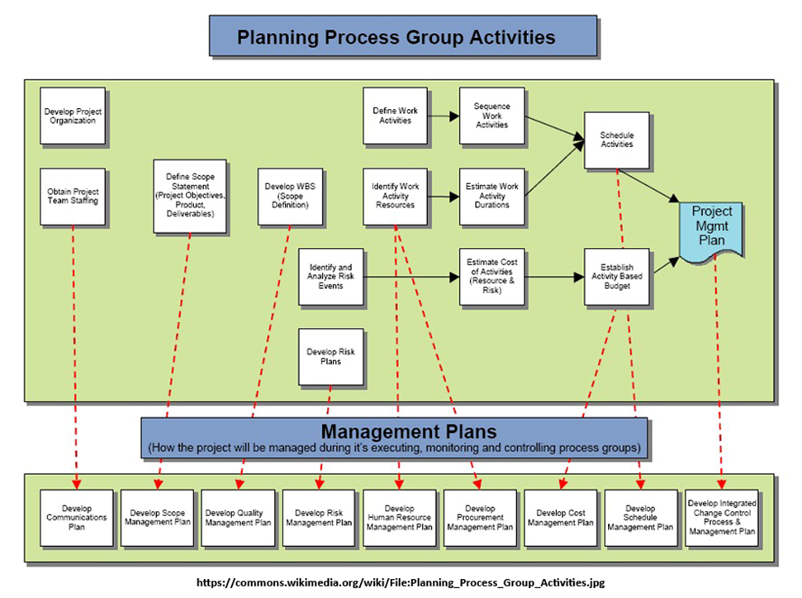
Reporting lines

Slide 167
Progress Report
A progress report may seem like something minor but it can go a long way in communicating the details of a project to both your supervisor and other staff members.
Providing this information can help with staffing, budgetary needs, support and guidance throughout the project.

Slide 168
Progress Report - Format
Research the aspects of your business that you need to cover in your progress report.
Collect reports from subordinates, peers, contractors and sub-contractors as needed.
Compose your statement of purpose or opening statement.
  This should include a brief description of the project.
  In this opening statement, explain why you are giving a progress report at this time.
Explain what work has already been completed in the body of the report.
Consider any problems you've run into while working on this project.
Write about what activities are still underway.
Create a spread sheet detailing which parts of the project are done and still in-progress
Summarise your status report.

Slide 169
Progress Report
Keeping people updated ensures that they stay involved and committed. Regular communication is essential to the well-being of any project.
Communication usually fails on the following:
• Ineffective communication channels
• Communication that is not honest
• Unwillingness to communicate bad news
• Not asking for help when it's needed

Slide 170
Measuring and Monitoring Success
Effective communication is key to successful projects – sharing the right messages with the right people at the right time.
A status report is an excellent communication tool for every project manager and is one of many valuable project management forms. It provides a way to update your team and your managers on the progress of a project.
An Effective Status Report
  Is written in clear simple language
  Informs the reader what the project is
  Communicates on the progress of the team, what has already been accomplished and what still needs to be done
Reward Your Team
Positive

Slide 172
Study Unit 5
IDENTIFY AND RECTIFY PROBLEMS

Slide 173
What will we cover?
Identify and rectify problems
SO4 - Identify and rectify problems occurring in a project.
Potential problems are identified, recorded and notified in terms that allow timely resolution. Symptoms of problems are identified, and root causes determined using recognised techniques. Appropriate problem-solving methods and techniques are identified, selected and applied to solve the problem. Unresolved problems are reported to higher authority. Problems are rectified within agreed time frames.

Slide 174
What will we cover?
Identify and rectify problems
SO4 - Identify and rectify problems occurring in a development project.
Potential problems are identified, recorded and notified in terms that allow resolution. Symptoms of problems are identified, and root causes determined. Appropriate problem-solving methods and techniques are identified, selected and applied to solve the problem. Unresolved problems are reported to higher authority. Problems are rectified within set time frames.

Slide 175
Introduction to Problem Solving
The aim in problem solving is to identify problems early before they can have a detrimental impact on the project. It is much easier to deal with a problem before it becomes a crisis
https://www.youtube.com/watch?v=cQPNVFZId68
https://libguides.bellevue.edu/c.php?g=148652&p=973491
https://www.youtube.com/watch?v=QTzDL_RjQ9U
https://www.youtube.com/watch?v=bZXDGQSuF9I&t=136s

Slide 176
Build a Problem-Solving Atmosphere
Encourage team members to be open about their concerns. They may identify a problem or may have solutions that you have not thought of.
Ask team members about possible problems at each project meeting.
Explain to team members how important it is to share any problems with the team and encourage them to come up with solutions as well.
Often team member get the idea that project managers do not want to hear about problems. concerns. Examine yourself as a project manager and see if you give this impression. If so, you should address it immediately.

Slide 177
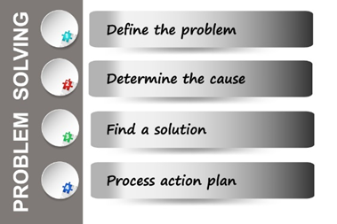
Structured Problem-Solving Method

Slide 178
Problem Solving – using a formal method
It prevents problem solvers from jumping to conclusions. People are often too willing to propose solutions before a problem is properly defined and its root cause has been identified
It ensures root cause analysis. An inability—or unwillingness—to identify the root cause is probably the single biggest problem regarding problem solving.
It demystifies the problem-solving process.
It prescribes which analytical tools to use and when.

Slide 179
Basic Problem-solving method
Step | Action | Description | Appropriate tools
1 | Decide on which problem to pursue | Most organisations must prioritise the issues and dedicate the necessary resources. | Pareto charts, run charts, pie charts, flowcharts and voting.
2 | Define the problem | In the clearest terms possible, what exactly is the problem? Provide details of who, what, where and when. Be very specific. Carefully defining the problem will give the raw material to successfully identify its root cause. | Pareto charts, check sheets and histograms
3 | Determine the root cause | Typical obstacle at this step is that people mistake a symptom for the root cause. Before team members are asked to participate in problem solving, they should be informed properly on how to separate symptoms from root causes. | interviewing, brainstorming, cause-and-effect diagrams, and voting

Slide 180
Basic Problem-solving method
Step | Action | Description | Appropriate tools
4 | Generate possible solutions and choose the most likely one | Come up with many alternative solutions, then narrow the possibilities to those solutions that can work for the problem. Agree upon a solution, either by group consensus or through voting. | brainstorming, Pareto charts and voting.
5 | Plan and execute the solution. | Even the best solution will fail if it not carefully planned and executed. This process consists of two phases: selling the solution to key stakeholders to get their buy-in and planning the project methodically to ensure that the solution is executed correctly | project planning, effective presentation skills, selling skills and pilot runs.
6 | Verify effectiveness. | After having implemented the solution, verify that it’s effective. The more objective this person is, the better. | auditing, interviewing, documentation, control charts process capability.

Slide 181
Basic Problem-solving method
Step | Action | Description | Appropriate tools
7 | Communicate and congratulate | People want information about what is being done about problems and how they are solved. This helps to build confidence. Recognition is also critical. People who successfully contribute to problem-solving efforts must be congratulated on their efforts | empathy, integrity, and effective speaking and writing skills.

Slide 182
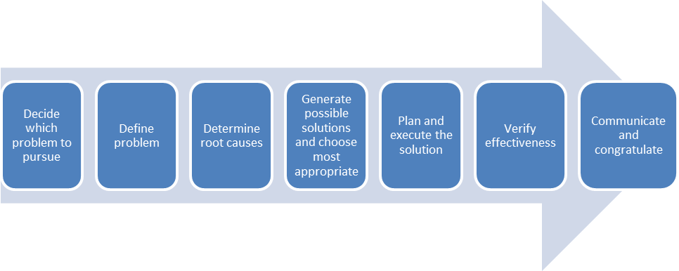
Basic problem-solving process

Slide 183
Basic problem-solving process
Ownership of the Problem
  Even if you use a team approach to problem solving, every problem should be assigned to a specific person. Make sure that this person accepts the ownership. The owner simply acts as the project manager for solving the problem.
Involve People Familiar with the Problem
  Persons that are most familiar with the different aspects of the problem should be involved in the problem-solving process.
  Often, these are the people taking orders, writing software, operating machines, driving forklifts and performing repairs.
  An organisation’s culture must allow all staff members to contribute actively to the process, irrespective of their level within the organisation

Slide 184
Identify and Rectify Problems
Potential Problems
In Project Management the major problems relate to three main areas:
  Time
  Cost
  Quality

Slide 185
Most common causes of problems in project management
Inadequate Planning: The project might not have been broken down into the different development phases properly; prioritising may have been ineffective, the plan might not have been detailed enough. There is no established schedule for tasks, activities and objectives.
Poor decision making: Lack of leaderships skills in the project manager could lead to poor decision making.
Poor communication: Lack of effective communication could lead to errors and delays. Everyone should be informed of the project status at all times.
Vague/changing requirements: It is essential that project requirements are defined clearly and completely from the start. Change requests can cause the project to drift and miss deadlines.

Slide 186
Most common causes of problems in project management
Inadequate funding or budget restraints – This problem is most likely if there has been change requests to the original plan.
Stakeholder approval – project phases should be analysed and discussed by all stakeholders before implementation and where problems or changes occur.
Missed deadlines - delays in the different phases of the project could lead to a missed deadline for the complete project.

Slide 188
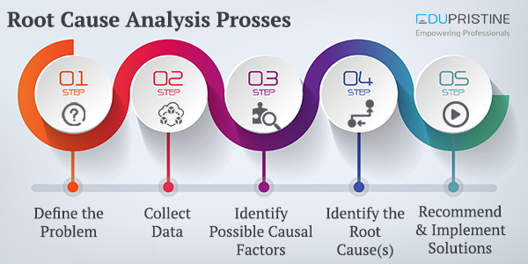
Identifying the Root Causes and Developing Plans to Remove Them
What is root cause analysis?
  Root cause analysis is a method of problem-solving that tries to identify the root causes of faults or problems.
  RCA practice tries to solve problems by attempting to identify and correct the root causes of events, as opposed to simply addressing their symptoms

Slide 189
Root causes can be classified in many ways:
Tangible causes – material, equipment, methods, facilities, environment
People causes – something done incorrectly or was poorly trained to do the job
Economic or external causes – changes in the economy such as a recession, political influences, disasters such as flooding or other acts of God, illness, etc. In other words, things we have very little control over.

Slide 190
Root causes can be classified in many ways:
Managerial causes – inappropriate organisational structure, lack of defined mission, poor communication, poorly trained or inadequate managers, lack of attention to tasks, or no consequences for poor performance
Organisational causes – Systems processes or decision-making processes faulty
Information management or technology causes – necessary information unavailable, inaccurate or incomplete when needed, hardware or software inadequate for organisational needs etc

Slide 191
Root causes can be classified in many ways:
Trend Analysis - Is the practice of collecting information and attempting to spot a pattern, or trend, in the information
Value Analysis - In manufacturing - a systematic analysis that identifies and selects the best value alternatives for designs, materials, processes, and systems is used.
Pareto Analysis - Is a formal technique used where many possible courses of action could be taken. The analyst estimates the benefit delivered by each action, and then selects a number of the most effective actions that deliver a total benefit reasonably close to the best possible one.
Cause and Effect and the Ishikawa Diagram -Each cause or reason for imperfection is a source of variation. Causes are usually grouped into major categories to identify these sources of variation.

Slide 192
Choosing the Best Methods to Identify Root Causes
Root causes could be anything from process-related factors, people factors, systems factors, workplace related problems, organisational policy, managerial factors and, external factors.
  In-Depth Interviews
  Surveys
  Feedback

Slide 193
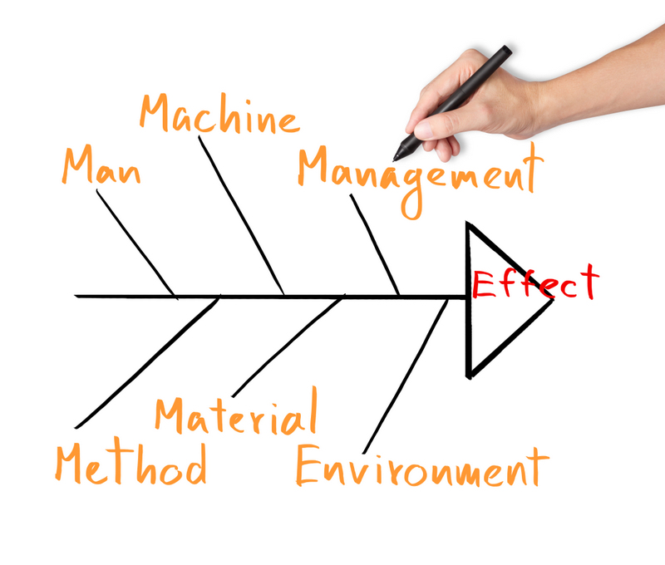
Ishikawa Diagram

Slide 194
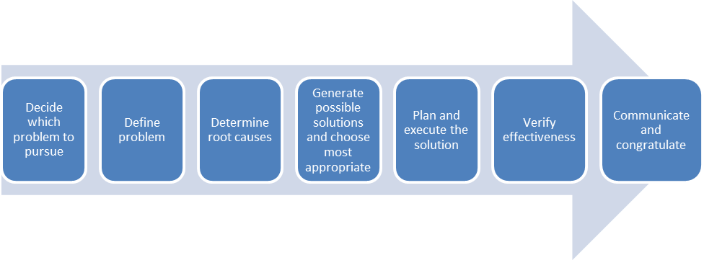
To Summarise

Slide 195
Who’s first – P/M and P/Team
https://www.youtube.com/watch?v=Vkd7JGl0-90
How to do Project Management Audit
https://www.youtube.com/watch?v=Bzif4ZBU5z8

Slide 196


