Slide 1
COMPLETE A RESEARCH ASSIGNMENT
Unit Standard ID: 10301| NQF Level 6 | Credits 20

Slide 2
Breakdown of 2 days
Day1
  General information on Unit standards / Portfolio Building.
  Study Unit 1 -PLAN A RESEARCH ASSIGNMENT
  Study Unit 2 - REVIEW RELEVANT LITERATURE
Day 2 + Recap
  Study 3 - CONSTRUCT A BASIC RESEARCH DESIGN AND GATHER AND ORGANISE DATA
  Study 4 - COMPILE RESEARCH FINDINGS AND PRODUCE A FINAL WRITTEN REPORT

Slide 3
Ground Rules
Days Training, Workshops, and Portfolio building
Breaks
Cell Phones
Participation
Portfolio Submission

Slide 4

Section 1 Overview
What Is a Portfolio?
Collection of Evidence that
Lists criteria for proving competence
Provides evidence that you meet criteria
Is organised to enable assessor to evaluate evidence against criteria.

Slide 5
Overview
The Portfolio of Evidence (PoE)
Section 1 – Administrative detail
Section 2 – Assessment planning
Section 3 – Assessment design matrix
Section 4 – Formative assessment activities
Section 5 – Summative assessment
Knowledge questionnaires

Slide 6
Overview
Section 6 – Summative assessment – Workplace assignments
Section 7 – Feedback
Section 8 – 10 Additional Evidence

Slide 7
Categories Of Evidence
Practical Competence
Foundational Competence
Reflective Competence

Slide 8
Overview
Competency
  Against Outcomes in Unit Standard
Interpret
  Outcomes in relation to workplace

Slide 9
Good Evidence
Valid
  Should relate to what is being assessed
Authentic
  Own evidence
Reliable
  Consistency
  Another assessor makes same judgment
Current
  As recent as possible
Sufficient
  Enough evidence

Slide 10
Assessment Brief
Purpose of Unit Standard
Persons credited with this unit standard will be able to complete a primary research assignment which is limited in scale, but which is effectively planned, focused, structured and the findings are presented in a written report.
This US provides practitioners with skills to access new knowledge and information from outside of their existing contexts and experiences.

Slide 11
Assessment Brief
Entry Level Requirements
Unit Standard ID 10292, 'Conduct research and liaison relevant to the learning situation', is required prior learning

Slide 12
Assessment Brief
Credit Value
10 credits = 100 notional hours
Theoretical + Practical + Workplace experience
24 Hours + 176 Hours – practical + workplace
Submission of Portfolio of Evidence (PoE) - based on Specific Outcomes (SOs) and Assessment Criteria (ACs).

Slide 13
Types of Assessment
Integrated Assessment
Diagnostic
Formative
Summative

Slide 14
Assessment Methods
Assessment Methods
Questioning
Product Evaluation
Observation

Slide 15
Assessment
Assessment
Formative
Summative
Evidence during
facilitation
Self Assessment
Knowledge Assessment
Summative Workplace
Assignments
Formative + Summative = Competent

Slide 16
Competence
Competent
Ability to perform task, action or function successfully
Certificate issued and credits awarded
Not Yet Competent
Not successful yet
Opportunities to remediate to address gaps

Slide 17
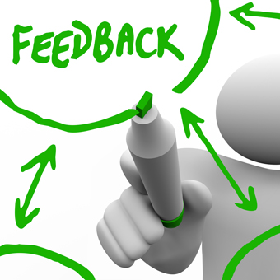
Re-Assessment
Specific feedback - focus on not yet competent areas
Re-assessment - same context and same conditions
Only Not Yet Competent specific outcomes - to be re-assessed
ENJO’s policy: - Two (2) re-assessments

Slide 18
Assessment Brief
Credit Accumulation
Credits will be awarded on successful completion of unit standards.
NB: - Quality Assurance Process
Assessment
Moderation
Verification

Slide 19
Assessment Brief
Assessment Tools and Matrix:
  All the specific outcomes
  Associated assessment criteria
  Range statements
  Critical cross-field, development outcomes
  Essential embedded knowledge.

Slide 20
Assessment Brief
ENJO Assessment Process:
  Integrated assessment against current SAQA registered unit standards and qualifications in a fair, valid, reliable and practicable manner.
  Moderation and verification procedures carried as per SAQA requirements.
  Learner competence demonstrated through formative and summative assessments.

Slide 21
Assessment Brief
Learners have the right to:
  Be informed when and how assessments are conducted
  Appeal against an assessment conducted.
  Get interpretation to the numeracy and literacy level of the skills programme, unit standard or qualification.

Slide 22
Assessment Brief
Facilitation and assessments will be conducted in English.
Learners may have an observer present; however observer may not partake, comment or interrupt the assessment process.
Assessment results will be available as soon as possible after the final assessment.
Learners may have access to results within normal working hours.

Slide 23
Assessment Brief
Additional Notes:
  Assessor will maintain telephonic and electronic contact until sufficient evidence has been submitted.
  Additional evidence may be submitted after initial submission.
  If you have a problem which might affect the outcome of assessment(s) you should notify the assessor. Where practicable such needs will be accommodated. (special needs)

Slide 24
Appeals and Disputes
Learner has right to appeal against:
Unfair assessment
Invalid assessment
Unreliable assessment
Unethical practices
Inadequate expertise and experience of the assessor
Appeals have to be submitted in writing to ENJO.

Slide 25
Section 1
Portfolio of Evidence
Section 1 – Administrative Detail

Slide 26

Section 1 - 2 Administrative Detail
Learner Information
ID
CV
Qualifications
Special Instructions
Declaration of Authenticity
Unit Standard
Sign all required documents

Slide 27
Special Instruction
No Tippex
Initial each page
Comments in full
ENJO or own templates to be used to complete portfolio
Use assigned colour unless instructed differently

Slide 28
Unit Standard
SAQA US ID
Unit Standard Title
NQF Level
Credits
Purpose of the Unit Standard
Learning assumed to be in place

Slide 29
Unit Standard
Unit Standard Range
Specific Outcomes
Assessment Criteria
Essential Embedded Knowledge (EEK)
Critical Cross-field Outcomes (CCFOs)
Notes

Slide 30


Let’s know one another?
Have you participated in a research project?
If yes, how was it conducted? – via - Interview/questionnaire/telephone call / Surveys (online or physical surveys) / Observations / Documents and records / Case studies.
Were you specifically selected or random?
Did the person give the background/reason/
purpose of this research?
Did they tell how the findings will be communicated?
What are your expectation?

Slide 31


Slide 32
STUDY UNIT 1
PLAN A RESEARCH ASSIGNMENT
https://slideplayer.com/slide/17260080/
https://slideplayer.com/slide/4998329/
https://bbamantra.com/project/selection-of-a-research-problem/
https://www.legit.ng/1174941-background-study-research-write-2021.html

Slide 33
Introduction
We have all been required to do research at one time or another, whether it be for a school project or for a specific purpose. So why do we do research?
The answer to this question is simple – we simply don’t know everything and we therefore need to look up or find out information in order to confirm our findings.
Why research is important?:
  It's a tool for building knowledge and facilitating learning.
  It's a means to understand issues and increase public awareness. It helps us succeed in business. It allows us to disprove lies and support truths.
  It allows us to disprove lies and support truths.
  It is a means to find, gauge, and seize opportunities.
  It promotes a love of and confidence in reading, writing, analyzing, and sharing valuable information.
  It provides nourishment and exercise for the mind.
https://owlcation.com/academia/Why-Research-is-Important-Within-and-Beyond-the-Academe
Research can take on many forms and be used for many different purposes. Depending on the subject, statistical research, literary research, informative research and many others can be classified as research.

Slide 34
Introduction
By the end of this learning intervention, you the learner, will be able to complete a research assignment culminating in a written report of approximately six thousand words on a subject relating to the learning context. So let us begin.
https://www.youtube.com/watch?v=Zs9IWGragFs
https://www.youtube.com/watch?v=JEZjwlDNEHY

Slide 35
What will we cover?
Plan a research assignment:
Research question or problem being investigated is clearly articulated.
Importance/significance of the research question or problem is explained.
Research paradigm, in which the assignment is located, is described accurately.
Intended scope of the research assignment is explained.
A logical sequence of research activities for collecting information/data is described.
A reasonable time frame is presented.
Potential research participants are identified.
Resources required are identified and are appropriate in terms of the scale of the research.

Slide 36
Planning a research assignment
Possibly the most important aspect of any research assignment is the planning stages of the assignment.
Without a proper, well-thought out plan, the research assignment will be confusing and chaotic to say the least. So how does one plan for a research assignment?
There are various methods which can be used. The choice of method you select is up to you. One of the most common methods is the Mind Map Method.
We are all familiar with this method by now, but let us recap on how it works.

Slide 37
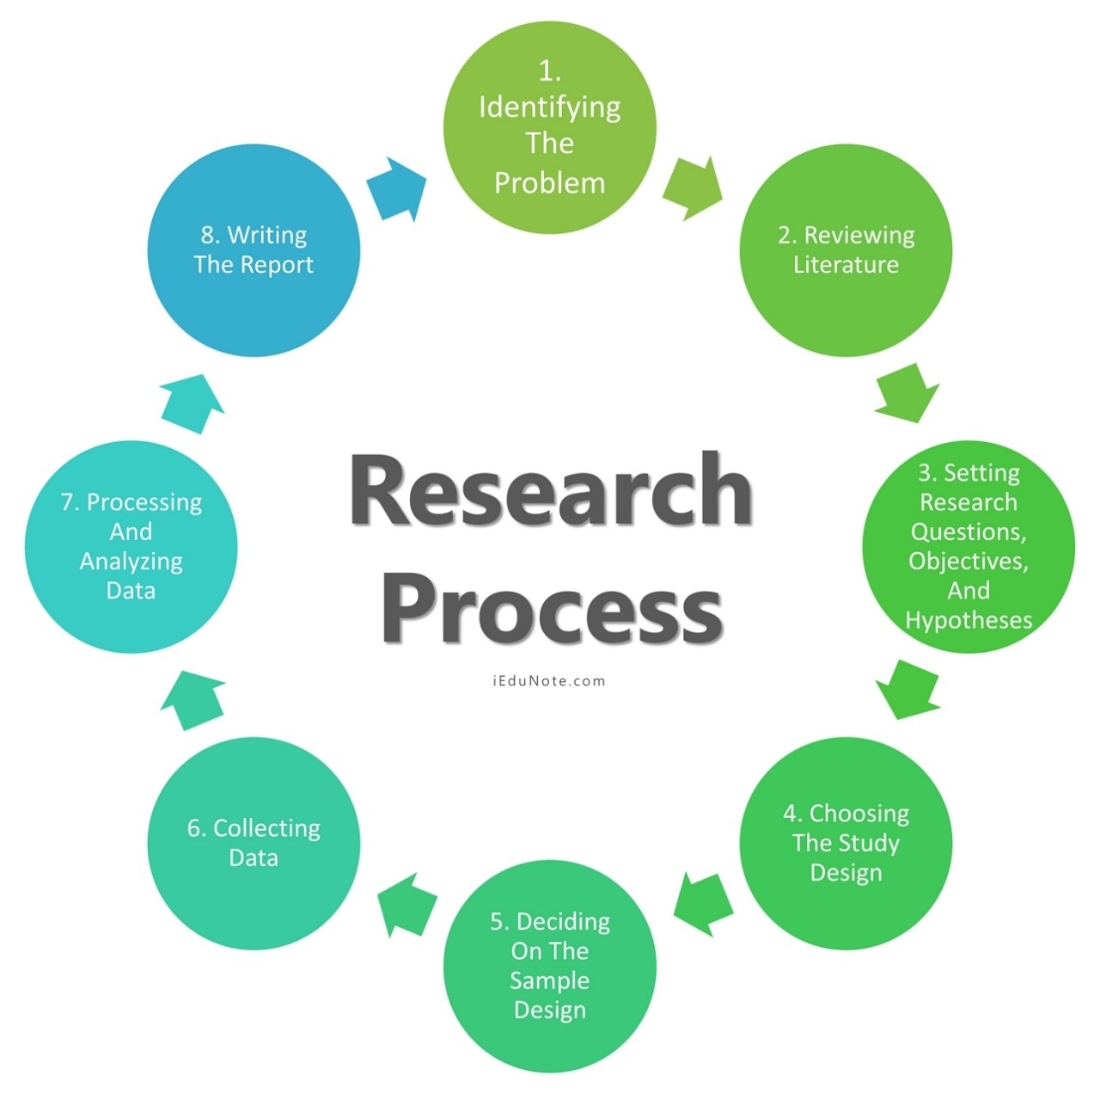

Slide 38
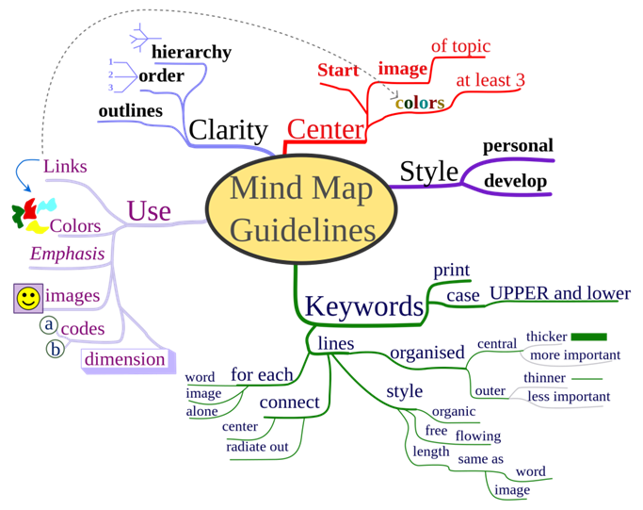
Planning a research assignment
Above is an example of a mind map taken from en.wikipedia.org.

Slide 39
What is and how do you create a mind map?
A diagram in which information is represented visually, usually with a central idea placed in the middle and associated ideas arranged around it.
Begin with the main concept. First, determine the main purpose of your mind map and write it down.
Add branches to the main concept. Now that you have determined the main purpose of your mind map, add branches that will outline the most basic subtopics.
Explore topics by adding more branches.
Add images and colors.

Slide 40
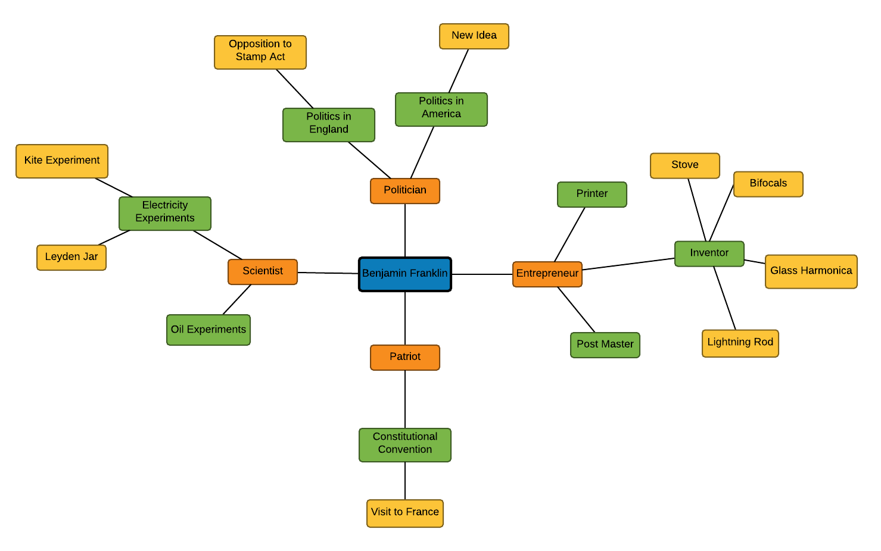

Slide 41
Planning a research assignment
As you can see, this illustrates how a particular document or paper can be set out. It sets out all the sections and sub-sections of the paper in a visual way so that you can see what has to be done at a glance.
As you think of new ideas or remember an aspect which must be included, you can add it to the mind map until you are happy that all aspects are covered and that the actual work can then begin.
In summary:
Plan:
  Establish a project file
  Set goals
  Gather information
  Identify relevant information
  Assess the material
  Prepare an outline

Slide 42
Planning a research assignment
2. Write the 1st draft
Revise, redraft, edit and produce the final product.
3.Let us look at an example regarding a research assignment now.

Slide 43
Planning a research assignment
Let us look at an example regarding a research assignment now.
2 - REVIEW LITERATURE
Authenticate
Verify
Evaluate
Relevancy
3 - CONSTRUCT BASIC DESIGN
Format
Skeleton layout
Headings
Body
1 - PLAN
Choose topic
Select sources
Choose format
Time frame
4 - GATHER AND ORANISE DATA
Select relevant data
Organise into categories
Arrange under headings
6 - COMPLETE FINAL WRITTEN REPORT
5000 to 6000 words
RESEARCH ASSIGNMENT
TOPIC
5 - COMPILE RESEARCH FINDINGS
Put data and information together

Slide 44
Planning a research assignment
The topic or research question .
Possibly the most important part of any research assignment is the topic. Without a good topic the research assignment will become tedious and difficult.
When it comes to choosing a topic, try to find a topic that truly interests you; try writing your way to a topic; talk with your course instructor, supervisor and colleagues about your topic and try to pose your topic as a question to be answered or a problem to be solved.

Slide 45
Planning a research assignment
What should you consider when choosing a research topic? There are a number of thing to take into consideration.
Is the topic relevant?
Is the information readily available?
Where is the information to be found?
Is the research topic familiar to you? Will you be able to gauge whether or not the information is pertinent?
Are there other papers written on the topic? If so will you be infringing any copyrights?
Is the topic controversial? Will it be opinion-based or factual?
Does the topic involve obtaining stats? If so are these readily available?

Slide 46
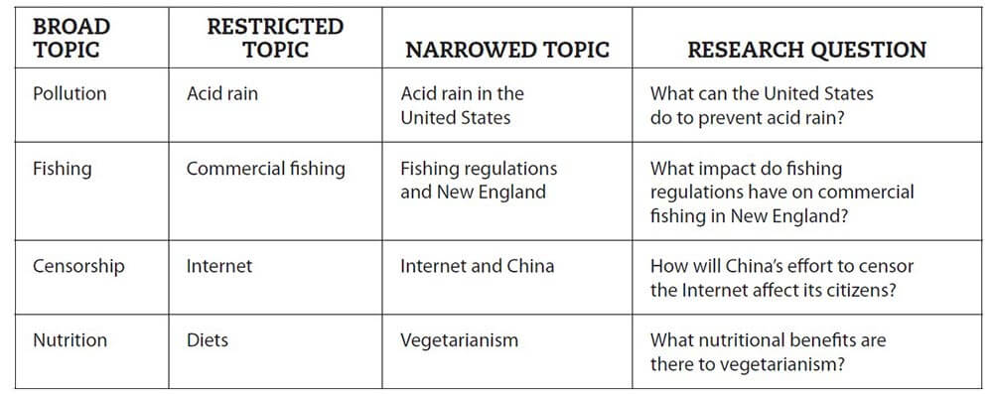
Some topics to consider
https://www.bachelorprint.eu/research/research-question/

Slide 47
Planning a research assignment
Research topics may be presented to you in the form of a list of possible topics to choose from. Or you may be asked to come up with your own topic. If you are stuck, remember to:
Choose a topic you’re interested in. What would you like to learn more about?
Find a problem that others may care about.
Look through your course materials for a general idea.
Browse through current magazines and newspapers.
Consult an encyclopaedia in your subject field.
Do a quick search on the Web.

Slide 48
When formulating your research question
DO WRITE | DON'T WRITE
✓ precise and narrow research questions | ✘ a research question based on false assumptions
✓ unbiased research questions | ✘ pseudo-questions (claims/statements in disguise)
✓ research questions relevant to your field of study | ✘ research questions containing inappropriate wording or concepts
✓ currently researchable research questions, i.e. that can be answered by methods available to students | ✘ a research question that is too general or too demanding
 | ✘ illogical research questions
https://www.bachelorprint.eu/research/research-question/

Slide 49
Planning a research assignment
To gain a better understanding of your topic you will have to do some background research. This will give you an overview of the subject and will allow you to put your topic into context.
You may find different aspects or perspectives of your subject that can be used to make your topic more specific.
Background research can be done using Encyclopaedias and reference works. For example Let us say you topic is euthanasia.

Slide 50
Planning a research assignment
Do a search or look through the internet and you will see that there are various types of euthanasia, that the legality of the procedure depends on the country or state, and that different viewpoints exist between various groups (religious leaders, patients, family members, nurses, doctors, etc.).
This information will give you a better idea of what points you want to discuss in your paper.
Depending on the assignment you may be asked to formulate your topic as a research question or as a thesis statement.

Slide 51
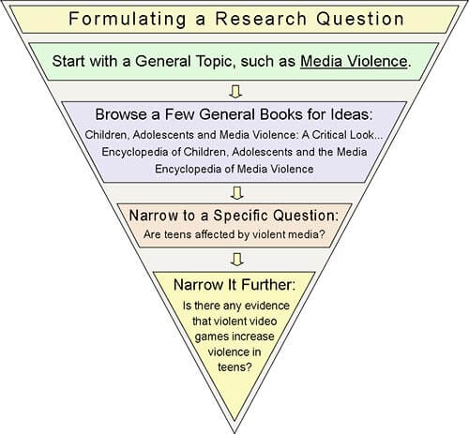
https://www.bachelorprint.eu/research/research-question/

Slide 52
Planning a research assignment
Research question
At the college level, research papers require more than a simple gathering of information and opinions. You need to ask questions: why, how, what if, where. What would you like to answer with your research?
By phrasing your topic as a question your paper becomes more focused. Your research question should have you reflect further on the topic and not be something you already know.
Thesis statement
The thesis statement answers your research question. It is the main purpose of your paper or in other words, a claim you make based on the research you’ve done.
The goal of the paper is to provide evidence to support your thesis. What do you want your audience to learn?

Slide 53
Planning a research assignment
Remember to go from general to specific while you’re refining your topic. If your topic is too broad or general, you will end up with too much information to go through. But don’t narrow it so much that you can’t find enough information (topic is too specific).
For example let us say your topic is the rising level of obesity, particularly obesity in children you and have come up with the research question of: “Why is there an increasing level of obesity in children?” You may need to narrow your topic down to one aspect of this question and focus on one potential cause of obesity. Your thesis statement becomes: “The proliferation of fast food restaurants has led to an increase in childhood obesity”. Can you see this?
You may need to modify your topic as you progress with your research. Remember to continue to question and remain flexible.

Slide 54
Planning a research assignment
Reasons for research
Research allows you to pursue your interests, to learn something new, to hone your problem-solving skills and to challenge yourself in new ways.
Working on a faculty-initiated research project gives you the opportunity work closely with a mentor–a faculty member or other experienced researcher. With a self-initiated research project, you leave Berkeley with a product that represents the distillation of your interests and studies, and possibly, a real contribution to knowledge.
Every field of study has its own research problems and methods. As a researcher you seek answers to questions of great interest to you. Your research problem could be aesthetic, social, political, scientific or technical. You choose the tools, gather and analyse the data.

Slide 55
Planning a research assignment
The importance of finding solutions via research
For many people, the main reason for being involved in research is to find out more information about their condition.
Whether the research is successful or not you’ll have contributed to knowledge on the subject, and this could lead to the development of better products, work conditions etc.
.

Slide 56
Research models or paradigms
Research models are applied to understanding particular application domains by means of deploying methods which have particular theories behind them. Research paradigms or models are deployed using one of a number of recognised research methodologies.
Theory
A theory is a set of interrelated concepts, definitions and statements arranged with the purpose of explaining and predicting phenomena.
Theory is a convenient way of organising facts and constructs into a meaningful and manageable form but it can be tested for quality.

Slide 57
Research models or paradigms
Methods
Methods or techniques are used to reveal the existence of, identify the value of or represent relationships between one or more concept.
There are two main types of research models. These are:
  Quantitative research - also known as traditional, positivist, experimental or empiricist
  Quantitative research is expressed in numbers and graphs. It is used to test or confirm theories and assumptions. This type of research can be used to establish generalizable facts about a topic.
  Common quantitative methods include experiments, observations recorded as numbers, and surveys with closed-ended questions.

Slide 58

Research models or paradigms
The second type of research model:
Qualitative research - also known as constructivist, naturalistic, interpretive, post positivist or post modern perspective.
Qualitative research is expressed in words. It is used to understand concepts, thoughts or experiences. This type of research enables you to gather in-depth insights on topics that are not well understood.
Common qualitative methods include interviews with open-ended questions, observations described in words, and literature reviews that explore concepts and theories..

Slide 59
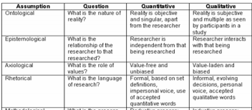
Research models or paradigms
Below is a table which explains this further.

Slide 60
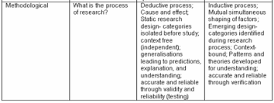
Research models or paradigms

Slide 61
Research philosophy
Ontology | What is reality?
Epistemology | How can we know reality?
Theoretical Perspective | What approaches can we use to acquire knowledge?
Methodology | What procedure can we use to acquire knowledge?
Method | What tools can we use for acquiring knowledge?
Sources | What data can we collect?

Slide 62
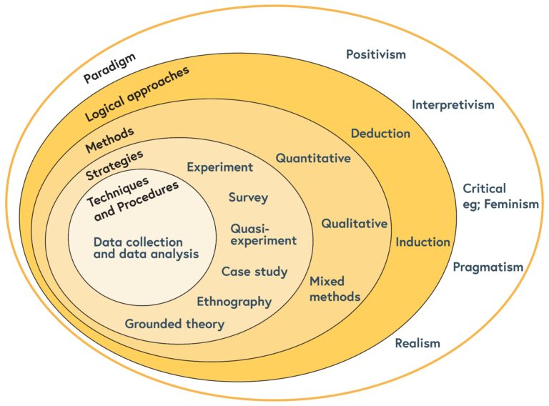
Stages - consider when planning your research & how the different research philosophies relate to each stages.

Slide 63
Research models or paradigms
The scope of the assignment
When choosing a topic and deciding on a research assignment, it is important to understand the scope of the assignment.
You must be able to describe the research topic accurately as well as the area of research you will base the assignment on.
For example, if it is education-based, you must be able to describe which sector of education it is based upon.

Slide 64
Research models or paradigms
The information file
Another very important aspect of research is to have a place to store and keep all your information together. A research file is a very helpful tool to have when gathering information and keeping track of all your findings.
The file can be divided into sections or categories and this will in turn help you to keep your information organised and easy to find or refer to.

Slide 65
Research models or paradigms
A project file should be used to store all notes and reference documents. Goals can be listed on a calendar or separate piece of paper where goals can be crossed off as you reach them. (Crossing off an item is very satisfying and helps to inspire you to reach the next goal).
Identify the resources you will need such as books, websites, audio visuals, magazines, reference books and journals, personal interviews, newspapers, questionnaire studies, lab reports or technical information supplied by the company itself.
Keep a comprehensive list of all the possible sources of information you will use.

Slide 66
Research models or paradigms
The format of the report (SO1 AC5)
The next step is to decide on the form your report will take. A report can take on the following structure:
Title page :
Acknowledgements :
Contents page :
Terms of reference :
Procedure :
Materials and methods :
Summary :
Introduction :
Main body :
Results :
Conclusion :

Slide 67
Research models or paradigms
Recommendations :
Appendices :
References :
Bibliography :
Glossary
Unlike essays, reports are written in sections with headings and sub-headings, which are usually numbered. Below are the possible components of a report, in the order in which they would appear. Check within your department which of these you should include. These headings can be adjusted to suit your report.

Slide 68
Research models or paradigms
Time frame
The next step in your planning is to consider the time frame of your assignment. Questions such as the following can be asked:
When is the report due?
How long will planning take?
How long will it take to gather information?
How long will it take to write the draft?
How long will it take to produce the final product?

Slide 69
Research models or paradigms
The answers to these questions will help you to determine the time frames. These should be noted and referred to regularly.
How much time is allowed for you to complete the process? You should have a contingency plan in place in case of unexpected developments such as load-shedding or the unavailability of internet or other resources.

Slide 70
Research models or paradigms
Sources of information
When planning your assignment, you will need to establish where you will get your information from.
If gathering information requires the participation of others (such as in the case of interviews and questionnaires) it is vital that you consult with these people in order to ensure that they have the time set aside to assist you.

Slide 71

Formative – page 73

Slide 73
Difference between Research and method and methodology
https://www.youtube.com/watch?v=vifGBH-0Wns
https://www.youtube.com/watch?v=KyuDYW9QbD4
https://www.youtube.com/watch?v=JEZjwlDNEHY
https://www.youtube.com/watch?v=7c8xP1gRIWs

Slide 74
Research models or paradigms
Sources of information
When identifying sources keep going back to your assignment and review its requirements. Was the number or type of information sources specified?
Do you need recent or historical information? Keep your list of concepts and keywords handy and be ready to change them or add to them as you go along. Take the time to develop a search strategy before you start your research.
Not all of the information you find will be useful. Conduct a preliminary evaluation of each information source before selecting it:

Slide 75
Research models or paradigms
Is it pertinent to your topic?
Does the publication date fall within the requested time frame?
Is it an academic publication or an authoritative source (written by an expert in the field)?
Remember:
Keep track of which quotes you want to use and what you would like to paraphrase.
Make note of all the relevant information for each of your information sources: author, title, publishing information, page number, date, etc. Include where you found it: database name, library, or on the web.
Save any web page you’re going to use: either print it out or save to your computer. Web pages can change.

Slide 76

Research models or paradigms
Some sources could be:
Literature
Internet
Experts or human resources
Physical resources
Own knowledge or experience
If making use of questionnaires or interviews in order to gather your information, it is important that you establish who will be participating in your surveys or research activities. You will need to establish the sample size of the sample you will use.
Complete Activity 1 in the PoE.

Slide 77
STUDY UNIT 2
REVIEW RELEVANT LITERATURE
https://www.youtube.com/watch?v=KkAnKGuX7fs
https://www.youtube.com/watch?v=_hLqI7TJiTQ

Slide 78
What will we cover?
Review relevant literature:
Sources are relevant to the topic of the research.
Main points made in the literature are elicited and synthesised, not simply paraphrased.
Review clearly indicates when sources are being quoted and when comment is that of the writer.
Relevance of ideas in the literature to own research is described.
Sources are adequately referenced.

Slide 80
Review Sources
Relevant sources
We briefly discussed sources in the previous chapter. Let us now look at this aspect in more detail.
Let us look at various sources of information now. You may make use of more than one or even all of the sources listed below:
Internet
Books (reference)
Statistics
Surveys and questionnaires
Written papers
Personal interviews
Newspapers
Archives
Databases

Slide 81
Review Sources
Television
Scholarly articles
Library catalogue
Periodical indexes
Bibliographies
Suggestions from your supervisor
Primary vs. secondary sources
Journals
Other relevant documents
When researching a paper you must ensure that the sources you use are relevant as well as current. If writing an assignment about a local issue, it is highly unlikely that sources which are overseas-based will be of any help unless referring to issues which affected a certain country and are now being experienced here.

Slide 82
Review Sources
How can you ensure that your sources are relevant?
When you utilise sources in a research paper, remember that the main focus of your paper should be about what you are saying, rather than what any individual source is saying.
You will dedicate portions of your paper to what your sources have to say, but these sources should always be discussed in relation to your own argument.
Your reader will be interested in the ideas the source offers, but this interest will be primarily in terms of how that source contributes to, or is relevant to, your own argument.

Slide 83
Review Sources
In order to make the strongest argument you can, you should always be trying to strike a balance between your sources and your own opinion. When you refer to multiple sources for a research paper, you might find yourself trying balance between the opinions of those sources and your own opinion.
In a case like this, it might be helpful to think of yourself as part of a conversation among scholars who are interested in the same topic.
Your paper is your chance to speak in the conversation, but you also need to accurately and clearly represent the other participants in the conversation.

Slide 84
Review Sources
As you think about what portion of a source to use in your paper, keep thinking back to what you're trying to do in your paper, and how the source helps you accomplish this goal.
When you choose the parts of a source that are most relevant to your argument, you may be surprised to find that you are using less of that source (and therefore spending more time analysing how it fits into your argument) than you originally imagined you would.

Slide 85
Summarising and synthesising texts
Summarising
What does summarising mean? “Into the Book”, a reading strategies web site for teachers and students, explains that when readers summarize, they “identify key elements and condense important information into their own words during and after reading to solidify meaning.”
It is very important when you summarise to make sure you use your own words, unless you are quoting. You must make it clear when the words or ideas that are not your own, that they are taken from another writer.
You must not use another person's words or ideas as if they were your own: this is Plagiarism and plagiarism is regarded as a very serious offence.

Slide 86
Summarising and synthesising texts
A summary is a shortened version of a text which contains the main points in the text and is written in your own words.
It is a mixture of reducing a long text to a short text and selecting relevant information. A good summary shows that you have understood the text.

Slide 87
Summarising and synthesising texts
Synthesising
Synthesizing takes the process of summarizing one step further. Instead of just restating the important points from text, synthesizing involves combining ideas and allowing an evolving understanding of text.
(www.beyondpenguins.ehe.osu.edu)
A synthesis is a combination, usually a shortened version, of several texts combined into one. It contains the important points in the text and is written in your own words.

Slide 88
Summarising and synthesising texts
To perform a synthesis you need to find suitable sources, and then select the relevant parts in those sources.
You can then use your paraphrase and summary skills to write the information in your own words. The information from all the sources has to fit together into one continuous text.

Slide 89
Summarising and synthesising texts
When it comes to researching there are many different techniques one can use when extracting information from sources. Eliciting is a way of extracting information by questioning such as:
Ask about previous assignments
Ask about class discussion relevant to the assignment
Pose the assignment as a question
Circle nouns (for subjects/topics), circle verbs (for tasks to be completed)
What happens in this passage?
How would you put that in your own words?
What's implied in this passage, or what are the assumptions?
How does this passage relate to the topic?
Mark points where you got lost, and say so.

Slide 90
Summarising and synthesising texts
Mark claims that could use more support
Ask what kind of information/evidence was presented during class or in class texts
List the main points (also referred to as gloss) on a separate sheet of paper
Look at the logical connection between points
Look at transitions between paragraphs for logical coherence
Ask questions of clarification
Paraphrase
Ask about premises and assumptions

Slide 91
Summarising and synthesising texts
Glossing
Glossing simply means putting a label or tag on a passage in a text. As someone working with a rough draft, you can gloss a paper as you read it, trying to get a grasp on the structure. The questions to ask are:
What was said here?
How many ideas are in this passage?
What is the gist of what was written?
What is the main idea/point here?
What does/should this passage do?
What question does this passage answer?

Slide 92
Summarising and synthesising texts
Paraphrasing
We've all watched movies or heard news stories we wanted to tell others about. We may have told our friends, our family, or our co-workers about what happened, how it happened, and why it happened. We related the storyline, the main characters, the events, and important points using our own words.
This is paraphrasing - using your own words to express someone else's message or ideas. In a paraphrase, the ideas and meaning of the original source must be maintained; the main ideas need to come through, but the wording has to be your own.

Slide 93
Summarising and synthesising texts
Let us look at a few examples now:
Original sentence: “Her life spanned years of incredible change for women”.
Paraphrased sentence: “Mary lived through an era of liberating reform for women”.
Original sentence: “Giraffes like Acacia leaves and hay, and they can consume 75 pounds of food a day”.
Paraphrased sentence: “A giraffe can eat up to 75 pounds of Acacia leaves and hay every day”.
(www.study.com)

Slide 94
Plagiarism
Plagiarism refers to intellectual theft i.e. using someone else’s thoughts in your work without referencing them. It’s taking the credit for someone else’s work, which goes against the rules of academia. Quoting is not banned, quite the opposite in fact. However, the author must be named.
Different forms. It does not just consist of copying but can also be an uncredited translation or the use of someone else’s ideas without referencing the author.
Plagiarism can definitely be uncovered. There is special software for this. If plagiarism is detected, there are serious consequences. Aside from plagiarism, copyright infringement and fraud are punishable criminal offenses.
So, you should familiarize yourself with the conventions of quotation to know what the grey areas are and avoid plagiarism in all its forms.
https://www.bachelorprint.eu/plagiarism-checker/plagiarism/

Slide 95
Quoting and writing in the 3rd person (
Let us look at a few examples now:
Original sentence: “Her life spanned years of incredible change for women”.
Paraphrased sentence: “Mary lived through an era of liberating reform for women”.
Original sentence: “Giraffes like Acacia leaves and hay, and they can consume 75 pounds of food a day”.
Paraphrased sentence: “A giraffe can eat up to 75 pounds of Acacia leaves and hay every day”.
(www.study.com)

Slide 96
Quoting and writing in the 3rd person (
One of your jobs as a writer is to guide your reader through your text. Don't simply drop quotations into your paper and leave it to the reader to make connections. Integrating a quotation into your text usually involves two elements:
A signal that a quotation is coming--generally the author's name and/or a reference to the work
An assertion that indicates the relationship of the quotation to your text

Slide 97
Quoting and writing in the 3rd person (
Often both the signal and the assertion appear in a single introductory statement, as in the example below. Notice how a transitional phrase also serves to connect the quotation smoothly to the introductory statement.
Ross (1993), in her study of poor and working-class mothers in London from 1870-1918 [signal], makes it clear that economic status to a large extent determined the meaning of motherhood [assertion]. Among this population [connection], "To mother was to work for and organize household subsistence" (p. 9)

Slide 98
Quoting and writing in the 3rd person (
The signal can also come after the assertion, again with a connecting word or phrase:
Illness was rarely a routine matter in the nineteenth century [assertion]. As [connection] Ross observes [signal], "Maternal thinking about children's health revolved around the possibility of a child's maiming or death" (p. 166).

Slide 99
Quoting and writing in the 3rd person (
Incorporate short direct quotations into the text of your paper and enclose them in double quotation marks:
According to Jonathan Clarke, "Professional diplomats often say that trying to think diplomatically about foreign policy is a waste of time."

Slide 100
Quoting and writing in the 3rd person (
Parenthetical citations
With short quotations, place citations outside of closing quotation marks, followed by sentence punctuation (period, question mark, comma, semi-colon, colon):
Menand (2002) characterizes language as "a social weapon" (p. 115).

Slide 101
Quoting and writing in the 3rd person (
Commas and periods
Place inside closing quotation marks when no parenthetical citation follows:
Hertzberg (2002) notes that "treating the Constitution as imperfect is not new," but because of Dahl's credentials, his "apostasy merits attention" (p. 85).

Slide 102
Quoting and writing in the 3rd person (
Semicolons and colons
Place outside of closing quotation marks (or after a parenthetical citation).
Question marks and exclamation points
Place inside closing quotation marks if the quotation is a question/exclamation:
Menand (2001) acknowledges that H. W. Fowler's Modern English Usage is "a classic of the language," but he asks, "Is it a dead classic?" (p. 114).

Slide 103
Quoting and writing in the 3rd person (
Place outside of closing quotation marks if the entire sentence containing the quotation is a question or exclamation:
Quotation within a quotation
Use single quotation marks for the embedded quotation:
The phrases "democratic fairness" and "encouraging consensus" are already in quotation marks in Dahl's sentence.]
How many students actually read the guide to find out what is meant by "academic misconduct"?
According to Hertzberg (2002), Dahl gives the U. S. Constitution "bad marks in 'democratic fairness' and 'encouraging consensus'" (p. 90).

Slide 104
Quoting and writing in the 3rd person
Quoting Only a Portion of the Whole
Use ellipsis points (. . .) to indicate an omission within a quotation--but not at the beginning or end unless it's not obvious that you're quoting only a portion of the whole.
Adding Clarification, Comment, or Correction
Within quotations, use square brackets [ ] (not parentheses) to add your own clarification, comment, or correction.
Use [sic] (meaning "so" or "thus") to indicate that a mistake is in the source you're quoting and is not your own.
(https://writing.wisc.edu/Handbook/QPA_quoting)

Slide 105
Quoting and writing in the 3rd person
Writing in third person is writing from the third person point of view and uses pronouns like he, she, it, or they.
It differs from the first person, which uses pronouns such as I and me, and from the second person, which uses pronouns such as you and yours.
The third person is the most common point of view used in fiction writing and is the traditional form for academic writing. Authors of novels and composers of papers use “he,” “she,” or “it” when referring to a person, place, thing, or idea.

Slide 106
Quoting and writing in the 3rd person
For example:
“He met her at a conference where she was the keynote speaker, and it was odd to him that her laptop had a fountain pen sticker on it, because that was his favourite kind of pen.
He had his with him and wondered about hers. “A laptop has its place on a desk or on a lap,” he thought, “but in the pocket near the heart and in the hand a fountain pen has its place.”
(http://www.quickanddirtytips.com)
Writing in the third person, you should refer to yourself as the ‘writer’, the ‘researcher’ the ‘compiler etc.

Slide 108
Relevance of information
Evaluating the information you find in the sources you use to research your assignment such as books, journals, and on the Internet is an important process.
Not all information sources will be authoritative, reliable, or well researched, but this does not mean they are not valuable for your field of study.
Primary sources of information are original materials that often convey new ideas, discoveries, or information. These sources originate from the time period under study.

Slide 109
Relevance of information
Examples of primary sources include:
Patents, technical reports
Original documents such as diaries, letters, emails, manuscripts, lab data/notes
Newspaper articles from the time period under study
Autobiographies, first-person accounts, case studies
Artifacts and archival material such as official documents, minutes recorded by government agencies and organizations, photographs, coins, fossils, natural specimens
Works of art such as literature, music, architecture, or paintings

Slide 110
Relevance of information
Secondary sources of information are based on primary sources. They are generally written at a later date and provide some discussion, analysis, or interpretation of the original primary source.
Examples of secondary sources include:
Review a
Articles or analyses of research studies about the same topic (also often in peer-reviewed publications)
Biographies, reviews, or critiques of an author
Analyses of original documents or archival material

Slide 111
Relevance of information
Tertiary sources of information are based on a collection of primary and secondary sources. Examples of tertiary sources include:
Textbooks (sometimes considered as secondary sources)
Dictionaries and encyclopaedias
Manuals, guidebooks, directories, almanacs
Indexes and bibliographies

Slide 112
Referencing sources
There are different methods of referencing sources, including:
In-text referencing
Footnotes
Endnotes.
The Harvard Referencing System, is an in-text referencing system which involves placing an abbreviated citation in your assignment which includes the author's surname, the year of publication, and (if a direct quote is used) the relevant page number.
For example: (Joyson 2004, p.8-10). A full bibliographic citation for the source is placed in the reference list at the end of your assignment.

Slide 113
Referencing sources
There are two main types of quotations: indirect and direct quotations.
An indirect quotation is when the original text has been paraphrased, i.e. rewritten in your own words.
A direct quotation is a word-for-word transcription of the original text by another author which must appear in inverted commas and end with a citation
When writing a report you are required to gather evidence and information from reliable sources.
This material will predominantly be factual. You would not be expected to use many direct quotations in a report, as it is generally the information itself which is important, rather than the specific wording.

Slide 114
Referencing sources
In a lab report for instance, you will naturally use information from sources such as your textbook, lab manual, a reference book, and articles published in a science or engineering journal.
When you use information from sources, you need to tell the reader where the information came from and where the reader can locate the sources. This is what citations and references are for.

Slide 115
Referencing sources
A citation tells the readers where the information came from. In your writing, you cite or refer to the source of information.
A reference gives the readers details about the source so that they have a good understanding of what kind of source it is and could find the source themselves if necessary. The references are typically listed at the end of the lab report.
There are many different forms of systems of citation and reference, varying across academic fields. Ascertain which system best fits your needs.
Complete Activity 2 in the PoE.

Slide 116


Slide 117
STUDY UNIT 3
CONSTRUCT A BASIC RESEARCH DESIGN AND GATHER AND ORGANISE DATA
RECAP FROM DAY 1

Slide 118
What will we cover?
Construct a basic research design:
Stages (steps) of the research activities are outlined and are logical.
Choice of data gathering methods is justified in terms research topic, research context and participants.
Selection of research participants is justified in terms of relevance to research topic or representativeness.
Instruments for gathering data are produced.
Methods for organising and analysing data are described.
Scale and scope of the design is appropriate to the overall research assignment.

Slide 119
What will we cover?
Gather and organise data:
Instruments for gathering data are piloted and amended if necessary.
Data gathered is organised in such a way that meaningful findings can be extracted.
Results and provisional findings are presented to research participants for feedback and modified if necessary.
Data is gathered in a manner which is in keeping with ethical norms.

Slide 121
Constructing Basic Research
Research is a process that requires patience and thought. There is no check list to make certain you have exhausted every resource and found the best research.
Research is more of an art rather than a science. There are steps you must take, however to thoughtfully go through this process.

Slide 122
Constructing Basic Research
The Process
The basic process for constructing the research paper may differ from assignment to assignment and from organisation to organisation. One process can be as follows:
Select the topic
Review the sources
Evaluate the sources
Be aware of all ethical issues
Be aware of all cultural issues
State the research question or hypothesis
Select the research approach
Determine how any variables are going to be measured

Slide 123
Constructing Basic Research
Select a sample
Select a data collection method
Collect and code the data
Analyse and interpret the data
Write the report
Disseminate the report

Slide 124
Constructing Basic Research
In summary let us look at a more detailed process now.
Choosing a Topic
Try to find a topic that truly interests you
Try writing your way to a topic
Talk with your course instructor and classmates about your topic
Pose your topic as a question to be answered or a problem to be solved

Slide 125
Constructing Basic Research
Selecting Sources
You will need to look at the following types of sources:
Library catalogue, periodical indexes, bibliographies, suggestions from your instructor
Primary vs. Secondary sources
Journals, books, other documents
Internet websites
Scholarly articles

Slide 126
Constructing Basic Research
Grouping and sequencing Information
The following systems will help keep you organized:
A system for noting sources on bibliography cards
A system for organizing material according to its relative importance
A system for taking notes
A categorised file for keeping all information organised and together

Slide 127
Constructing Basic Research
Draft an outline
Consider the following questions:
What is the topic?
Why is it significant?
What background material is relevant?
What is my thesis or purpose statement?
What organizational plan will best support my purpose?
Write the introduction -
In the introduction you will need to do the following things:
Present relevant background or contextual material
Define terms or concepts when necessary
Explain the focus of the paper and your specific purpose
Reveal your plan of organization
https://www.youtube.com/watch?v=FTC-5P1VFFU

Slide 128
Constructing Basic Research
Write the body of the report
Use your outline as a flexible guide
Build your report around points you want to make
Integrate your sources into your discussion
Summarize, analyse, explain, and evaluate published material rather than simply reporting it
Write the conclusion
If the argument or point of your report is complex, you may need to summarize the point of the report for your reader.
If before your conclusion you have not yet explained the significance of your findings use the end of your report to explain their significance.
Move from a detailed back to a general level of thought that takes the topic back to the perspective provided by the introduction.
Perhaps suggest what areas of this topic need further research.

Slide 129
Constructing Basic Research
Revising the final draft
Check the logical flow of introduction, body and conclusion.
Check the topic sentences, sequence of ideas within paragraphs, use of details to support findings, summary sentences where necessary and use of transitions within and between paragraphs.
Review sentence structure, word choices, punctuation, spelling.
Check the consistent use of one system, citation of all material not considered common knowledge, appropriate use of endnotes or footnotes, accuracy of list of works cited.

Slide 130
Constructing Basic Research
Each research assignment is different. It is important that you select the correct method for your assignment and that the method you select is relevant and follows a logical sequence in order to avoid confusion.

Slide 131
Constructing Basic Research
Research assignments can be broken down into segments and each segment can have a specific time frame as well. For example, one way to do this would be to divide the research paper into the following steps, which must be handed in at intervals according to notional hours.
Define your topic using appropriate sources such as the internet, encyclopaedia articles, class readings, or scholarly reviews of the literature for background information.
Develop a list of relevant keywords and phrases to search for and record which keywords best identify relevant resources and explain

Slide 132
Constructing Basic Research
Use databases to find books, articles and web sites that are relevant to your topic. Complete an annotated bibliography explaining why each resource is appropriate for your paper and how it will support the report.
Hand in a rough draft, the assessor/supervisor’s critique of which will include an evaluation of the types and appropriateness of information used.
Once these steps are completed you can divide the next section into similar steps and proceed as before until the task is complete. Whichever system works for you or for the type of report you are completing will be acceptable.

Slide 133
Data gathering methods and instruments
Data Collection is an important aspect of any type of research study. Inaccurate data collection can impact the results of a study and ultimately lead to invalid results.
There are many different data gathering methods which can be used depending on the nature of your assignment.
Quantitative data collection methods rely on random sampling and structured data collection instruments that fit varied experiences into fixed response categories. They produce results that are easy to summarise, compare, and generalise.

Slide 134
Data gathering methods and instruments
Quantitative research is concerned with testing theories derived from theory and/or being able to estimate the size of a phenomenon of interest. Depending on the research question, participants may be randomly assigned to different actions.
Typical quantitative data gathering strategies include:
Experiments/clinical trials.
Observing and recording well-defined events (e.g., counting the number of patients waiting in emergency at specified times of the day).
Obtaining relevant data from management information systems.
Administering surveys with closed-ended questions (e.g., face-to face and telephone interviews, questionnaires etc).

Slide 135
Data gathering methods and instruments
In Quantitative research (survey research), interviews are more structured than in Qualitative research.
In a structured interview, the researcher asks a standard set of questions and nothing more. Face -to -face interviews have a distinct advantage of enabling the researcher to establish a relationship with potential participants and therefor gain their co-operation.
These interviews yield highest response rates in survey research. They also allow the researcher to clarify ambiguous answers and when appropriate, seek follow-up information.

Slide 136
Data gathering methods and instruments
Questionnaires can be sent to a large number of people and saves the researcher time and money.
People are more truthful while responding to the questionnaires regarding controversial issues in particular due to the fact that their responses are anonymous.
But they also have disadvantages. The majority of the people who receive questionnaires don't return them and those who do might not be representative of the originally selected sample.

Slide 138
Data gathering methods and instruments
Web based questionnaires, is a new and inevitably growing methodology. This involves receiving an e-mail where you click on an address that takes you to a secure web-site to fill in a questionnaire. This type of research is often quicker and less detailed.
Some disadvantages of this method include the exclusion of people who do not have a computer or are unable to access a computer. Also the validity of such surveys are in question as people might be in a hurry to complete it and so might not give accurate responses.

Slide 139
Data gathering methods and instruments
Qualitative data collection methods play an important role in impact evaluation by providing information useful to understanding the processes behind observed results and assess changes in people’s perceptions of their well-being
Furthermore qualitative methods can be used to improve the quality of survey-based quantitative evaluations by helping generate evaluation theories; strengthening the design of survey questionnaires and expanding or clarifying quantitative evaluation findings.

Slide 140
Data gathering methods and instruments
These methods are characterized by the following attributes:
They tend to be open-ended and have less structured protocols (i.e., researchers may change the data collection strategy by adding, refining, or dropping techniques or informants)
They rely more heavily on interactive interviews; respondents may be interviewed several times to follow up on a particular issue, clarify concepts or check the reliability of data
They use triangulation to increase the credibility of their findings (i.e., researchers rely on multiple data collection methods to check the authenticity of their results)

Slide 141
Data gathering methods and instruments
Generally their findings are not generalizable to any specific population, rather each case study produces a single piece of evidence that can be used to seek general patterns among different studies of the same issue
Regardless of the kinds of data involved, data collection in a qualitative study takes a great deal of time.
The researcher needs to record any potentially useful data thoroughly, accurately, and systematically, using field notes, sketches, audiotapes, photographs and other suitable means.
The data collection methods must observe the ethical principles of research.

Slide 142
Data gathering methods and instruments
The qualitative methods most commonly used in evaluation can be classified in three broad categories:
In-depth interview
Observation methods
Document review

Slide 143
Data gathering methods and instruments
Questionnaires
We have discussed briefly the use of questionnaires and interviews as methods of gathering data.
Questionnaires are often used to gather data and determine specifics when compiling a research assignment.
Questionnaires must be fit for purpose – in other words they must be relevant to the type of audience as well as the type of information you are trying to obtain.

Slide 144
Data gathering methods and instruments
In some cases it may be a good idea to ‘test’ a compiled questionnaire in order to assess the effectiveness of the questionnaire before it is distributed.
This will save a lot of time and effort as if there are any issues; one can rectify them before the final product is sent out. Using a few volunteers or a control group will help you to determine this.
Once the questionnaire is deemed suitable and you are satisfied that it will produce the results you desire, you can distribute it to the relevant people. Results can then be collected and the information sorted into categories and findings can be sorted and confirmed.

Slide 145
Data gathering methods and instruments
If ay findings seem to be inaccurate or unclear, you can go back to the participants and get their feedback on the subject. The findings can then be adjusted according to the new information obtained.
Always bear in mind that any data gathering techniques must be ethical and not performed in such a way as to illicit information illegally. For example, ascertaining information regarding a person’s HIV status may not be obtained by any other means except with the full consent of the participant. Bank accounts may not be accessed to ascertain earnings or incomes etc.
Confidentiality is a very important issue to consider. Also ‘spamming’ can be seen as an invasion of privacy in some instances. The bottom line is that you must ensure that your information is gathered in an ethical and considerate manner.

Slide 146
Data gathering methods and instruments
When completing a survey, one should decide the size of the test sample first. The test sample is the number of people you would need in order to get a good idea of the information you are trying to establish. Good practice is to test the questionnaire on a smaller group at first in order to see if the questions are fit for purpose and that they enable you to gather the information you are looking for.
This is called running a pilot. A pilot will help you to see which questions are relevant and if more specific questions are needed. A pilot will help you to see if the instruments are working before you distribute it too widely.
Should you find that the instrument is lacking in any way, you can then make the necessary adjustments and redistribute the adjusted instrument.

Slide 147
Data gathering methods and instruments
When evaluating whether or not an instrument is working, you should ask yourself the following:
Were the questions understood correctly?
Did the questions elicit the desired response?
Should any questions be changed or removed?
Should questions be added?
Should questions be clarifies or shortened etc.?
Once the amendments are made you can use them for data gathering. Remember that the size of the target group will have an impact on the validity of the research. Too small a group will not give a sufficient result and a group which is too large will be time consuming to gather results from.

Slide 148
Data gathering methods and instruments
Validity of an instrument
Validity is the extent to which an instrument measures what it is supposed to measure and performs as it is designed to perform.
It is rare, if nearly impossible, that an instrument be 100% valid, so validity is generally measured in degrees. As a process, validation involves collecting and analysing data to assess the accuracy of an instrument.
There are numerous statistical tests and measures to assess the validity of quantitative instruments, which generally involves pilot testing. The remainder of this discussion focuses on external validity and content validity.

Slide 149
Data gathering methods and instruments
External validity is the extent to which the results of a study can be generalized from a sample to a population. Establishing eternal validity for an instrument, then, follows directly from sampling.
Recall that a sample should be an accurate representation of a population, because the total population may not be available.
An instrument that is externally valid helps obtain population generalizability, or the degree to which a sample represents the population.

Slide 150
Data gathering methods and instruments
Content validity refers to the appropriateness of the content of an instrument. In other words, do the measures (questions, observation logs, etc.) accurately assess what you want to know?
This is particularly important with achievement tests. Consider that a test developer wants to maximize the validity of a unit test for 7th grade mathematics.
This would involve taking representative questions from each of the sections of the unit and evaluating them against the desired outcomes.

Slide 151
Data gathering methods and instruments
Reliability of instruments
Reliability can be thought of as consistency. Does the instrument consistently measure what it is intended to measure?
It is not possible to calculate reliability; however, there are four general estimators that you may encounter in reading research:
On page 54 is an example of a questionnaire used to gather information about employee skills in an organisation.

Slide 152
Data gathering methods and instruments
Examples of instruments are:
Researcher-completed Instruments | Subject-completed Instruments
Rating scales | Questionnaires
Interview schedules/guides | Self-checklists
Tally sheets | Attitude scales
Flowcharts | Personality inventories
Performance checklists | Achievement/aptitude tests
Time-and-motion logs | Projective devices
Observation forms | Socio-metric devices

Slide 153
Data gathering methods and instruments
Tables
A table helps organise information so it is easier to see patterns and relationships. If a variable is continuous the table reveals a lot more information. It may show the range, interval, and number of readings.
Tables with multiple variables can provide a lot of information. They can be read by selecting and controlling factors to search for patterns in the data.

Slide 154
Data gathering methods and instruments
It can be difficult to see numerical relationships and patterns with a table. A graph may make these clearer. When clumping information into bands, there is no indication of how many are in each category.
Purposes of graphs
Graphs are a way of exploring the relationships in data as well as displaying and reporting data, making it easier to report patterns and relationships, shapes of distributions, and trends.

Slide 155
Data gathering methods and instruments
Any graph used to report findings should show
The significant features and findings of the investigation in a fair and easily read way
The underlying structure of an investigation in terms of the relationships between and within the variables
The units of measurement
The number of readings (though sometimes these will be in the accompanying text)
The range and interval of readings, where appropriate.
It is good practice (but only a convention) to put the dependent variable on the horizontal (x) axis and the independent on the vertical (y) axis.

Slide 156
Data gathering methods and instruments
Bar graphs
Bar graphs should be used for categorical, ordered, and discrete variables. If the number of units in a discrete variable is large it may be displayed as a continuous variable.

Slide 157
Data gathering methods and instruments
Line graphs
Line graphs should be used for continuous variables.

Slide 158
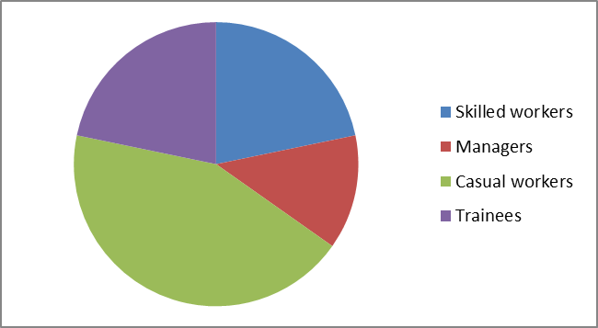
Data gathering methods and instruments
Pie graphs
Pie graphs (sometimes called pie or circle charts) are used to show the parts that make up a whole.
They can be useful for comparing the size of relative parts. Because it is difficult to compare different circle graphs, and often hard to compare the angles of different sectors of the pie, it is sometimes better to choose other sorts of graphs.

Slide 159
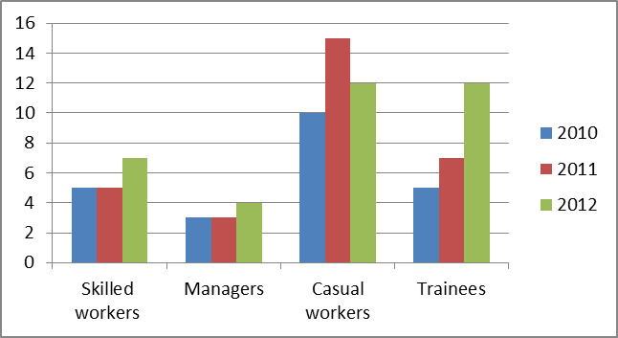
Data gathering methods and instruments
Histograms
Use histograms when y-axis gives the frequency of, or occurrences for continuous data that has been sorted into groups, for example, 20-24 metres. All bars are usually of equal width.
They can be turned into line graphs by connecting the middle of the top section of each vertical bar. Histograms are not joined up bar graphs and should not be used for categorical data (unless the number of units in each group is large).

Slide 160
Data gathering methods and instruments
On a graph you get an overall shape of a variable or the relationships between variables.
A line graph represents a numerical or mathematical relationship and so has more information "buried" in it than other graphs. Line graphs can sometimes be used to make predictions for values that were not measured, by interpolating or extrapolating the trend, or by looking at the shape.

Slide 161
Data gathering methods and instruments
Graphs can tell you a lot about the design of an investigation, but they don't tell you everything.
For example, they don't usually tell you which variables were controlled, the sample size, or the method of measurement.
So there are lots of questions to ask to find out about validity and reliability, and also about the actual context of the investigation.

Slide 162
Data gathering methods and instruments
The scales on the axes can be stretched or shrunk to emphasise one side of a relationship or to make a point that may not be justified by the data. A graph implies a relationship but not necessarily a cause.
For example, a graph may show that houses cost less in March than they did in February, but it does not show why this happened. We may infer it is because the interest rates have gone up.

Slide 163
Data gathering methods and instruments
Organising data
Once the data has been gathered what do you do with it? There are many ways of organising data. One must decide on the method that is best suited to your needs or organisation. In most organisations there will be policies and procedures in place which will tell you how the data must be organised.
The most common way of storing data these days is via a database. Data can also be stored on spreadsheets, in tables and summaries. Your organisation will specify the method you should use.

Slide 164
Data gathering methods and instruments
The storage of originals will be specified by the organisational policies as well. In some cases, originals must be stored for a pre-determined period of time.
Depending on the nature of the document, some must be stored for 5 year periods – when it comes to questionnaires or other data this can vary from company to company and from researcher to researcher.
No matter what the policy is, it is a good idea to store the originals for future reference as well as in the case of something unexpected happening such as your computer system crashing etc.
Originals should also be scanned in and saved as soft copies on the computer or external source in the case of something unexpected happening such as water damage or fire destroying the originals.
As you can see it is a good idea to save your documents in a number of ways.

Slide 165
Data gathering methods and instruments
Evaluating data
When analysing data, especially from questionnaires, the responses to the questions must be recorded and organised in order to extract the information and sort it.
Questionnaires can be given to participants before and after an intervention (pre and post) in order to compare their behaviours, practices, and household fitting and appliances.

Slide 166
Data gathering methods and instruments
This requires participants to complete two questionnaires if you want to have an individual comparison between pre and post intervention.
In many cases, you may get some participants completing the pre questionnaire, and others the post questionnaire, which leaves you to either use a very small sample, or look at the average results for before and after.
This can be an important consideration if the number of participants is small.

Slide 167
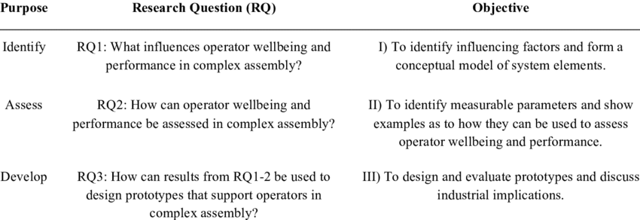
Research questions connected to objectives.

Slide 168
Data gathering methods and instruments
Remember that confidentiality is extremely important when it comes to personal information and there are laws and policies in place to protect people’s information. Make sure you are familiar with these
Complete Activity 3 in the PoE.

Slide 170
Summary of Design and data gathering
https://www.youtube.com/watch?v=IwJVnfw44SU

Slide 171
STUDY UNIT 4
COMPILE RESEARCH FINDINGS AND PRODUCE A FINAL WRITTEN REPORT

Slide 172
What will we cover?
Compile research findings
Results or findings of the research are clearly described.
Results or findings relate to an analysis of data gathered.
Results or findings reported relate to the original research question or problem.
Wider conclusions or recommendations are justified in terms of data gathered.
Limitations of the research assignment are identified and acknowledged in findings and conclusions.

Slide 173
What will we cover?
Produce a final, written research report
Report has a logical and coherent structure with relevant sections.
Presentation of the report is in keeping with organisational guidelines and requirements.
Report is completed within required time frame.
Stages and processes of the research assignment are described accurately and in adequate detail.
Language of the written report is lucid (clear) and comprehendible.

Slide 174
Compiling Research Findings
Assessing results of research
We have discussed in detail the methods for gathering information. Whichever method you choose, you will need to make sure that your data is organised before you can start sifting through and making sense of things.
The best way to do this is to make use of the research file mentioned in a previous chapter. To take this one step further, you can divide your research information into categories or sub-headings.

Slide 175
https://www.youtube.com/watch?v=HAyHyDiISqY
First Draft

Slide 176
Compiling Research Findings
For example, you could have a section or category for:
Questionnaire findings or survey results
Statistics
Newspaper articles and historical data
Recent findings such as information taken from websites
Encyclopaedia references
Written reports and scholarly articles
Own findings…etc.

Slide 177
Compiling Research Findings
The categories and sections are totally dependent on the type of research assignment you are doing as well as your own methods of organising. Everyone is different and you must use what works best for you personally to ensure your research assignment is successful.
Remember to indicate the measure of your findings, such as the percentage of respondents and their responses. (E.g. 60% of the respondents indicated xxx. 40% of the respondents indicated xxx)

Slide 178
Compiling Research Findings
Once you have your data organised and set out, you can begin arranging it into the report format. For instance data or information which relates to the introduction part of the report must be labelled as ‘introduction’ and filed under that section or sub-heading.
You can then go through all the data and ensure that all information pertaining to that section are filed under that sub-section in order to ensure that you have not forgotten to include anything.
This should be done for all sections of the paper in turn until you have a complete file of information and all sections are full.

Slide 179
Compiling Research Findings
Once this is done, you must go through each section and review the data or information for validity and relevance.
Throw out any information which does not fit with the topic and eliminate ‘superfluous’ information which may not be necessary in getting your point across.
See if the information can be used under another heading or section, but constantly check for flow of information. The information must flow in a logical way and not jump around and cause the reader confusion.

Slide 180
Compiling Research Findings
Before sitting down and compiling the draft report, go through all the information and data and identify any gaps in information that may exist.
By throwing out some information, you may find that you need to obtain more relevant information to take its place.
Or you may read through the collected data and it may not make logical sense to you as it may need something additional to fill in the gap and make more sense possibly.
If more clarity or information is needed, research these areas and add the new information to the relevant section of the file.

Slide 181
Compiling Research Findings
Writing the draft
Once the above is done – and only then, is it time to start compiling the draft document.
By writing a draft and putting all the info together in a rough form, you will be able to see what works and what does not work. Perhaps you come across a section where the information is scant and where you need more input or consideration.
Perhaps you write the draft and you find that there is a section which is perhaps not as relevant as you thought, or one piece of information would fit better in another part of the report.

Slide 182
Compiling Research Findings
A mistake some people make is to think that once they have written a draft, the report is basically done. This is not so; the first draft is only one part of the whole writing process that leads to a finished, presentable, and hopefully excellent report.
The idea of the first draft is to get the ideas out, to give your report body, and to give you some content to shape and change into a finished product.
You may need to write a number of drafts in order to get to that final report, but, if you have really thought through your ideas and planned well, you may only need to write one draft which you then edit. It depends on what happens in the first draft - and it is best not to expect too much or too little from it.

Slide 183
Compiling Research Findings
How to do the first draft
Have your notes, your plan, and any other resource materials you may need in front of you. Any planning and preparation which has been done on a computer, is best printed out so that you can see them while you are working.
Once you are ready, try to write the draft all the way through in one stage. Do not worry about any specific part of it yet. If you can let yourself get into the flow of writing, your words will come more easily, and you are more likely to find connections between the ideas. Don't rush: Let yourself explore the ideas as you go.
Don't worry over any particular paragraph and try to get the whole report out of your head and onto the page.

Slide 184
Compiling Research Findings
If you get stuck on the introduction, continue onto the first paragraph and come back to the introduction once you are more in the flow of things.
Similarly you can skip any of the paragraphs while writing the first draft. If you get stuck on any section, move forward and then go back to work on it in the second draft/editing stage.
The main point is to write the report as a flowing document and to let the ideas and words come out onto the paper. At this stage of writing, don’t spend any time fixing anything.
Don’t change anything. Don’t even worry about your spelling or grammar. You will fix and change in the next stage.

Slide 185
Compiling Research Findings
Limitations of the research assignment
All research has limitations, whether it is performed by undergraduate and master's level dissertation students, or seasoned academics.
These research limitations range from flaws in the research design, which can be quite serious, to more common problems, such as the challenge of justifying how and why your findings answer the research questions and/or hypotheses that were set.
These limitations are usually set out in a section of the research paper or report called the Research Limitations section. Let us consider how to write the Research Limitations section of your paper.

Slide 186
Compiling Research Findings
In particular, your Research Limitations section should be:
Well structured
Properly weighted
Honest
Pragmatic.
If the researcher was investigating the career choices of students at a university of 20,000 students (the population in question), only a small number of these students (e.g., a sample of 400 students), may need to be surveyed. It may then be possible to make generalisations about the career choices of the population of 20,000 students based on the data collected from the sample of 400 students.

Slide 187
Compiling Research Findings
However using a probability sampling technique can be very difficult. In fact, there are many reasons why it may be impossible (or near on impossible) to use a probability sampling technique.
In such cases, researchers are forced to use non-probability sampling techniques, where is it no longer possible to make generalisations (i.e., statistical inferences) from the sample to the population being studied. However, this does not mean that any study that uses a quantitative research design, but fails to use a probability sampling technique, is of low quality or flawed.
It simply means that some things that are limitations in theory are not necessarily weaknesses in practice. It means that you need to adopt a practical approach to your research, whilst acknowledging potential limitations.

Slide 188
Compiling Research Findings
Assess and evaluate the draft
After you have written the first draft of your report, you might think that most of your work has been completed.
You might take a break for several days and completely forget about your writing. Though this rest is necessary, do not rush into creating a final draft when you decide to come back to your report.
The writing process is more complicated than that, requiring a writer to make a second draft before making it final. The second draft may be thought of as an enhanced and more detailed copy of the first one, and its main purpose is to make sure that you haven’t missed anything crucial.

Slide 189
Compiling Research Findings
Reread your first draft carefully, examining how each of your main points are expressed, how the hypothesis holds up to the rest of your report, and the technical side of your writing such as grammar, punctuation, and spelling.
Fill in the blank spaces that you might have left while writing the first draft; include content that you noted separately while writing your first draft. Put simply, clean up the clutter: complete all sentences, expand a little on all ideas that weren’t fully elaborated on.
Take a closer look at the order your arguments are organised in and see whether they hold together. This means that the report should flow from one point to another in a convincing manner. At this step, you might want to change certain key points, or even the structure of the whole essay.

Slide 190
Compiling Research Findings
Analyse each argument you introduce and decide whether the evidence is sufficient, and whether the argument is appropriate to your topic. In other words, consider whether your arguments answer the question: “Does this argument match my hypothesis and develop its concept properly?”
Pay additional attention to the introduction and conclusion section. Think of several catch phrases for the introduction that would draw in reader’s attention and logically lead to the thesis statement. Also, think about the best way to summarise your arguments and thesis statement in the conclusion.
Keep checking that the information keeps coming back to and fits in with the original research question or topic. Identify any limitations of the assignment and acknowledge the findings and conclusions.

Slide 192
Compiling Research Findings
The Final Product
We have discussed at length all the aspects that make up the final report as well as all the steps to take in order to arrive at the final product.
Now it is up to you to produce a report which covers all aspects in a logical and coherent way with relevant sections which flow easily and put the required information in an acceptable format.

Slide 193
Compiling Research Findings
The accepted format must be established before you begin the final report. This can be established by consulting the organisational policies and procedures if applicable, or you can follow the format that works for you. An example of the format is as follows:
Cover page
Title of the Research
Abstract/executive summary
Introduction
Research methodology

Slide 194
Compiling Research Findings
Findings
Discussion
Conclusion
References
Appendices
This format can be used as a base to work from and can be adapted as needed.

Slide 195
Compiling Research Findings
Cover page
This page will hold the basic information of the research paper or thesis. The title of the paper as well as the author and date of research can be placed here.
Title of the research
This section speaks for itself and has the title of the paper.

Slide 196
Compiling Research Findings
Abstract /executive summary
This is the 'shop window' for your report. It is the first (and sometimes the only) section to be read and should be the last to be written. It should enable the reader to make an informed decision about whether they want to read the report itself. Length depends on the extent of the work reported - usually a paragraph or two and always less than a page. It should briefly explain:
The purpose of the work
Methods used for research
Main conclusions reached
Any recommendations

Slide 197
Compiling Research Findings
Introduction
This section should explain the rationale for undertaking the work reported on, and the way you decided to do it. Include what you have been asked (or chosen) to do and the reasons for doing it.
State what the report is about. What is the question you are trying to answer? If it is a brief for a specific reader (e.g. a feasibility report on a construction project for a client), say who they are.
Describe your starting point and the background to the subject: e.g., what research has already been done (if you have to include a Literature Review, this will only be a brief survey); what are the relevant themes and issues; why are you being asked to investigate it now?

Slide 198
Compiling Research Findings
Explain how you are going to go about responding to the brief. If you are going to test a hypothesis in your research, include this at the end of your introduction. Include a brief outline of your method of enquiry. State the limits of your research and reasons for them.

Slide 199
Compiling Research Findings
Research methodology
This section should be written in such a way that a reader could replicate the research you have done. State clearly how you carried out your investigation.
Explain why you chose this particular method (questionnaires, focus group, experimental procedure etc). Include techniques and any equipment you used. If there were participants in your research, who were they? How many? How were they selected?
Write this section concisely but thoroughly – Go through what you did step by step, including everything that is relevant. You know what you did, but could a reader follow your description?

Slide 200
Compiling Research Findings
Findings
This section has only one job, which is to present the findings of your research as simply as possible. Use the format that will achieve this most effectively: e.g. text, graphs, tables or diagrams. Don't repeat the same information in two visual formats (e.g. a graph and a table).
Label your graphs and tables clearly. Give each figure a title and describe in words what the figure demonstrates. Save your interpretation of the results for the Discussion section.

Slide 201
Compiling Research Findings
Discussion
This is probably the longest section. It brings everything together, showing how your findings respond to the brief you explained in your introduction and the previous research you surveyed in your literature review.
This is the place to mention if there were any problems (e.g. your results were different from expectations, you couldn't find important data, or you had to change your method or participants) and how they were or could have been solved.

Slide 202
Compiling Research Findings
Conclusion
This should be a short section with no new arguments or evidence. Sum up the main points of your research. How do they answer the original brief for the work reported on? This section may also include:
Recommendations for action
Suggestions for further research
References
List full details for any works you have referred to in the report. For the correct style of referencing to use, check any instructions you may have been given.

Slide 203
Compiling Research Findings
Appendices
This should include any additional information that may help the reader but is not essential to the report's main findings; for instance, interview questions, raw data, or a glossary of terms used.
Label all appendices and refer to them where appropriate in the main text (e.g. 'See Appendix A for an example questionnaire').
The above format can be expanded upon. The final report must be produced and submitted within the required/agreed timeframe and if you have followed your planning steps carefully, this should not pose any problems.
Perhaps it would be a good idea to write a summary of how you arrived at the final product citing the various stages and processes followed.

Slide 204
Compiling Research Findings
The final report must be written in such a way as to be easily understood by the target reader. Any technical language must be in keeping with the required norms of the industry. In other words, the report must be easy to understand or comprehend by the reader.
https://www.youtube.com/watch?v=-JcgRyJUfZM

Slide 205
Compiling Research Findings
Let us recap now on what is required of you.
You will be required to produce a report consisting of approximately five thousand (5000) to seven thousand five hundred (7500) words which translates into twenty (20) to thirty (30) pages of approximately two hundred and fifty (250) words per page.
If working on a computer, adjust the font so that it is not too big or too small. An average and acceptable size and font is Arial 10 – 12 or Calibri 10 – 11. However the font you choose is up to you, as long as you bear in mind that it cannot be too large or too small in order to meet the requirements of the report.
Complete Activity 4 in the PoE.

