Slide 1
Labour Law Workshop

Slide 2
Ground Rules
3 – Day Training Workshop
Breaks
Cell Phones
Participation
Portfolio Submission

Slide 3
Labour Law Workshop
Study Unit 1:
Key Elements of the Employment Equity Legislation

Slide 4
Introduction
The Employment Equity Act applies to the following employer groups:
Employers who employ 50 or more employees
Employers who employ fewer than 50 employees but whose annual turnover equals or exceeds the applicable turnover of a small business in terms of Schedule 4 of the Act

Slide 5
Introduction
The Employment Equity Act applies to the following employer groups:
An employer appointed by a collective agreement
Municipalities
Organs of the state except for
- The National Defence Force
- The National Intelligence Agency
- The South African Secret Service

Slide 6
1.1 The Key Elements of Employment Equity Legislation
The Employment Equity Act (1998) was passed in order to:
  Promote the constitutional right of equality and the exercise of true democracy
  Eliminate unfair discrimination in employment
  Ensure the implementation of employment equity
  Achieve a diverse workforce representative of our people
  Give effect to the obligations of the republic as a member of the international labour organisation

Slide 7
1.1 The Key Elements of Employment Equity Legislation
The purpose of the EEA (Chapter I)
Promoting equal opportunity and fair treatment in employment through the elimination of unfair discrimination
Implementing affirmative action measures to redress the disadvantages in employment
Implementing affirmative action to ensure equitable representation in all occupational categories and levels in the workforce

Slide 8
1.1 The Key Elements of Employment Equity Legislation
Overview of the EEA (Chapter 1)
Prohibition of unfair discrimination
No person may unfairly discriminate against an employee.
Medical testing of an employee is prohibited, unless
- legislation permits or requires the testing; or
- it is justifiable

Slide 9
1.1 The Key Elements of Employment Equity Legislation
Affirmative Action (AA) (Chapter III)
Every employer must:
Display a summary of the provisions of the Act in all languages
Take steps to consult with employees on AA matters
Disclose all relevant information
Conduct analyses of policies, procedures, practices and the working environment to identify any problems relating to employment equity
Submit a report to the Director General regarding EE

Slide 10
1.1 The Key Elements of Employment Equity Legislation
Affirmative Action (AA) (Chapter III)
Every employer must:
Practice successive employment equity
Draw up a new plan before the end of the term of the previous one
Assign a manager to take responsibility for the EE plan
Inform employees of the Act as well as the report submitted
Maintain records in respect of its workforce
Include in the report information regarding the remuneration and benefits in each occupational category and level of the employer’s workforce

Slide 11
1.1 The Key Elements of Employment Equity Legislation
Commission for Employment (Chapter IV)
The Commission advises the Minister:
The Minister must provide the Commission with staff necessary to carry out its functions.
The commission may call for written representation from members of the public or hold public hearings.
The Commission must submit an annual report to the Minister.

Slide 12
1.1 The Key Elements of Employment Equity Legislation
Monitoring, Enforcement and Legal Proceedings
Any employee or trade union may bring an alleged contravention of this Act to attention.
The labour inspector has the authority to enter, question and inspect.
An employer may object to a compliance order .
An employer may appeal to the labour court.
The Minister needs to keep a register of employers that have submitted the reports required

Slide 13
1.1 The Key Elements of Employment Equity Legislation
Monitoring, Enforcement and Legal Proceedings
The following must be taken into account:
Representation of people from designated groups
Progress made in implementing employment equity
Reasonable efforts made by the employer to implement the equity plan
Extent to which barriers have been eliminated
Any other prescribed factor

Slide 14
1.1 The Key Elements of Employment Equity Legislation
Monitoring, Enforcement and Legal Proceedings
The Director General may conduct a review to determine whether an employer is complying with the EEA.
Non-compliance with the Act may give the Director General grounds to refer the issue to the Labour Court.
A conflict of proceedings should allow the labour court to reach a decision before the CCMA proceeding is concluded.
Disputes regarding the same employer may be consolidated.
The Commissioner of the CCMA has the authority to make any appropriate arbitration award.

Slide 15
1.1 The Key Elements of Employment Equity Legislation
Monitoring, Enforcement and Legal Proceedings
The Labour Court has exclusive jurisdiction.
No person may discriminate against an employee who exercises any right conferred by this Act.
The procedure for disputes must be followed.
The term ‘employee’ used in this Act refers to applicants for a particular position in an organisation.
The ‘designated groups’ that are referred to, include black people, women and those who are disabled.
If any disputes arise the employee may lay a complaint with the CCMA.

Slide 16
1.2 The Employment Equity Plan
The plan must state:
The objectives to be achieved for each year of the plan
The affirmative action measures to be implemented
Where underrepresentation has been identified, the numerical goals" to achieve the equitable representation
The timetable for each year of the plan for the achievement of goals and objectives

Slide 17
1.2 The Employment Equity Plan
The plan must state:
The duration of the plan
The procedures that will be used to monitor and evaluate the implementation of the plan
The internal procedures to resolve any dispute
The persons in the workforce responsible for monitoring and implementing the plan
Any other prescribed matter

Slide 18
1.2 The Employment Equity Plan
Requirements to be suitably qualified for a job:
a) Formal qualifications
b) Prior learning
c) Relevant experience
Capacity to acquire, within a reasonable time, the ability to do the job
An employer may not discriminate against a person because of that person's lack of relevant experience.

Slide 19
1.2 The Employment Equity Plan
Equity plans should include:
Adult –based education and training
Specialised skills training
Career planning

Slide 20
Labour Law Workshop
Study Unit 2:
The Link Between Employment Equity and the Business Strategy

Slide 21

2.1 The Business Strategy of an Organisation
Strategic management is the art, science and craft of formulating, implementing and evaluating cross-functional decisions that will enable an organisation to achieve its long-term objectives.

Slide 22
2.1 The Business Strategy of an Organisation
Processes
Strategy Formulation
Perform a situation analysis, self-evaluation and competitor analysis:
internal and external
micro-environmental and macro-environmental
Set short- and long-term objectives are set.
Craft vision statements, mission statements, corporate objectives, strategic business unit objectives and tactical objectives.
Strategic plan on how to achieve objectives.

Slide 23
2.1 The Business Strategy of an Organisation
Processes
Three-step strategy formulation process:
• where you are now
• where you want to go, and then
• how to get there

Slide 24
2.1 The Business Strategy of an Organisation
Processes
Strategy Implementation
Allocate and manage sufficient resources
Establish a chain of command or some alternative structure
Assigning responsibility of specific tasks or processes
Monitor results, compare to benchmarks and best practices, evaluate efficacy and efficiency, control variances, and make adjustments
Acquire resources, develop the process, training, process testing, documentation, and integration with legacy processes.

Slide 25
2.1 The Business Strategy of an Organisation
Processes
Strategy Evaluation
Suitability (would it work?)
Feasibility (can it be made to work?)
Acceptability (will they work it?)

Slide 26
2.1 The Business Strategy of an Organisation
Processes
General approaches
The Industrial Organisational Approach
Based on economic theory
Assumptions — rationality, self-discipline behaviour, profit maximisation
The Sociological Approach
Deals primarily with human interactions
Assumptions — bounded rationality, satisfying behaviour, profit sub-optimality

Slide 27
2.1 The Business Strategy of an Organisation
Processes
Levels of Strategy
Corporate Strategy
Business Strategy
Functional Strategy
Operational Strategy

Slide 28
2.2 Implementing Employment Equity
The Department of Labour recommends three phases in the implementation of EE:
Preparation
Implementation
Monitoring

Slide 29
2.2 Implementing Employment Equity
Preparation
All the organisation’s employees need to be
made aware of the content and application of the Act
sensitive to employment equity and anti-discrimination issues
made aware of the process to be followed
made aware of their role in the process

Slide 30
2.2 Implementing Employment Equity
Preparation
Methods to inform employees:
Pamphlets
Newsletters
Workshops
Videos
Training sessions

Slide 31
2.2 Implementing Employment Equity
Preparation
Issues that can be reviewed:
All employment practices
Practices related to succession and experience planning, and related promotions and transfers
Utilisation and job assignments
Current training and development methods, strategies and access to training
Remuneration structures and practices
Employee benefits arrangements

Slide 32
2.2 Implementing Employment Equity
Preparation
Issues that can be reviewed:
Disciplinary practices
Working conditions
The number and nature of dismissals, voluntary terminations and retrenchments
Organisational culture
Practices relating to the management of HIV / AIDS in the workplace that could be discriminatory

Slide 33
2.2 Implementing Employment Equity
Preparation
Next steps:
Compile a workplace profile with number of employees from designated groups with relevant demographics
Compare diversity profiles with other organisations of similar size or in a similar industry
Set objectives and formulate measures.
Formulate and develop measures for each specific practice

Slide 34
2.2 Implementing Employment Equity
Preparation
Department of Labour provides guidance for the following:
Appointment of members from designated groups.
Increasing the pool of available candidates.
Training and development of people from designated groups.
Promotion of people from designated groups.
Reasonable accommodation for people from designated groups.

Slide 35
2.2 Implementing Employment Equity
Preparation
The following resources should be allocated:
Budgets should be allocated to implement the agreed components of the plan
People must be identified and given responsibility for its implementation
Training should be provided and an infrastructure created, e.g. a meeting room

Slide 36
2.2 Implementing Employment Equity
Preparation
Communicate the plan to all stakeholders for review
Keep records of the plan
Implement mechanisms to monitor and evaluate the implementation
Evaluate progress at structured and regular intervals
Report on progress to the consultative forum and all stakeholders
Review and revise the plan
Provide internal procedures to resolve any dispute

Slide 37
2.2 Implementing Employment Equity
Implementation
Take affirmative action measures to improve the diversity profile of the organisation
Support relevant educational constitutions or to offer bursaries in order to improve skills shortages.
Implement mechanisms to monitor and evaluate the implementation
Set a time frame with target dates
Allocate resources to implement the plan
Share the plan with all stakeholders in the organisation

Slide 38
2.2 Implementing Employment Equity
Monitoring
Monitor and evaluate plan continuously
Submit regular reports to DoL
Complete and submit the Employment Equity Report Form (EEA2) to Director General

Slide 39
Labour Law Workshop
Study Unit 3:
Employment Equity and the Factors Impacting On It

Slide 40
3.1 Factors Impacting on Employment Equity
Economical Factors
The financial position of the employer
The provincial and national economically active population as presented in form EEA 8
Competition from other organisations in terms of remuneration offered
Availability of donor-funded bridging programmes
Present and planned vacancies
The anticipated growth or reduction in the employer’s workforce

Slide 41
3.1 Factors Impacting on Employment Equity
Social Factors
The degree to which employees from designated groups are underpresented
The availability of suitably qualified persons from designated groups
Appointing staff who did not always fit into the exact employment equity profile
Skills shortages in specialised areas
Non-retention of staff from the targeted groups

Slide 42
3.1 Factors Impacting on Employment Equity
Social Factors
The role of employment equity representatives on selection committees
The commitment of employment equity committees to monitor and implement the progress
Alignment projects to address and improve institutional climate
The provision of a mentorship and developmental programme for new staff
The expected turnover of employees in the employer’s workforce
Labour turnover trends and underlying reasons

Slide 43
3.1 Factors Impacting on Employment Equity
Political Factors
South Africa is undergoing a very fast transition towards an inclusive democracy.
Economic growth and business development in cannot be realized when socio-political protests and instability are happening regularly.
EE can contribute to socio-economic integration of society, stability of democracy and the creation of a climate for economic growth

Slide 44
Labour Law Workshop
Study Unit 4:
Non-compliance with Employment Equity Strategy

Slide 45
4.1 Non-Compliance
Specific attention will be paid to:
Determine whether EE reports were submitted and if copies of those reports were available at the workplace
Ensure that employers have representative EE consultative forums and if minutes are kept
Establish stakeholders' levels of awareness and understanding of EE matters
Monitor general compliance of employers with the legislation
Penalties for non-compliance include a fine which depends on the nature of the violation

Slide 46
4.2 Proposal to the EE Committee
Always include:
A description of what needs to be done
Why it should be done
How it should be done
How long it should take to do
Who should be doing it
Where it should be done
How much it will cost

Slide 47
4.2 Proposal to the EE Committee
Proposal will consist of:
Executive Summary
The Need
Objectives
Methods
Evaluation

Slide 48
Labour Law Workshop
Study Unit 5:
The Purpose and Application of the Basic Conditions of Employment Act (BCEA)

Slide 49
5.1 The Major Purpose and Application of the BCEA
The purpose of the BCEA(Act 75) is to
Give effect to fair labour practices referred to in section 23(1) of the constitution by establishing and making provision for the regulation of basic conditions of employment
Comply with the obligations of the republic as a member state of the international labour organisation
Provide for matters connected therewith

Slide 50
5.1 The Major Purpose and Application of the BCEA
Aspects covered in this act include:
• Working time
• Leave
• Remuneration
• Deductions
• Notice of termination
• Administrative obligations
• Prohibition of the employment of children
• Forced labour

Slide 51
5.1 The Major Purpose and Application of the BCEA
This Act applies to all employers and employees except:
Members of the National Defence Force, the National Intelligence Agency, the South African Secret Service and the South African National Academy of Intelligence
Unpaid volunteers working for an organisation serving a charitable purpose.

Slide 52
5.1 The Major Purpose and Application of the BCEA
An employee means:
Any person, excluding an independent contractor, who works for another person or for the State and who receives, or is entitled to receive, any remuneration
Any other person who in any manner assists in carrying on or conducting the business of an employer

Slide 53
5.2 The Major Features of the BCEA
The Act consist of 11 Chapters. These are summarised on pages 87 – 90 of the Learner Guide.

Slide 54
5.2 The Major Features of the BCEA
The Act also has the following schedules:
1. Maximum working hours
2. Maximum permissible fines
3. Transitional provisions
4. Laws repealed

Slide 55
5.2 The Major Features of the BCEA
The General Administrative Regulations include:
1. Definitions
2. Informing employees of their rights
3. Keeping of records
4. Record of Employees’ wages
5. Written particulars of employment
6. Certificate of service
7. Ministerial determination
8. Subpoenas
9. Securing an undertaking
10. Compliance order
11. Objections to compliance order
12. Proof of service
13. Inspector certificates in terms of Section 63

Slide 56
5.2 The Major Features of the BCEA
BCEA forms that are prescribed by the act are:
1. Summary to be kept by an employer in terms of Section 30
2. Wages Register
3. Attendance Register
4. Payslip
5. Certificate of Service
6. Application for Ministerial Determination
7. Determination in terms of Section 50 (Variation by Minister)
8. Subpoena
9. Undertaking
10. Receipt (Form BCEA 10)
11. Receipt (Form BCEA 11)
12. Compliance Order
13. Notice of Objection

Slide 57
5.2 The Major Features of the BCEA
Codes of Good Practice include:
Arrangement of working time
Protection of employees during pregnancy and after the birth of a child
Lastly the Act also include Sectoral and Ministerial determinations and notices.

Slide 58
5.3 Sectoral Determinations
A sectoral determination controls the terms and conditions of employment for workers in that particular sector. It may, amongst others:
Set minimum wages in sectors
Regulate payment in kind
Regulate pension and medical aid schemes
Prohibit or regulate piece work
Set minimum standards for housing for workers who live on the employer's premises

Slide 59
5.3 Sectoral Determinations
A sectoral determination controls the terms and conditions of employment for workers in a sector. It may, amongst others:
Set minimum wages in sectors
Regulate payment in kind
Regulate pension and medical aid schemes
Prohibit or regulate piece work
Set minimum standards for housing for workers who live on the employer's premises

Slide 60
5.3 Sectoral Determinations
Sectoral determinations will be set in sectors where there is no centralised collective bargaining, and which require detailed and specific regulations (e.g. the agricultural sector)
Sectoral determinations may have different conditions to those in the Basic Conditions of Employment Act (BCEA).
The conditions in the sectoral determinations will override the conditions in the BCEA.

Slide 61
5.3 Sectoral Determinations
The Employment Conditions Commission:
Investigates conditions in a specific industry or sector.
Holds meetings in each main area in South Africa.
Makes recommendations to Minister of Labour
Once the Minister approves the recommendations, they are published in the Government Gazette as a Wage Determination or sectoral determination.
The provisions of a sectoral determination are binding

Slide 62
5.3 Sectoral Determinations
BCEA sectoral determinations cover:
1. Contract Cleaning Sector, South Africa
2. Civil Engineering Sector
3. Clothing and Knitting Sector, South Africa
4. Learnerships
5. Private Security Sector, South Africa
6. Domestic Worker Sector
7. Farm Worker Sector
8. Wholesale and Retail Sector
9. Children in the Performance of Advertising, Artistic and Cultural Activities, SA
10. Taxi Sector
11. Forestry Sector, South Africa
12. Farm Worker Sector, South Africa
13. Hospital Sector, South Africa

Slide 63
Labour Law Workshop
Study Unit 6:
Working Time and Leave

Slide 64
6.1 Working Hours
Chapter II of the BCEA deals with working hours. This Part of the Act is divided into 13 sections (sections 6 – 18)
See Learner Guide p 95 - 106

Slide 65
6.1 Working Hours
Collective agreement means a written agreement concerning terms and conditions of employment or any other matter of mutual interest concluded by one or more registered trade unions, on the one hand and, on the other hand—
a) one or more employers
b) one or more registered employers' organisations
c) one or more employers and one or more registered employers' organisation

Slide 66
6.1 Working Hours
Compressed Workweeks:
Schedules with fewer than the usual five workdays a week.
The hours worked per day are increased so that the hours worked per week are still the same.
An employee may, for example, work a 40 hour week consisting of 10-hour working days.
The advantages of this system include
a larger number of days off during the week
reduced transport costs
better use of equipment

Slide 67
Labour Law Workshop
Study Unit 7:
Employment, Remuneration and Termination of Employment

Slide 68
7.1 Informing Employees of their Employment Rights
Chapter IV of the BCEA deals with particulars of employment and remuneration. This Part of the Act is divided into 9 sections (sections 28 - 35).
See Learner Guide p 107 - 108

Slide 69
7.2 The Keeping of Records
Records must be kept of payments, deductions, calculations and all information relating to remuneration.
See Learner Guide p 108 - 112

Slide 70
7.2 The Keeping of Records
Remuneration means any payment in money or in kind, or both in money and in kind, made or owing to any person in return for that person working for any other person, including the State, and "remunerate" has a corresponding meaning.

Slide 71
7.3 Termination of Employment
The BCEA also gives rules as to how organisations should treat the termination of employees.
This section of the Act is divided into seven Sections, numbered 36 to 42.
See Learner Guide p 112 - 116

Slide 72
7.3 Termination of Employment
NEDLAG means the National Economic, Development and Labour Council established by section 2 of the National Economic, Development and Labour Council Act, 1994 (Act No. 35 of 1994)
Public Service means the public service referred to in section 1(1) of the Public Service Act, 1994 (Proclamation No. 103 of 1994), and includes any organisational component contemplated in section 7(4) of that Act and specified in the first column of Schedule 2 to that Act, but excluding--
a) the members of the National Defence Force,
b) the National Intelligence Agency,
c) the South African Secret Service, and
d) the South African National Academy of Intelligence.

Slide 73
7.3 Termination of Employment
The CCMA is the Commission for Conciliation, Mediation and Arbitration established in terms of section 112 of the Labour Relations Act, 1995.

Slide 74
Labour Law Workshop
Study Unit 8:
Monitoring, Enforcement and Legal Proceedings

Slide 75
8.1 Monitoring of Compliance of the BCEA
Chapter X of the BCEA deals with the enforcement of and compliance to the Act. This Part of the Act is divided into 18 sections (sections 63 – 81)
See Learner Guide p 117 - 125

Slide 76
8.1 Monitoring of Compliance of the BCEA
Employment law includes this Act any other Act the administration of which has been assigned to the Minister, and any of the following Acts :
The Unemployment Insurance Act, 1966 (Act No. 30 of 1966)
The Skills Development Act 1998(Act No 97 of 1998)
The Employment Equity Act, 1998 (Act No. 55 of 1998);
The Occupational Health and Safety Act, 1993 (Act No. 85 of 1993)
The Compensation for Occupational Injuries and Diseases Act, I993 (Act No. 15 130 of 1993

Slide 77
8.1 Monitoring of Compliance of the BCEA
Trade union means a trade union registered under section 96 of the Labour Relations Act, 1995.
A trade union is an association of employees whose principal purpose is to regulate relations between employees and employers, including any employers organisations.

Slide 78
8.2 The Protection of Employees against Discrimination
Section 79 deals with the Protection of rights of Employees.
See Learner Guide p 125.

Slide 79
8.3 The Dispute Resolution Path
Section 80 deals with the Procedure for disputes.
See Learner Guide p 126.

Slide 80
8.3 The Dispute Resolution Path
The following steps must be followed:
On receiving a dispute, a Commissioner must be appointed to resolve the dispute by conciliation within 30 days. The parties may agree to a a longer period.
The Commissioner determine the process to follow.
If one Commissioner has been appointed to resolve more than one dispute of the same parties, the Commissioner may consolidate the proceedings so that all the disputes are dealt with in the same proceedings.

Slide 81
8.3 The Dispute Resolution Path
4. In the conciliation proceedings a party to the dispute may appear in person or be presented only by;
A director or employee of that party; or
b) Any member, office bearer or official of that party’s registered trade union or registered employers’ organisation.

Slide 82
8.3 The Dispute Resolution Path
5. When conciliation has failed, or at the end of the 30-day period or any other period agreed between the parties:
a) The Commissioner must issue a certificate stating whether or not the dispute has been resolved;
b) The Commission must serve a copy of that certificate on each party to the dispute or the person who presented a party in the conciliation proceedings; and
c) The Commissioner must file the original of that certificate with the Commission.

Slide 83
8.3 The Dispute Resolution Path
6. If a dispute involves parties engaged in an essential service, then the parties may consent within seven days of the date the Commissioner received the referral:
a) To the appointment of a specific commissioner to resolve the dispute through conciliation; and
b) To that Commissioner’s terms of reference.

Slide 84
8.3 The Dispute Resolution Path
If the parties do not consent to either of those matters within the seven-day period, the Commission must as soon as possible:
(i) Appoint a Commissioner to attempt to resolve the dispute; and
(ii) Determine the Commissioner’s terms of reference.

Slide 85
Labour Law Workshop
Study Unit 9:
The Creation of the CCMA, its Origins, Functions, Powers and Duties

Slide 86
9.1 The Establishment, Functions, Powers and Duties of the CCMA
The functions of the CCMA are to:
Attempt to resolve workplace disputes by conciliation and arbitration
Assist in the establishment of workplace forums and statutory councils
Publish information and statistics about its activities (section 115 of the act)
Advise on getting legal advice

Slide 87
9.1 The Establishment, Functions, Powers and Duties of the CCMA
The functions of the CCMA are to:
Determine dispute resolution fees, if applicable
Make rules to regulate:
- The meeting procedure of its committees
- Conciliation and arbitration procedures
- Office hours for delivering processes
- Forms to be used
- How arbitration costs are calculated; and to
Publish these rules in the government gazette

Slide 88
9.1 The Establishment, Functions, Powers and Duties of the CCMA
The CCMA provides advice and training on :
Forming collective bargaining bodies
Forming and managing workplace forums
Preventing and resolving disputes and grievances
Disciplinary procedures
Workplace restructuring
Affirmative action and equal opportunity programmes
Preventing sexual harassment

Slide 89
9.2 The Structures and Functions of the CCMA
The CCMA is controlled by a governing body that consists of 10 members:
One chairperson
Three persons who represents organised business
Three persons who represent the State (nominated by NEDLAC and appointed by the Minister of Labour)

Slide 90
9.3 The Work of the CCMA
Conciliation is an alternative dispute resolution process whereby the parties to a dispute (including future interest disputes) agree to utilize the services of a conciliator, who then meets with the parties separately in an attempt to resolve their differences.

Slide 91
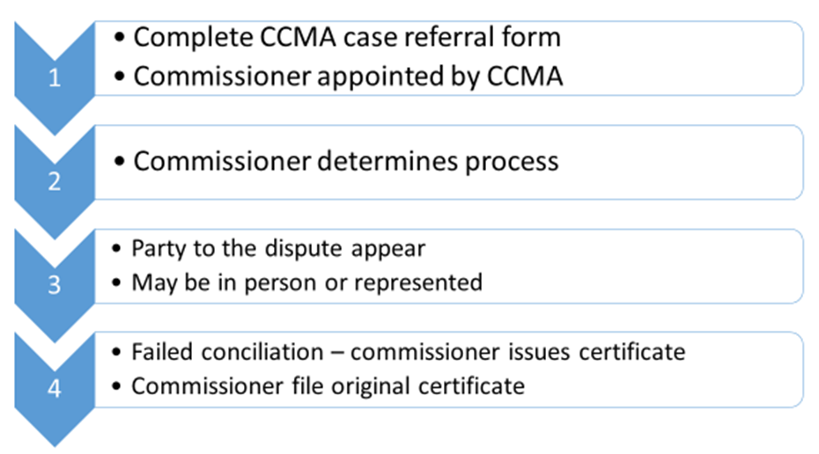
9.3 The Work of the CCMA
Conciliation Steps:

Slide 92
9.3 The Work of the CCMA
Parties may give permission within seven days:
To the appointment of a specific commissioner to attempt to resolve the dispute through conciliation; and
To that Commissioner’s terms of reference.

Slide 93
9.3 The Work of the CCMA
If the parties do not give permission the Commission must as soon as possible:
Appoint a Commissioner to attempt to attempt to resolve the dispute.
Determine the Commissioner’s terms of reference.

Slide 94
9.3 The Work of the CCMA
Arbitration means the act of deciding as an arbiter; giving authoritative judgment.

Slide 95
9.3 The Work of the CCMA
Arbitration
Where conciliation has failed, disputes may be referred to arbitration or the Labour Court.
If the LRA requires a dispute to be resolved through arbitration, the commission must appoint a commissioner to arbitrate that dispute.

Slide 96
9.3 The Work of the CCMA
Arbitration
A party to the dispute may give evidence, call witnesses, question witnesses of any other party, and address concluding arguments.
With the consent of all the parties, the commissioner may suspend the arbitration proceedings and attempt to resolve the dispute through conciliation.
Within 14 days of the conclusion of the arbitration proceedings, the commissioner must sign and issue an arbitration award with brief reasons.

Slide 97
9.3 The Work of the CCMA
Con-Arb Process
If the conciliation process does not succeed, arbitration follows and is led by the same Commissioner, unless the parties object.
The relevant Commissioner determines the arbitration process with the emphasis on the fast and fair settlement of the dispute with the fulfilment of the minimum formal legal requirements.

Slide 98
9.3 The Work of the CCMA
Con-Arb Process
A party may appear in person or be represented.
Within 14 days of the conclusion of the proceedings, an arbitration award with brief reasons, should be issued by the Commissioner.
5. The arbitration award is final and binding and no appeal is possible.

Slide 99
9.3 The Work of the CCMA
The Act makes provision for arbitration under the auspices of the CCMA in the following cases:
Disclosure of information disputes
Alleged unfair dismissal concerning misconduct
Incapacity
Alleged unfair labour practice
Unfair suspension of an employee

Slide 100
9.3 The Work of the CCMA
The Act makes provision for arbitration under the auspices of the CCMA in the following cases:
Failure to pay severance pay
Disputes relating to the functioning of workplace forums
Disputes concerning organisational rights of trade unions

Slide 101
Labour Law Workshop
Study Unit 10:
The Creation and Functioning of a Bargaining Council

Slide 102
10.1 The Establishment, Parties Functions, Powers and Duties of Bargaining Council
A collective agreement means a written agreement concerning terms, conditions of employment or any other matter of mutual interest concluded by one or more registered trade unions and one or more employers and/or registered organisations.

Slide 103
10.1 The Establishment, Parties Functions, Powers and Duties of Bargaining Council
The Establishment of Bargaining Councils:
Organisations may establish a bargaining council for a sector or area by:
Adopting a constitution for a council that meets the requirements of Section 30 of the LRA
Obtaining registration of the bargaining council in terms of Section 29

Slide 104
10.1 The Establishment, Parties Functions, Powers and Duties of Bargaining Council
The Establishment of Bargaining Councils:
Membership of a bargaining council is on a voluntary basis and the following general conditions apply:
The parties to the council must adopt a constitution that complies with the LRA
Half of the council representatives must be appointed by the employer and the other half by the union
Parties have equal voting power•

Slide 105
10.1 The Establishment, Parties Functions, Powers and Duties of Bargaining Council
The Establishment of Bargaining Councils:
Membership of a bargaining council is on a voluntary basis and the following general conditions apply:
Provision must be made for the representation of small- and medium-sized enterprises
The parties to the council must appoint the chairperson and other office-bearers
Minutes must be kept of every meeting
Small levies are paid by employers and employees

Slide 106
10.2 The Structures and Functions of a Bargaining Council
See Learner Guide p 137

Slide 107
10.2 The Structures and Functions of a Bargaining Council
According to Section 28 of the LRA, in relation to its registered scope, a bargaining council may
Conclude collective agreements
Enforce those collective agreements
Prevent and resolve labour disputes
Perform the dispute resolution functions
Establish and administer a fund to be used for resolving disputes
Promote and establish training and education schemes

Slide 108
10.2 The Structures and Functions of a Bargaining Council
According to Section 28 of the LRA, in relation to its registered scope, a bargaining council may
Establish and administer pension, provident, medical aid, sick pay, holiday, unemployment and training schemes or funds or any similar schemes or funds.
Develop proposals for submission to NEDLAC .
Determine the matters that may not be an issue for the purpose of a strike or a lockout in the workplace.
Confer on workplace forums additional matters for consultation.

Slide 109
10.2 The Structures and Functions of a Bargaining Council
According to section 29 of the LRA the constitution of every bargaining council must at least provide for:
The appointment of representatives of the parties to the bargaining council.
The representation of small and medium enterprises.
The circumstances and manner in which. representatives must vacate their seats' and the procedure for replacing them.
Rules for the convening and conducting of meetings of representatives.

Slide 110
10.2 The Structures and Functions of a Bargaining Council
According to section 29 of the LRA the constitution of every bargaining council must at least provide for:
The manner in which decisions are to be made.
The appointment or election of office-bearers and officials, their functions, and the circumstances and manner in which they may be removed from office.
The establishment and functioning of committees.
The determination through arbitration of any dispute arising between the parties to the bargaining council.

Slide 111
10.2 The Structures and Functions of a Bargaining Council
According to section 29 of the LRA the constitution of every bargaining council must at least provide for:
The procedure to be followed if a dispute arises between the parties to the bargaining council.
The procedure to be followed if a dispute arises between a registered trade union that is a party to the bargaining council, or its members, or both, on the one hand, and employers who belong to a registered employers' organisation that is a party to the bargaining council, on the other hand.

Slide 112
10.2 The Structures and Functions of a Bargaining Council
According to section 29 of the LRA the constitution of every bargaining council must at least provide for:
The procedure for exemption from collective agreements
The banking and investment of its funds
The purposes for which its funds may be used
The delegation of its powers and functions

Slide 113
10.2 The Structures and Functions of a Bargaining Council
According to section 29 of the LRA the constitution of every bargaining council must at least provide for:
The admission of additional registered trade unions and registered employers ' organisations as parties to the bargaining council.
A procedure for changing its constitution
A procedure by which it may resolve to wind up

Slide 114
10.2 The Structures and Functions of a Bargaining Council
The Registration of Bargaining Councils
On receipt of the application, the Registrar of Labour Relations publishes a notice in the Government Gazette. An objection may be lodged.
After this process is completed, the Industrial Registrar sends the application and all other relevant documentation to NEDLAC for judgement on demarcations.
If all the requirements are met, the Registrar issues a certificate of registration.

Slide 115
10.2 The Structures and Functions of a Bargaining Council
Bargaining Councils in the Public Service
The council may designate a sector of the public service to establish a bargaining council.
The President may also designate a sector to establish the bargaining council in respect of employees of the State or organs of the state who are not employees that are engaged in the public service.

Slide 116
10.2 The Structures and Functions of a Bargaining Council
Agents of Bargaining Councils
The Minister of Labour may appoint an agent to help the council enforce any collective agreement that was concluded in the council.
Once the agent has received a certificate stating that they are a designated agent in terms of the Act, the agent obtains powers similar to those of a commissioner.

Slide 117
10.2 The Structures and Functions of a Bargaining Council
Statutory Councils
The powers and functions of a statutory council are:
To perform dispute resolution functions
To promote and establish training and education schemes
To establish and administer, among other things, pension, provident, medical aid and unemployment funds
To conclude collective agreements on the above

Slide 118
Labour Law Workshop
Study Unit 11:
Collective Agreements: Origins, Structures and Legal Standing

Slide 119
11.1 Origins of a Collective Agreement
Collective bargaining is an integral part of the South African labour environment.
The collective bargaining process is the heart of industrial relations.
The most important principles behind the LRA of 1995 are co-ordination and co-operation.
The Act tries to include the hole workforce.
It encourages bargaining by placing a high value on agreements that were reached between parties.

Slide 120
11.2 Parties to a Collective Agreement
One or more employers
One or more registered employers' organisations
One or more employers and one or more registered employers' organisations

Slide 121
11.3 Legal Status of a Collective Agreement
Section 31 of the LRA states that a collective agreement concluded in a bargaining council binds
The parties to the bargaining council who are parties to the collective agreement
Each party to the collective agreement and the members of every other party in the collective agreement

Slide 122
11.3 Legal Status of a Collective Agreement
Section 31 of the LRA states that a collective agreement concluded in a bargaining council binds
The members of a registered trade union that is a party to the collective agreement and the employers who are members of a registered employers' organisation
The conduct of the employers in relation to their employees or the conduct of the employees to their employers

Slide 123
11.3 Legal Status of a Collective Agreement
A bargaining council may ask the Minister to extend a collective agreement to non-parties to the collective agreement if at a meeting of the bargaining council
The members of one or more major registered trade unions in the bargaining council vote in favour of the extension
The members of one or more of the major registered employer organisations in the bargaining council vote in favour of the extension.

Slide 124
Labour Law Workshop
Study Unit 12:
The Process to Extend Collective Agreements

Slide 125
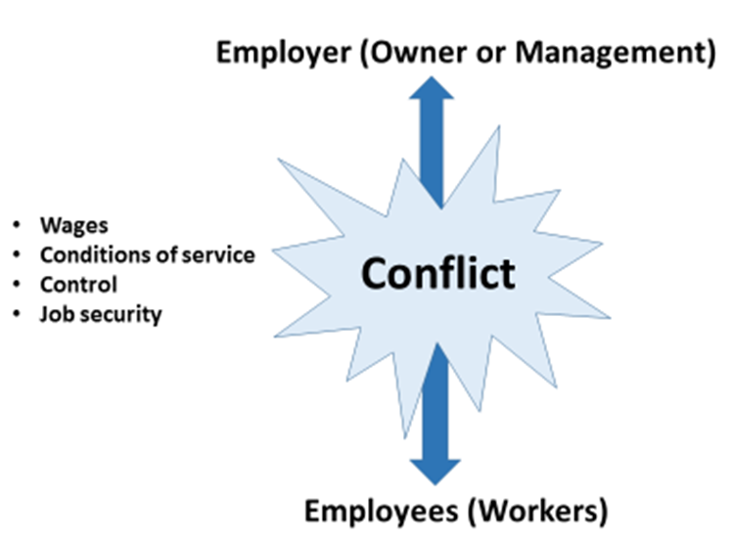
12.1 Parties to a Collective Agreement
Inherent conflict between employer and employee:

Slide 126
12.1 Parties to a Collective Agreement
Worker representation through trade unions involves:
The process of unionising workers
Negotiation of collective agreement
Interpretation of collective agreements covering wages, hours of work and conditions of employment
Engaging in concerted economic action
Dispute-settling procedures
Administration of collective agreements

Slide 127
12.1 Parties to a Collective Agreement
Fundamental principles with regards to worker presentation from outside the organisation via trade unions:
Workers should only belong to one specific trade union.
All workers who want to participate in the decision-making process of the organisation must transfer their power of attorney to their representatives by mutual consent.

Slide 128
12.1 Parties to a Collective Agreement
Fundamental principles with regards to worker presentation from outside the organisation via trade unions:
The representative must realise that his/her responsibility to the group is above his/her own needs and wants, and to overcome own prejudices in pursuing the needs of the group .
Employer and workers must formulate rules together to guide them during the collective bargaining process.

Slide 129
12.1 Parties to a Collective Agreement
Fundamental principles with regards to worker presentation from outside the organisation via trade unions:
The rule-making includes substantive and procedural components.
The substantive component focuses on the economic goals
The procedural component usually regulates collective relationships

Slide 130
12.1 Parties to a Collective Agreement
Employer Organisations
Large sector-based employers’ organisations:
SEIFSA
COM
BIFSA
AMEO
SAMEIA
• SMREA

Slide 131
12.1 Parties to a Collective Agreement
Employer Organisations
The functions registered sector based employer organisations are:
To provide a forum development of a coordinated strategy ifor the n dealing with organised labour
To control wage increases by negotiating on a collective basis with trade unions
To provide procedures for the resolution of disputes and to develop a body of rules which are accepted by both trade union and employer parties
•

Slide 132
12.1 Parties to a Collective Agreement
Employer Organisations
The functions of these registered sector based employer organisations are:
To assist member organisations with information on legislative changes, guidance on industrial relations action and the administration of the agreement
To provide a coordinated system of employee benefit schemes

Slide 133
12.1 Parties to a Collective Agreement
Employer Organisations
The functions of these registered sector based employer organisations are:
• To use their power to lobby the government in order to ensure that government serves the interest of employers by passing acceptable legislation
• To react by collective protest against any government actions which may not be acceptable to employers

Slide 134
12.1 Parties to a Collective Agreement
Employer Organisations
The functions of these registered sector based employer organisations are:
To liaise with trade union federations at a centralised level over issues of national interest
To use the media as a means of promoting support for policies and positions that the organisation may have adopted and to counteract any unfavourable publicity

Slide 135
12.1 Parties to a Collective Agreement
Employer Organisations
The functions of these registered sector based employer organisations are:
To proactively use their collective power to lobby the government in order to ensure that government serves the interest of employers by passing acceptable legislation.
To react by collective protest against any government actions which may not be acceptable to employers.

Slide 136
12.1 Parties to a Collective Agreement
Employer Organisations
The functions of these registered sector based employer organisations are:
To liaise with trade union federations at a centralised level over issues of national interest.
To use the media as a means of promoting support for policies and positions that the organisation may have adopted and to counteract any unfavourable publicity.

Slide 137
Labour Law Workshop
Study Unit 13:
Statutes, Contracts and Agreements

Slide 138
13.1 Sources of Information
Bargaining council agreements are substantive agreements but they may also contain the following:
Certain procedural items such as job evaluation and grading systems
Retrenchment procedures
Grievance and disciplinary procedures (not advised)

Slide 139
13.1 Sources of Information
Centralised Agreements
Collective agreements concluded by bargaining councils.
They bind the parties to the collective agreement.
A bargaining council may ask the Minister to extend such a collective agreement to non-parties to the collective agreement within its registered scope and identified in the request.

Slide 140
13.1 Sources of Information
A recognition agreement is a collective agreement which aims to provide a framework within which the various parties operate to keep contact with one another and to preserve industrial peace in the organisation.

Slide 141
13.1 Sources of Information
Centralised Agreements
Advantages of recognition agreements:
They cater better for specific needs at plant level.
Smaller unions do not see themselves as strong enough to influence industrial relations on a national or regional basis.
Many see the official system as being bureaucratic and slow.
Via recognition agreements, unions can also focus on local community affairs.

Slide 142
13.2 Rights and Obligations
The process of negotiation will be influenced by:
Location
Differences in the organisation and product-manufacturing methods of organisations
Differences in the size of the organisations
Differences in the way the parties organise themselves for bargaining
Differences from one industry to another

Slide 143
13.2 Rights and Obligations
The process of negotiation will be influenced by:
Differences in the economic and political situation
Differences in the personalities of the negotiators from one bargaining situation to another

Slide 144
13.2 Rights and Obligations
Feedback must be given as soon as possible to:
Trade unions
The negotiators must inform all the other managers
Management must communicate with the different supervisors and shop stewards , who will inform the workers about the results
The contract must be communicated to the personnel department specifically
The wage officer
Other organisations in the group

Slide 145
13.2 Rights and Obligations
A contractual right means legally binding promises given to you by your employer in your contract of employment.
A contractual obligation means there will be a liability once an event contemplated in the agreement has occurred.

Slide 146
13.2 Rights and Obligations
A statute means a legislative act: an act passed by a legislative body.
A contract means a promise between two or more persons involving the exchange of some good or service.
An agreement is the statement (oral or written) of an exchange of promises.
.

Slide 147
13.2 Rights and Obligations
Enforceable contract: One for which a legal remedy is offered in a case where the contract is not fulfilled, or when statutory requirements have not be met,.
Several requirements must be met for a contract to be valid and legally binding.
When a party does not fulfil the promise made in a valid, enforceable contract, the contract has been "breached."

Slide 148
Labour Law Workshop
Study Unit 14:
Ensuring Compliance with Statutory and Other Conditions of Employment

Slide 149
Ensuring Compliance with Statutory and Other Conditions of Employment
The agreement becomes official once approved, ratified and signed by employer and employee representatives.

Slide 150
Labour Contracts
Vary in length and content
See example on p 153 of Learner Guide

Slide 151
14.1 Contracts and Conditions
Management rights generally include:
Decisions governing the working environment of employees, including supervising the workforce
Controlling production
Setting work rules and procedures
Assigning duties
Use of plant and equipment

Slide 152
14.1 Contracts and Conditions
Grievance Procedure
Disputes arise when a contract is enforced.
Most contracts contain a contract administration process to solve conflicts.
Most disciplinary systems contain disciplinary steps, beginning with an oral warning and ending in discharge.
If the employee feels that the discipline was unjust, he/she can file a grievance

Slide 153
14.2 Making Adjustments and Review Procedures
Negotiating a Change
1. Determine whether direct negotiation is allowed.
2. Approach the employee or employer.
3. Understand the priorities of both sides.
4. Negotiate the change.
5. Make sure the negotiations are valid under the law of contracts.

Slide 154
Labour Law Workshop
Study Unit 15:
The Application of Substantive Conditions

Slide 155
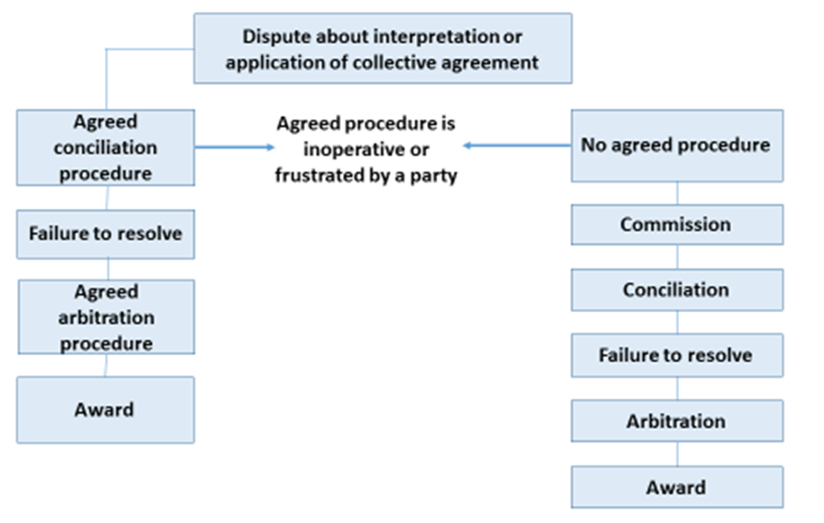
15.1 Solving Problems

Slide 156
Agency Shop Agreements
In terms of the LRA a representative trade union and an employer and an employer’s organisation may conclude a collective agreement, to be known as an agency shop agreement, requiring the employer to deduct an agreed agency fee from the wages of employees identified in the agreement and who are not members of the trade union but are eligible for membership thereof.

Slide 157
15.1 Solving Problems
Agency Shop Agreements
An agency shop agreement is binding if employees were not to forced to become members of the trade union and the agreed agency fees are paid.
The amount deducted must be paid into a separate account.
An employer does not need employees’ permission to deduct the agreed agency fee from their wages.

Slide 158
Closed Shop Agreements
In terms of the LRA a representative trade union and an employer’s organisation may conclude a collective agreement, to be known as a closed shop agreement, requiring all employees covered by the agreement to be members of the trade union.

Slide 159
15.1 Solving Problems
Closed Shop Agreements
A closed shop agreement is binding only
if there is a ballot of the employees to be covered by the agreement
if two thirds of the said employees vote in favour of the agreement
there is no provision for compulsory membership of the representative trade union prior to employment
If no part of the amount deducted is paid or contributed to a political party

Slide 160
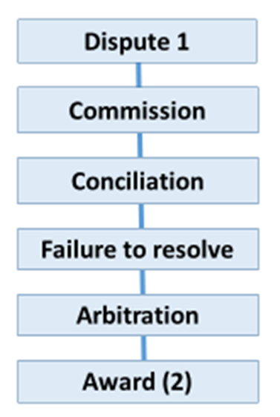
15.1 Solving Problems
The process for collective agreements – agency shop and closed shop agreements

Slide 161
15.1 Solving Problems
The CCMA compulsory statutory functions are to:
Conciliate workplace disputes
Arbitrate certain categories of disputes that remain unresolved after conciliation
Establish picketing rules
Facilitate the establishment of workplace forums and statutory councils

Slide 162
15.1 Solving Problems
The CCMA compulsory statutory functions are to:
Compile and publish information and statistics about our activities
Consider applications for accreditation and subsidy by bargaining councils and private agencies
Provide support for the Essential Services Committee

Slide 163
15.1 Solving Problems
The Labour Court
The labour court is a superior court
It has authority and inherent powers
Its standing is equal to a court with authority and inherent powers
Its standing is equal to a court of a provincial division of the supreme court.
The powers of the Labour Court, according to section 158 of the LRA are set out on p 170 – 172 of the Learner Guide

Slide 164
15.1 Solving Problems
The Labour Court
Proceedings are open to the public
The Labour Court may exclude members of the general public, or specific persons, where a court of a provincial division of the Supreme Court could have done so.
Any party may appeal to the Labour Appeal Court against any final judgment.
Leave to appeal may be granted subject to any conditions that the court concerned may determine.

