Slide 1
HIV and Aids
Unit Standard ID 13915 | NQF Level 3 | Credits 4

Slide 2
Ground Rules
Days Training, Workshops, and Portfolio building
Breaks
Cell Phones
Participation
Portfolio Submission

Slide 3

Section 1 Overview
What Is a Portfolio?
Collection of Evidence that
Lists criteria for proving competence
Provides evidence that you meet criteria
Is organised to enable assessor to evaluate evidence against criteria.

Slide 4
Overview
The Portfolio of Evidence (PoE)
Section 1 – Administrative detail
Section 2 – Assessment planning
Section 3 – Assessment design matrix
Section 4 – Formative assessment activities
Section 5 – Summative assessment
Knowledge questionnaires

Slide 5
Overview
Section 6 – Summative assessment – Workplace assignments
Section 7 – Feedback
Section 8 – 10 Additional Evidence

Slide 6
Categories Of Evidence
Practical Competence
Foundational Competence
Reflective Competence

Slide 7
Overview
Competency
  Against Outcomes in Unit Standard
Interpret
  Outcomes in relation to workplace

Slide 8
Good Evidence
Valid
  Should relate to what is being assessed
Authentic
  Own evidence
Reliable
  Consistency
  Another assessor makes same judgment
Current
  As recent as possible
Sufficient
  Enough evidence

Slide 9
Assessment Brief
Purpose of Unit Standard
This unit standard provides a broad introduction to HIV/AIDS in the workplace. It introduces a broad case of knowledge about HIV/AIDS that will enable learners to be informed and caring workers in an industry. The focus is knowledge, skills, values and attitudes in relation to the learner`s own context and experience of the world of work.

Slide 10

Assessment Brief
Entry Level Requirements
There is open access to this unit standard. Learners should
Hold a GETC or equivalent qualification or
Be competent in communication and mathematical literacy NQF level 2

Slide 11
Assessment Brief
Credit Value
4 credits = 40 notional hours
Theoretical + Practical + Workplace experience
Submission of Portfolio of Evidence (PoE) - based on Specific Outcomes (SOs) and Assessment Criteria (ACs).

Slide 12
Types of Assessment
Integrated Assessment
Diagnostic
Formative
Summative

Slide 13
Assessment Methods
Assessment Methods
Questioning
Product Evaluation
Observation

Slide 14
Assessment
Assessment
Formative
Summative
Evidence during
facilitation
Self Assessment
Knowledge Assessment
Summative Workplace
Assignments
Formative + Summative = Competent

Slide 15
Competence
Competent
Ability to perform task, action or function successfully
Certificate issued and credits awarded
Not Yet Competent
Not successful yet
Opportunities to remediate to address gaps

Slide 16

Re-Assessment
Specific feedback - focus on not yet competent areas
Re-assessment - same context and same conditions
Only Not Yet Competent specific outcomes - to be re-assessed
ENJO’s policy: - Two (2) re-assessments

Slide 17
Assessment Brief
Credit Accumulation
Credits will be awarded on successful completion of unit standards.
NB: - Quality Assurance Process
Assessment
Moderation
Verification

Slide 18
Assessment Brief
Assessment Tools and Matrix:
  All the specific outcomes
  Associated assessment criteria
  Range statements
  Critical cross-field, development outcomes
  Essential embedded knowledge.

Slide 19
Assessment Brief
ENJO Assessment Process:
  Integrated assessment against current SAQA registered unit standards and qualifications in a fair, valid, reliable and practicable manner.
  Moderation and verification procedures carried as per SAQA requirements.
  Learner competence demonstrated through formative and summative assessments.

Slide 20
Assessment Brief
Learners have the right to:
  Be informed when and how assessments are conducted
  Appeal against an assessment conducted.
  Get interpretation to the numeracy and literacy level of the skills programme, unit standard or qualification.

Slide 21
Assessment Brief
Facilitation and assessments will be conducted in English.
Learners may have an observer present; however observer may not partake, comment or interrupt the assessment process.
Assessment results will be available as soon as possible after the final assessment.
Learners may have access to results within normal working hours.

Slide 22
Assessment Brief
Additional Notes:
  Assessor will maintain telephonic and electronic contact until sufficient evidence has been submitted.
  Additional evidence may be submitted after initial submission.
  If you have a problem which might affect the outcome of assessment(s) you should notify the assessor. Where practicable such needs will be accommodated. (special needs)

Slide 23
Appeals and Disputes
Learner has right to appeal against:
Unfair assessment
Invalid assessment
Unreliable assessment
Unethical practices
Inadequate expertise and experience of the assessor
Appeals have to be submitted in writing to ENJO.

Slide 24
Section 1
Portfolio of Evidence
Section 1 – Administrative Detail

Slide 25

Section 1 - 2 Administrative Detail
Learner Information
ID
CV
Qualifications
Special Instructions
Declaration of Authenticity
Unit Standard
Sign all required documents

Slide 26
Special Instruction
No Tippex
Initial each page
Comments in full
ENJO or own templates to be used to complete portfolio
Use assigned colour unless instructed differently

Slide 27
Unit Standard
SAQA US ID
Unit Standard Title
NQF Level
Credits
Purpose of the Unit Standard
Learning assumed to be in place

Slide 28
Unit Standard
Unit Standard Range
Specific Outcomes
Assessment Criteria
Essential Embedded Knowledge (EEK)
Critical Cross-field Outcomes (CCFOs)
Notes

Slide 29
HIV and Aids
Study Unit 1: Know and understand HIV/AIDS and its effects on the human immune system

Slide 30
HIV and AIDS are known and explained at a basic level of understanding.
Terminology
The terms HIV and AIDS stand for:
  HIV (Human Immunodeficiency Virus)
  AIDS (Acquired Immune Deficiency Syndrome)

Slide 31
What is HIV?
HIV stands for Human Immunodeficiency Virus. Like all viruses, HIV cannot grow or reproduce on its own.
In order to make new copies of itself it must infect the cells of a living organism.

Slide 32
What is HIV?
HIV can further be explained as follows:
H | Human: because this virus can only infect human beings.
I | Immuno-Deficiency: because the effect of the virus is to create a deficiency, a failure to work properly, within the body's immune system.
V | Virus: because this organism is a virus, which means one of its characteristics is that it is incapable of reproducing by itself. It reproduces by taking over the machinery of the human cell.

Slide 33
What is AIDS?
AIDS (Acquired Immune Deficiency Syndrome) is a deadly disease caused by a virus. The AIDS virus cripples the immune system. A person with AIDS is vulnerable to infections and certain kinds of cancer that take advantage of the body’s lowered ability to fight back.

Slide 34
What is AIDS?
AIDS can further be explained as follows:
A | Acquired: because it's a condition one must acquire or get infected with; not something transmitted through the genes
I | Immune: because it affects the body's immune system, the part of the body which usually works to fight off germs such as bacteria and viruses
D | Deficiency: because it makes the immune system deficient (makes it not work properly)
S | Syndrome: because someone with AIDS may experience a wide range of different diseases and opportunistic infections.

Slide 35
Other related questions:
What is an immune system? | The immune system, which is made up of special cells, proteins, tissues, and organs, defends people against germs and microorganisms every day.
What is a ‘window period’? | The "window period" is the time it takes for a person who has been infected with HIV to react to the virus by creating HIV antibodies.
What is voluntary counselling and testing (VCT)? | VCT is the confidential procedure that is followed when you decide (on a voluntary basis) to take an HIV test. As the result of the test can be life changing, it is important that you are properly counselled before you take the test.

Slide 36
Other related questions:
ARV | Anti-retroviral treatment
DNA | Deoxyribonucleic acid
MTCT | Mother to Child Transmission
PMTCT | Prevention of mother-to-child transmission
STD | Sexually Transmitted Disease
WB | Western Blot

Slide 37
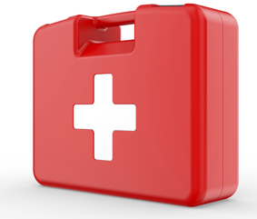
Other related questions:
To explain the difference between AIDS and HIV in simple terms:
AIDS does not kill directly. The AIDS virus makes its victims defenceless against other infections that kill them. HIV (Human Immunodeficiency Virus) is a term for the virus that causes AIDS.

Slide 38
THE IMMUNE SYSTEM
Your immune system can be seen as a little doctor who lives inside you and prevents you from getting sick all the time.
The immune system, which is made up of special cells, proteins, tissues, and organs, defends people against germs and microorganisms every day.
The immune system does a great job of keeping people healthy and preventing infections.
But sometimes problems with the immune system can lead to illness and infection.

Slide 39
Your immune system
Through a series of steps called the immune response, the immune system attacks organisms and substances that invade body systems and cause disease.
The immune system defends the body against infectious organisms.
The immune system is made up of a network of cells, tissues, and organs that work together to protect the body.
The cells involved are white blood cells that seek out and destroy disease-causing organisms or substances.

Slide 40
Your immune system
White blood cells, also known as leukocytes, are produced or stored in many locations in the body in the lymphoid organs.
There are clumps of lymphoid tissue throughout the body.
The white blood cells, or leukocytes, circulate through the body via lymphatic vessels and blood vessels.
In this way, the immune system works in a coordinated manner to monitor the body for germs or substances that might cause problems.

Slide 41
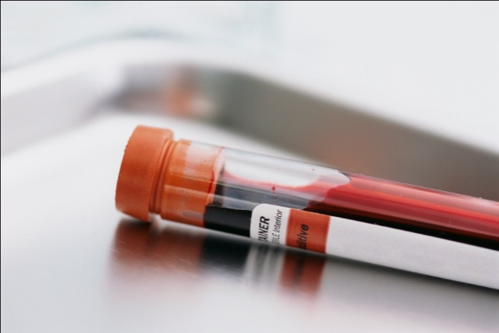
HIV and the Immune System
The structure of HIV is similar to that of many other viruses. HIV has a core of genetic material surrounded by a protective covering, called a capsid.
The genetic material in the core is RNA (ribonucleic acid), which contains the information that the virus needs in order to replicate.
You can think of RNA as the set of rules the virus follows in order to live.

Slide 42
HIV and the Immune System
“Replication” means "the action of copying or reproducing something."

Slide 43
HIV and the Immune System
Viral RNA has a protein called "reverse transcriptase" that is crucial for viral replication inside T cells. T cells are white blood cells that help coordinate actions of the immune system.
Like all other viruses, HIV has proteins that are particular to it. These proteins are called antigens.
Antigens have diverse functions in viral replication. In the case of HIV, a combination of two antigens, gp120 and gp41, allow the virus to hook onto T cells and infect them.
These antigens are located on the surface of the virus.

Slide 44
DNA
DNA stands for “deoxyribonucleic acid.”

Slide 45
HIV targets the T cells
T cells are the main target of HIV in the blood, and they act as the host that the virus needs in order to replicate.
The T cell has a core that contains genetic material in the form of DNA (deoxyribonucleic acid).
The difference between RNA and DNA is that RNA is a single strand of genetic material, while DNA is a double strand.
This difference is crucial in the process of T cell infection by HIV.

Slide 46
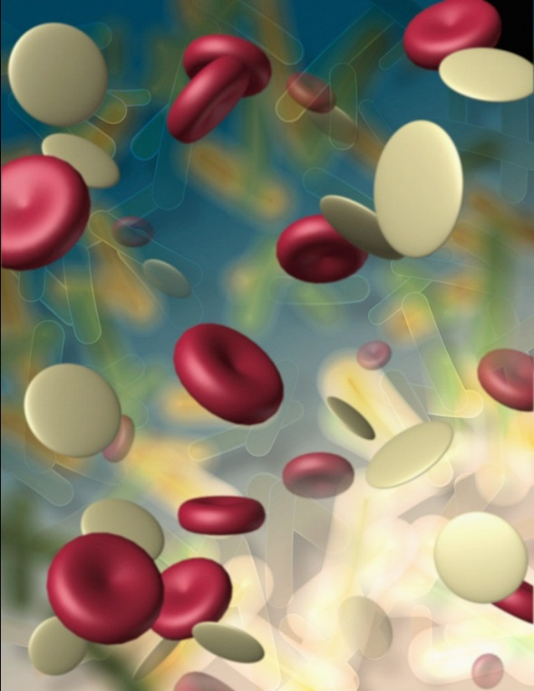
HIV targets the T cells
When HIV successfully latches onto a T cell, the next step is to inject its core with the viral RNA and the reverse transcriptase.

Slide 47
HIV takes control of T Cells
In order to infect the cell, the viral RNA needs to travel into the T cell's core, where it can change the cell's rules and convert it into a figurative virus factory.
However, for that to happen, an important transformation needs to take place.
Normally, the T cell's core communicates with the rest of the cell by transforming DNA into RNA and sending it out of the core.

Slide 48
HIV takes control of T Cells
The genetic material's passport to leave the core is to be transformed into single-stranded RNA.
In the same fashion, the passport to enter the core is to be transformed into double-stranded DNA.
In other words, Viral RNA needs to become DNA in order to start the replication process.

Slide 49
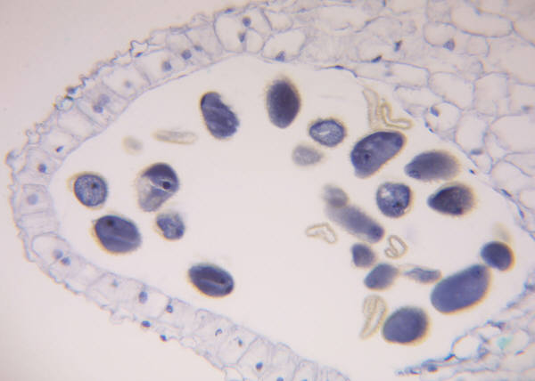
HIV takes control of T Cells

Slide 50
HIV
HIV is considered a retrovirus because of its ability to change RNA into DNA.
This is accomplished by the reverse transcriptase.

Slide 51
HIV replicates
HIV is considered a retrovirus because of its ability to transform RNA into DNA.
Once transformed, the viral DNA will travel into the T cell's core and attach itself to the cell's DNA.
If the T cell is activated, it will start producing new virus instead of performing normal T cell functions

Slide 52
The Window Period and the Elisa Test
The window period:
A "window period" is the time it takes for a person who has been infected with HIV to react to the virus by creating HIV antibodies. This is called seroconversion.
During the window period, people infected with HIV have no antibodies in their blood that can be detected by an HIV test, even though the person may already have high levels of HIV in their blood, sexual fluids, or breast milk.

Slide 53
Seroconversion
Seroconversion is the process where the body of someone who has been infected starts to reacts to the virus by creating HIV antibodies.

Slide 54
The Window Period and the Elisa Test
What does this mean?
Three months are the normal window period for most of the population.
Many people will have detectable antibodies in three or four weeks.
Although HIV may not be detected by a test during the window period, HIV can be transmitted during that time. In fact, individuals are often most infectious during this time (shortly after they have been exposed to HIV).

Slide 55
HIV test results
A positive result means:
You are HIV-positive (carrying the virus that causes AIDS) and you can infect others who come into contact with your blood (by having sex, sharing needles and various other ways.)
You should take necessary precautions to avoid transmitting HIV to others.

Slide 56
HIV Result
A positive result on a HIV test does not mean you have AIDS. You will not necessarily get AIDS if HIV is treated correctly.

Slide 57
HIV test results
A negative result means:
No HIV antibodies were found in your blood at this time.
A negative result does NOT mean you are not infected with HIV (you may still be in the "window period").

Slide 58

HIV test results
…THAT IS WHY IT IS EXTREMELY IMPORTANT TO KNOW WHAT A WINDOW PERIOD IS.

Slide 59
HIV test results
An indeterminate result means:
The entire HIV test must be repeated with a new blood sample, usually several weeks after the first blood test.
Indeterminate results usually occur if the test is performed just as the person begins to seroconvert.

Slide 60
Elisa Test
Antibody tests are extremely accurate. Rapid tests, for example, have an accuracy rate exceeding 99%.
However, positive results from a test must be confirmed by another test to ensure that a person is HIV-positive.

Slide 61
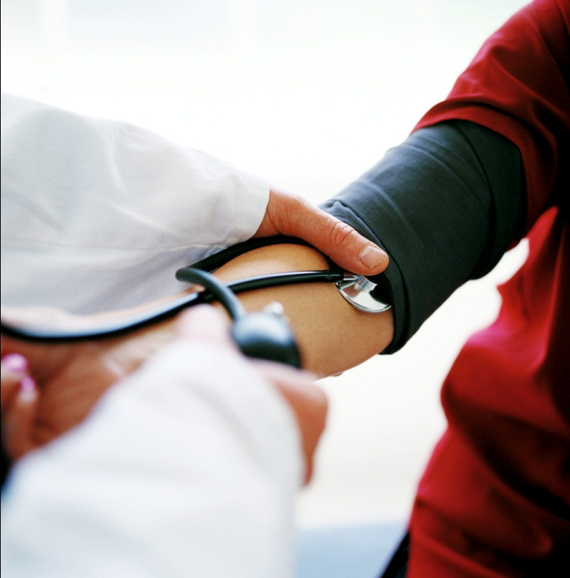
Elisa Test
The accuracy of a medical test is a combination of two factors:
  sensitivity and
  specificity

Slide 62
Elisa Test
The ELISA test is extremely sensitive (about 99.5%), which means it will detect very small quantities of HIV antibody.
The high sensitivity of the test creates a slightly lower specificity. This means the result could be "false positive." To compensate for this, confirmatory tests are automatically performed after a positive ELISA.
The WB and IFA are highly specific for HIV antibodies, so they rule out false positive ELISAs nearly every time.
Only when the confirmatory test is also reactive is the result reported as HIV positive
People tested during the window period may test negative, even if they have been infected.

Slide 63
Why babies test positive
Babies born to HIV positive mothers are tested for HIV differently than adults.
A baby keeps antibodies from its mother, including antibodies to HIV, for many months after birth.
Therefore, an antibody test given before the baby is 18 months old may be positive even if the baby does NOT have HIV infection.

Slide 64
HIV
When babies are more than 18 months old, they no longer have their mother's antibodies and can be tested for HIV using the antibody test.

Slide 65
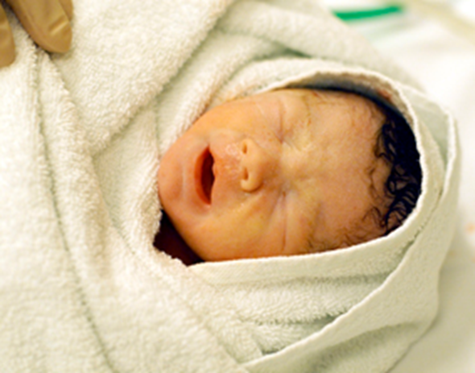
Preliminary Tests
Preliminary HIV tests for babies are usually performed at three time points:
1. birth to 14 days
2. 1 to 2 months
3. 3 to 6 months

Slide 66
Preliminary Tests
If babies test negative on two of these preliminary tests, they should be given an HIV antibody test between 12-18 months.
Babies are considered HIV positive if they test positive on two of these preliminary HIV tests. Babies who test positive for HIV antibodies will need to be retested at 15 to 18 months. At 18 months, babies should have an HIV antibody test to confirm HIV infection. A positive HIV antibody test given after 18 months of age confirms HIV infection in children.

Slide 67
Voluntary Counselling and Testing (VCT)
VCT is the confidential procedure that is followed when you decide (on a voluntary basis) to take an HIV test.
As the result of the test can be life changing, it is important that you are properly counselled before you take the test.

Slide 68
STEPS IN VCT
Step One – Pre-test Counselling
You will be assigned a code number- you will not be required to give your name.
During the pre-test counselling session, which lasts between 20-45 minutes, you will be told about the test and HIV disease.
Ways to cope with a positive diagnosis will be discussed.
You will be able to ask questions.

Slide 69
STEPS IN VCT
Step Two – Testing
If you agree to take the test, you will be asked to sign a consent form.
You can also choose not to sign but to only give verbal consent.
You must then supply a small sample of blood from a finger prick, or a saliva sample.
Most hospitals and clinics use a rapid HIV test, which means that the results will be available within 20 minutes.

Slide 70
STEPS IN VCT
Step Two – Testing
If this test is not available an Elisa test will be done, which requires a larger blood sample from your arm.
It also needs to be sent away to a laboratory.
You will be told when to return for your results, which can take up to two weeks.

Slide 71
STEPS IN VCT
Step Three – Results and Post-test Counselling
Your results will be given during a post-test counselling session.
The health professionals and counsellors who conduct and discuss the test with you must, by law, keep the results strictly confidential.
You decide whether to tell your family and friends if you are HIV-positive.

Slide 72
Voluntary Counselling and Testing (VCT)
Children over 14 years of age do not need permission from a parent or guardian to have an HIV test.
Children under the age of 14 do require permission, although in emergency situations, such as after a rape when a HIV test is required, a doctor can authorise a test.

Slide 73
Rapid HIV Testing
In this test different substances combine with the antibodies in your body, and that causes a specific colour, a stripe or a dot, depending on the manufacturer of the test kit.
You can usually get the results within 20 minutes.

Slide 74
ELISA TEST (Enzyme-Linked Immuno-Sorbent Assay or EIA)
This test works with enzymes that react with antibodies in the body, and will then cause a colour that is read by a machine. This is then put into a value.
This usually takes up to two weeks.
Usually, when the Rapid Test is positive, and ELISA test will be done to make sure that the results are correct.

Slide 75
ELISA TEST (Enzyme-Linked Immuno-Sorbent Assay or EIA)
If any of these tests were done during the window period, the results may be negative.
It is therefore good to have yourself re-tested after six months if you have any idea that you might be HIV positive.

Slide 76

What if your test is negative?
If your test is negative, you will be given advice on how to prevent HIV infection in the future.

Slide 77
What if your test is negative?
If you have had unprotected sex in the three-month period before taking the test, you will be advised to come for a second test after another three months.
This is because there is a time period after HIV infection, called the window period, when tests cannot accurately pick up the infection.

Slide 78
What if your test is positive?
If your test is positive, you will be given another different test to confirm the result. If the second test is negative, a blood sample will be taken and sent to a laboratory for further testing to establish the correct diagnosis.
If the second test is positive, counselling and advice on how to manage your health and delay the development of
AIDS will be provided.
You will also be advised on how to reduce the risk for your sexual partner(s) and how to deal with the issue of disclosure to your family and friends.

Slide 79
What if your test is positive?
The counsellor will refer you to a government HIV service point.
The next important step is to find out how advanced your disease is.
You will have to undergo more tests to measure your CD4 count (which indicates how strong your immune system is) and your viral load (which measures the number of viruses in your blood).
You will be given appropriate advice on how to stay as healthy as possible, and treatment if necessary

Slide 80

Where to get VCT

Slide 81
Where to get VCT
The majority of hospitals and clinics now provide a free VCT service. Several national non-profit organisations (NPOs), such as the love Life Planned Parenthood Association of South Africa (PPASA) Youth Centres also provide a free VCT service.
The AIDS helpline on 0800 012 322 or the karabo website can provide information about the nearest government VCT centre for any person wanting an HIV test.
Any questions a person may have about the VCT process will also be answered by the AIDS helpline counsellors.

Slide 82
Going to work with HIV
Employers may not ask job applicants about the existence, nature or severity of a disability. Nor can an employer require any applicant to undergo a medical examination. Thus, an employer cannot ask applicants if they have HIV infection, AIDS, or any opportunistic infection associated with AIDS.

Slide 83
Going to work with HIV
Nor can an employer require any applicant to take an HIV antibody test because that is a medical examination. However, applicants may be asked about their ability to perform specific job functions.

Slide 84

Going to work with HIV
In many cases, HIV infection and AIDS will not interfere with the individual's ability to perform the essential job functions.
Once an employer obtains information about an individual’s HIV status, it must be kept confidential and the employer could be held liable if there is any breach of confidentiality.

Slide 85
Lifestyle changes
Diet
A healthy diet can help prevent opportunistic infections. People with HIV/AIDS often do not eat enough because:
  They don’t feel like eating. The illness and the medicines taken for it may reduce the appetite, modify the taste of food and prevent the body from absorbing it.
  Symptoms such as a sore mouth, nausea and vomiting make it difficult to eat
  They are too tired. Tiredness, isolation and depression reduce the appetite and the willingness to make an effort to prepare food and eat regularly.

Slide 86
Lifestyle changes
It is essential to a balanced diet to consume food from every food group. In the pictures to the right, you will see the most important foods in the five food groups.
Vitamins and minerals are also essential to keep healthy. They also boost the immune system.
It is important to have three good meals daily with frequent snacks in between.

Slide 87

Emotional battles
Living with HIV is not only a physical battle, but an emotional one as well:
Finding out you have HIV will change your life but doesn't have to control your world.
If you feel sad for a couple of weeks, you may be suffering from depression.

Slide 88
Sexual relationships
With the right information and precautions you can still have a safe and rewarding sexual relationship with your partner.
Today an HIV mother can even have a baby without the fear of transmitting the virus to her unborn child.

Slide 89
ARV
ARV stands for “Anti-retroviral treatment”

Slide 90
Medical costs
Most public hospitals offer patients living with HIV the advantage of paying on a ‘sliding scale’.
This means each person pays according to what they can afford. Pregnant women and children below the age of 6 years can get free medical services.
The comprehensive treatment and care plan, approved by the government, includes providing people with anti-retroviral treatment in government hospitals, clinics and identified service points.
Ongoing monitoring of patients is required for people on ARV treatment.

Slide 91
Herbal treatment
There are many natural products that can boost the immune system and improve the lifestyle of someone living with HIV.
It is recommended to avoid buying these natural/herbal products from alternative medicine “doctors.”
The pills are easily available from natural medicine shops in shopping centres and also from large chain stores like Clicks and Dischem.

Slide 92
Pre And Post Test Counselling
Voluntary Counselling and Testing (VCT) is the confidential procedure that is followed when a person decides (on a voluntary basis, meaning was not forced) to take an HIV test.
As the result of the test can change a person’s whole life, it is important to be properly counselled before taking the test.

Slide 93
Pre And Post Test Counselling
Step One – Pre-test Counselling
You will get a code number- you will not be asked to give your name. During the pre-test counselling session, which lasts between 20-45 minutes, you will be told about the test and HIV disease. Ways to cope with a positive diagnosis will be discussed. You will be able to ask questions. The counsellor will make sure that you understand the implications of HIV testing, and will help you to decide if you want to do it, or not.

Slide 94
Pre And Post Test Counselling
Step Two – Testing
If you agree to take the test, you will be asked to sign a form in which you give permission for the test to be done. You must then supply a small sample of blood from a finger prick, or a saliva sample. Most hospitals and clinics use a rapid HIV test, which means that the results will be available within 20 minutes. If this test is not available an Elisa test will be done, which will need a larger blood sample from your arm. It also needs to be sent away to a laboratory. You will be told when to return for your results, which can take up to two weeks.

Slide 95
Pre And Post Test Counselling
Step Three – Results and Post-test Counselling
Your results will be given during a post-test counselling session. The health professionals and counsellors who did and discussed the test with you must, by law, keep the results strictly confidential. You decide whether to tell your family and friends if you are HIV-positive.
Children over 14 do not need permission from a parent or guardian to have an HIV test. Children under the age of 14 do require permission, although in emergency situations, such as after a rape when a HIV test is required, a doctor can give permission to do a test.

Slide 96
Pre And Post Test Counselling
If your Test is Negative:
If your test is negative you will receive advice on how to prevent HIV infection in the future.
If you have had unsafe sex in the three-month period before taking the test, you will be asked to come for a second test after another three months. This is because there is a time period after HIV infection, called the window period, when tests cannot accurately pick up the infection.

Slide 97
Pre And Post Test Counselling
If your Test is Positive:
If your test is positive another different test will be done to make sure that the result is correct.
If the second test is negative, a blood sample will be taken and sent to a laboratory for further testing to find out what the correct diagnosis is.
If the second test is positive, counselling and advice on how to manage your health and delay the development of AIDS will be given.
You will also be told on how to reduce the risk for your sexual partner(s) and how to deal with the issue of telling your family and friends. The counsellor will refer you to a government HIV service point.

Slide 98
Pre And Post Test Counselling
If your Test is Positive:
The next important step is to find out how far your disease has advanced – in which of the stages you are. You will have to undergo more tests to measure your CD4 count (which indicates how strong your immune system is) and your viral load (which measures the number of viruses in your blood).
You will receive advice on how to stay as healthy as possible, and on what treatment you must get.

Slide 99
Pre And Post Test Counselling
An HIV test cannot show the following:
How a person was infected
Who the person got the infection from
When the person first became infected
If a person has AIDS – different kinds of blood tests need to be done

Slide 100
Places where VCT are done include, amongst others
The majority (90+%) of government health facilities (hospitals and clinics) now provide a free VCT service. All government HIV service points offer VCT.
Most of the ATICCs (AIDS Training, Information and Counselling Centres) set up by the government throughout the different provinces provide free VCT.
Many Non-Profit Organisations (NPO’s), such as love Life Youth Centres and the Planned Parenthood Association of South Africa (PPASA) Youth Centres provide a free VCT service (search the AIDS buzz directory under VCT sites to find out which organisations offer a testing service).
Large businesses usually offer free VCT to their employees.

Slide 101
Places where VCT are done include, amongst others
Private doctors and hospitals. Private laboratories will not do an HIV test without a doctor’s referral, and will only give the results to the referring doctor. This is because the doctor needs to provide pre- and post-test counselling. The person will be charged for this service. Medical Aids generally cover the cost of VCT.
Mobile VCT facilities, for instance, New Start, run by the Society for Family Health, provides a mobile VCT service. The organisation pitches its hallmark blue tents in poor and under-serviced areas on the outskirts of Johannesburg, Durban and Cape Town. This free and convenient VCT facility is meant for people who do not usually visit clinics or travel to the city centres (see directory for further information).

Slide 102
Pre And Post Test Counselling
The AIDS helpline on 0800 012 322 can provide information about the nearest VCT centre for any person wanting an HIV test. Any questions a person may have about the VCT process will also be answered.
Remember that the testing for HIV/AIDS, and also the results are confidential – please do not discuss the testing or status of other people, or even of yourself, where everybody can read it, especially not on Facebook or Twitter.
If you feel you want to share your own results, do it with a few trusted friends or family members. Important to remember is that you never have the right to discuss of any other person with friends or family, or on social media.

Slide 103
Stages Of The Disease
HIV-infection can be divided into the following stages:
Primary HIV infection stage.
Asymptomatic latent stage.
Minor symptomatic stage.
Major symptomatic stage and opportunistic diseases
AIDS-defining conditions: Severe symptomatic stage

Slide 104
Primary HIV infection stage
The critical stage of HIV begins as soon as seroconversion has taken place. Seroconversion means the point in time when a person’s HIV status changes from being HIV negative to HIV positive.
This stage usually occurs four to eight weeks after an individual has been infected with the HI virus.

Slide 105
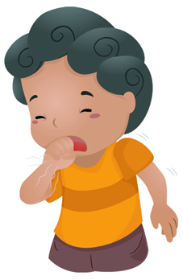
Primary HIV infection stage
Many people develop flu-like symptoms such as sore throat, headache, mild fever, fatigue, muscle and joint pains, swelling of the lymph nodes, rash, and oral ulcers.
These symptoms usually last from between one and two weeks.

Slide 106

The asymptomatic latent stage
In this stage, an infected person displays no symptoms. Infected individuals are often not even aware that they are carrying the HI virus.
They often accidentally infect new sex partners.

Slide 107
The asymptomatic latent stage
The virus remains active in the body during this stage. It continues to damage its victim’s immune system.
HIV-infected people can remain healthy for a long time, show no symptoms and carry on with their work.

Slide 108

The minor symptomatic stage of HIV disease
Minor and early symptoms of HIV disease usually begin to manifest in the third stage.
This starts when people with HIV antibodies begin to present the following symptoms:
Fevers
Swelling in the neck, armpits and groin
Rashes
Sores in the mouth
Weight loss
Tiredness
Shingles

Slide 109
The major symptomatic stage of HIV infection and opportunistic diseases
The following symptoms are usually an indication of advanced immune deficiency:
Bacterial infections, skin rashes, shingles and cold sores
Fever lasting more than a month and night sweats
Persistent diarrhoea for more than a month and more weight loss
Abdominal discomfort, headaches
Persistent cough and reactivation of tuberculosis

Slide 110
Aids-defining conditions: The severe symptomatic stage
Only in the last stage of HIV infection can people be said to have full-blown Aids. It takes about 18 months for the major symptomatic stage to develop into Aids.
The symptoms of HIV disease become more acute, patients become infected by rare organisms that do not respond to antibiotics, the immune system deteriorates, and more untreatable opportunistic conditions and cancers begin to manifest.
While people with AIDS usually die within two years, anti-retroviral therapy and the prevention and treatment of opportunistic infections may prolong this period.

Slide 111
Aids-defining conditions: The severe symptomatic stage
Many of the following problems usually plague the Aids patient in the final stage:
Continuous diarrhoea, nausea and vomiting
Conditions in the mouth may become so painful that the patient is no longer able to eat.
Cervical cancer.
Severe skin infections, warts and ringworm.
Respiratory infections, persistent cough, chest pain and fever.
Pneumonia, especially pneumocystis carinii pneumonia (PCP).
Severe shingles

Slide 112
Aids-defining conditions: The severe symptomatic stage
Many of the following problems usually plague the Aids patient in the final stage:
Nervous system problems - often complaining of pains
Neurological abnormalities with symptoms such as memory loss and seizures.
Skin cancer
Lymphoma or cancer of the lymph nodes.
Tuberculosis.
Other sexually transmitted diseases.

Slide 113
Death rates and chances of survival
HIV/AIDS is a serious problem worldwide but those who are taking effective treatment often live healthy, productive lives. It's common to find no patients with HIV on hospital's wards.
The treatment is called highly active anti-retroviral therapy, or HAART.
A new study from London included more than 16,000 people, where researchers compared death rates of those infected with HIV death rates of the general population.
They made a remarkable observation: Among those diagnosed in the last 10 years, there was no increased risk of death in the first 5 years of infection.

Slide 114
Death rates and chances of survival
People who had higher death rates related to HIV infection were more likely to be:
Older at the time when the HIV infection was first diagnosed
Users of injection drugs
Males

Slide 115
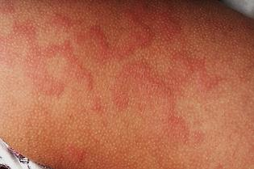
Death rates and chances of survival
In August 2013, Tivicay (dolutegravir) has been approved as treatment of the infection HIV-1, a strain of the virus that causes AIDS.
The drug, among a class called integrase strand transfer inhibitors, interferes with an enzyme that HIV needs to multiply. It has been approved in combination with other antiretroviral drugs, like the ones seen below.

Slide 116
Some approved All-in-one Combination drugs for HIV
Pill’s appearance | Drug
 | Stribild (elvitegravir + cobicistat + tenofovir + emtricitabine)
 | Atripla (efavirenz + tenofovir + emtricitabine)
 | Complera (rilpivirine + tenofovir + emtricitabine)

Slide 117
HIV and Aids
Study Unit 2: Know and understand how HIV/AIDS is transmitted

Slide 118
Body Fluids
HIV can be detected in several fluids and tissue of a person living with HIV, namely:
Blood
Semen
Vaginal secretions
Breast milk

Slide 119
Body Fluids
It is important to understand however, that finding a small amount of HIV in a body fluid or tissue does not mean that HIV is transmitted by that body fluid or tissue.
Only specific fluids from an HIV-infected person can transmit HIV.
These specific fluids must come in contact with a mucous membrane or damaged tissue or be directly injected into the blood-stream (from a needle or syringe) for transmission to possibly occur.

Slide 120
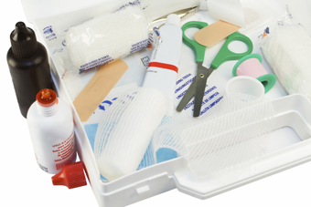
Transmitting the HIV Virus
HIV is most commonly transmitted through specific sexual behaviours or sharing needles with an infected person.

Slide 121
Vaginal sex
Vaginal sex is the most common way the virus is transmitted. HIV can be found in the blood, semen, pre-seminal fluid or vaginal fluid of a person infected with the virus.
In women, the lining of the vagina tears most of the time during sex and can allow HIV to enter the body.
HIV can also be directly absorbed through the mucous membranes that line the vagina and cervix. Infection is thus unavoidable.

Slide 122
Vaginal sex
In men, HIV can enter the body through the urethra (the opening at the tip of the penis) or through small cuts or open sores on the penis.
Not having sex is the most effective way to avoid HIV.
If you choose to have vaginal sex, use a latex condom to help protect both you and your partner from HIV and other STDs.
Studies have shown that latex condoms are very effective, though not perfect, in preventing HIV transmission when used correctly and consistently.

Slide 123
Anal sex
Unprotected (without a condom) anal sex is considered very risky behaviour.
HIV can be found in the blood, semen, and pre-seminal fluid of a person infected with the virus.
In general, the person receiving the semen is at greater risk of getting HIV because the lining of the rectum is thin and may allow the virus to enter the body during anal sex.
However, a person who inserts his penis into an infected partner also is at risk because HIV can enter through the urethra (the opening at the tip of the penis) or through small cuts, abrasions, or open sores on the penis.

Slide 124
Anal sex
Abstaining from sex, not having sex, is the most effective way to avoid HIV. If people choose to have anal sex, they should use a latex condom.
However, condoms are more likely to break during anal sex than during vaginal sex. Thus, even with a condom, anal sex can be risky.

Slide 125
Oral sex
It is possible for either partner to become infected with HIV through performing or receiving oral sex.
It is a less common mode of transmission than other sexual behaviours (anal and vaginal sex).

Slide 126
Oral sex
However, if the person performing oral sex has HIV, blood from their mouth may enter the body of the person receiving oral sex through various places:
The lining of the opening at the tip of the penis
The lining of the vagina or cervix
The lining of the anus
Directly into the body through small cuts or open sores.
Cells lining the mouth of the person performing oral sex may allow HIV to enter their body.

Slide 127
HIV
Not having sex is the most effective way to avoid HIV.

Slide 128
Advice about oral sex
If you choose to perform oral sex, and your partner is male, use a latex condom on the penis.
If you or your partner is allergic to latex, polyurethane condoms can be used.
If you choose to have oral sex, and your partner is female, use a latex barrier (such as a natural rubber latex sheet, a dental dam, or a cut-open condom that makes a square) between your mouth and the vagina.

Slide 129
Oral Protection
A latex barrier such as a dental dam reduces the risk of blood or vaginal fluids entering your mouth. Plastic food wrap also can be used as a barrier.

Slide 130
Advice about anal sex
If you choose to perform oral sex with either a male or female partner and this sex includes oral contact with your partners anus, use a latex barrier such as a natural rubber latex sheet, a dental dam, or a cut-open condom that makes a square between your mouth and the anus.
If you choose to share sex toys with your partner, such as dildos or vibrators, each partner should use a new condom on the sex toy and be sure to clean sex toys between each use.

Slide 131
Mother to Child Transmission
Mother-to-child transmission (MTCT) is when an HIV-infected woman passes the virus to her baby.

Slide 132
Mother to Child Transmission
MTCT can occur during:
pregnancy,
labour and delivery, or
breastfeeding.
Without treatment, around 15-30% of babies born to HIV positive women will become infected with HIV during pregnancy and delivery. A further 5-20% will become infected through breastfeeding.

Slide 133
Mother to Child Transmission
Effective prevention of mother-to-child transmission requires a strategy:
Preventing HIV infection among parents.
Making HIV testing and other prevention methods available.
Avoiding unwanted pregnancies among HIV positive women
Providing appropriate counselling and support to women living with HIV.
Preventing the transmission of HIV from HIV positive mothers to their infants during pregnancy, labour, delivery and breastfeeding.
Integration of HIV care, treatment and support for women found to be positive and their families.

Slide 134
Mother to Child Transmission
Mothers with HIV are advised not to breastfeed.
However if they live in a country where safe water is not available then the risk of life-threatening conditions from formula feeding may be higher than the risk from breastfeeding.

Slide 135
Dangers Of Drug Abuse And Behaviour
Any drug or alcohol usage contributes to the spread of HIV / AIDS because they interfere with good decision making.
And if needles are shared with HIV positive people, the virus can be spread in this way.

Slide 136
Dangers Of Drug Abuse And Behaviour
Drug and alcohol usage can also lead to the condom not being used correctly.

Slide 137
Dangers Of Drug Abuse And Behaviour
Also, remember that alcohol abuse interferes with the body’s use of vitamins and minerals, both critical in maintaining a healthy immune system.
It decreases white blood cell counts and this inhibits the body’s ability to fight infection.
Like alcohol abuse, drug abuse results in high-risk behaviours that include unprotected sex and the sharing of contaminated needles.

Slide 138
Drugs
Drugs are chemicals or substances that change the way our bodies work.
Drugs may intensify or dull your senses, alter your sense of alertness, and sometimes decrease physical pain.
Although it can feel good at first, they can do a lot of harm to the body and brain.
Drinking alcohol, taking illegal drugs, and sniffing glue can all cause serious damage to the human body and immune system.

Slide 139
Drugs
Some drugs severely impair a person's ability to make healthy choices and decisions.
Teens that drink, for example, are more likely to get involved in dangerous situations, such as driving under the influence or having unprotected sex.

Slide 140
Drugs
The effects of some common drugs:
Alcohol first acts as a stimulant, and then it makes people feel relaxed and a bit sleepy. High doses of alcohol seriously affect judgment and coordination.
Cocaine is a stimulant that affects the central nervous system, giving users a quick, intense feeling of power and energy. Injecting cocaine can give you hepatitis B or C or HIV/AIDS if you share needles with other users.

Slide 141
Drugs
The effects of some common drugs:
Ecstasy combines a hallucinogenic with a stimulant effect, making all emotions, both negative and positive, much more intense. Many users experience depression, paranoia, anxiety, and confusion. There is some concern that these effects on the brain and emotion can become permanent with chronic use of ecstasy. In other words, it makes you dumb.

Slide 142
Drugs
The effects of some common drugs:
Heroin gives you a burst of euphoric feelings, especially if it is injected. This high is often followed by drowsiness, nausea, stomach cramps, and vomiting. Users feel the need to take more heroin as soon as possible just to feel good again. Users who inject heroin often have collapsed veins and put themselves at risk of getting deadly infections such as HIV/AIDS, hepatitis B or C, and bacterial endocarditis (inflammation of the lining of the heart) if they share needles with other users.

Slide 143
Drugs
The effects of some common drugs:
Inhalants are breathed in directly from the original container (sniffing or snorting), from a plastic bag (bagging), or by holding an inhalant-soaked rag in the mouth (huffing). Inhalants make you feel giddy and confused, as if you were drunk. Long-time users get headaches, nosebleeds, and may suffer loss of hearing and sense of smell. Inhalants are the most likely of abused substances to cause severe toxic reaction and death. Using inhalants, even one time, can kill you.

Slide 144
Drugs
The effects of some common drugs:
Marijuana can affect mood and coordination. Users may experience mood swings that range from stimulated or happy to drowsy or depressed. As with other drugs that impair your decision making abilities, Marijuana may cause you to have unsafe sex with someone infected with HIV.

Slide 145
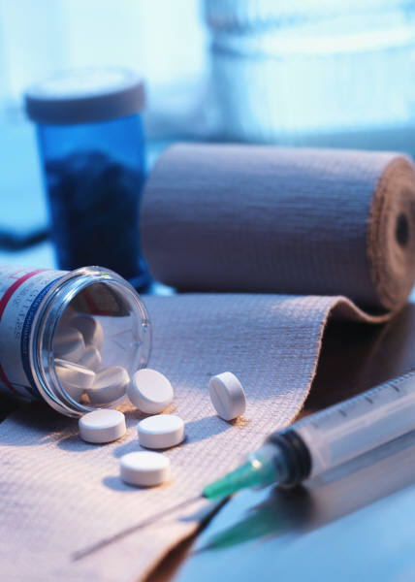
Drugs
The best way to reduce your change of being infected with HIV because of drug use, is simply not to use drugs. There are many drug treatment centres throughout South Africa. You can use the internet or Yellow Pages to find a centre near you. You can also visit a clinic nearby and ask a professional for advice.

Slide 146
Blood Products
In South Africa, blood donated for transfusions or blood products is screened for antibodies related to HIV and for the presence of one of the viral proteins.
Any contaminated blood is discarded.
The probability of HIV infection via blood transfusion in this country is therefore extremely low, but can still occur because the tests used do not detect very early HIV infection in a donor.

Slide 147
Blood Products
“Whole” blood is still frequently used for transfusion, particularly where blood services have limited facilities and resources, but the processing of units of whole blood into their constituent components is becoming more common.
Depending on their clinical condition, most patients need only one component or product, so this process enables a unit of whole blood to be used for more patients.

Slide 148
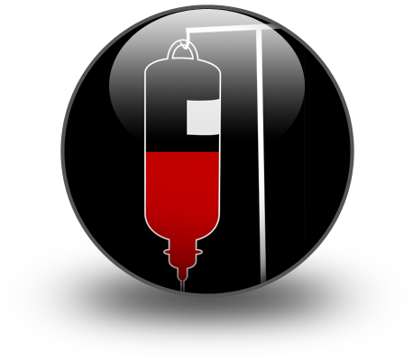
Blood’s components
About 45 per cent of the total volume of blood is made up of:
Red blood cells
White blood cells
Platelets

Slide 149
HIV and Aids
Study Unit 3: Know what behaviour is safe and what behaviour carries the risk of HIV transmission.

Slide 150
Relationship Between Human Behaviour And HIV/AIDS
In South Africa, the number of people infected with HIV/AIDS remains very high due to a certain amount of unawareness in the general population about:
What HIV/AIDS is
How it is transmitted
What one can do to prevent getting it
How it is treated
Common effects of having it

Slide 151
Relationship between human behaviour and HIV/AIDS
Generally speaking, we all know that if a person’s actions are based on ignorance instead of knowledge, bad things happen. Our every-day behaviour should be cautious, not risky.
People who live without caution are more likely to be involved with unsafe sex, drugs, dirty needles and other dangerous activities like gangs, anonymous intercourse, crime and immorality.
If people make themselves familiar with the information about HIV/AIDS and preventative precautions, they are more likely to have safe behavioural patterns.

Slide 152

Relationship Between Human Behaviour And HIV/AIDS
People who play with fire, burn their fingers. Be safe.

Slide 153
Avoid Contracting Or Spreading HIV/AIDS
Transmitting HIV / AIDS in the Workplace
HIV is spread through the exchange of body fluids such as blood and semen, where it is found in high quantities. It is found in tiny amounts in saliva and urine too.

Slide 154
Transmitting HIV / AIDS in the Workplace
The following precautions are important:
All employees need to receive training on how to prevent HIV transmission when helping an injured person.
Treat all blood as infected blood. Do not touch it.
If you want to help someone, the first thing that anyone providing first aid should be aware of when entering a situation is the potential for danger to themselves.

Slide 155
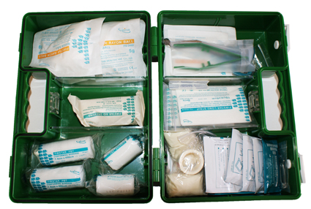
Transmitting HIV / AIDS in the Workplace
The following precautions are important:
Ensure that your workplace has a fully stocked first aid kit.
Make sure it includes gloves. Never help an injured person without them.
Use a mouthpiece to give CPR

Slide 156
High, Medium and Low Risk Behaviour
High, medium and low risk behaviour
HIV is spread through the exchange of body fluids such as blood and semen, where it is found in high quantities. It is found in tiny amounts in saliva and urine too.

Slide 157
High, Medium and Low Risk Behaviour
Other STD/STIs (sexually transmitted diseases and infections) can spread through surface contact as well as through exchange of fluids.

Slide 158
High, Medium and Low Risk Behaviour
Reducing the exchange of fluids from one person's body to another will reduce the risk of infection.

Slide 159
High, Medium and Low Risk Behaviour
You can choose the level of risk you are willing to take. If possible, talk to your partner about risks and practises before you start having sex.

Slide 160
High, Medium and Low Risk Behaviour
How much risk are you taking?
Giving or receiving oral sex using a latex barrier on a woman or a condom on a man – low risk.
Massage, touching, masturbating or being masturbated as long as there is no contact with your partner’s semen or vaginal fluids – low risk.
Using sex toys that no one else has used - low risk.
Injecting with a new needle – low risk.
Giving or receiving oral sex using a latex barrier/condom - low risk.

Slide 161
High, Medium and Low Risk Behaviour
How much risk are you taking?
Kissing or touching each other’s genitals: infections like oral herpes can be spread to the genitals from the partner’s mouth - low risk.
Giving or receiving vaginal or anal sex using a condom - medium risk.
Injecting with a used needle that has been cleaned with bleach and water – medium risk.
Unprotected sex - High risk.

Slide 162
High, Medium and Low Risk Behaviour
How much risk are you taking?
Using a sex toy that someone else has used - High risk.
Sharing contaminated needles - High risk.
IV drug use, tattooing, skin piercing or acupuncture with unsterilized, used needles - High risk.

Slide 163
Reasons Why Certain Behaviours And Activities Carry A Low Risk Of Infection
The immune system contains many types of cells which guard against germs responsible for most diseases.
HIV is transmitted from an infected person by body fluids.
As a result, anyone who is occupationally (at their workplace) exposed to these body fluids risks contracting the disease.

Slide 164
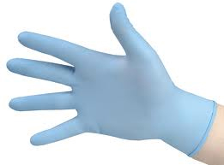
Reasons Why Certain Behaviours And Activities Carry A Low Risk Of Infection
Preventive measures include:
Wearing protective clothing
Wearing protective gowns
Wearing protective gloves
Wearing protective masks
Wearing protective goggles

Slide 165
Preventive Measures
The transmission of HIV occurs only when the virus enters the bloodstream.

Slide 166
Reasons Why Certain Behaviours And Activities Carry A Low Risk Of Infection
Casual contact with a person who has HIV does not pose a risk. Several studies indicate that the follow situations pose NO RISK. Sharing with an HIV positive person any of the following:
Telephones,
Swimming pools,
Toilets or other
Household items

Slide 167

Reasons Why Certain Behaviours And Activities Carry A Low Risk Of Infection
HIV is also not transmitted:
During the preparation or serving of food and beverages.
While traveling through air
By mosquitoes or other insects.

Slide 168
The Role of Sexually Transmitted Diseases (STDs) in Transmitting HIV / AIDS
STDs and HIV / AIDS
A sexually transmitted disease (STD) is one that is moved from one organism to another through sexual intercourse or genital contact.

Slide 169
STDs and HIV / AIDS
It has been proven the presence of STDs makes it more likely for the body to get aids.

Slide 170
STDs and HIV / AIDS
Some STDs cause open wounds or ulcers to form in the genital area. These openings provide a way for HIV to enter the blood stream.
While some STDs do not cause open wounds, the presence of the STD causes the body to increase the concentration of CD4 cells in the genital area.
It has been shown that increased concentrations of CD4 cells in the genital area provide HIV with a favourable target for infection.

Slide 171
STDs and HIV / AIDS
People infected with an STD have increased concentrations of HIV in their genital fluids, increasing the possibility of HIV transmission.
One studied showed that men infected with HIV and gonorrhoea has 10 times more HIV in their semen than men infected only with HIV.
If you get treatment for an STI, it can also slow the spread of HIV. Using condoms and abstaining from sex are the keys to reducing the risk of STDs and HIV.

Slide 172
HIV and Aids
Study Unit 4: Know what guidelines and assistance are available to support workers with HIV/AIDS

Slide 173
Company Policy On HIV/AIDS
HIV in the workplace
In 2013 an HIV report concluded that the total number of persons living with HIV in South Africa increased from an estimated 4 million in 2002 to 5,26 million by 2013. For 2013, an estimated 10% of the total population is HIV positive.
Approximately seventeen percent of South African women in their reproductive ages are HIV positive.

Slide 174
Company Policy On HIV/AIDS
Employers should set in place an HIV workplace policy that can prevent discrimination against people with HIV / AIDS. The policy must control practices and procedures and ensure that employees living with HIV/AIDS are treated in a fair and consistent way. The policy should also describe the treatment of employees that are indirectly affected by the epidemic.

Slide 175
Company Policy On HIV/AIDS
The Department of Health’s HIV and AIDS guidelines states:
“HIV, AIDS and Tuberculosis contribute significantly to the burden of disease faced by South Africans.
This is particularly true for poor and vulnerable groups.
This is why the government has decided to put a huge effort into addressing HIV and AIDS and TB in an integrated manner.
The most important strategy to combat these diseases is the HIV and AIDS Counselling and Testing (HCT) Campaign.”

Slide 176

Company Policy On HIV/AIDS
Their policy is based on the following:
“Once people know their status, the government will show people the benefits of prevention and early access to treatment. To achieve this, the department will work closely with social partners to promote open dialogue among communities, civil society and social partners.” - Source: South African Department of Health

Slide 177
The Problems of a Worker with HIV / AIDS
There are some limitations encountered by people with HIV/AIDS.
Let us discuss some possible limitations in order to gain knowledge on how to overcome these situations. Be aware that not all people with HIV/AIDS will need accommodations to perform their jobs and many others may only need a few accommodations.
The following is only a sample of the possibilities available. Numerous other accommodation solutions may exist.

Slide 178
The Problems of a Worker with HIV / AIDS
Questions to Consider:
What limitations is the employee experiencing?
How do these limitations affect his/her job performance?
What accommodations are available to reduce these problems?
Has the employee been consulted regarding possible accommodations?
Do supervisory personnel and employees need training?

Slide 179
Employers Play A Proactive Role In Addressing The AIDS Pandemic
Employers have some responsibilities in the workplace regarding HIV and AIDS:
Making sure all their workers, HIV positive and negative persons, are tested for the virus
Making sure all their employees understand the virus, like we explained in previous sections of this learner guide
Creating a safe workplace for unaffected workers
Creating a caring environment for HIV positive workers.

Slide 180
Organisational HIV policy
Employers should set in place an HIV workplace policy that can prevent discrimination against people with HIV / AIDS.
The policy must control practices and procedures and ensure that employees living with HIV/AIDS are treated in a fair and consistent way.
The policy should also describe the treatment of employees that are indirectly affected by the epidemic.
Irrespective of your company's size, it is very important that you have a clear and comprehensive HIV/AIDS workplace policy in place.

Slide 181

Government HIV and health programmes
A plan to scale-up South Africa's fight against HIV/Aids was announced on World Aids Day, 2011.
Prevention is at the heart of the new National Strategic Plan for HIV, which aims to reduce new infections by 50% by taking a holistic approach.

Slide 182
Government HIV and health programmes
The NSP has identified four objectives that will help South Africa reach these goals:
Address the social and structural factors that drive HIV and affect the way they care for affected people.
Prevent new HIV infections through a combination of biomedical, behavioural, social and structural interventions.
Sustain health and wellness, primarily by access to quality treatment, care and support services, and to develop programmes that focus on wellness.
Protect the human rights of people living with HIV, primarily through ending stigma, discrimination, human rights violations and gender inequality.

Slide 183
The National Strategic Plan’s HIV Counselling and Testing campaign
In 2010, the government launched its HIV Counselling and Testing campaign, which offers free testing to all patients at public hospitals and clinics across the country.
While providing people with the information and interventions they need to manage their health and to prevent further HIV transmission.
The campaign aims to ensure that people in need are fast-tracked onto the treatment programme.
You can access this free service at public hospitals and clinics across the country.

Slide 184
HIV Treatments
The U.S. has highly respected official guidelines on when the best time is for a person to start HIV meds, as well as what to start treatment with.
They currently recommend the following drugs as First-Line Regimens:

Slide 185
HIV Treatments
1 | Atripla
2 | Reyataz + Norvir + Truvada
3 | Prezista + Norvir + Truvada
4 | Isentress + Truvada
5 | Kaletra + Combivir (for pregnant women)

Slide 186
When To Start
CD4 count above 500: | Starting is worth considering.
CD4 count between 350 and 500: | Starting is recommended.
CD4 count below 350 (or if you've ever had an AIDS-defining illness): | Start as soon as possible.

Slide 187
Rights Of All Workers In Respect Of HIV/AIDS
The South African Labour Guide presents a code of good practice on aspects of HIV/AIDS Employment that is freely available to the public and should be consulted if any questions arise about workers who are HIV positive and their rights.

Slide 188
Rights Of All Workers In Respect Of HIV/AIDS
The Code suggests:
The Human Immunodeficiency Virus (HIV) and the Acquired Immune Deficiency Syndrome (AIDS) are serious public health problems which have socio economic, employment and human rights implications.
It is recognised that the HIV/AIDS epidemic will affect every workplace, with prolonged staff illness, absenteeism, and death impacting on productivity, employee benefits, occupational health and safety, production costs and workplace morale.

Slide 189
Rights Of All Workers In Respect Of HIV/AIDS
The Code suggests:
HIV knows no social, gender, age or racial boundaries, but it is accepted that socio-economic circumstances do influence disease patterns.
HIV thrives in an environment of poverty, rapid urbanisation, violence and destabilisation. Transmission is exacerbated by disparities in resources and patterns of migration from rural to urban areas.
Women are particularly more vulnerable to infection in cultures and economic circumstances where they have little control over their lives.

Slide 190
Rights Of All Workers In Respect Of HIV/AIDS
The Code suggests:
Furthermore HIV/AIDS is still a disease surrounded by ignorance, prejudice, discrimination and stigma. In the workplace unfair discrimination against people living with HIV and AIDS has been perpetuated through practices such as pre-employment HIV testing, dismissals for being HIV positive and the denial of employee benefits.

Slide 191
Rights Of All Workers In Respect Of HIV/AIDS
The Code suggests:
One of the most effective ways of reducing and managing the impact of HIV/AIDS in the workplace is through the implementation of an HIV/AIDS policy and programme. Addressing aspects of HIV/AIDS in the workplace will enable employers, trade unions and government to actively contribute towards local, national and international efforts to prevent and control HIV/AIDS. In light of this, the Code has been developed as a guide to employers, trade unions and employees.

Slide 192
Rights Of All Workers In Respect Of HIV/AIDS
The Code suggests:
Furthermore the Code seeks to assist with the attainment of the broader goals of:
  Eliminating unfair discrimination in the workplace based on HIV status;
  Promoting a non-discriminatory workplace in which people living with HIV or AIDS are able to be open about their HIV status without fear of stigma or rejection;
  Promoting appropriate and effective ways of managing HIV in the workplace;
  Creating a balance between the rights and responsibilities of all parties; and
  Giving effect to the regional obligations of the republic as a member of the Southern African development community.

Slide 193

Universal Precautions
Many people risk contact with blood or other body fluids in their workplace.
Universal Blood and Body Fluid Precautions are widely accepted in most workplaces as crucial measures to protect workers from exposure to disease-causing biological agents.

Slide 194
Universal Precautions
These agents include:
Faeces
Blood
Saliva
Mucous
Urine
Semen
Vaginal fluids
Other body fluid containing blood.

Slide 195
Universal Precautions
Infection can occur when these agents come into contact with broken skin or contact with mucous membranes of the eyes, nose and mouth.
It is important to consider all biological wastes as infectious.
All members should follow these universal precautions at all times.

Slide 196
Universal Precautions
Five Steps of Universal Precautions
Education – understanding the dangers
Hand washing
Use of protective barriers like masks
Cleaning of contaminated surfaces
Safe handling/disposal of contaminated material

Slide 197
Workplace ‘Code Of Behaviour’.
Every organisation should have a HIV/AIDS workplace programme. Companies can usually implement change in the following areas:
Developing an HIV/AIDS workplace policy
Provide education and awareness in the workplace
Implement fair employment practices
Provide care and support in the workplace
Community involvement

Slide 198
Workplace ‘Code Of Behaviour’.
We can achieve this by being conducting various awareness and education programmes, encouraging voluntary testing, promoting condom distribution and enforcing universal infection control measures, providing access to counselling for HIV positive people, having an HIV policy and HIV committee and assist in adequate referrals.

Slide 199
Example of a HIV workplace ‘Code of Behaviour’
The purpose of this policy is to provide clarity on MY COOL COMPANY's views and commitments with regard to HIV/AIDS and the comprehensive management of HIV positive employees and employees living with AIDS. The scope of this policy applies to all staff.
RESPONSIBLE PERSONS
  The HIV/AIDS Committee
  All levels of Management
  All employees

Slide 200

A presentation: HIV / AIDS in the Workplace
How can I support someone who has HIV/AIDS?

Slide 201

Eat a balanced diet
Protein (meat, fish, eggs, nuts), carbohydrates
(Pap, potatoes, rice, bread), vegetables and fruit.

Slide 202

Care for their feelings
When they feel scared or depressed, they must talk to someone. Just like you and me.

Slide 203
Support their immune system
They have to avoid alcohol, smoking, stress and people who are sick with flu, colds and other infectious diseases, including STIs.
This is good advice for all of us!

Slide 204
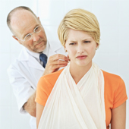
Get medical care
Go for regular check-ups and stay in tune with their health.
When any of us gets sick, we have to go to the doctor and soon we feel a little better.

Slide 205
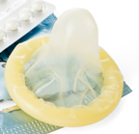
Practice safe sex and use condoms
So that they do not get any more sexually transmitted diseases.
Abstain from unsafe sex whether you are HIV positive or not.
Use Condoms.

Slide 206
HIV And AIDS
Study Unit 5: Know and understand the implications of the HIV/AIDS pandemic

Slide 207
AIDS Orphans
The HIV and AIDS epidemic has left in its wake a population of orphaned or vulnerable children, many of whom are living with HIV and AIDS themselves.
There are currently about millions of orphans in South Africa of which about half are HIV/AIDS orphans.
Not only are many AIDS orphans struggling with the implications of their own medical condition, but are living in a context of sadness and stress associated with the death of a parent or caregiver, discrimination, and poverty, a status that is linked to HIV and AIDS.

Slide 208
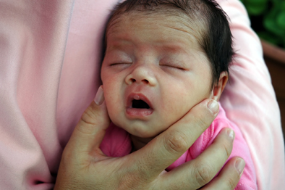
AIDS Orphans
Children living with HIV and AIDS face medical, cognitive, behavioural, and psychosocial problems as a result of their illness and the context in which they live.
AIDS orphans represent one of the most damaging effects of the HIV/AIDS epidemic. Focused research and planning are urgently needed to ensure that the effect on children and society at large are adequately managed.

Slide 209
The cost of HIV / AIDS
The cost of HIV/AIDS to South Africa will be significant in economic terms. South Africa currently faces one of the highest HIV prevalence rates in the world. HIV/AIDS is estimated to be reducing South Africa’s growth rate by a minimum of 0.35% per year.
HIV/AIDS will cause great long-term damage to the national economy because the disease often robs children of a proper education through the death of one or both parents, and so undermines the basis of economic growth over the long haul.

Slide 210

The cost of HIV / AIDS
By taking the lives of young adults, AIDS seriously weakens a country’s tax base. As a result, national finances will come under increasing pressure. Less income from taxes will reduce the government’s ability to finance public expenditures, including those aimed at accumulating human capital, such as education and public health services.

Slide 211
The cost of HIV / AIDS
A vital step in decreasing the economic effects of HIV/AIDS is to develop more comprehensive policies that cater for the economic needs of South Africa.
These polices should include both treatment and prevention programs, but may even include various economic measures like targeted skill training required in affected sectors.

Slide 212
The Need for Medical Care
The long-term objectives of AIDS campaigns are:
To encourage people to know their HIV status
To give people prevention methods in order
To take proactive steps to the population’s general healthy lifestyle - irrespective of HIV status
To increase the incidence of health-seeking behaviour;
To increase access to treatment, care and support services

Slide 213

The Need for Medical Care
All South Africans are encouraged to go for their own HIV tests and to know their status.

Slide 214
The Need for Medical Care
In South Africa, the AIDS epidemic is adding more and more pressure on the health sector. As the epidemic matures, the demand for care for those living with HIV rises, as does the toll of AIDS on health workers. As the HIV rate of a country rises, the strain placed on its hospitals is likely to increase.
Hospitals are struggling to cope because there are often too few beds available. This shortage results in people being admitted only in the later stages of illness, reducing their chances of recovery.

Slide 215
The Need for Medical Care
While AIDS is causing an increased demand for health services, large numbers of healthcare professionals are being directly affected by the epidemic.
A study in one region of Zambia found that 40% of midwives were HIV-positive.
Although the recent increase in the provision of antiretroviral drugs has brought hope to many in Africa, it has also put increased strain on healthcare workers.
Providing antiretroviral treatment to everyone who needs it requires more time and training than is currently available in most countries.

Slide 216
The Effect of HIV / AIDS on Family Income
One study estimated that households experience a decline in income of between 48 percent and 78 percent when a household member dies from HIV/AIDS, excluding the costs of funerals

Slide 217

The Effect of HIV / AIDS on Family Income
The toll of HIV and AIDS on households can be very severe.
Although no part of the population is unaffected by HIV, it is often the poorest sectors of society that are most vulnerable to the epidemic and for whom the consequences are most severe.

Slide 218
The Effect of HIV / AIDS on Family Income
Other countries in the region are experiencing the same problem, as individuals who would otherwise provide a household with income are prevented from working – either because they are ill with AIDS themselves or because they are caring for another sick family member.
Such a situation is likely to have repercussions for every member of the family.
Children may be forced to abandon their education and in some cases, women may be forced to turn to sex work ('prostitution').
This can lead to a higher risk of HIV transmission, which further exacerbates the situation.

Slide 219
The Effect of HIV / AIDS on the Workplace
HIV / AIDS radically affects labour, setting back economic and social progress. The vast majority of people living with HIV in Africa are between the ages of 15 and 49 - in the prime of their working lives.
AIDS damages businesses by pressing productivity, adding costs, diverting productive resources, and exhausting skills.
In addition, as the impact of the epidemic on households grows more severe, market demand for products and services can fall.

Slide 220
The Effect of HIV / AIDS on the Workplace
The epidemic influences productivity through increased non-attendance. Workers do not show up for work.

Slide 221

The Effect of HIV / AIDS on the Workplace
In areas that have been hit hardest by the epidemic, it found that up to 40% of companies reported that HIV and AIDS were having a negative effect on profits.

Slide 222
The Effect of HIV / AIDS on the Workplace
The implications of HIV in the IT world:
The vast majority of people living with HIV in Africa are between the ages of 15 and 49.
People of those ages are running the IT world. As a result, the whole IT sector is dramatically affected.
All of us will also have to start paying more, because company costs for health-care, funeral benefits, and pension fund commitments are likely to rise as the number of people dying increases.
The people who do not show up for work can account for as much as 25-54% of company costs.
These AIDS-related effects could cut profits by at least 6-8%.

Slide 223
The implications of HIV on the Labour/Agriculture Sub-sector
The economic results of HIV suggests that the sector that will be most influenced will be mining, followed closely by transportation and storage.

Slide 224
The implications of HIV on the Labour/Agriculture Sub-sector
Farming and agriculture is particularly susceptible to the epidemic and is facing a severe social and economic crisis in some locations due to its impact.

Slide 225
Why HIV/AIDS is leading to falling labour quality and supply
(A summary of HIV/AIDS effect on businesses)
Illness and death due to HIV/AIDS significantly raise the industry’s direct costs (medical and funeral expenses) as well as indirectly through the loss of valuable skills and experience. The epidemic thus unfavourably affects companies’ efficiency and productivity.

Slide 226

Why HIV/AIDS is leading to falling labour quality and supply
Thus, HIV/AIDS is leading to falling labour quality and supply, more frequent and longer periods of absenteeism (non-attendance), losses in skills and experience, resulting in shifts towards a younger, less experienced workforce and subsequent production losses.
These impacts intensify existing skills shortages and increase costs of training and benefits.

