Slide 1
MODULE 3: MATHEMATICS AND STATISTICS
Unit Standard ID 9015, 9016 and 7468 | NQF Level 4| Credits 16

Slide 2
Ground Rules
Days Training, Workshops, and Portfolio building
Breaks
Cell Phones
Participation
Portfolio Submission
Notes:
Submit within 8 weeks
A willingness to learn
Participation in the class
Punctuality
Willingness to speak up when your expectations are not met

Slide 3

Section 1 Overview
What Is a Portfolio?
Collection of Evidence that
Lists criteria for proving competence
Provides evidence that you meet criteria
Is organised to enable assessor to evaluate evidence against criteria.

Slide 4
Overview
The Portfolio of Evidence (PoE)
Section 1 – Administrative detail
Section 2 – Assessment planning
Section 3 – Assessment design matrix
Section 4 – Formative assessment activities
Section 5 – Summative assessment
Knowledge questionnaires

Slide 5
Overview
Section 6 – Summative assessment – Workplace assignments
Section 7 – Feedback
Section 8 – 10 Additional Evidence

Slide 6
Categories Of Evidence
Practical Competence
Foundational Competence
Reflective Competence

Slide 7
Overview
Competency
  Against Outcomes in Unit Standard
Interpret
  Outcomes in relation to workplace

Slide 8
Good Evidence
Valid
  Should relate to what is being assessed
Authentic
  Own evidence
Reliable
  Consistency
  Another assessor makes same judgment
Current
  As recent as possible
Sufficient
  Enough evidence

Slide 9
Assessment Brief
Purpose of Unit Standard
The purpose of this skills programme is to provide learners with the opportunity to provide evidence of their competence in the numerical skills component of Qualification 67463: Human Resources Management and Practices Support

Slide 10
Assessment Brief
Entry Level Requirements
The credit value is based on the assumption that people starting to learn towards this unit standard al-e competent in Mathematical Literacy and Communications at NQF level 3.

Slide 11
Assessment Brief
Credit Value
10 credits = 100 notional hours
Theoretical + Practical + Workplace experience
Submission of Portfolio of Evidence (PoE) - based on Specific Outcomes (SOs) and Assessment Criteria (ACs).

Slide 12
Types of Assessment
Integrated Assessment
Diagnostic
Formative
Summative

Slide 13
Assessment Methods
Assessment Methods
Questioning
Product Evaluation
Observation

Slide 14
Assessment
Assessment
Formative
Summative
Evidence during
facilitation
Self Assessment
Knowledge Assessment
Summative Workplace
Assignments
Formative + Summative = Competent

Slide 15
Competence
Competent
Ability to perform task, action or function successfully
Certificate issued and credits awarded
Not Yet Competent
Not successful yet
Opportunities to remediate to address gaps

Slide 16

Re-Assessment
Specific feedback - focus on not yet competent areas
Re-assessment - same context and same conditions
Only Not Yet Competent specific outcomes - to be re-assessed
ENJO’s policy: - Two (2) re-assessments

Slide 17
Assessment Brief
Credit Accumulation
Credits will be awarded on successful completion of unit standards.
NB: - Quality Assurance Process
Assessment
Moderation
Verification
Notes:
Page 2 of file

Slide 18
Assessment Brief
Assessment Tools and Matrix:
  All the specific outcomes
  Associated assessment criteria
  Range statements
  Critical cross-field, development outcomes
  Essential embedded knowledge.

Slide 19
Assessment Brief
ENJO Assessment Process:
  Integrated assessment against current SAQA registered unit standards and qualifications in a fair, valid, reliable and practicable manner.
  Moderation and verification procedures carried as per SAQA requirements.
  Learner competence demonstrated through formative and summative assessments.

Slide 20
Assessment Brief
Learners have the right to:
  Be informed when and how assessments are conducted
  Appeal against an assessment conducted.
  Get interpretation to the numeracy and literacy level of the skills programme, unit standard or qualification.

Slide 21
Assessment Brief
Facilitation and assessments will be conducted in English.
Learners may have an observer present; however observer may not partake, comment or interrupt the assessment process.
Assessment results will be available as soon as possible after the final assessment.
Learners may have access to results within normal working hours.

Slide 22
Assessment Brief
Additional Notes:
  Assessor will maintain telephonic and electronic contact until sufficient evidence has been submitted.
  Additional evidence may be submitted after initial submission.
  If you have a problem which might affect the outcome of assessment(s) you should notify the assessor. Where practicable such needs will be accommodated. (special needs)

Slide 23
Appeals and Disputes
Learner has right to appeal against:
Unfair assessment
Invalid assessment
Unreliable assessment
Unethical practices
Inadequate expertise and experience of the assessor
Appeals have to be submitted in writing to ENJO.

Slide 24
Section 1
Portfolio of Evidence
Section 1 – Administrative Detail

Slide 25

Section 1 - 2 Administrative Detail
Learner Information
ID
CV
Qualifications
Special Instructions
Declaration of Authenticity
Unit Standard
Sign all required documents

Slide 26
Special Instruction
No Tippex
Initial each page
Comments in full
ENJO or own templates to be used to complete portfolio
Use assigned colour unless instructed differently

Slide 27
Unit Standard
SAQA US ID
Unit Standard Title
NQF Level
Credits
Purpose of the Unit Standard
Learning assumed to be in place

Slide 28
Unit Standard
Unit Standard Range
Specific Outcomes
Assessment Criteria
Essential Embedded Knowledge (EEK)
Critical Cross-field Outcomes (CCFOs)
Notes

Slide 29
STUDY UNIT 1
APPLY KNOWLEDGE OF STATISTICS AND PROBABILITY

Slide 30
Situations or Issues that can be dealt with through Statistical Methods
Introduction
Wherever you work or whatever job you do, you cannot escape statistics – very few decisions that we make for business, industry or government are made without giving some consideration to statistical data.
Such data includes financial data, population demographics, attitudes and lifestyle choices of people, health statistics, and much, much more.
It is therefore important that you have a basic understanding of statistics and the collection, organising and representing data.

Slide 31
Situations or Issues that can be dealt with through Statistical Methods
Data
The HR practitioner needs to have a thorough understanding of exactly what data is. It is important to note that data:
Is organised information
Can be numbers, words, measurements, observations or even just descriptions of things
Can be organised in tables and charts
As there are different methods available for collecting data, we have to make sure that we use appropriate methods of data collecting to maximise the effectiveness and efficiency of the data collection and thus ensure the resolution of any problems.

Slide 32
Situations or Issues that can be dealt with through Statistical Methods
Data must be:
•Collected
•Organised
•Represented
•Interpreted

Slide 33
Situations or Issues that can be dealt with through Statistical Methods
Collection of Data
The HR environment offers many opportunities for collection of data. Just look around you and you will note that you can collect data from everyday occurrences such as:
•How many employees make use of their own transport to get to work?
•How many employees were present on a specific day?
•How many male employees are there in the organisation?
•How many employees are married?
•Which recreational activities do the employees enjoy most?
The easiest way to determine the answers to all these questions is to ask employees to complete a questionnaire or a survey.

Slide 34
Situations or Issues that can be dealt with through Statistical Methods
Data Tables
One of the easiest and most effective ways of organising data collected is using a data table.
For this data table to be effective, it is necessary to arrange the data into columns and rows and ensure that the rows and columns are clearly ladled.
Advantages of a data table
It is a table that is designed to reflect specific data.
Makes it easier to sort and access information.
If you are computer literate, the easiest way to set up such a table is to use a spreadsheet programme. This will allow you to sort the information and also to represent the data in graphic format.

Slide 35
Situations or Issues that can be dealt with through Statistical Methods
Example of a data table
Ages of employees in the organisation
Year | 20 – 29 year olds | 30 – 39 year olds | 40 – 49 year olds | 50 – 59 year olds
2013 | 5 | 10 | 13 | 28
2014 | 10 | 15 | 20 | 45
2015 | 12 | 20 | 25 | 57
2016 | 18 | 25 | 27 | 70
TOTAL | 45 | 70 | 80 | 200

Slide 36
Situations or Issues that can be dealt with through Statistical Methods
Tally Charts
A tally chart is another way in which you can collect information. You can use descriptions or pictures in a tally chart and then count by using tally marks.
Tally marks are usually grouped in four lines with a line drawn through to indicate the fifth.
Advantages of tally charts:
Records numbers accurately
Give a simple picture of the data
Tallying is a way of counting in fives.

Slide 37
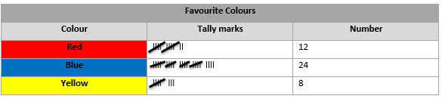
Situations or Issues that can be dealt with through Statistical Methods
Example of a Tally charts
• Which colour is the least favourite colour?

Slide 38
Situations or Issues that can be dealt with through Statistical Methods
Population and Sample
A population is any entire collection (set) of people, animals, plants or things from which we may collect data. It is the entire group we are interested in, which we wish to describe or draw conclusions about.
For Example: You want to do a study on the sports activities of all 20 – 29 year olds. All 20 – 29 year olds. year olds will then be seen as the population/census.
In order to make any generalisations about a population, a sample, that is meant to be representative of the population, is often studied. For each population there are many possible samples.

Slide 39
Situations or Issues that can be dealt with through Statistical Methods
A sample is generally selected for study when the population is too large to study as a whole. However, the sample should be representative of the general population. You can usually best achieve this by random sampling.
It is impossible to do a study on all 20 – 29 year olds, therefore you need to select a smaller group of 20 – 29 year olds that are representative of the complete population, your sample can thus be a group of 100 20 – 29 year olds selected from three areas in Gauteng.

Slide 40
Situations or Issues that can be dealt with through Statistical Methods
You will then investigate the sample and draw conclusions about the complete population.
It is important that the investigator carefully and completely defines the population before collecting the sample, including a description of the members to be included.
Example 1:
The population for a study of employee health might be all employees born in Mpumalanga in the 1980's.
The sample might be all babies born on 17th May in any of the years (1980-1989).

Slide 41
Situations or Issues that can be dealt with through Statistical Methods
Example 2
If there are a 120 employees in your organisation and you want to obtain information on each member of the group, (all 120), then the group is called the population.
If you however just choose the employees who have birthdays in the first four months of the year, you are using a sample.
A study of the whole population is accurate, but can be difficult to do. A sample is not as accurate, but may be good enough, and it is a lot easier.

Slide 42
Situations or Issues that can be dealt with through Statistical Methods
Remember that a sample is a group of units selected from a larger group (the population).
By studying the sample you can draw valid conclusions about the larger group.
A unit is a single person, animal, plant or thing which is actually studied by a researcher - the basic objects upon which the study or experiment is carried out.
For example, a person, a monkey, a sample of soil, a pot of seedlings, a postcode area, or a doctor's practice.
Consider:
What is the difference between a population and a sample?

Slide 43
Methods for Collecting, Recording and Organising Data
Appropriate methods for collecting, recording and organising data should be used to maximise efficiency and ensure the resolution of a problem or issue.
The most common techniques/methods used in the collection of data are the following:
Observation
Personal interview
Using questionnaires

Slide 44
Methods for Collecting, Recording and Organising Data
Observation
Observing the environment is an appropriate method to use when we cannot ask questions.
This is used during direct examination and recording of an ongoing activity.

Slide 45
Methods for Collecting, Recording and Organising Data
Advantages | Disadvantages
Problems such as incomplete or distorted recall are avoided. | The observer or instrument must be free of bias and must accurately record the extent of interest. This could be time-consuming.
Data can be gathered more or less continuously over an extended time period. | Observation may cause inaccurate results as the individuals who are under observation may be aware of this fact and as a result their behaviour may be biased.

Slide 46
Methods for Collecting, Recording and Organising Data
Personal Interview
The direct asking of appropriate questions can be used to gather information.
It is important however that the interviewer asks questions that are printed on a questionnaire and records the respondent’s answers in designated spaces on the questionnaire.

Slide 47
Methods for Collecting, Recording and Organising Data
Advantages | Disadvantages
People respond much more readily when they are approached directly. | The interviewer may not follow directions for selecting respondents.
Direct contact reduces misinterpretations. | The respondent may be influenced by the manner in which the interviewer asks questions or uses body language.
The face to face communication allows the interviewer to observe the respondent’s reactions to particular questions. | The interviewer may make errors in recording the respondent’s answers.
The interviewer is able to collect relevant supplementary information. | The respondent may not answer as truthfully as expected.

Slide 48
Methods for Collecting, Recording and Organising Data
Questionnaires/Surveys
This is used when individuals are asked to complete questionnaires on their own.
Questionnaires are :
•Normally used in surveys when we want to collect information that we can use to solve a particular problem.
•Only effective if the questions are direct and relate to our research.

Slide 49
Methods for Collecting, Recording and Organising Data
Advantages | Disadvantages
If questions are constructed properly the relevant information can be obtained easily. | If questions are not planned properly irrelevant responses may hamper the research.
Respondents can complete questionnaires anonymously and thus be more open and honest. | Should respondents have to identify themselves, they are not always that honest.
It is easy to record the results of a questionnaire. | Some questionnaires are never returned.

Slide 50
Types of Data
Categorical Data
Categorical (also called qualitative, and sometimes nominal or ordinal) data is data where what is being recorded cannot be readily identified with the real numbers.
Examples include colours of cars (red, green, and black), size of eggs (small, medium, large), gender (male, female). One can count the number of cars of various colours, and display that information in a bar chart or pie chart, but one cannot combine the various cars and conclude that the average car is brown.
(We shall not devote much attention to categorical data because we cannot manipulate it. Our focus will be on quantitative data)

Slide 51
Types of Data
Quantitative Data
Quantitative data can be identified with the real numbers.
Examples include: age, I.Q., weight, height. Identification with the real numbers makes it easier to organise, understand, and communicate data.

Slide 52
Types of Data
N.B.: We can count all data, whether categorical or quantitative, the terms categorical and quantitative refer to the essence of the individual items which we are counting.
Statistics is the summary of data gathered from a population of people or things. Sometimes it is used to generalise the characteristics of that research group to the whole population.
An example would be to say 80% of the sample of employees in your organisation, said that their favourite car is a Volkswagen. Therefore, you could conclude that 80% of all learners ‘ favourite car is a Volkswagen.
.

Slide 53
Types of Data
For the research data to be generalised to everybody from the same group, you need to make sure that you ask enough people, and that you picked a few people from all the areas and population groups.
If you only asked a few 50 year old employees, one can hardly say that all the Chile employees prefer Volkswagens.
So it is better to try and use a “random sample” where everybody has an equal chance of being picked.
The group of employees you ask is called the sample, and the whole group that this sample belongs to is called the population.

Slide 54
Types of Data
To make sense of all the data that the researchers gather they may want to calculate:
•How many people gave a certain answer (for instance, 80% of the employees preferred Volkswagen) – this is called the mode
•What the average is (e.g. the average age of employees in the organisation) – this is called the mean

Slide 55
Types of Data
Quantitative research:
•Is designed so that it can be replicated (repeated).
•Should result in valid results that can be proved to be true
•Requires a sample that is representative of the population. There should be a clear reason for the sampling procedure used
•Usually involves statistical analysis to generalise from the sample to a wider population
•Uses a variety of methods, e.g. observation, interview, or other information, to describe, understand or interpret a situation or issue
Research that is poorly designed and therefore does not have a clearly defined question or systematic and rigorous methods should not be managed as audit or service evaluation.

Slide 56
Selecting Data Sources and Databases
Data Sampling Methods
When we sample we want to estimate the variables, or parameters, of the population. Therefore, the samples must be taken in a manner that ensures that they are representative of the population.
When our sampling methods produce results that consistently and repeatedly differ from the truth about the population, we are doing something wrong.
Our sampling must consistently produce results that have a high precision in estimating the parameters of the population and these estimates must have low bias. The two most commonly used sampling techniques are described below.

Slide 57
Selecting Data Sources and Databases
Simple Random Sampling (SRS)
The simple random sampling technique is very easy and forms the basis of other probability sampling techniques.
In SRS the sample is chosen in such a way that everyone has the same chance of being chosen.
Let’s do an example on SRS to demonstrate how it works.

Slide 58
Selecting Data Sources and Databases
In a fund raising function a draw is conducted for four winning tickets.
Altogether 20 people bought the tickets for the draw.
Because we can’t decide who should win, winners have to be chosen randomly.
The tickets are put in a container and thoroughly mixed.
One ticket is drawn from the container and he result noted and the ticket put aside.
The remaining tickets are mixed again and a second draw is done and the same procedure is repeated until 4 tickets have been drawn.
Physical mixing and drawing of the tickets is simple and this is all that is behind an SRS.

Slide 59
Selecting Data Sources and Databases
Systematic Sampling
Systematic sampling is often used in a training situation, especially where the learners sit or stand in a circle. Sampling begins by selecting the first element. Thereafter, subsequent observations are selected at a uniform interval.
Think of systematic sampling as a circle. You choose a random place on the circle and then keep going around the circle until the desired number of elements is selected.
For example, I want to choose 5 learners from a selection of 30. The number of total elements in my population is 30 and I number them from 0 to 19. I want 5 learners so I can calculate the stepping rate around the circle as 30 ÷5 = 6.

Slide 60

Selecting Data Sources and Databases
I then choose a random number to start and pick every sixth learner as part of my sample.
The figure below shows a circle of 30 people. You would select any random starting point, marked by an arrow. The subsequent learners are selected by counting systematically around the circle. I went in a clockwise manner but could have gone counter clockwise if I chose.
This sampling scheme has resulted in some biased results when applied blindly. If you are using this technique and there is a cycle in your population, just ensure you don’t end up using the same cycle to sample.

Slide 61
Selecting Data Sources and Databases
For example:
A natural cycle consists of the days of the week. Let’s assume that I want to estimate the amount of traffic passing through an intersection.
If I choose 7 as my sampling interval and my randomly chosen day is a Sunday, I will be only obtaining data from Sunday.
The traffic on a Sunday will probably provide a different result than a Monday or a Friday.
The systematic sampling technique is very easy to set up and is a simplified version of the SRS.

Slide 62
Selecting Data Sources and Databases
The advantages of systematic sampling are:
It may be more convenient and easier to administer than other sampling techniques. This is especially true if the information is kept in some filing system (electronic or manual).
A complete list of the population is not always necessary.
This technique may ensure a more representative sample by covering the whole range of population elements.
If the population is homogeneous, systematic random sampling is just as reliable as an SRS. If the population is heterogeneous, systematic random sampling is more reliable than an SRS. (This means that you need to take fewer samples to obtain the same result.)

Slide 63
Selecting Data Sources and Databases
The disadvantages of systematic sampling are:
If a cycle exists in the records systematic sampling may coincide with this cycle and produce a biased result.

Slide 64
Data Type and Purpose
Surveys
Data can be collected using three main types of surveys: censuses, sample surveys, and administrative data. Each has advantages and disadvantages. As learners, you may be required to collect data at some time. The method you choose will depend on a number of factors.
Census
A census refers to data collection about every unit in a group or population. If you collected data about the height of everyone in your group, that would be regarded as a group census. There are various reasons why a census may or may not be chosen as the method of data collection.

Slide 65
Data Type and Purpose
Advantages
Sampling variance is zero: There is no sampling variability attributed to the statistic because it is calculated using data from the entire population.
Detail: Detailed information about small sub-groups of the population can be made available.
Disadvantages
Cost: In terms of money, conducting a census for a large population can be very expensive.
Time: A census generally takes longer to conduct than a sample survey.
Response burden: Information needs to be received from every member of the target population.
Control: A census of a large population is such a huge undertaking that it makes it difficult to keep every single operation under the same level of scrutiny and control.

Slide 66
Data Type and Purpose
Sample Survey
In a sample survey, only part of the total population is approached for data. If you collected data about the height of 10 people in a group of 30, that would be a sample survey of the group rather than a census. Reasons one may or may not choose to use a sample survey include:
Advantages
Cost: A sample survey costs less than a census because data are collected from only part of a group.
Time: Results are obtained far more quickly for a sample survey, than for a census. Fewer units are contacted and less data needs to be processed.
Response burden: Fewer people have to respond in the sample.
Control: The smaller scale of this operation allows for better monitoring and quality control.

Slide 67
Data Type and Purpose
Disadvantages
Sampling variance is non-zero: The data may not be as precise because the data came from a sample of a population, instead of the total population.
Detail: The sample may not be large enough to produce information about small population sub-groups or small geographical areas.
Administrative Data
Administrative data are collected as a result of an organisation's day-to-day operations. Examples include data on births, deaths, marriages, divorces and car registrations. For example, prior to being issued a marriage license, a couple must provide the registrar with information about their age, sex, birthplace, address and previous marital status. These administrative files can be used later as a substitute for a sample survey or a census.

Slide 68
Data Type and Purpose
Advantages
Sampling variance is zero: There is no variability attributed to the statistic because it was calculated using data from the entire population.
Time series: Data are collected on an ongoing basis, allowing for trend analysis.
Simplicity: Administrative data may eliminate the need to design a census or survey and the associated work.
Response burden: Since the data are already collected, there is no additional burden on the respondents.

Slide 69
Data Type and Purpose
Disadvantages
Flexibility: Data items may be limited to essential administrative information, unlike a survey.
Population: Data are limited to the population on whom the administrative records are kept.
Change over time: Definitions are created to serve specific purposes, but often change and evolve over time. The statistician must understand that there is a possibility of change to the definitions of these files.
Concepts and definitions: The definitions are established by those who create and manage the file for their own purposes. For example, income definitions may not include everything a user expects to see.
Data quality: The emphasis placed on data quality may differ from organization to organisation. This may be evident when someone relies on data collected from another organisation.
A mind map is a diagram used to represent words, ideas, tasks, or other items linked to and arranged radially around a central key word or idea.

Slide 70
Graphical Representation of Data
Different graphs can be used to represent the data collected. We will look at three different graphs that can be used to represent data:
Picture graphs
Pie chart
Bar graph

Slide 71
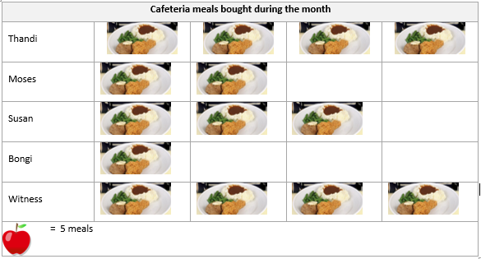
Graphical Representation of Data
Picture Graphs
A picture graph is also called a pictogram. It is mainly used when you want to display information about people or objects. This is the type of graph that will work very well in the ECD environment.

Slide 72
Graphical Representation of Data
1. How many meal did Witness buy? ……………………………….
2. Who bought the most meals? ………………………………………..
3. Who bought the least meals? ………………………………………..
4. How many meals were sold during the month? ……………..

Slide 73
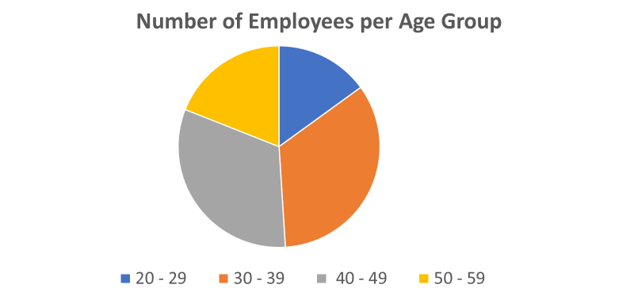
Graphical Representation of Data
Pie Chart
A pie chart can easily be populated from data that was captured on a spreadsheet. The full circle represents the complete sample that was investigated, thus 100%. The size of each slice shows how much of the total the slice represents in a percentage. A pie chart is used to illustrate proportions of the total amount.

Slide 74
Graphical Representation of Data
The disadvantages of a pie chart is that if it is not distinctly labelled then the viewer may not have an idea of how big the actual sample was and of how big each proportion was.
Use the pie chart to answer the following questions.
Which age group has the least employees? …………………………….
Which age group has the most employees? ……………………………..
You would like the organisation to grow during the next year and you have decided to focus on specific age groups in your next intake. Which groups would you focus on? .......................................................................

Slide 75
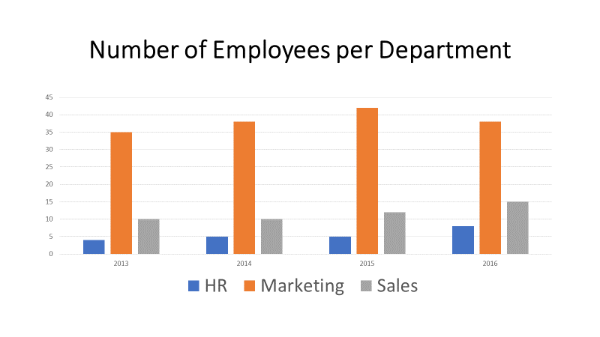
Graphical Representation of Data
Bar Graph (Bar Chart)
Bar charts could also easily be generated from data that was recorded in a spreadsheet. Bar charts are normally used when we want to compare data. There are many types of bar charts or column charts, but they should have uniform width, spacing and a zero value. Bar graphs are used when there is no continuity between data groups.

Slide 76
Graphical Representation of Data
Use the bar chart to answer the following questions:
With how many people did the HR department grow? …………………………………………..
During which year did the organisation employee the most marketers?…………………….
With how many employees did the sales team grow? …..………………………………………….

Slide 77
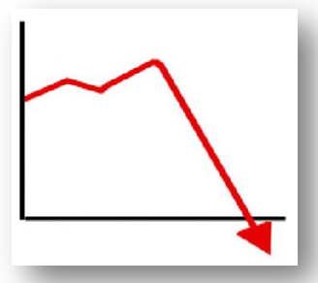
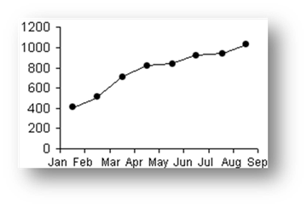
Graphical Representation of Data
Line Graph
A line graph is used to show changes through time or space In this graphs points are joined by straight lines. The vertical heights of the points above the horizontal axis are proportional to the quantities they represent.
Broken line graphs are usually used where there is some connection between the individual pieces of data.

Slide 78
Probability in Data
Probability is, in essence the mathematics of chance. It will give us an answer to the question: How sure are we that a particular event is going to happen?
There are some things that we are sure that will definitely happen, e.g. when we go to bed at night, we can be sure the sun will rise the next morning. If today is Sunday, then we can be certain that tomorrow is Monday.
There are however cases where there is a lower or no chance that something will happen. For instance, the chance of seeing an elephant in the middle of town is very low, but it could happen if the circus was in town. The probability of these events lies between 0 and 1. A probability of ½ means that there is a 50 – 50 chance of it happening.

Slide 79
Probability in Data
There are some events that will never happen. For example the chance of throwing a 10 on a normal die is 0%. A normal die only goes up to 6. So the probability of this is 0.
Probability scale
0 | ½ | 1
Impossible | Even | Certain
In weather forecasts, probability of rain is indicated as percentages.

Slide 80
Probability in Data
Making Predictions
Once we have collected data and carefully analysed patterns we can base predictions upon the analysis of the recurring events. In Mathematics predictions are best referred to as forecasting which is making an educated guess based on recurring patterns of activity.
Let’s say your organisation has decided to start a community garden as part of a community outreach. You have planted 25 cabbage seedlings, but only 5 grew into large cabbages. So it is safe to presume that under similar conditions it is possible to repeat this 5 out of 25 (or the odds being 1 out of 5) when you plant cabbage seedlings again. Of course, this may not be able to be repeated all of the time, but it can provide a clear idea of a credible prediction that is based on some form of empirical evidence.
.

Slide 81
Probability in Data
Example 1
We place ten red balls and ten yellow balls in a bucket. Sihle has to take ten balls from the bucket while being blindfolded. What are the chances that Sihle will pick up a yellow ball?
The chances are the following:
There are 20 possible or expected outcomes, and all are equally likely. If Sihle takes a yellow ball you get a favourable outcome. There are 10 chances out of 20 that Sihle will take yellow balls from the bowl.
.

Slide 82
Probability in Data
Example 2: Probability of a single event
The following formula can be used to determine the probability of a single event:
Probability of a single event = Number of ways in which an event can occur
Number of possible outcomes
Michael’s house has 1 lounge, 2 bathrooms, I kitchen and 3 bedrooms. There are thus seven possible outcomes. (1 + 2 + 1 + 3 = 7).
.

Slide 83
Probability in Data
1.What is the probability that Michael is in the kitchen?
Probability = Number of ways in which an event can occur
Number of possible outcomes
= 1/7
2.What is the probability that Michael is in a bedroom?
Probability = Number of ways in which an event can occur
Number of possible outcomes
= 3/7
.

Slide 84
Calculations and the Use of Statistics
Working with Averages
Calculating the average of data gives us a well-balanced picture of what the standard is.
We constantly compare ourselves with some type of average, e.g. the average height or weight of others in our age group or even the performance of others in a test. The list of comparisons is endless.
The average is calculated by establishing the middle point of any data being handled.
This will give us an indication of whether the data we are calculating is average, below average or above average

Slide 85
Calculations and the Use of Statistics
Example 1
You have written 5 tests and have scored the following percentages for the tests:
Test 1= 45%; Test 2 = 63%; Test 3 = 59%; Test 4 = 74% and Test 5 = 85%
What is your average mark for all the tests?
Find the average:
Add all the percentages: 45 + 63 + 59 + 74 + 85 = 326
Divide the total of percentages by the number of tests written : 326 ÷ 5 = 65.2
Your average for the tests is thus 65.2%

Slide 86
Calculations and the Use of Statistics
Example 2
Mrs Mbuli works in the HR department. She has 9 employees. Their ages are as follows:
21; 29; 31; 42; 54; 38; 46; 35; 51
What is the average age in the HR department?
Add all the ages: 21 + 29 + 31 + 42 + 54 + 38 + 46 + 35 + 51
Divide the total of ages by the number of children in the class: 347 ÷ 9 = 38,6
The average age is 38,6

Slide 87
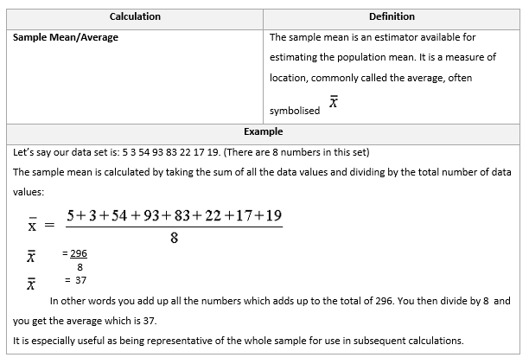
Calculations and the Use of Statistics

Slide 88
Calculations and the Use of Statistics
Median
It sometimes happens that we want to know which value of a set of numbers lies in the middle of the set.
We then have to determine the median.
In order to do this we have to first organise the data into order of numerical value.
From smallest number to the biggest number and then determine which number falls in the middle

Slide 89
Calculations and the Use of Statistics
Example 1
You have been given the following data. You will note that there is an odd number of data.
10; 12; 3; 8; 20; 8; 5; 13; 17; 19; 4; 7; 11; 10; 12; 9; 14
What is the median of the data?

Slide 90
Calculations and the Use of Statistics
Organise the numbers from the lowest to the highest:
3; 4; 5; 7; 8; 8; 9; 10; 10; 11; 12; 12; 13; 14; 17; 19; 20
Count how many numbers you have. In this it is an odd number = 17
Determine the median. This is the number that lies in the middle of the organised set of data. This means that there will be an equal number of data below and above the median.
You could divide 17 by 2: e.g. 17 ÷ 2 = 8.5. You median will thus fall on the 9th value
3; 4; 5; 7; 8; 8; 9; 10; 10; 11; 12; 12; 13; 14; 17; 19; 20
10 is the median. There are thus 8 numbers below the median and 8 numbers above the median

Slide 91
Calculations and the Use of Statistics
Example 2
Determine the median of the following data.
19; 27; 11; 7; 14; 22; 1; 5; 7; 25; 6; 10; 23; 19; 16; 25; 9; 26; 20; 17
Organise the data from lowest to highest number:
1; 5; 6; 7; 7; 9; 10; 11; 14; 16; 17; 19; 19; 20; 22; 23; 25; 25; 26; 27
Count how many numbers you have = 20
Determine the median. In this case it is an even number of data. 20 ÷ 2 = 10.
1; 5; 6; 7; 7; 9; 10; 11; 14; 16; 17; 19; 19; 20; 22; 23; 25; 25; 26; 27
The median thus falls hallway between 16 and 17. Thus 16 + 17 = 33
Median is 33 ÷ 2 = 16.5

Slide 92
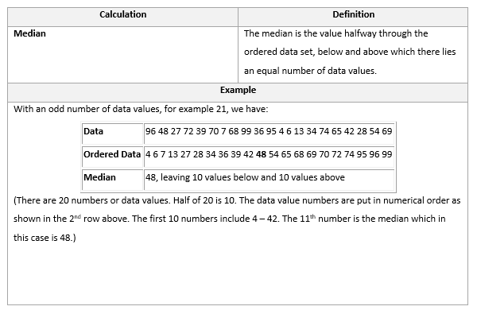
Calculations and the Use of Statistics

Slide 93
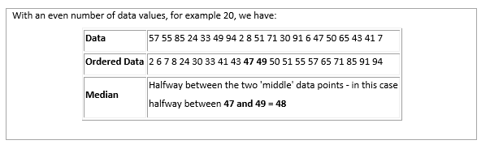
Calculations and the Use of Statistics

Slide 94
Calculations and the Use of Statistics
The Mode
When you look at a set of data. You will see that it mostly consists of a number of different values, but you will also note that there are some values that are repeated.
These numbers that are repeated are called the mode.
You might find that this is the case when you look at test results of a number of learners.
There may be a number of learners who scored exactly the same results in the test. That could lead to a number of different conclusions, e.g. the test was too easy, or the test was too difficult or some learners may have cheated. This would warrant further investigation.

Slide 95
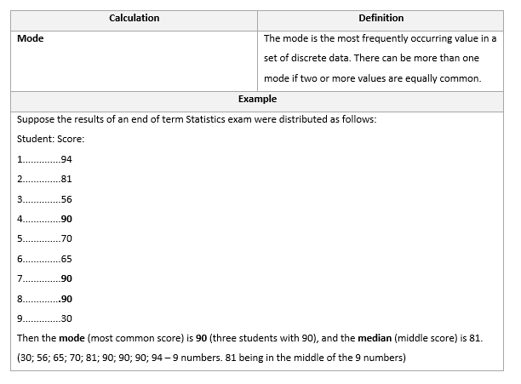
Calculations and the Use of Statistics

Slide 96
Problems Related to Data and Sampling
There are two separate types of errors than can affect our results. These errors are called ‘sampling errors’ and ‘non-sampling errors’.
Sampling errors are errors:
Caused by the act of taking a sample
That cause sample results to differ from the results of a census/population
Non-sampling errors are errors that :
Are not related to the act of selecting a sample
May even be present in a census

Slide 97
Problems Related to Data and Sampling
Answers You Need to Know
In order to develop critical thinking on all issues and become a participating citizen contributing toward the future of South Africa, you must ask the following questions when confronted with statistical results.
Needless to say, if you are reporting on some issue and wish to use statistics, you would need to include the following points in your report.

Slide 98
Problems Related to Data and Sampling
What was the population? That is, whose opinions were being sought?
How was the sample selected? Look for mention of random sampling or probability sampling.
What was the size of the sample? Look for a measure of precision (margin of error) and confidence (95%).
How were the subjects contacted?
When was the survey conducted? Was the survey conducted just after some event that may have influenced opinion and responses?
What were the exact questions asked?

Slide 99


Assessments
Complete Formative Activity 1 in your PoE
Do the Knowledge Questionnaire 1 in your PoE.

Slide 100
STUDY UNIT 2
REPRESENT ANALYSE AND CALCULATE SHAPE AND MOTION

Slide 101
An Introduction to Measurement and Geometry
Measurement and geometry are essential aspects of mathematics.
Many of the concepts you have learnt previously will be required as essential embedded knowledge.
Whenever you are faced with solving problems, always draw a rough sketch to assist you in understanding all the elements in the problem.
You need not be an artist or draw rigidly to scale. A rough being able to “see” the problem through drawing a rough sketch, your problem-solving skills and insight will increase at once.

Slide 102
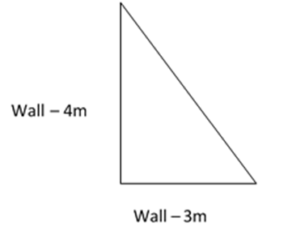
An Introduction to Measurement and Geometry
Example:
You want to fence a portion of your garden to keep the dogs out. The sides are 3m and 4m. How long is the new fence?

Slide 103
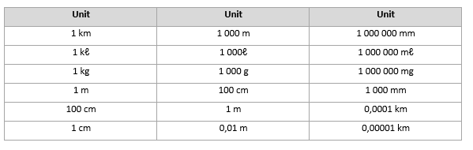
Measuring and Calculating Physical Quantities
Converting Measurement
It is very often also necessary to convert measurements to one common unit of measurement to make sure that the calculations are done correctly. The following table can be used as a guideline to help you to do accurate conversions.

Slide 104
Measuring and Calculating Physical Quantities
Physical Quantities
A physical quantity refers to a specific way in which matter or energy can be repeated or quantified (measured).
The basic measurements of physical entities are:
Length
Mass
Time

Slide 105
Measuring and Calculating Physical Quantities
Combinations of these entities allow one to measure a variety of observations, for example:
The distance between two points is a length
The number of tiles needed to cover the SURFACE of a living room, is calculated as length x length
Water is pumped as litres per second, which is calculated as length x length x length per second

Slide 106
Measuring and Calculating Physical Quantities
It is very important to use the correct instruments to take measurements.
It is impossible to measure the distance between two towns with a tape measure, but a ruler can be used to measure the diameter of a soccer ball.
The accuracy with which measurements are taken is directly linked to the reason for taking the measurements.
For instance, when doing a scientific experiment it is very important to take measurements extremely accurate.

Slide 107
Measuring and Calculating Physical Quantities
There are a large number of physical quantities that can be measured in mathematics and the following are but a few of these:
Length
Length refers to the space or distance between two particular points.
Example
Peter is 1,69m tall. His length is determined by measuring the space from the bottom of his feet (point A) to the top of his head (point B).

Slide 108
Measuring and Calculating Physical Quantities
Mass and Weight
People often use these two terms as if they were identical, and although it does not matter for everyday use, there is a difference between mass and weight.

Slide 109
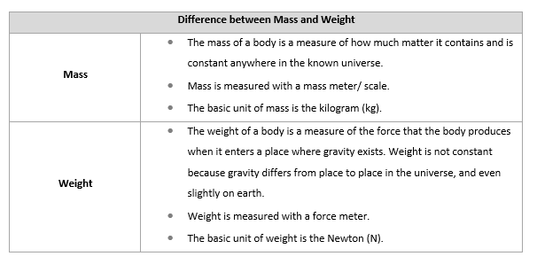
Measuring and Calculating Physical Quantities

Slide 110
Measuring and Calculating Physical Quantities
Speed and Acceleration
Speed | The speed of an object is the rate of change of its distance with respect to time. Put in simpler terms, speed is how fast an object is moving.
Example
You travel from Johannesburg to Cape Town (a distance of approximately 1400km). You leave Johannesburg at 06:00 on the Friday morning and arrive in Cape Town at 22:00 the Friday evening. You have travelled 1400km at an average speed of 87,5km per hour.

Slide 111
Measuring and Calculating Physical Quantities
Acceleration | The acceleration of an object is the rate of change of its speed with respect to time. Acceleration has both speed and direction. To completely understand acceleration, it is necessary to understand what velocity is. Velocity is the rate at which an object changes position. It is speed with direction.

Slide 112
Measuring and Calculating Physical Quantities
Example
A good example of acceleration is when you are standing at a red traffic light and it turns green. You accelerate by increasing the force on the accelerator. To decelerate, one takes one’s foot off the accelerator and puts pressure on the brake pedal.
To illustrate velocity, do the following:
Stand up and take one step forward
Now take one step back to your original position
Your position does not change, even though you are putting out energy. However, to maximise your velocity, you need to make an effort to move forwards, backwards or sideways (note the direction) and place yourself in another direction.

Slide 113
Measuring and Calculating Physical Quantities
Now do the following:
Stand up and take three steps forward
Now take one step back
In this case your displacement, or velocity, is two steps forward.
You need at least two of the following elements to calculate acceleration:

Slide 114
Measuring and Calculating Physical Quantities
Thus:
Displacement = Velocity multiplied by time (vxt)
Velocity = Displacement divided by time (d÷t)
Time = Displacement divided by velocity (d÷v)

Slide 115
Measuring and Calculating Physical Quantities
Estimating the Measure of Quantities
Estimation is an important process, as it often leads to better planning of the solution to a problem and provides a way of checking to make sure whether an answer at least makes sense.
Example
To estimate lengths, rather inaccurate but conventional measures are used:
The length of a good stride is approximately one meter
The span of a hand is approximately 20cm
The area of two soccer fields is approximately 1 hectare

Slide 116
Measuring and Calculating Physical Quantities
Accuracy and Precision in Measurement
Accurate measurement has become an important element of people’s daily lives.
People are already aware that no measurement is ever exact.
The reason for this lies in what we are measuring , how we are measuring it and the instrument that is used to make that measurement. The best accuracy anyone can claim is half of the least measurement being taken.

Slide 117
Measuring and Calculating Physical Quantities
What does this mean?
When a measurement is given as 16cm, this means that the object being measured is closer to 16cm than to either 17cm or 15cm. thus the greatest length the 16cm could be is less than 16,5cm and the least length it could be is 15,5cm.
All measurements are affected by inaccuracies, e.g. when you weigh a toddler, you will get different readings if you weigh the child on different scales and in different places. The speedometer on your car either under reads the speed you are driving or it over reads the speed.
The allowed difference between an accurate reading and an inaccurate reading is called the tolerance.

Slide 118
Measuring and Calculating Physical Quantities
Tolerance
Tolerance is the variation in measurement for a particular measuring device that can be allowed. The tolerance allowed on measuring devices varies according to the quantity being measured and the nature of the device.
Example
The butchers’ scales have an approximate tolerance of 7 grams for 4,5 kilograms.
Every measurement has some potential for error. The difference between the stated measurement and the true value is defined as the error.
Error = Measured Value – True Value

Slide 119
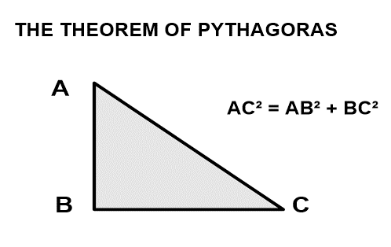
Measuring and Calculating Physical Quantities
Heights and Distances
A useful tool in the calculation of heights and distances is the ‘theorem of Pythagoras’, which states that in any right-angled triangle, the square on the hypotenuse (the longest side) is equal to the sum of the squares on the other two sides

Slide 120
Volumes and Surface Areas
Surface Area
The area of a surface of an object is referred to as the surface area.
There are two dimensions or proportions to the surface area of an object – the length and the breadth, or width.
The length refers to the longer side while the breadth refers to the shorter side of the object.

Slide 121

Volumes and Surface Areas
Example
Look at the rectangle below. The dark outer lines show the perimeter of the figure, while the coloured section shows the area that the rectangle takes up
The formula for calculating the Area of a rectangular object:
Area = Length x Breadth
A = l x b

Slide 122
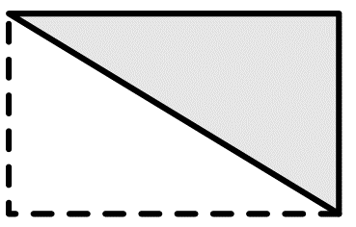
Volumes and Surface Areas
Surface Area of a Triangle
When looking at the triangle below and it is doubled up, one can see that it is really half of a rectangle.
The surface area of a triangle will therefore be half of the surface area of that of a rectangle. However, instead of using the term “breadth”, rather refer to the height of the triangle and instead of the “length”, refer to the base of the triangle.
The formula for calculating the surface of a triangle:
Area of a triangle = ½ base x height

Slide 123
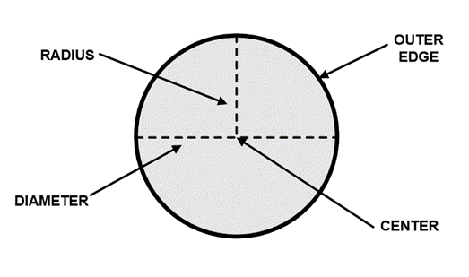
Volumes and Surface Areas
Surface Area of a Circle
Before working out the surface area, you first need to refresh your knowledge of the circle.
The outer edge is also called the circumference.
If a number of lines are drawn from the centre of the circle to the outer edge, all the lines will be equal in length. These lines are called the radius of the circle.

Slide 124
Volumes and Surface Areas
Example
What is the surface area of a circle with a diameter of 12 meters?
Diameter = 12 meters (remember radius is used in the formula)
Radius = diameter / 2
Radius = 12/2
= 6 meters
pi = 3,14
Area of a circle = π r²
= 3,14 x (6m)²
= 3,14 x (6 x 6)(m x m)
= 3,14 x 36 x m²
= 113,04 m²

Slide 125
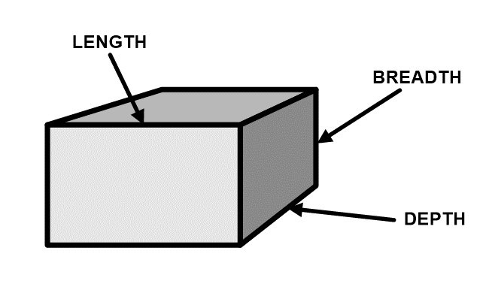
Volumes and Surface Areas
Volume
The volume of an object refers to how much can fit into the object and requires another dimension to be added, which is height or sometimes called depth.
Volume of a Rectangle

Slide 126
Volumes and Surface Areas
Example
A publishing company sends their books with a courier to various bookshops. They need to find boxes that are large enough to pack the books in.
They must have the following dimensions:
• length = 310 mm
• breadth = 465 mm
• depth = 534 mm
Formula for calculating the volume of a rectangle:
Volume = length x breadth x height
Or
Volume = area x height

Slide 127
Volumes and Surface Areas
Volume = length x breadth x height
= 310 mm x 465 mm x 534 mm
= 144 150 mm² x 534 mm
= 76 976 100 mm³
The numbers would be easier to handle if they are converted to cm
= 3, 1 cm X 4, 65 cm x 5,34 cm
= 14,415 cm² x 5, 34 cm
= 76, 9761 cm³

Slide 128
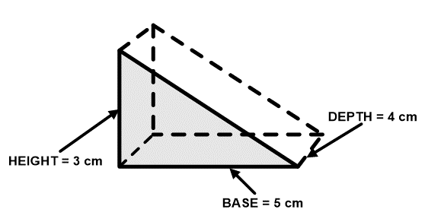
Volumes and Surface Areas
Volume of a Triangle
Once the concept of volume is understood, it does not matter what shape is given, as long as its area can be worked out, its volume can be calculated.
A three-dimensional triangle is referred to as a triangular prism.
Formula for calculating the volume of a triangle:
Volume = ½ base x height x depth

Slide 129
Volumes and Surface Areas
Example
Calculate the volume of a triangle with a base of 5 cm and a height of 3 cm.
Area of a triangle = ½ base x height
= ½(5 cm) x 3 cm
= 2,5 cm x 3 cm
= 7,5 cm²
To calculate the volume of a triangle, the area of the triangle must be multiplied by the depth:
Volume of a triangle = area x depth
= 7,5 cm² x 4 cm
= 30 cm³

Slide 130
Volumes and Surface Areas
Volume of a Circle
A circle with a volume is called a cylinder. The formula for calculating the volume stays the same, that is:
The formula for calculating the volume of a cylinder:
Volume of a cylinder = area x depth

Slide 131
Volumes and Surface Areas
Example
Area of a cylinder = π r²
= 3,14 x 2,5m (radius is ½ x diameter)
= 7 85 m²
Volume of a cylinder = area x depth
= 7,85 m² x 1,5m
= 11,775 m³

Slide 132
Use Symbols and Units in Accordance with SI Conventions
At the heart of the SI is a short list of basic units defined in an absolute way without referring to any other units. In all there are seven SI base units:
The metre for distance
The kilogram for mass
The second for time
The ampere for electric current
The kelvin for temperature
The mole for amount of substance
The candela for intensity of light
Other SI units, called SI derived units, are defined algebraically in terms of these fundamental units.

Slide 133
Use Symbols and Units in Accordance with SI Conventions
Example
The SI unit of force, the newton, is defined to be the force that accelerates a mass of one kilogram at the rate of one metre per second This means the newton is equal to one kilogram metre per second squared, so the algebraic relationship is N=kg·m·s

Slide 134
Use Symbols and Units in Accordance with SI Conventions
Using Measuring Instruments
Measuring instruments show the number of measurement units involved in whatever is being measured, e.g. a micrometer can measure the thickness of paper or thin metal foil to 0.03 millimetres.
Each kind of quantity is measured using a certain kind of measuring instrument:
Thermometers measure temperature
Balances and scales measure weight
Clocks measure time
Ammeters and voltmeters measure electricity

Slide 135
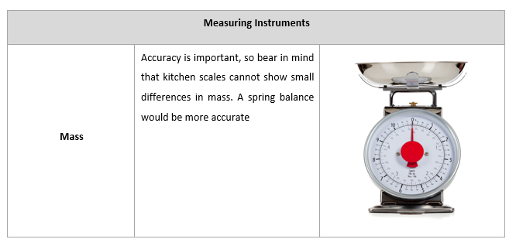
Use Symbols and Units in Accordance with SI Conventions

Slide 136
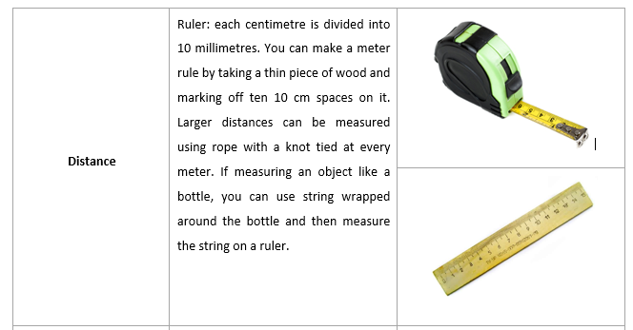
Use Symbols and Units in Accordance with SI Conventions

Slide 137
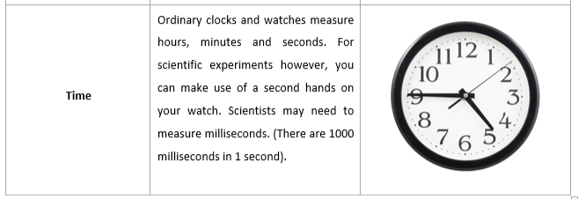
Use Symbols and Units in Accordance with SI Conventions

Slide 138
Use Symbols and Units in Accordance with SI Conventions
The measurements discussed thus far are made using measuring instruments. Graphic instruments can also be used in scientific studies.
These include cameras, microscopes and telescopes (where an entire picture is presented).
We have established that accurate measurement plays an important part in science.
Quantities measured include electric current, length, temperature, time and weight. Most other measured quantities are related to these basic ones.

Slide 139
Use Symbols and Units in Accordance with SI Conventions
Example
A Speedometer measures speed by measuring the basic quantities length over distance and time.
Most scientific instruments have three things in common:
A transducer: Gives the quantity being measured
A scale of values: Provides a comparison with the output of the transducer
A readout: Gives the result of the instrument reading

Slide 140
Use Symbols and Units in Accordance with SI Conventions
Example
A thermometer has a glass tube containing alcohol or mercury as a transducer.
The numbers along the tube are the scale of values.
The position of the alcohol or mercury along the numbers provides the readout that tells you what the temperature is.

Slide 141
Use Symbols and Units in Accordance with SI Conventions
Using a Meter Stick
A common mistake in using a meter stick is to position the stick against the object to be measured as illustrated in the picture below.
Such a procedure introduces the possibility of two types of measuring errors:
Parallax
Zero error

Slide 142
Use Symbols and Units in Accordance with SI Conventions
Parallax
Parallax occurs when there is the change in apparent position when an object is viewed from two separate points.
If you hold up two fingers in line with your nose and move your head from side to side while viewing them, you will notice an exchange in the relative position of the fingers as you change your point of view. This is parallax.
In the case of a meter stick placed as in the diagram below, if you do not look straight at the scale, any distance between the scale and the object to be measured will shift the apparent value, meaning that different values will be obtained from different positions.

Slide 143
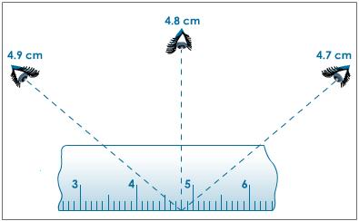
Use Symbols and Units in Accordance with SI Conventions
Illustration of parallax error caused by improper placement and or viewing of meter stick.
To avoid parallax, scale of the measuring instrument should be placed as closely as possible to the object being measured.

Slide 144
Use Symbols and Units in Accordance with SI Conventions
Zero Error
Zero error occurs when the normal zero position of a measuring device is incorrect.
For instance
when a meter stick is worn at the end
a balance does not read zero when empty. or
the jaws of a calliper meet improperly
To avoid such errors with a meter stick, one can avoid using the end altogether. Choose an arbitrary mark as the “zero” from which to make all measurements.

Slide 145
Use Symbols and Units in Accordance with SI Conventions
Check to see that the zero position is correct for devices like vernier callipers, micrometers and balances. Such devices should read zero when closed and they should close completely.
Check balances to see that they read zero when empty.
You may be able to adjust the device correctly for zero error, but usually it is easier to record the error and use it as the zero mark for all measurements.

Slide 146
Use Symbols and Units in Accordance with SI Conventions
Reading a Vernier Scale
The vernier scale, which is used in measuring lengths and angles, has a short scale or ruler, which slides along a longer scale. The Vernier will not readily be used by ordinary people or ECD practitioners, but it is always good to know that there are more instruments that can be used for measurement.
It was named after Pierre Vernier, a French mathematician who invented it in the 1600’s. Engineers often use callipers with a vernier attachment for measurements.
A vernier is an auxiliary scale on a measuring instrument which makes it possible to accurately read fractional divisions of the main scale. A common form of vernier in the metric system has 10 divisions on the vernier scale covering nine divisions on the main scale.

Slide 147
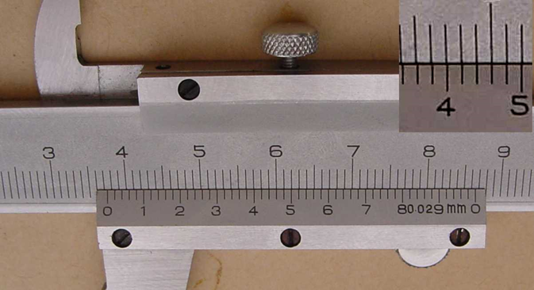
Use Symbols and Units in Accordance with SI Conventions
If the smallest main scale division is 1mm, then the vernier scale is 9mm long and each division of the vernier scale is 0.9mm. That is, a vernier scale division is 0.1mm shorter than a main scale division.
In general, the divisions on a vernier scale cover (n-1) divisions on the main scale. The difference in length between a vernier division and a main scale division is 1/n times a main scale division. This is called the least count of the instrument. For instance, the least count of the device illustrates is: 1/10x1m = 0.1mm.

Slide 148
Use Symbols and Units in Accordance with SI Conventions
If zero on the vernier coincides with the five-division mark on the main scale, the first vernier mark will be 1/10 of a main scale division to the left of the main scale six-division mark.
The second vernier mark will be 2/10 to the left of the next main scale mark, and so forth.
Consequently, if the vernier were moved ahead so that the second vernier mark lined up with the seven-division mark on the main scale, the zero vernier mark would be 2/10 of a main scale division to the right of the five-division mark on the main scale.
The reading would then be 5.2 as illustrated in the right part of the figure.

Slide 149
Use Symbols and Units in Accordance with SI Conventions
To read a vernier, follow the following steps:
Determine the least count of the instrument. This is the smallest main scale division divided by the number of vernier divisions (0.1mm in the above example).
Read the main scale division at or just to the left of the zero mark of the vernier (5 in the above example).
Note which vernier division lines up with main scale division. Multiply the number of this vernier division by the least count and add this result to the main scale reading (5.0+ 2x 0.1 = 5.2mm in the example above).

Slide 150
Use Symbols and Units in Accordance with SI Conventions
Using a Micrometer Calliper
A micrometer is an instrument for measuring small dimensions, often used by surveyors.
A micrometer calliper has a micrometer screw attached to it. This can be closed on the object being measured and, by turning the screw, measurements can be made to 0.0025 millimetres.
A micrometer calliper is essentially a precision screw mounted in an open frame with suitable scales. Instead of using a vernier scale to improve precision, a micrometer uses two scales: a barrel scale and a circular scale.

Slide 151
Use Symbols and Units in Accordance with SI Conventions
In taking measurements with the micrometer, several precautions are necessary.
Often, two turns of the thimble are required to advance one division along the barrel scale, so you will need to be aware of whether one of these turns has already been made when reading the circular scale.
For instance, a micrometer with mm markings on the barrel scale and 50 divisions on the circular scale, but which requires two turns to advance one unit along the main scale has a least count of 1mm/(2x50) = 0.01mm.
A reading of “25” on the circular scale of such a micrometer thereof could mean either 0.25mm or 0.75mm (0.50 + 0.25). The operator must be able to discern these readings.

Slide 152
Use Symbols and Units in Accordance with SI Conventions
The threads of most micrometer screws are very delicate and easily distorted by forcing the jaws against the object being measured.
Even without distortion, different readings will result from different applied force of the micrometer jaws.
Most micrometers have a ratchet on the end which will slip when the proper force is applied. Use this ratchet to ensure constant pressure when taking measurements.
Another precaution is to check for zero error and to make suitable corrections. Most micrometers can be mechanically adjusted to eliminate zero error.

Slide 153
Using Maps
A world map is a map of the surface of the Earth, which may be made using any of a number of different map projections.
Maps of the world are often either:
Political- shows territorial borders or
Physical - show features of geography such as mountains, soil type or land use

Slide 154
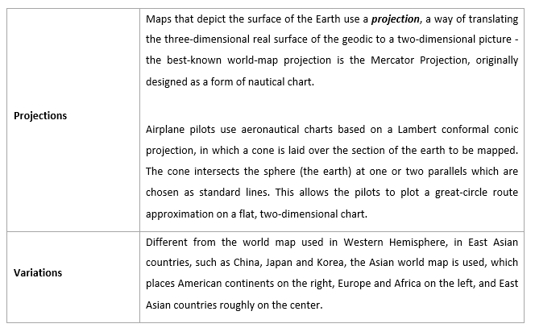
Using Maps

Slide 155
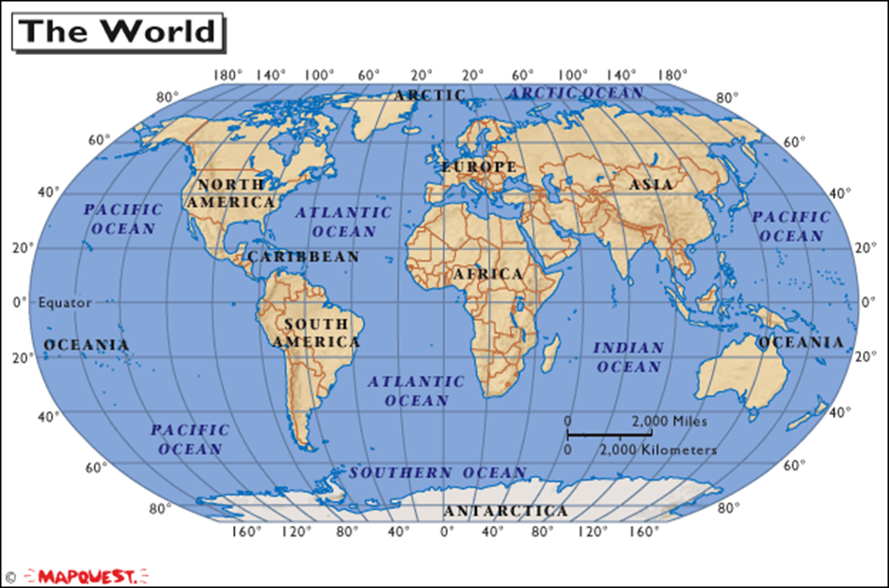
Using Maps

Slide 156
Using Maps
International Time Zones
Standard Time uses Greenwich, a borough of London, England as the zero degree meridian, or "Prime Meridian', and divides the world into 24 zones, from pole to pole.
Time is the same throughout each zone, and differs from the international basis of legal and scientific time, called "Co-ordinated Universal Time" (UTC), by a set number of hours.
In a few regions, however, the legal time kept is not the same as one of the 24 standard time zones because there are half-hour or quarter-hour differences there.

Slide 157
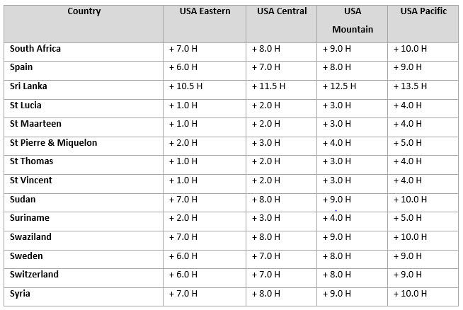
Using Maps
The following table gives an indication of how time differs in relation to areas of the USA.

Slide 158
Cartesian Co-ordinate System
In mathematics, the Cartesian co-ordinate system is used to determine each point uniquely in a plane through two numbers, usually called the x-co-ordinate and the y-co-ordinate of the point.
To define the co-ordinates, two perpendicular directed lines (the x-axis or abscissa and the y-axis or ordinate), are specified, as well as the unit length, which is marked off on the two axes.
Cartesian co-ordinate systems are also used in space (where three co-ordinates are used) and in higher dimensions.

Slide 159
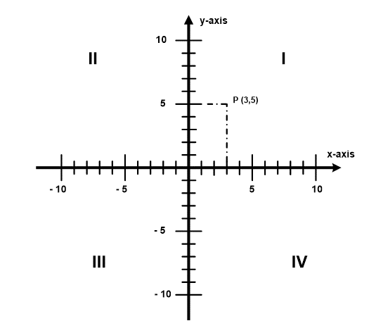
Cartesian Co-ordinate System
Two-dimensional Co-ordinate System

Slide 160
Cartesian Co-ordinate System
The arrows on the axes indicate that they extend forever in their respective directions (i.e. infinitely).
The point of intersection, where the axes meet, is called the origin normally labelled O.
The x and y axes define a plane that is referred to as the xy plane. Given each axis, choose a unit length, and mark off each unit along the axis, forming a grid.
To specify a particular point on a two dimensional co-ordinate system, indicate the x unit first (abscissa), followed by the y unit (ordinate) in the form (x,y), an ordered pair.

Slide 161
Cartesian Co-ordinate System
The choice of letters comes from a convention, to use the latter part of the alphabet to indicate unknown values. In contrast, the first part of the alphabet was used to designate known values.
An example of a point P on the system is indicated in the figure above, using the co-ordinate (3,5).
The intersection of the two axes creates four regions, called quadrants, indicated by the Roman numerals I (+,+), II (−,+), III (−,−), and IV (+,−). The quadrants are labelled anti-clockwise starting from the upper right ("northeast") quadrant.
In the first quadrant, both co-ordinates are positive, in the second quadrant x-co-ordinates are negative and y-co-ordinates positive, in the third quadrant both co-ordinates are negative and in the fourth quadrant, x-co-ordinates are positive and y-co-ordinates negative.

Slide 162
Scale Drawings
A map cannot be of the same size as the area it represents. So, the measurements are scaled down to make the map of a size that can be conveniently used by users such as motorists, cyclists and bushwalkers.
A scale drawing of a building (or bridge) has the same shape as the real building (or bridge) that it represents but a different size. Builders use scaled drawings to make buildings and bridges.
A ratio is used in scale drawings of maps and buildings.
That is:
The scale of a drawing – Drawing length: Actual length
Likewise, we have:
Map scale - Map distance: Actual distance

Slide 163
Scale Drawings
A scale is usually expressed in one of two ways:
Using units as in 1 cm to 1 km
Without explicitly mentioning units as in 1 : 100 000.
Note: A scale of 1 : 100 000 means that the real distance is 100 000 times the length of 1 unit on the map or drawing.
Example 1
Write the scale 1 cm to 1 m in ratio form.
Solution:
1cm to 1m = 1cm : 1m
= 1cm : 100cm
= 1 : 100

Slide 164
Scale Drawings
Geometrical Relationships
In the following section we look at the properties of geometrical shapes.
Lines
A straight line is a one-dimensional shape as it has only length.
A●-------------------------------------------------------------------------●B
Angles
When two straight lines meet, an angle is formed,
A, B, C and D are all angles

Slide 165
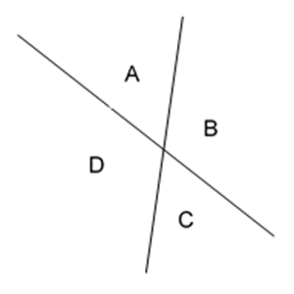
Scale Drawings
There are a number of different angles, which are described below:

Slide 166
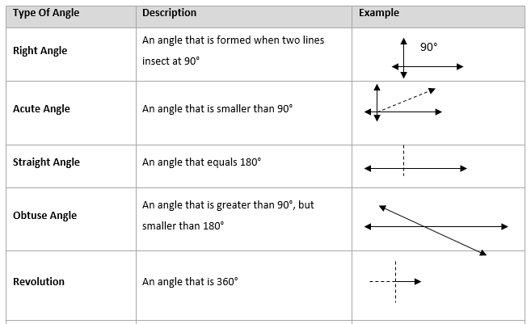
Scale Drawings

Slide 167
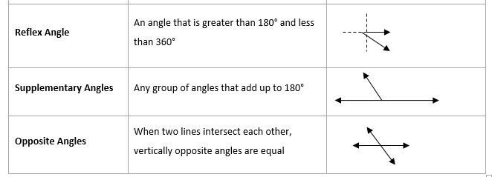
Scale Drawings

Slide 168
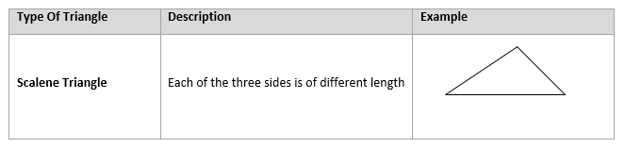
Triangles
When lines meets each other, they create shapes. A shape made by three lines is called a triangle.
A triangle always have three interior angles.

Slide 169
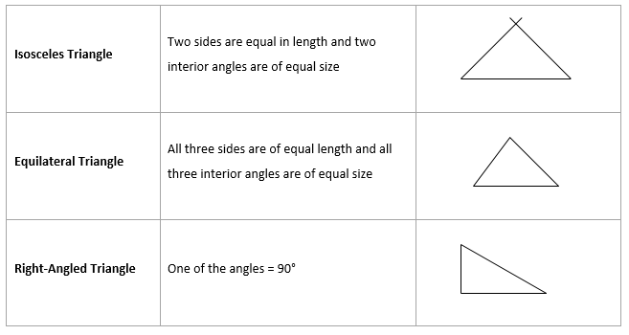
Triangles

Slide 170
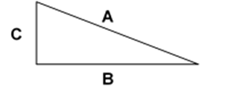
Triangles
Remember these theorems:
The sum of the interior angles of any triangle = 180° (supplementary).
When one side of a triangle is extended, an exterior angle is formed which is always equal to the sum of the two interior angles.
In any right-angled triangle, the square of the longest side is equal to the sum of the squares of the two other sides.
Thus:
In ∆ABC: A² = B² + C²

Slide 171
Triangles
Example
If line C = 3 cm and line B = 2 cm, then
A² = B² + C²
A² = 2² + 3²
A² = 4 + 9
A² = 13
A = √13
A - 3,6055512

Slide 172
Tessellations
A tessellation is created when a shape is repeated over and over again, covering a plane without any gaps or overlaps. Another word for a tessellation is a tiling.
A dictionary will tell you that the word "tessellate" means to form or arrange small squares in a checked or mosaic pattern. The word "tessellate" is derived from the Ionic version of the Greek word "tesseres," which in English means "four." The first tilings were made from square tiles.

Slide 173
Tessellations
Calculating Tesselations
A regular polygon has three, four, five or more sides and angles, all equal.
A regular tessellation means a tessellation made up of congruent regular polygons.
Regular means that the sides and angles of the polygon are all equivalent (i.e., the polygon is both equiangular and equilateral).

Slide 174
Tessellations
Congruent means that the polygons that you put together are all the same size and shape. Only three regular polygons tessellate in the Euclidean plane:
Triangles
Squares
Hexagons
We can't show the entire plane, but imagine that these are pieces taken from planes that have been tiled. Here are examples on the next slide:

Slide 175
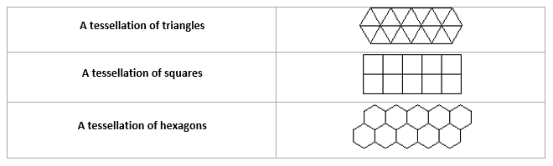
Tessellations
When you look at these three examples you can easily notice that the squares are lined up with each other while the triangles and hexagons are not.
Also, if you look at six triangles at a time, they form a hexagon, so the tiling of triangles and the tiling of hexagons are similar and they cannot be formed by directly lining shapes up under each other - a slide (or a glide!) is involved.

Slide 176
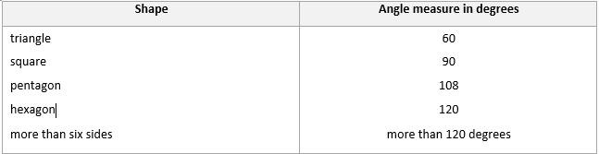
Tessellations
You can work out the interior measure of the angles for each of these polygons:

Slide 177
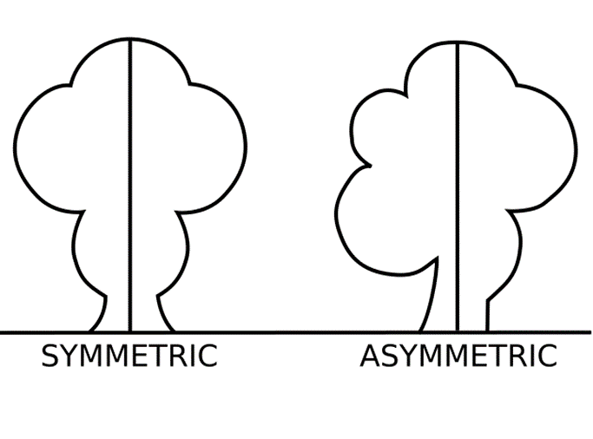
Symmetry
Symmetry is when one shape becomes exactly like another if you flip, slide or turn it.
The simplest type of Symmetry is "Reflection" (or "Mirror") Symmetry, as shown in this picture below.

Slide 178
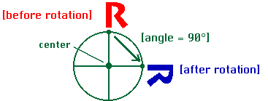
Symmetry
Rotation
To rotate an object means to turn it around. Every rotation has a center and an angle.

Slide 179
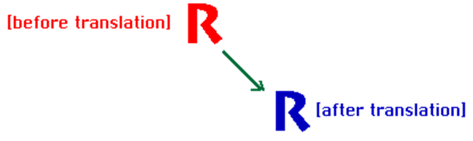
Symmetry
Translation
To translate an object means to move it without rotating or reflecting it. Every translation has a direction and a distance.

Slide 180
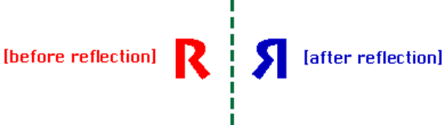
Symmetry
Reflection
To reflect an object means to produce its mirror image. Every reflection has a mirror line. A reflection of an "R" is a backwards "R".

Slide 181
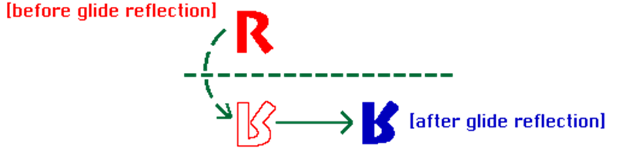
Symmetry
Glide Reflection

Slide 182
Symmetry
A glide reflection combines a reflection with a translation along the direction of the mirror line. Glide reflections are the only type of symmetry that involve more than one step.
Symmetries create patterns that help us organise our world in our minds (conceptually).
Symmetric patterns occur in nature, and are invented by artists, craftspeople, musicians, choreographers, and mathematicians.
In mathematics, the idea of symmetry gives us a precise way to think about this subject.
We will talk about plane symmetries, those that take place on a flat plane, but the ideas generalise to spatial symmetries too (symmetries in space).

Slide 183
Symmetry
Plane symmetry involves moving all points around the plane so that their positions relative to each other remain the same, although their absolute positions may change.
Symmetries preserve distances, angles, sizes, and shapes
For example, rotation by 90 degrees about a fixed point is an example of a plane symmetry.
Another basic type of symmetry is a reflection. The reflection of a figure in the plane about a line moves its reflected image to where it would appear if you viewed it using a mirror placed on the line. Another way to make a reflection is to fold a piece of paper and trace the figure onto the other side of the fold.
A third type of symmetry is translation. Translating an object means moving it without rotating or reflecting it. You can describe a translation by stating how far it moves an object, and in what direction.
The fourth (and last) type of symmetry is a glide reflection. A glide reflection combines a reflection with a translation along the direction of the mirror line.

Slide 184
Nets of Solids
Please see description of all solid shapes on page 93 of the Learner Guide.
Net Diagrams
Net of a Cube
Once you have chosen a net design, you need to draw it out.
Here is one of them as an example. Scale it up to the size you want, and put a tab on every other edge for gluing it together. It's certainly possible to make a cube from ordinary paper, but it will be fragile. Don't sit on it by mistake! You can also use thin card.
Draw out the design and cut it out carefully, using scissors that aren't blunt or covered with glue.
Before gluing, it is important to fold the design, and it's easier to do this if you score the lines first.
Use a ball-point pen to go over all lines in the design, including the tabs. The ball-point pen will make a mark, so if you can find a ball point pen that doesn't work, that will be perfect

Slide 185
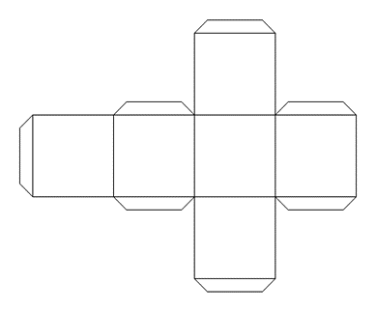
Nets of Solids
Press quite heavily with the point of the pen, but don't tear the paper.
Now fold the paper to make right angles, and you will see the cube start to appear. It doesn't matter which way you fold the design.
Once you have scored the edges with the ball-point pen, you will find it easy to fold it either way.
Use small dabs of glue to stick it, or it will end up very messy

Slide 186
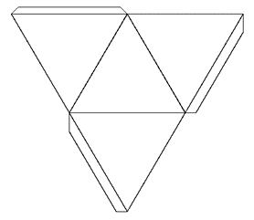
Nets of Solids
Net of a Tetrahedron
Net of Star
It is easy to make an attractive star.
Start with a shape such as an octahedron or a cube octahedron. Make this shape up and wait for it to dry
Now make the points. You will need one for each face.
Here are the nets for the cube octahedron, but you will need six of the four-sided points and eight of the three-sided points.
These don't make a solid, and there are tabs round the hole at the bottom. If you want, you can make a taller point, which will make a more pointy star.

Slide 187
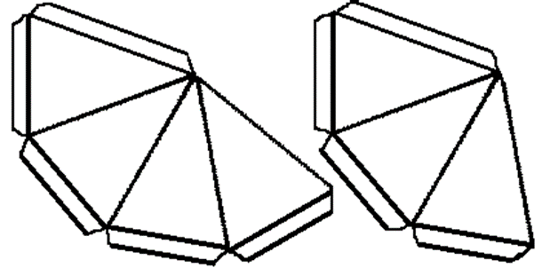

Nets of Solids
Experiment for yourself! Remember that the base of the point must match the edge of the original shape, and the triangles must be isosceles (with two sides the same).
Once you have made all the points, and allowed the glue to dry, carefully glue each one to each face of the original solid.
Do Formative Activity 2 in your PoE
Do the Knowledge Questionnaire 2 in your PoE.

Slide 188
STUDY UNIT 3
PLANNING AND CONTROLLING FINANCIAL INSTRUMENTS

Slide 189
Introduction
Previously, both the way in which annual accounts are prepared and the information they contain has been discussed.
Reading these accounts and understanding the story they tell is often useful and necessary to do as the absolute figures in the accounts are not particularly meaningful and they need to be put into context.

Slide 190
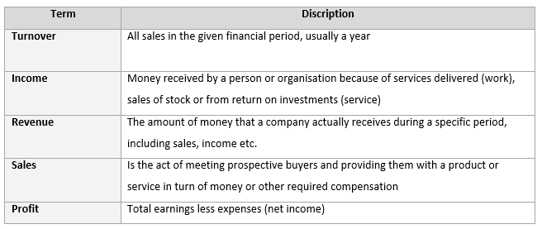
Terminology

Slide 191
Cash Flow / Liquidity
The gap between revenues and earnings is created by expenses. Operating expenses, or overheads, are the costs of doing business, such as paying employees, leasing space for an organisation running costs, such as electricity, water and food and marketing the organisation.
As with one-time gains, one-time losses should be excluded when looking at an organisation’s long-term prospects.
If expenses grow faster than revenues, earnings will shrink.
For a company that's growing rapidly, redirecting money to stimulate growth may make sense, but profits from the growth should be reflected in future earnings as revenues and expenses stabilise.

Slide 192
Cash Flow / Liquidity
Factors to be aware of:
Cash flow: A measure of how much money is flowing into the organisation minus how much is being paid out. It should grow with earnings.
Since cash flow looks at income without regard to fixed expenses, items such as taxes, interest and non-cash charges won't mask an organisation's ability to generate income from its core business.
Information about cash flow can generally be found along with the discussion about liquidity.
Credit: Ensure that the organisation is not allowing unusually high levels of credit.
Check accounts receivable to see how much the organisation is owed by clients who have purchased goods or services on credit.
This gets tallied as a current asset even though the organisation has not yet received payment

Slide 193
Cash Flow / Liquidity
Stock: Look for consistency in inventory levels.
Sudden jumps could signal overzealous production or shrinking demand in the marketplace.
This is especially worrisome in the high-tech sector, where technological advances can quickly turn today's leading-edge product into tomorrow's obsolete clunker.
To reduce stockpiles, management may have to offer steep discounts, which will cut into future earnings.
Research and Development (R&D):
If R&D expenditures fall, the company may become less able to keep up with competition.
Increases should be accompanied by new and improved services and teaching methods, otherwise the organisation may not be spending wisely.

Slide 194
Cash Flow / Liquidity
In addition to all the numbers, the entire set of financial statements, including notes, should be read to put the numbers in context with the organisation’s goals and strategies.
This section should offer explanations for any figures that seem out of line.
The financial outlook may also contain management's strategy on competition and industry trends that can affect business.

Slide 195
Cash Flow / Liquidity
It is vitally important that the liquidity indicators are observed closely.
The cash flow statements will already give a clear indication of the organisation’s liquidity position and this can be confirmed by examining the liquidity ratios.
However, do not assume that an organisation is about to go into liquidation when its current assets are less than its current liabilities.
Be aware of the timing when cash will be received and when it will be paid out.
The investment ratios of an organisation can also be addressed. Some of these incorporate data external to the organisation.

Slide 196
Analysis of Financial Statements
It is important to realise that the analysing of financial reports is as important as the financial statements itself, if not more important. It will have no sense to have financial statements for an organisation, if nobody knows how to interpret the different figures and to determine if the organisation has performed better or worse compared to the previous years.
Interpretation of accounts is a detailed explanation of the financial performance of an organisation incorporating the information contained within a set of financial accounts.
The basic procedure involves three main stages:
The collection of data
The analysis of the data collected
The interpretation of the results

Slide 197
Analysis of Financial Statements
Financial interpretation is concerned with an organisation’s financial health – both presently and in the future.
The following aspects can help this interpretation:
Profitability
Efficiency
Liquidity - can the business pay its dues?
Financial structure - is the split of financing between shareholders and borrowing sensible and safe?
Shareholder satisfaction

Slide 198
Analysis of Financial Statements
Analysing the Financial Strengths and Weaknesses of an Organisation
To establish the financial strengths or weaknesses of an organisation, management is required to judge the organisation’s financial results against industry standards, the previous year’s financial information and targets / goals / budgets. Financial ratios can also be used.
Industry standards: Financial information pertaining to businesses can be obtained by employing the services of a suitably qualified business advisor. Some larger organisations publish their information on the internet for easy access for their shareholders.
Previous financial results: This information is readily available in established businesses.
Budgets: Comparing budgets to actual expenses will indicate where variances occur and the reasons behind the variances can be investigated.

Slide 199
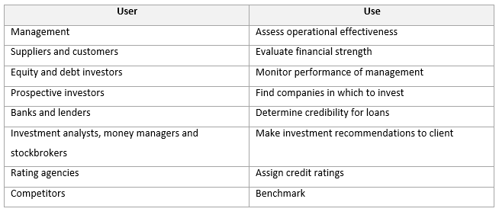
Analysis of Financial Statements
Financial statements are useful for the following:

Slide 200
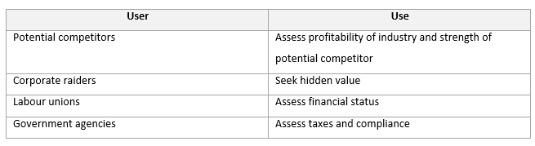
Analysis of Financial Statements
Financial statements are useful for the following:
It is not only the directors who should be interested in the financial ratios, but also the banks, as suppliers of funding, investors, creditors, etc.

Slide 201
Analysis of Financial Statements
For example a profit of R15 million might seem a large amount, but how does it compare with the forecasted and budgeted profit levels? How does it compare with last year’s actual profit? How does it compare with the results of similar companies/ competitors ?
These questions cannot always be answered from the accounts themselves. The figures have to be reworked and put into context. There are various ways of doing this but the most common is called Ratio Analysis.
Financial Ratios
Financial ratios are a simple, but effective way of analysing and interpreting financial statements. By calculating only a few ratios it is possible to determine the health of an organisation, without having to study complex sets of financial statements.

Slide 202
Analysis of Financial Statements
Financial ratios are calculated by expressing one figure (or sets of figures) from the financial statements in relation to another figure.
The results are sometimes expressed in % or it could be Rands, days or times per year.
These financial rations can be classified into the following major categories:
Liquidity ratios
Leverage or Gearing ratios
Activity ratios
Profitability ratios
Investment performance ratios

Slide 203
Analysis of Financial Statements
Value of Financial Ratios
Financial ratios should always be used with caution. Ratios frequently give an indication of the symptoms of a problem.
Further investigation or analysis is needed to identify the cause of the problem.
It is also important to compare financial ratios from year to year. In doing this, it actually becomes clear if the ratios are improving or not.
Ratios only have meaning if they can be compared with some kind of norm. For example, is a debt ratio of 60% good or bad?
If it is known that companies similar to the one being analysed have an average debt ratio of 40% and the lower ratio is the better option, it can be accepted that 60% is not good.

Slide 204
Analysis of Financial Statements
There are three norms used for comparison:
Cross sectional analysis: Comparing the company being analysed to companies of similar size and with similar markets (products).
Time series analysis: Comparing the company being analysed with its own performance over time.
Rules of thumb: Certain values, found to be consistent over time, have developed into norms themselves.

Slide 205
Financial Ratios Analysis
Liquidity Ratios
All current assets are eventually transformed into cash.
All current liabilities eventually have to be paid for with cash.
The source for the cash, which is needed to pay current liabilities, is current assets.
There should, therefore, always be sufficient current assets in relation to the level of current liabilities - this relationship is called liquidity
Liquidity refers to a firm's ability to meet its obligations over the short term, that is have the necessary cash available from cash reserves, cash sales and debtors to pay for sufficient stock and to make payments due to creditors.

Slide 206
Financial Ratios Analysis
These ratios measure the ability of the company to pay its current liabilities out of current assets.
Two ratios are commonly used to measure an organisation 's liquidity:
Current Ratio
The most commonly-used ratio is the current ratio, which is calculated by dividing current assets by current liabilities.
Current assets ÷ Current liabilities = Current ratio

Slide 207

Financial Ratios Analysis
Thus in this example each R1 of current liabilities is covered by R3.50 of current assets. Banks and short-term lenders look for a ratio of 2:1 in an average manufacturing concern – Tip Top Services is in an extremely healthy position.

Slide 208
Financial Ratios Analysis
Quick Ratio or Acid Test
This ratio gives an indication of the organisation 's ability to meet its obligations over the short term.
As stocks are the least liquid of all the current assets, a more conservative test of the ability of the organisation to meet its short-term maturing obligation is to subtract the stock figure from current assets and then divide the balance (more liquid assets) by current liabilities.

Slide 209
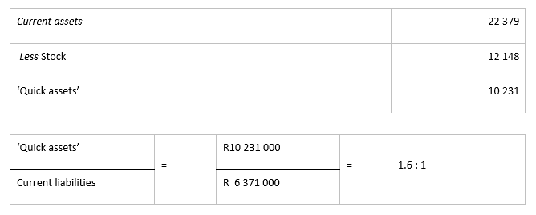
Financial Ratios Analysis
This is still a healthy figure. Most lenders expect a quick ratio between 1 and 1.5. This is a stricter measure of liquidity than the current ratio and is also known as the acid test.

Slide 210
Financial Ratios Analysis
Leverage Ratios
These ratios provide a measure of the extent to which borrowed funds are used to finance organisation assets. The greater the proportion of borrowed funds, the greater the financial risk to the lenders – this pushes up the interest rate on new borrowings as the additional risk is taken into account.
Total Debt / Total Assets (Debt Ratio)
This ratio is calculated by adding the total liabilities of the business and dividing the total assets

Slide 211
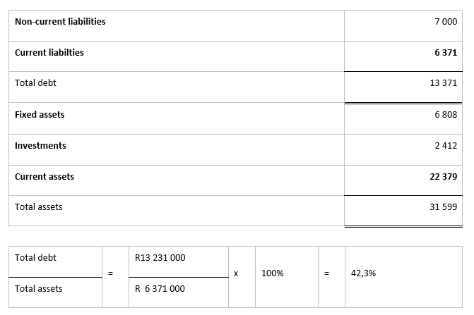
Financial Ratios Analysis

Slide 212
Financial Ratios Analysis
The ratio in the previous slide is fairly good. Where an organisation has more than 50% of its assets funded by debt the creditors, rather than the shareholders, are supplying most of the finances and therefore bear most of the risk.
Long-Term Debt / Capital Employed (Debt: Equity Ratio)
The total debt ratio shown above includes short-term borrowings. The providers of long term-debt are more interested in knowing how much of the long-term capital is provided by debt:

Slide 213
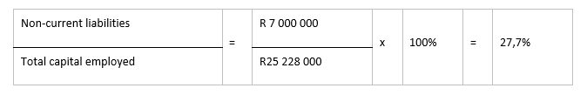
Financial Ratios Analysis
Circumstances vary from industry to industry, percentages below 50% are usually considered acceptable.
The age of the organisation is a key factor, as new companies in rowing industries should be funded as far as possible from equity (shareholders’ funds).

Slide 214
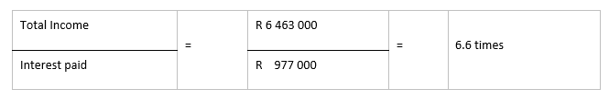
Financial Ratios Analysis
Times Interest Earn
This measure indicates the extent to which interest on debt can be met by organisation earnings.
An organisation which cannot earn sufficient to cover its interest payments is unprofitable.
An interest cover of three times is generally expected by lenders

Slide 215
Financial Ratios Analysis
Activity Ratios
These are measures of business efficiency in the management of two key current assets, namely stock and accounts receivable (debtors), and the settlements of accounts payable (creditors). These ratios measure the speed (in terms of days or number of times per year). Current assets and liabilities are converted into cash. Activity ratios are, therefore, also a measure of a firm's liquidity.
Debtors Collection Period
The credit terms granted to customers are partly determined by generally accepted trade practices, and partly by the efficiency of the organisation’s credit control department. Slow paying customers tie up working capital and force the organisation to seek bridging finance for longer periods.

Slide 216

Financial Ratios Analysis
Profitability
The ability of a company to generate profits is essential to its long-term survival. Profits are necessary to sustain growth, to attract new capital and to reward shareholders for risk-taking.

Slide 217

Financial Ratios Analysis
Gross Profit
This indicates the profitability of basic services offered. It should stay the same every year.
This means that each R100 of fees contains a gross profit of R20.50.
Changes in profit margin from previous years are an important indication of efficiency, types of services and the intensity of competitive activity.
Strong competition will tend to force down the process and lower profit margins.

Slide 218

Financial Ratios Analysis
Net Profit Margin
This measure indicates the profitability after all expenses, including tax and preference dividends, have been deducted.
Net profit margin % =

Slide 219
Financial Ratios Analysis
Return On Investment
Operating profit for the year expressed as a percentage of the value, at the year end, of the resources employed to earn that operating profit. This ratio is referred to as
ROI (Return On Investment)
ROCE (Return On Capital Employed)
RONA (Return On Net Assets)
Net Assets = Fixed assets + Working capital (inventories + work in progress + trade debtors – trade creditors)
The operating profitability ratios are closely linked via a third ratio: the asset turnover ratio, or velocity ratio.
This ratio reveals what sales have been generated for every rand invested in net operating assets and as such is the starting point for the measurement of asset productivity.

Slide 220
Financial Ratios Analysis
Efficiency
Traditional accounting does not reveal how efficiently an entity has been managed, that is, how well its resources have been looked after.
Profit may, to some extent, be used as a measure of efficiency, but accounting profit is subject to a great many arbitrary adjustments and is not entirely reliable.
What needs to be done is to put whatever evidence exists into context, compare it with earlier accounting periods and if possible, with other similar entities.

Slide 221
Plan and Control Financial Instruments
Insurance
Insurance helps to protect against risk – one thus takes out an insurance policy to provide financial protection for the business should an out-of-the ordinary situation arise.
Before considering any type of insurance, make a list of potential risks and how this would affect the individual or the business.

Slide 222
Plan and Control Financial Instruments
Short-Term Insurance
Short-term insurance can be taken out for short-term risks i.e. assets which could include:
Vehicles
Household contents
Jewellery
Computers
Office equipment etc.
The policy would cover the household or business contents and would have to be renewed each year. It is important to revalue the replacement value of the insured items when renewing the policy to ensure that one does not over- or underinsure.

Slide 223
Plan and Control Financial Instruments
The premiums are often determined by the physical area where the contents is held i.e. level of risk concerning crime and the security of the building.
Generally premiums are high due to the high incidence of insurance fraud.
When submitting a claim, the insurance company will first assess the damage before considering the claim to determine whether there was any negligence from the owner.

Slide 224
Plan and Control Financial Instruments
There are numerous packages available and care should be taken to find an insurance policy best suited to individual needs:
Policies could include damage to the building
All risks insurance provides coverage against all risks of loss or damage to the property
Third party insurance for vehicles only covers the other vehicle when involved in an accident
Insurance can cover items bought on hire purchase in the case of the items being stolen or damaged during the hire purchase agreement

Slide 225
Plan and Control Financial Instruments
Long-Term Insurance
Long-Term insurance is taken out to cover long-term risks i.e. disability, retirement and death.
Long-term insurance can also be called life assurance. It is insurance taken out to provide for the dependants after death, thus the insured person pays monthly premiums until death, where a sum of money is paid out to the surviving dependants.

Slide 226
Plan and Control Financial Instruments
Life assurance is a long-term commitment and some policies have a built-in annual premium increase.
It is important to consider these aspects before signing the contract, because although the contract can be cancelled, there may be penalties payable as the policy has not come to term.
Insurance companies may not pay out the policy when they suspect foul play .i.e. murder, suicide or misrepresentation even if the premium payments are not up to date.

Slide 227
Plan and Control Financial Instruments
Unit Trusts
Unit trusts, also known as mutual funds or growth funds, have been an excellent investment over the last couple of years for the smaller investor.
A unit trust is a kind of a ‘club’ for investing in the JSE Securities Exchange (JSE)
Depending on the company, anyone can join for as little as R50 per month
Units are created every time money is invested in a unit trust – the value is determined by the underlying value of all the assets of the particular fund, divided by the number of unit trust holder

Slide 228
Plan and Control Financial Instruments
The value is calculated on a daily basis, depending on the level of share prices
As an investor in unit trusts a person pays money to the unit trust management company who buys shares on the investor’s behalf
By law the fund management has to buy the units back – if they do not have the funds they have to sell some of the shares

Slide 229
Plan and Control Financial Instruments
The Stock Exchange
The stock exchange is the licensed organisation where all shares (stocks) of listed companies (Ltd or Limited companies) are bought and sold.
The South African stock exchange is known as the JSE Securities Exchange (JSE) – the government issues the license which is renewable each year. The JSE is regulated by the Stock Exchange Act No. 1 of 1985, which defines the conditions under which a stock exchange must operate. The JSE is administered by the statutory body of the Financial Services Board.
Stocks are ordinary share capital that can be divided either into units of stock or into shares.

Slide 230
Plan and Control Financial Instruments
Investors can also trade in the following:
Options: Purchased options give the holder the right to convert them into shares at a fixed price and by a specific date. Options are negotiable on the JSE.
Futures. This is an agreement between two parties – a buyer and a seller, for the sale and purchase of a commodity, security or currency in standardised quantities and quality at a later date at a fixed price. The futures contract trades on a futures exchange and is subject to a daily valuation and settlement procedure. On expiry, settlement may result in the physical delivery of the underlying instrument, or cash.
Bonds. A bond is an IOU note issued by the central government, municipalities and other large organisations like Eskom, Post Office, Spoornet and the Landbank. The bond issuer borrows money from the holder of the bond and pays interest periodically (typically every six months) and repays the capital borrowed at a later stage (up to 20 years). Bond prices are sensitive to changes in interest rates i.e. the higher the rate, the lower the price.

Slide 231
Simple and Compound Interest
Simple Interest
Simple interest is the simplest form of interest and is calculated over a specific time for a specific amount.
Formula for calculating simple interest:
I = Prt
I = Interest R= rate of interest
P = principle sum T = the period/time

Slide 232

Simple and Compound Interest
Example:
Sam invests R1 000.00 on a fixed deposit account for a period of one year. He earns 8% interest per year on this investment. How much interest will he have earned after one year?
I = Prt
I = R1 000 x 8%
So after one year Sam has earned R80.00 interest on his R1 000.00 investment. The total investment now R1 080.00.

Slide 233

Simple and Compound Interest
If he now invests the R1 080.00 for another 12 months at an interest rate of 7%, his investment will earn the following interest after a year:
I = Prt
I = R1 080 x 7%

Slide 234
Simple and Compound Interest
At the end of year two, Sam earns another R75.60 on his investment. His return on investment of year one is R80.00 and year two is R75.60. Over the two years, his return on investment is R155.60.
If Sam invested the R1 000.00 for two years at a Rate of 8% per annum, instead of one year, he would have earned interest as follows:

Slide 235

Simple and Compound Interest
I = Prt
I = 2(R1 000 x 8%)
His return on investment would have been R160.00 for two years.

Slide 236
Simple and Compound Interest
Compound Interest
Compound interest is interest that compounds and results is interest being earned on interest. Interest is earned on both the principle amount plus interest that was earned earlier.
Should one deposit R100 in a bank account at 10% and the interest is calculated annually, the balance will be R110.00 at the end of the first year and R121 at the second year. The additional R1 that was earned from the first year is the result of compound interest.

Slide 237
Simple and Compound Interest
Interest can be compounded on a monthly, quarterly, half yearly or other basis. The formula for calculating compound interest is a bit more complicated than simple interest because interest is constantly added to the principle (original) amount.
The principle amount increases as the interest is calculated and added to it.
Example
Sally invests R1 000.00 on an investment that earns 8% interest per annum, but which is calculated and compounded on a monthly basis.

Slide 238

Simple and Compound Interest
The long calculation would be as follows:

Slide 239

Simple and Compound Interest
The simple interest formula can be applied each month, bearing in mind that the principle amount also increases each month. This method is acceptable for small investments – short-term, but for larger long-term investments the following formula is used:

Slide 240
Simple and Compound Interest
The simple interest formula can be applied each month, bearing in mind that the principle amount also increases each month. This method is acceptable for small investments – short-term, but for larger long-term investments the following formula is used:
Formula for calculating compound interest: A = P(1+r/n) nt
A = is the amount or total value of the investment after a certain period
P = is the principle that is invested at the beginning of the period
r = is the rate in the percentage per annum
t = is the number of periods
n = is the frequency paid

Slide 241

Simple and Compound Interest
Example
Lucas invests R2 000.00 for a period of one year at an interest rate of 8.25% where interest is compounded monthly.

Slide 242

Simple and Compound Interest
A = P(1+r/n) nt

Slide 243

Simple and Compound Interest
To test if the formula is correct

Slide 244
Simple and Compound Interest
This formula can be applied to any situation where interest is compounded.
Example
Steve buys a car for R56 000.00. The bank is charging him 12% interest, compounded per month. How much will Steve pay for the car in the end if he is paying it off over three years?

Slide 245


Simple and Compound Interest
A = P(1+r/n) nt

Slide 246
Simple and Compound Interest
Always check whether your answer is realistic!
When Steve has paid off his car, he would have paid R80 080 for it, which is the original price plus all the interest he has paid.
Interest can be compounded at various periods and the table below is an explanation of the terminology often used to express the periods.

Slide 247

Simple and Compound Interest

Slide 248

Simple and Compound Interest
Summary: Difference between Simple Interest and Compound Interest

Slide 249
Mortgage Loans
Mortgage loans or home loans are usually granted to a person who:
Can prove employment for a particular period
Can confirm income
Can show that instalments can be afforded
Has a clean credit record
Has a clean banking record
Has a deposit
Wants to buy a home
There are many institutions that offer home loans and each has its own set of criteria, which are now regulated by the National Credit Act.
A home loan is a legal agreement by which a person takes out a loan using the property being bought as a security.

Slide 250
Hire Purchase
When an article is bought on hire purchase (HP) it only becomes one’s property once it has been paid in full.
HP is a good way to buy items that cost a lot of money and the cash is not available and one cannot wait until it can be afforded.
Buying on HP is expensive, because finance charges are added to the price of the item.
The payments must be made on the due dates, otherwise interest will be charged on the late payment.
The total cost of an item includes not only the direct cost of purchasing and operating but also the ‘opportunity cost’. Opportunity cost refers to what could have been done with the money used on the purchase.

Slide 251
Hire Purchase
Example: if a person withdrew savings to buy a car, the opportunity cost is the loss of interest that the savings would no longer be earning
When financing a purchase, the best, easiest and cheapest way is to pay cash, however few people are able to do this and most people seek financing to purchase items like a car. The new National Credit Act will affect this process and one will have to prove that the purchase is affordable.
When repaying HP it is important to remember that by paying the minimum amount each month, one will also be liable for the maximum amount of interest.

Slide 252
Present Values
Present value refers to the value of something at the present time. Often it is necessary to calculate what the value of the item will be in the future, in today’s money terms.
Formula for calculating present value: PV = V/(1+r) 1
V = is the current value of the item
r = is the rate of interest

Slide 253

Present Value
Example
A person wanted to invest an amount of R5 000 in an investment scheme that will pay 8% interest. However a computer is required and the money is needed – what would the future amount of the investment be in today’s terms?
PV = V/(1+r)¹

Slide 254
Annuities
An annuity is an investment made each month (or) year that will ensure a fixed allowance from a particular date. Some of the most common annuities are:
Life annuity. Pays you a regular amount until the day one dies, however there are no beneficiaries.
Joint life annuity. Are taken out by partners i.e. husband and wife, and they hold this annuity jointly. If one partner passes away the annuity will continue to pay the income to the surviving partner.
Level annuity. Is when income is paid at a fixed rate throughout the life of the individual.
Joint and survivorship annuity. Pays out at one level for the duration of the holder’s life and then another level, between 50% and 100% of the original, for the duration of the holder’s spouse’s life.

Slide 255
Sinking Fund
A sinking fund can be defined as an annuity invested in an order to meet a known commitment at some future date. Sinking funds are usually used for the following purposes:
Repayment of debts.
To provide funds to purchase a new asset when the existing asset is fully depreciated.
Example of debt repayment using a sinking fund:
Here a debt is incurred over a fixed period of time, subject to a given interest rate. A sinking fund must be set up to mature to the outstanding amount of the debt.

Slide 256
Sinking Fund
For example, if K250,000 is borrowed over three years at the rate of 12% compounded, the value of the outstanding debt at the end of third year will be K250,000(1.12)3 = K351,232. If money can be invested at 9.5%, we need to find the value of the annuity, A, which must be paid into the fund in order that it matures to K351,123.
Assuming that payments into the funds are in arrears, we need:
That is the annual payment into the sinking fund is K106,627.8 (which will produce, 9.5%, K251,232 at the end of 3 years).

Slide 257
Costs and Revenue
Costs
Costs can be described as something of value, usually an amount of money, given up in exchange for something else, usually goods or services. All expenses are costs, but not all costs are expenses. (An expense is the cost of resources used to produce revenue.)
As a verb, cost means to estimate the amount of money needed to produce a product or perform a service.

Slide 258
Costs and Revenue
Costs are therefore expenses the company has to pay during the production of its product. There are 3 main types of costs, these are:
Fixed costs,
Variable costs, and
Semi-variable costs:

Slide 259

Costs and Revenue

Slide 260
Costs and Revenue
Total costs are calculated by adding together fixed, variable and semi-variable costs.
Other costs can be defined as follows:
Operating Costs: The day-to-day expenses incurred in running a business
Marginal Costs: is the increase in total cost when output is increased. Thus, the cost associated with one additional unit of production - also called incremental cost.

Slide 261
Costs and Revenue
Revenue
Revenue is the total amount credited in payment for goods and services over a particular time period. In general companies recognise revenue only when the goods or services are fully transferred over to the customer and when the amount of revenue to be received can be determined
Marginal revenue is the increase in the total revenue when the output is increased. Thus, the revenue associated with one additional unit of production.
As long as marginal revenue is more than marginal cost, the output should increase. For example, by increasing output to one more unit, more revenue (income) is generated, but cost is also increased

Slide 262
Costs and Revenue
Marginal Cost and Revenue
Marginal cost is the increase in total cost when output is increased, thus, the cost associated with one additional unit of production. It is also called incremental cost.
Marginal revenue is the increase in the total revenue when the output is increased, thus the revenue associated with one additional unit of production.
As long as marginal revenue is more than marginal cost, the output should increase. For example, by increasing output to one more unit, more revenue (income) is generated, but cost is also increased.

Slide 263

Costs and Revenue
If marginal cost is more than marginal revenue, the production of more units will deplete profits in order to find a balance to:
Ensure that a company is producing the optimal level of units to maximise profits.
Ensure that marginal revenue exceeds marginal cost.
The company should ensure that marginal cost and marginal revenue is calculated correctly.

Slide 264

Costs and Revenue
Example
The Tyre Manufacturers want to calculate the relationship between marginal cost and marginal revenue to ensure that their production is functioning at a profitable margin. They want to increase their output by one unit per week, i.e. one tyre per week

Slide 265

Costs and Revenue
Management have drawn up a table to illustrate how output affects costs.

Slide 266

Costs and Revenue
This can be illustrated on a graph as follows:

Slide 267

Costs and Revenue
When the demand for a product decreases, the price of the product needs to be lowered in order to sell more units.
The relationship can be expressed between marginal revenue and output as follows:
Change in total revenue from selling one more unit of output (additional revenue earned on last unit alone) is when an additional unit is sold at a lower price.
When an existing unit is sold at a lower price, the prices of all the previous units are reduced.

Slide 268
Costs and Revenue
Example
The Tyre Manufacturer can sell:
•50 tyres at a price of R17.00 each to earn R850.00 of revenue
or
•60 tyres at a price of R15.00 each to earn R900.00 of revenue
By selling 10 tyres more at R15.00 each (10x15) = R150.00, they are gaining R150 more revenue than when they sell 50 tyres, but they are losing R2.00 per tyre on the first 50 tyres (50x2) = R100 in revenue, because the first 50 tyres are sold for a lower price.
Thus there is a net increase in revenue of only (R150-R100) = R50.

Slide 269
Costs and Revenue
Profit
Profit is the amount of money left over after costs have been covered. It is therefore calculated by: total revenue minus total costs.
•Profit can be used as a measure of the businesses success, attracting investors and reinvesting back into the business.
•The quality of profit can also be measured.
•Low quality profit is gaining money from an event which is unlikely to occur again in the future but high quality profit is from normal trading activities which should continue to occur in the future.
•It is important when told a company's profit, that it is clear what type of profit it is (gross, operating, pre-tax or after tax).

Slide 270
National and International Economy
Understanding Monetary Policy
Monetary policy is one of the tools that a national Government uses to influence its economy. It uses this to control the supply and availability of money, and to influence the overall level of economic activity in line with its political objectives.
Usually this goal is "macroeconomic stability" –
low unemployment,
low inflation,
economic growth,
balance of external payments.
Monetary policy is usually administered by a Government appointed "Central Bank", like the South African Reserve Bank.

Slide 271
National and International Economy
Modern Monetary Policy
Governments realised that money supply affected economic activity and so they actively try to influence money supply through "monetary policy".
Nations created central banks to establish "monetary authority". This meant that rather than accepting whatever happened to money supply, they would actively try to influence the amount of money available.
This would influence credit creation and the overall level of economic activity.

Slide 272
National and International Economy
The Effectiveness of Monetary Policy
At the extremes, monetary policy is a strong force. In countries such as the Russian Republic, Poland or Brazil, where the printing presses run fulltime to pay for government operations, money supply is expanding rapidly and the currency becomes rapidly worthless compared to goods and services it can buy. We have seen this trend in our neighbouring country Zimbabwe as well.
Very high levels of inflation or "hyperinflation" is the result. With 30-40% monthly inflation rates, citizens buy hard goods as soon as they receive payment in the currency and those on fixed income have their investments made worthless.

Slide 273
National and International Economy
At the other extreme, restrictive monetary policy has shown its effectiveness with considerable force.
Germany has maintained a very stable monetary regime and resulting low levels of inflation.
In any event, insights into monetary policy are very important to the investor. The availability of money and credit are key considerations in the pricing of an investment.

Slide 274
Operations of a Modern Central Bank
The Central Bank attempts to achieve economic stability by varying the quantity of money in circulation, the cost and availability of credit, and the composition of a country's national debt.
The Central Bank has three instruments available to it in order to implement monetary policy:
Open market operations
Reserve requirements
The 'Discount Window'

Slide 275
Operations of a Modern Central Bank
Open market operations are the buying or selling of Government bonds by the Central Bank in the open market.
If the Central Bank were to buy bonds, the effect would be to expand the money supply and hence lower interest rates, the opposite is true if bonds are sold.
This is the most widely used instrument in the day to day control of the money supply due to its ease of use, and the relatively smooth interaction it has with the economy as a whole.

Slide 276
Operations of a Modern Central Bank
Reserve requirements are a percentage of commercial banks', and other depository institutions', demand deposit liabilities (i.e. cheque accounts) that must be kept on deposit at the Central Bank as a requirement of Banking Regulations.
Though seldom used, this percentage may be changed by the Central Bank at any time, thereby affecting the money supply and credit conditions.
If the reserve requirement percentage is increased, this would reduce the money supply by requiring a larger percentage of the banks, and depository institutions, demand deposits to be held by the Central Bank, thus taking them out of supply.
As a result, an increase in reserve requirements would increase interest rates, as less currency is available to borrowers.
This type of action is only performed occasionally as it affects money supply in a major way.
Altering reserve requirements is not simply a short-term corrective measure, but it is a long-term shift in the money supply.

Slide 277
Operations of a Modern Central Bank
Finally, the Discount Window is where the commercial banks, and other depository institutions, are able to borrow reserves from the Central Bank at a discount rate.
This rate is usually set below short term market rates (T-bills).
This enables the institutions to vary credit conditions (i.e., the amount of money they have to loan out), thereby affecting the money supply.
The Discount Window is the only instrument which the Central Banks do not have total control over.
In theory, if money supply is affected, then monetary policy can establish ranges for inflation, unemployment, interest rates, and economic growth. A stable financial environment can be created in which savings and investment can occur, allowing for the growth of the economy as a whole.

Slide 278
The South African Economy
Our economy in South Africa is mixed – both capitalism and socialism.
Capitalism = where production facilities are privately owned.
Socialism = where production facilities are publicly owned (by the government)
A mixed economy has the advantage of both private ownership with its ability to introduce innovations and to meet the needs of the private sector; and government action that can provide collective needs such as – policing, education and roads.

Slide 279
The South African Reserve Bank
This is the only bank in South Africa with the right to issue bank notes
It acts as a keeper of the other banks’ cash reserves
Other banks can also borrow money from the Reserve Bank
It also is the custodian of the country’s gold and foreign reserves, and it supervises the activities of foreign banks

Slide 280
Economics Policies to Control Inflation
Controlling inflation has become one of the main objectives of government economic policy in many countries.
Effective policies to control inflation need to focus on the root causes of inflation in the economy.
For example, if the primary cause is excess demand for goods and services, then government policy should look to reduce the level of aggregate demand.
If cost-push inflation is the main cause, production costs need to be controlled for the problem to be reduced.

Slide 281
Economics Policies to Control Inflation
Higher interest rates reduce aggregate demand in the following main ways:
Discouraging borrowing by both households and companies
Increasing the rate of saving (the opportunity cost of spending has increased)
The rise in mortgage interest payments will reduce homeowners' real ‘effective' disposable income and their ability to spend. Increased mortgage costs will also reduce market demand in the housing market
Business investment may also fall, as the cost of borrowing funds will increase; some planned investment projects will now become unprofitable and, as a result, aggregate demand will fall.
Higher interest rates could also be used to limit monetary inflation; a rise in real interest rates should reduce the demand for lending and therefore reduce the growth of broad money.

Slide 282
Economics Policies to Control Inflation
Fiscal Policy
Higher direct taxes (causing a fall in disposable income)
Lower Government spending
A reduction in the amount that the government sector borrows each year.

Slide 283
Economics Policies to Control Inflation
Problems with Forecasting Inflation
Inflation can never be forecast with perfect accuracy
The overall inflation measure is the result of millions of pricing decisions made by large and small businesses
The calculation of the retail price index is always subject to error and omission
Moreover, the nature of the inflation process makes it very difficult to forecast, even when inflationary conditions in the economy appear to be favourable

Slide 284
Economics Policies to Control Inflation
External economic shocks can make forecasts inaccurate, for example, a sharp increase in world oil prices (an inflationary shock) or sudden falls in global share prices (a deflationary shock), both have enormous feedback effects through the economic system
The exchange rate might also go up and down leading to volatility in the prices of imported goods and services

Slide 285
Economics Policies to Control Inflation
Exchange Rates
This is the exchange ratio between different currencies. For example, a South African wine producer who exports wine to the UK will want to be paid in pounds (£), someone going on holiday to the UK will also need to exchange his/her Rands for pounds.
The Foreign Exchange market handles these exchanges according to the rate of exchange at the moment of exchange (these rates change all the time).

Slide 286
Economics Policies to Control Inflation
All countries operate through the same process. You can check the current interest rates on a daily basis by looking in a newspaper, on the internet, by watching the news on TV, or by listening to the news on the radio. (Ask learners if they know the day’s current exchange rate for the rand against the following currencies: £, €, $(US))

Slide 287
Economics Policies to Control Inflation
Tax
All over the world people pay money to their government in return for services that the government provides.
In South Africa, the Minister of Finance is responsible for drawing up a budget in which total government spending is announced. Projects include:
Defence,
Policing,
State-funded education
Health care.

Slide 288
Economics Policies to Control Inflation
Individual taxation (direct and indirect tax) is responsible for the greatest amount of money that the government uses in this way. The tax year in South Africa reaches from 1 March of the current year until 28 February of the next year. The laws regarding income are statutes in the Income Tax Act; the act makes provision for tax to be collected in three ways:
Employees’ tax
Tax assessment
Provisional tax

Slide 289
Economics Policies to Control Inflation
Employees’ tax is paid according to PAYE:
PAYE. Pay as you earn is a form of income tax which is levied once the income of an employee exceeds R75 750 if you are younger than 65 years.
If you are 65 years of age or older, the tax threshold (i.e. the amount above which income tax becomes payable) increases to R117 300.
For taxpayers aged 75 years and older, this threshold is R131 150
This amount is adapted yearly.

Slide 290

Economics Policies to Control Inflation
Rebates
Primary R13 653
Secondary (Persons 65 and older) R7 479
Tertiary (Persons 75 and older) R2 493

Slide 291
Economics Policies to Control Inflation
Tax Assessment
Those individuals who have been taxed on the PAYE system must submit a tax return at the end of the financial year (end February).
The assessment assesses taxable income in relation to taxable liability.
If the incorrect taxes have been paid, the balance needs to be paid to the Receiver of Revenue (SARS in South Africa) or the balance will be refunded to the employee.
At the end of the year employees must receive an IRP5 form which shows how much PAYE and /or SITE has been deducted for the past year.

Slide 292
Economics Policies to Control Inflation
The following records should be kept during the tax year to assist in completing the tax return:
Salary slips
Medical expenses i.e. doctor bills, prescriptions and statement of claims from the Medical Aid
Receipts from dividend payments, or income from other investments during the year
Note of any contributions made to retirement annuities or any other long-term investments, both taxable and non-taxable.
IRP5 from the employer and statements of interest earned from bank

Slide 293
Economics Policies to Control Inflation
Provisional Tax
Provisional tax is the manner in which tax is collected – provisional taxpayers pay exactly the same tax as other taxpayers with the same income. All companies and close corporations are automatically provisional taxpayers.
Individuals become provisional taxpayers when:
They earn more than R1 000 a year that is not subject to PAYE
They become directors of companies or closed corporations
They engage in a trade or profession

Slide 294

Economics Policies to Control Inflation
Direct Tax vs Indirect Tax

Slide 295
Economics Policies to Control Inflation
Value Added Tax (VAT)
The most common example of indirect consumption tax is value added tax (VAT)
OUTPUT VAT - INPUT VAT = VAT PAYABLE
Different types of VAT is payable in South Africa:
Input VAT that is VAT that is payable to suppliers
Output VAT is VAT that is charged
Zero rate VAT relates to products and services where VAT is not charged.

Slide 296
Economics Policies to Control Inflation
Input (VAT)
Vat paid to suppliers is - INPUT VAT
Calculate Input VAT:
R 228 000 ÷ (1.14) = #
# - total = Total Input VAT
Output (VAT)
Vat charged is called - OUTPUT VAT
Calculate VAT OUTPUT
To calculate OUTPUT VAT given the sales including VAT, use the following formula:
(Total Sales Including Vat) X (14 ÷114)
Example: Sales R228 000 X (14÷114) = R28 000.00

Slide 297
Economics Policies to Control Inflation
Zero Rate VAT
Exports, brown bread, milk, petrol, diesel and the sale of a business.
Goods and Services Exempt
Certain educational services, rail, bus, taxi-fares, rental for a home and life assurance.
The frequency with which a person has to pay VAT over to the SA Revenue Service is determined by what "taxable period" he/she qualify for. There are four categories of tax periods: A, B, C and D.

Slide 298
Economics Policies to Control Inflation
Categories A and B require VAT returns to be submitted every two months. All vendors that do not fall into C or D will be part of A or B. Small businesses with an annual turn-over of less than R 1,2 million (from 1 July 2006, currently R1 million), are to submit VAT returns only every four months. However, they may elect to remain on the two-monthly return cycle if so desired.
January, March, May, July, September, and November for Category A.
February, April, June, August, October, December for Category B.
Category C required VAT returns to be submitted every month. The Commissioner will allocate a tax period to every vendor. If your annual sales exceed R30 million, you are obliged to fall into Category C.
Category D only applies to certain farmers and requires returns to be submitted every six months.

Slide 299
Economics Policies to Control Inflation
A standard return (VAT return) must be submitted within 25 days of the end of each tax period (VAT cycle). The SA Revenue Service will impose penalties and interest on late submission. Penalties are 10% of the amount payable and interest is levied at the standard charge for interest.
DIRECT TAX
Calculated by income earned by individuals
INDIRECT TAX
Value added Tax (VAT)

Slide 300
Economics Policies to Control Inflation
Tax Avoidance and Tax Evasion
Tax Evasion is when individuals falsify records, fail to disclose how much they have earned or try and divert funds elsewhere. This can result in heavy fines or even imprisonment as tax evasion is a criminal offence.
By disclosing all one’s income and expenses, it may be possible and legal to minimise one’s tax liability.
This is called Tax Avoidance. This can only be done when specific detailed and honest records of financial affairs are kept. The Income Tax Act recognises that there are ways of paying less rather than more to the Receiver.

Slide 301
Economics Policies to Control Inflation
Certain expenses may be claimed against tax. The following list indicates what income escapes income tax:
Various lump sum payments from pension and retirement annuity funds
Proceeds of life assurance policies, except for isolated non-standard policies
Gifts and inheritances
The tax-free income from certain types of investments, like a matured endowment policy
War pensions
Unemployment benefit payments
Compensation paid out for work-related injuries, diseases, etc.
That portion of your income that is paid out a bona fide business expenses in order to generate income
Bursaries and grants
Special awards
Retirement gratuities paid out of public funds

Slide 302

Productivity
Productivity is the relationship between output of goods and services and the inputs of resources (factors of production) used to produce them. Productivity is usually measured in terms of ratios.

Slide 303
Productivity
Productivity is how effectively and efficiently a quality product can be produced. Effectively refers to how a desired result is produced and efficiently means to work with a minimum of wasted effort and / or expense. Quality is the degree of excellence of a product or service, when measured against another product or service.
Productivity can be enhanced through:
Improving basic processes by research and development (long-term)
Improving and providing new plant, equipment and machinery (long-term)
Simplifying products and reducing variety (medium term)
Improving existing methods and procedures (short term)
Improving the planning of work and the use of labour (short term)
Increasing the overall effectiveness of employees (short term

Slide 304

Productivity
Productivity is affected by the following factors:
Labour skills and labour costs
Site suitability and site cost
Energy supply and cost
Transportation cost (to and from the site)
Material supply and cost
Community factors (i.e. local laws, political stability)

Slide 305
Productivity
Example
Sarah wants to set up a factory 100km north of Bela Bela in the Limpopo Province. The production line involves a complicated number of machines that produce electronic gadgets for the aircraft industry. Sarah will have to ask the following questions and will have to determine what the impact will be on the establishment and optimisation of the business:
What is the skills level of the people in the immediate area?
If skills levels are low, how long will it take to train future employees to use the machinery?
If skills levels are high, are there enough people to ‘man’ the factory?
How much must these people earn by law?
How much can Sarah afford?
How accessible is the site? Is there transport to and from the site for labour?

Slide 306
Productivity
Can raw materials be transported to the site easily and cost-effectively?
If not, how does this impact on the production, cost of production and profit?
Are the raw materials available locally in the province or country, or must it be imported?
If imported, from where and how does the exchange rate influence these imports?
How will the exchange rate impact cost of production, revenue and profit?

Slide 307
Productivity
Once these questions have been answered the following needs to be decided:
Is it a viable proposition to set up a factory at this location?
Should a new site be considered – close to a harbour or airport?
Should the whole idea be abandoned?
Organisations should spend adequate time on doing research to make sure that, once the business is established, it can do more than survive – it needs to be sustained over a long period.
Where productivity is low, the revenue and cost of production is affected negatively and therefore positive growth is hampered.

Slide 308
Equitable Distribution of Resources
The equitable distribution of resources forms part of welfare economics, which describes how well the economy of a country works. Equitable distribution of resources refers to:
The division amongst members of society, as individuals, of the national income and wealth
The sharing of the value of the output of goods amongst the factors of production – labour, land, capital and management
The sharing of this value takes the form of monetary payments consisting of:
Wages and salaries
Rent
Interest
Profit

Slide 309
Equitable Distribution of Resources
These factors tend to increase the income of one group or another above the level it would reach through the unimpeded operation of the law of supply and demand. Taxation also affects income distribution.
Thus, the equitable distribution of income in a country shows how income is divided between different groups and/or individuals. The income per person directly reflects the ‘health’ of the economy in a country and discloses the standard of living in that particular country.

Slide 310
Equitable Distribution of Resources
Ultimately, the whole drive to……
Improve productivity
Work smarter not harder
Increase productivity
Increase skills and education levels, etc.
…..is not to enrich government but, to increase the standard of living for each South African.

Slide 311
The Global Economy
Defining Global Economy
The study of the structure and performance of national economies and of the policies that governments use to try to affect economic performance.
Measure Global Economy
Use the stock exchange of different countries, e.g. The Johannesburg Stock Exchange (JSE) in South Africa. Different measurements instruments can be used :
Fuel prices
The gold price
Exchange rates are a great way to see what the economic prosperity in different countries are.

Slide 312
The Global Economy
The following graphs are representations of the increase and decrease of different measurements in the global economy over a one year period. All values should be ignored.

Slide 313
The Global Economy
The big decrease in all five graphs was caused by the global economic crisis, which started in September 2008, and shows that these elements are good measures for the global economy.

Slide 314

The Global Economy
It is possible to calculate how much the different elements have decreased during this time:
Current value – Previous value = Amount of change
If the Amount of change is negative, it means a decrease. If the Amount of change is positive, it means an increase
Example:

Slide 315
The Global Economy
Amount of change in the value of Gold = $712.40 – $912.90
= $ -200.50
Thus a decrease of $200.50
Amount of change in the value of Oil = $60.93 – $80.68
= $ -19.75
Thus a decrease of $19.75
From this example it is clear that the value of Gold has decreased a lot more than that of Oil. However, it is not correct to use these values to say that the value of Gold took a bigger dip than that of Oil, because the value of Gold is almost 10 times that of Oil.

Slide 316
The Global Economy
(Current value – Previous value) ÷ Previous value x 100 = Percentage change.
Percentage change in the value of Gold = ($ -200.50) / $912.90 x 100 = -22%
Thus a decrease of 22%
Percentage change in the value of Oil = ($ -19.75) / $80.68 x 100 = -24.5%
Thus a decrease of 24.5%
This shows that the value of Oil took a bigger dip than that of Gold, which is in contradiction to the conclusion of the previous example.
The last conclusion is the correct one and also gives an idea of the global economic status for that period.
The global economy decreased by about 23% during the month of October 2008.

Slide 317
The Global Economy
The Effect of Global Economy on a Country’s Economy
Importing and exporting will be affected due to a change in the exchange rate, making importing cheaper and exporting less profitable or making importing more expensive and exporting more profitable
Exchange rates will be affect - a country’s currency will either be appreciated or deprecated
Inflation will either increase or decrease, depending on what is happening in the global economy
Investments in a country will definitely be affected due to exchange rates and interest rates.

Slide 318
The Global Economy
Credit Crunch
South Africa is seen as one of the countries which were least affected by the global economic crisis. This is due to the new credit law and banks that were not allowed to lend money to the American house debt scheme (which was the main reason for the start of the crisis).
In the graphs above that represent a few examples of stock exchanges all over the world, the conclusion can be drawn that companies all over the world were damaged by the crisis due to the decrease in their stock values.
Individuals were also affected. A lot of people invested in stocks and these prices had sharp declines because of the economic crisis.

Slide 319


The Global Economy
The following graph indicates that the amount of passengers on SAA flights has decreased in 2008/2009. This is also because of the global financial crisis.

Slide 320
Assessments
Do Formative Activity 3 in your PoE.
Do the Knowledge Questionnaire in your PoE.
Do the Workplace Assignments in your PoE

