Slide 1

ECD: Basic Child Knowledge
Unit Standard ID 244484 | NQF Level 4 | Credits 8
Unit Standard ID 244469 | NQF Level 4 | Credits 10

Slide 2
Ground Rules
Days Training, Workshops, and Portfolio building
Hygiene & Safety
Breaks
Cell Phones
Participation
Portfolio Submission

Slide 3

Section 1 Overview
What Is a Portfolio?
Collection of Evidence that
Lists criteria for proving competence
Provides evidence that you meet criteria
Is organised to enable assessor to evaluate evidence against criteria.

Slide 4
Overview
The Portfolio of Evidence (PoE)
Section 1 – Administrative detail
Section 2 – Assessment planning
Section 3 – Assessment design matrix
Section 4 – Formative assessment activities
Section 5 – Summative assessment
Knowledge questionnaires
Section 6 – Summative assessment – Workplace assignments
Section 7 – Feedback
Section 8 – 10 Additional Evidence

Slide 5
Categories Of Evidence
Practical Competence
Foundational Competence
Reflective Competence

Slide 6
Overview
Competency
  Against Outcomes in Unit Standard
Interpret
  Outcomes in relation to workplace

Slide 7
Good Evidence
Valid
  Should relate to what is being assessed
Authentic
  Own evidence
Reliable
  Consistency
  Another assessor makes same judgment
Current
  As recent as possible
Sufficient
  Enough evidence

Slide 8
Assessment Brief
Purpose of Module
This Qualification will enable recipients of this Qualification to facilitate the all-round development of young children in a manner that is sensitive to culture and individual needs (including special needs), and enable them to provide quality early childhood development services for children in a variety of contexts, including community-based services, ECD centres, at home and in institutions.
This section will equip recipients with the necessary communication skills.

Slide 9

Assessment Brief
Entry Level Requirements
Communication at NQF level 3 or equivalent.

Slide 10
Assessment Brief
Credit Value
18 credits = 180 notional hours
Theoretical + Practical + Workplace experience
Submission of Portfolio of Evidence (PoE) - based on Specific Outcomes (SOs) and Assessment Criteria (ACs).

Slide 11
Types of Assessment
Integrated Assessment
Diagnostic
Formative
Summative

Slide 12
Assessment Methods
Assessment Methods
Questioning
Product Evaluation
Observation

Slide 13
Assessment
Assessment
Formative
Summative
Evidence during
facilitation
Self Assessment
Knowledge Assessment
Summative Workplace
Assignments
Formative + Summative = Competent

Slide 14
Competence
Competent
Ability to perform task, action or function successfully
Certificate issued and credits awarded
Not Yet Competent
Not successful yet
Opportunities to remediate to address gaps

Slide 15

Re-Assessment
20 working days after submission
Specific feedback - focus on not yet competent areas
Re-assessment - same context and same conditions
Only Not Yet Competent specific outcomes - to be re-assessed
ENJO’s policy:
One (1) Initial Assessment +
Two (2) Re-Assessments
per Person per Portfolio

Slide 16
Assessment Brief
Credit Accumulation
Credits will be awarded on successful completion of unit standards.
NB: - Quality Assurance Process
Assessment
Moderation
Verification

Slide 17
Assessment Brief
Assessment Tools and Matrix:
  All the specific outcomes
  Associated assessment criteria
  Range statements
  Critical cross-field, development outcomes
  Essential embedded knowledge.

Slide 18
Assessment Brief
ENJO Assessment Process:
  Integrated assessment against current SAQA registered unit standards and qualifications in a fair, valid, reliable and practicable manner.
  Moderation and verification procedures carried as per SAQA requirements.
  Learner competence demonstrated through formative and summative assessments.

Slide 19
Assessment Brief
Learners have the right to:
  Be informed when and how assessments are conducted
  Appeal against an assessment conducted.
  Get interpretation to the numeracy and literacy level of the skills programme, unit standard or qualification.

Slide 20
Assessment Brief
Facilitation and assessments will be conducted in English.
Learners may have an observer present; however observer may not partake, comment or interrupt the assessment process.
Assessment results will be available as soon as possible after the final assessment.
Learners may have access to results within normal working hours.

Slide 21
Assessment Brief
Additional Notes:
  Assessor will maintain telephonic and electronic contact until sufficient evidence has been submitted.
  Additional evidence may be submitted after initial submission.
  If you have a problem which might affect the outcome of assessment(s) you should notify the assessor. Where practicable such needs will be accommodated. (special needs)

Slide 22
Appeals and Disputes
Learner has right to appeal against:
Unfair assessment
Invalid assessment
Unreliable assessment
Unethical practices
Inadequate expertise and experience of the assessor
Appeals have to be submitted in writing to ENJO.

Slide 23
Section 1
Portfolio of Evidence
Section 1 – Administrative Detail

Slide 24

Section 1 - 2 Administrative Detail
Learner Information
ID
CV
Qualifications
Special Instructions
Declaration of Authenticity
Unit Standard
Sign all required documents

Slide 25
Special Instruction
No Tippex
Initial each page
Comments in full
ENJO or own templates to be used to complete portfolio
Use assigned colour unless instructed differently

Slide 26
Unit Standard
SAQA US ID
Unit Standard Title
NQF Level
Credits
Purpose of the Unit Standard
Learning assumed to be in place
Refer to Learner Guide

Slide 27
Unit Standard
Unit Standard Range
Specific Outcomes
Assessment Criteria
Essential Embedded Knowledge (EEK)
Critical Cross-field Outcomes (CCFOs)
Notes
Refer to Learner Guide

Slide 28

Basic Child Knowledge
Study Unit 1:
Development Stages of Babies and Children

Slide 29
Development Theories
Child development that occurs from birth to adulthood has been ignored
Field of child development finally began to emerge early in the 20th-century
Focussed on abnormal behaviour
Researchers became interested in
  typical child development
  influences on development
It is essential fully understand the cognitive, emotional, physical, social and educational growth

Slide 30
Psychoanalytic Child Development Theory - Sigmund Freud
Stressed the importance of childhood events and experiences
Mainly focused on mental disorders rather that normal functioning
Child development is described as a series of 'psychosexual stages
These stages are oral, anal, phallic, latency and genital
He believed all aspects of personality development are somehow related to sex
Belief that several driving forces also develop during those same years
These developments will determine a person's adult personality and explain how they interact with the world
Notes:
Psychoanalytic Child Development Theories

Slide 31
Sigmund Freud
The Id - present at birth,
  Urges a person to ensure basic needs are met
  Wants (demands) whatever feels good at the time with no regard to anything or anyone else
The Ego - within three years
  The "reality principle," meaning that there is reality in every circumstance
  Children of three can understand that impulsiveness and self-centred behaviours have unpleasant consequences
  The Ego's job is to see that the Id's needs are met while it is realistic about the manner in which these needs are cared for.

Slide 32

Sigmund Freud
The Superego - develops by the age of five
  Called the conscience
  Dictate a child’s sense of right and wrong
  Moral and ethical lessons taught by parents and other caregivers take hold
  Children are able to internalise the messages, making them a part of the long-term personality

Slide 33
Psychoanalytic Child Development Theory - Erik Erikson
A stage theory of development
According to his theory there is human growth throughout the entire human lifespan
Each stage of development focuses on overcoming conflict
Success or failure in dealing with the conflicts at each stage can impact overall functioning
Focuses on the social aspects of evolvement
Advancements come in a predetermined order
The socialisation aspect was stressed, rather than cognitive development.
Notes:
Theorist Erik Erikson also proposed a stage theory of development

Slide 34
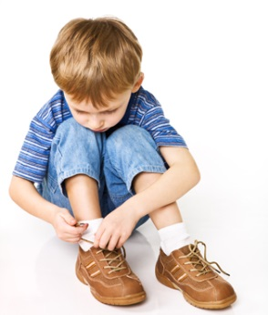
Erik Erikson
Divided human lifespan into eight categories
Own unique time frame and characteristics
Failing to complete one stage has a negative impact on being able to manoeuvre well through the remaining

Slide 35
Erik Erikson
Trust vs. Mistrust: Birth to 1 year
  Forms first feelings about the world
  Whether or not it is a safe place based on the level of consistent care provided
  When trust develops successfully, the child feels secure
  If a sense of security is not developed, a fear and inner mistrust of the world is formed
  Anxiety and insecurity are signs of an unsuccessful beginning

Slide 36
Erik Erikson
Autonomy vs. Shame and Doubt: 1 to 3 Years
  Children become more independent, when they try to assert their opinions and do things in their own way
  First attempts at making decisions important milestones
  If a child's efforts at independent thinking are supported and encouraged - self-confidence increases
  Low self-esteem and a tendency to be overly dependent on others can have their roots in an unsuccessful transition

Slide 37
Erik Erikson
Initiative vs. Guilt: 3 to 6 Years
  Kids like to express their assertiveness by
    choosing activities,
    inventing own solutions to problems and
    approaching others to socialise
  If these efforts are recognised and rewarded, children flourish
  If they are made to feel foolish or not allowed to even try- they may go through their lives preferring to follow, rather than lead.

Slide 38
Erik Erikson
Industry vs. Inferiority: 6 Years to Puberty
  School years provide opportunities to take initiative in planning and following through on projects.
  Positive feedback help children to feel confident and capable.
    Important characteristics for happiness and future success.
  If, not encouraged, children may doubt their capabilities
    Child will usually not reach their full potential.

Slide 39
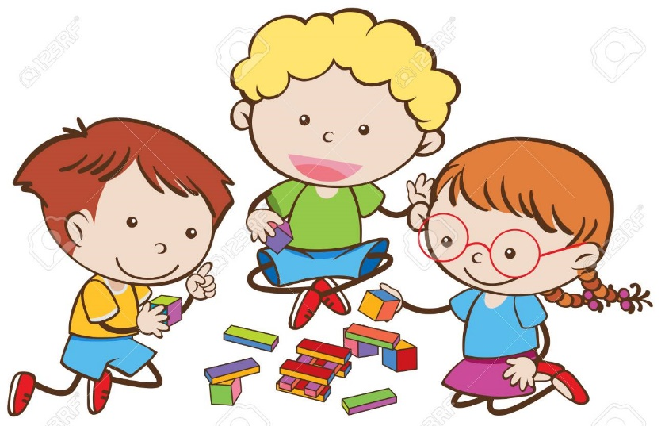
Cognitive Child Development Theory - Jean Piaget
Children think differently than adults
First to note that children play an active role in gaining knowledge of the world.
Children can be thought of as "little scientists" who actively construct their knowledge and understanding of the world.
Children go through a number of fixed stages
Notes:
Perhaps the most widely accepted and most cited

Slide 40
Jean Piaget
Sensory Motor Stage: Birth to 2 Years
  Large amount of growth and development takes place in the first two years
  Children go from being helpless to walking, talking, and to being able to make sense of the world around them
  Most important milestones
    Mastery of "object permanency,"
    Ability to understand that even when a person or object is removed from their line of sight, it still exists
    Helps them to have a safety and security

Slide 41

Jean Piaget
Pre-operational Stage: 2-7 Years
  Language skills develop fast, allowing kids to express themselves more easily.
  Also, children are egocentric, - they believe that everyone sees the world the way that they do
  Conservation - the ability to understand that quantity does not change just because shape changes
Notes:
Once object permanency is achieved, children move onto this next stage

Slide 42
Jean Piaget
Concrete Operations Stage: 7 to 11 Years
  Ability to consider a number of factors at the same time
  Ability to solve increasingly complex problems
  Can now understand how to group similar objects, even if they are not identical
  Ability to place things in order according to size
  Still have some distinct limitations to their thinking process
  Difficult to understand things that they haven't personally seen, touched, heard, tasted, or smelled.

Slide 43
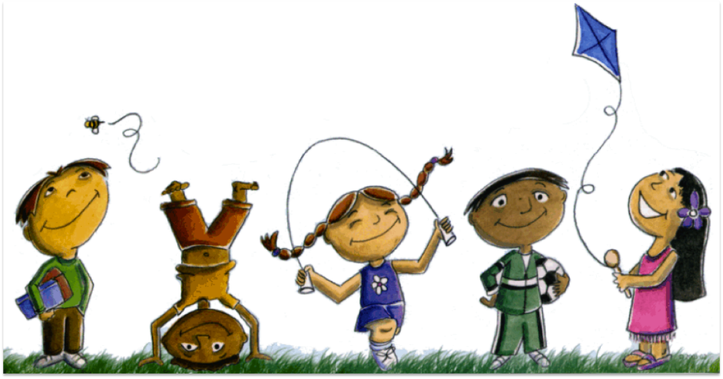
Jean Piaget
Formal Operations Stage: 11 and Beyond
  Hold a much broader understanding of the world around them
  Are able to think in abstract ways
  Able to hypothesise possible outcomes to a given problem
  Can think of ways in which to test their theories
  Learn to use deductive reasoning to draw conclusions

Slide 44
Behavioural Child Development Theories
Focus on how environmental interaction influences behaviour
Based upon the theories of theorists such as John B. Watson, Ivan Pavlov and B. F. Skinner
Deal only with observable behaviours.
Development is seen as a reaction to rewards, punishments, stimuli and reinforcement
Differs considerably from other child development theories because it does not involve internal thoughts or feelings.
It focuses purely on how experience shapes who we are.
Behaviours that are ignored or punished will decrease

Slide 45
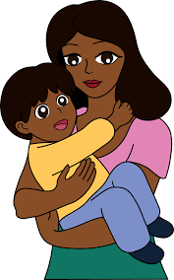
Social Child Development Theories -
John Bowlby
John Bowbly proposed one of the earliest theories of social development
Bowlby believed that early relationships with caregivers
  play a major role in child development and
  continue to influence social relationships throughout life.
  This is called the Theory of Attachment.
  There are four stages of attachment in the development of a child

Slide 46
John Bowlby
Pre-attachment (0-2 months):
  Infants do not discriminate one person from another – no fear of strangers
Attachment-in-the-making (2-6 months):
  Infant directs signals to a particular person.
  Recognises his/her parents but do not protest when separated
Clear-cut attachment (6months – 3 or 4 years):
  Separation anxiety.
  Can be attached to several
Goal-corrected partnership (3-4 yrs onwards):
  Understand caregiver’s schedule.
  Separation protests decline.

Slide 47
Social Child Development Theories –
Mary Ainsworth
Mary Ainsworth is best known for her elaboration on the work of John Bowlby and attachment Theory.
She developed a procedure to observe and assess the quality of attachment in relationships between a caregiver and child.
She called this procedure the Strange Situation.
The child is observed while he/she is playing for twenty minutes.
During this time caregivers and strangers enter and leave the room, recreating the flow of the familiar and unfamiliar persons in the lives of most children.

Slide 48
Mary Ainsworth
The caregiver and the child are introduced to the experimental room.
The caregiver and the child are left alone.
The caregiver does not participate while the child plays and explores.
A stranger enters, converses with the caregiver, then approaches the child. The caregiver leaves without the child noticing it.
First separation episode: The stranger adjusts his/her behaviour to that of the child.
First reunion episode: The caregiver greets and comforts the child, then leaves again.
Second separation episode: The child is left alone.
Continuation of second separation episode: The stranger enters and again adjusts his/her behaviour to that of the child.
Second reunion episode: The caregiver enters, greets the child, and picks him/her up. The stranger leaves without the child noticing it.
Notes:
The arranged sequence of events is as follows:

Slide 49

Mary Ainsworth
Two aspects of the child's behaviour are observed:
  The amount of exploration the child engages in during the time period.
  The child's reactions to the departure and return of his/her caregiver.
On the basis of their behaviour, children are categorised into three groups

Slide 50
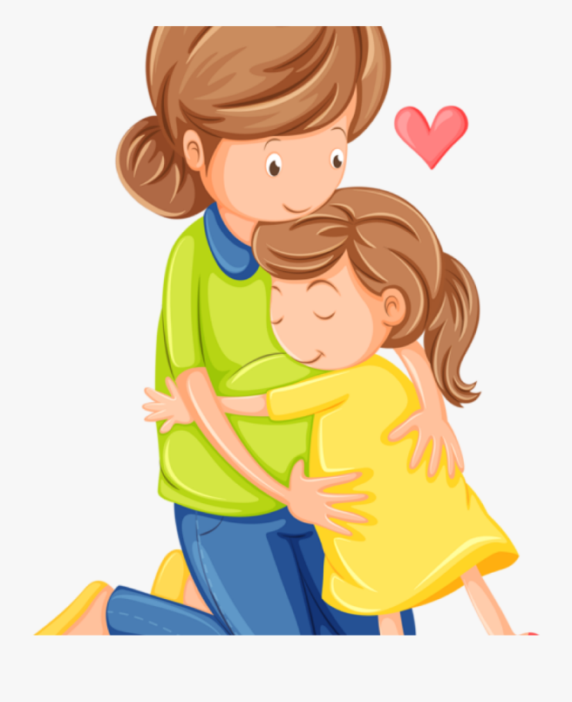
Mary Ainsworth
Secure Attachment (successful)
  A child who is securely attached to its caregiver
    will explore freely while the caregiver is present,
    will engage with strangers,
    will be visibly upset when the caregiver leaves
    will be happy to see the caregiver return.
  The child will not engage with the stranger if the caregiver is not in the room.

Slide 51
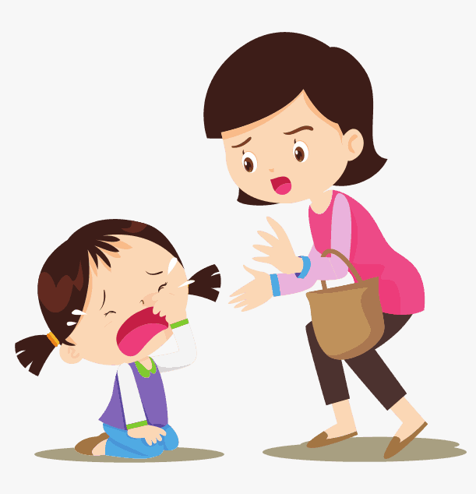
Mary Ainsworth
Anxious-Ambivalent Insecure Attachment (successful)
  Child will be nervous of exploration and of strangers, even when the caregiver is present.
  When the caregiver departs, the child is extremely upset.
  The child will be ambivalent when they return and will stay close to the caregiver
  Will be resentful, and also resistant when the caregiver tries to get his/her attention.
Notes:
Ainsworth’s Strange Situation Procedure has been criticised more in the way in which it is applicated than in its validity. For example, many critics feel the twenty-minute time-frame for the procedure is too short, and that too many variables can come into play, such as the caregiver’s and infant’s moods at the time, the role that cultural variation can play, etc. But support for Ainsworth’s basic concept remains intact.

Slide 52

Social Child Development Theories -
Albert Bandura
Children learn new behaviours from observing other people
Intrinsic reinforcements such as a sense of pride, satisfaction and accomplishment could also lead to learning
By observing the actions of others, including parents and peers, children develop new skills and acquire new information.
Notes:
Psychologist Albert Bandura proposed what is known as social learning theory. According to this theory of child development

Slide 53
Albert Bandura
Albert Bandura concluded a social theory out of this, it consists of four steps:
  Attention
  Retention (memorising the seen behaviour)
  Trying the behavior (production of the behaviour)
  Develop Motivation (a sense of pleasure)
The development of a child is severely influenced by reward or punishments that are done upon him or on someone else that the child is watching.

Slide 54
Social Child Development Theories -
Lev Vygotsky
A seminal learning theory that is very influential, in the field of education.
Like Piaget, Vygotsky believed that children learn actively and through hands-on experiences.
His sociocultural theory also suggested that parents, caregivers, peers and the culture at large were responsible for the development of higher order functions.
Vygotsky identified four different stages of speech development

Slide 55

Lev Vygotsky
Primitive speech stage Birth to 2 years:
  The child is beginning to learn to speak,
  Mainly imitating words and naming objects, or responding emotionally (crying) or socially (laughing).
Naïve psychological stage 2 to 4 years:
  The child is beginning to realise that words are symbols for objects.
  They have a great curiosity as to what objects are called.

Slide 56
Lev Vygotsky
Egocentric or private speech stage 4 to 7 years:
  Children often talk aloud to themselves as they perform tasks or solve problems in this stage of ration of their thinking.
Ingrowth or inner speech stage 8 years on:
  Private speech declines and becomes much more internalised.
  They solve using private speech when faced with unusual or complex problems

Slide 57
Social Child Development Theories -
Margaret Mahler
Focusses on the mother/child relationship
Her study on separation-individuation is considered her most valued contribution
This theory stresses the importance of consistent attentiveness especially from the mother during a child's first three years of life as extremely important to the ultimate goal of raising children who grow to be successful, adaptable adults
Important to give children loving and attentive home environment.
The primary caregiver must be warm, nurturing and aware of the changing needs of the child
Notes:
Mahler's Separation-Individuation Theory

Slide 58
Margaret Mahler
Normal Autistic Phase: Birth to 1 Month
  A newborn infant is totally unaware of anything but its own needs.
  The primary caregiver needs to be available to lovingly meet the baby's needs and introduce tender, caring interaction.
Normal Symbiotic Phase: 1 to 5 Months
  Babies begin to learn about their world and develop their very first human bond.
  Positive stimuli (cuddling, smiling, engaged attention) and relief of discomfort (feeding promptly when hungry, changing of soiled nappies, providing an appropriate sleep environment) - helps infant to develop a trust that his/her needs will be met.
  This strongly builds a basis for security and confidence.

Slide 59
Margaret Mahler
Sub-phase One: Differentiation - 5 to 10 Months
  As baby matures an increased interest in the primary caregiver and the outside world develops
  The baby is not yet able to understand that he/she exists outside of his/her view, and parents are often the first to notice their baby's first outward signs of separation anxiety
  Babies are most comfortable to express interest in outside stimuli when they feel safe in the primary caregiver's arms
  Being aware of the primary caregiver’s presence helps the baby's emotional well-being

Slide 60

Margaret Mahler
Sub-phase Two: Practicing - 10 to 16 Months
  Mobility increases – babies explore their environment
  Still not ready for extended separation from the primary caregiver
  Independent playtime is enjoyed
  The baby is only comfortable to play on his/her own when they can see the primary caregiver.

Slide 61
Margaret Mahler
Sub-phase Three: Rapprochement - 16 to 24 Months
  A confusing time - One minute, they are running from their primary caregiver, refusing their attention or wishes, and the next they are anxiously clinging a toddler's sometimes opposing desires and needs.
  Children first get a real sense that they are individuals
  They continue to enjoy exploring their environment
  Much of their growth comes from socialisation
  Imitation of others is common
  Normal for them to want the things that others have
  Toddlers often become a bit "low key" when they are not around their primary caregiver
  They may be very demanding of their primary caregiver's attention
  When they don't get their way, frustrated toddlers often throw temper tantrums.

Slide 62
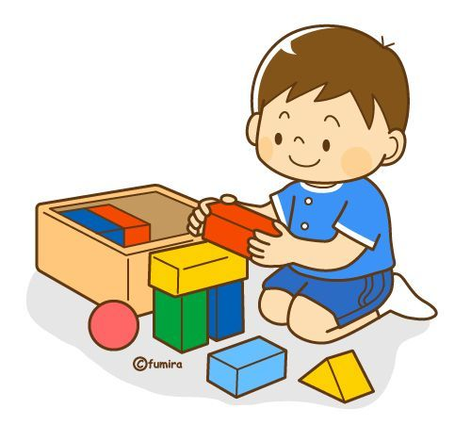
Margaret Mahler
Sub-phase Four: Consolidation and Object Constancy - 24 to 36 Months
  Children begin to be more comfortable to be separated from primary caregivers,
  Two year olds begin to accept that they are unique from their primary caregivers without anxiety,
  The child will accept substitutes for the primary caregiver when they are absent.
Notes:
As you can see, some of psychology's best known thinkers have developed theories to help explore and explain different aspects of child development. Today, contemporary psychologists often draw on a variety of theories and perspectives in order to understand how kids grow, behave and think.

Slide 63
Development Stages
Babies grow in such unique ways:
  The baby who sits up weeks before her peers might be one of the last to learn how to crawl.
  Reasoning behind the series of timelines.
Babies aren't identical the timelines allow for variations in stages of development
They will definitely not all reach their milestones at the same age
There is nothing wrong with a child that reaches his/her milestones at a later or even earlier age
Milestones are an indication of what you can expect of a baby or child

Slide 64
Milestones
Remember that it is never cast in stone,
Allow for different development phases in each child.

Slide 65

Influences on Development
Physical, socio-emotional and cognitive development do not stand alone from each other
The status of a child in one area can influence his/her development in other areas.
Notes:
Discuss with the group – what affects development
See LG for examples

Slide 66
The First Year
Physical Development
  Infants grow at a tremendously fast rate
  Length can be expected to double
  By their first birthday, most infants will be crawling and even may be taking a timid first step!
  Refer to table in Learner Guide for expected milestones (Pg43)
Notes:
Discuss table in learner guide

Slide 67
The First Year
Emotional Development
  The most essential ingredient in infant care is a warm, responsive, and dependable adult caregiver
  Spend lots of time holding, cuddling, and playing with the infants in your care.
  You will be richly rewarded with babbles, smiles, and squeals of laughter.
  Refer to table in Learner Guide for expected milestones (Pg45)
Notes:
Discuss table in learner guide

Slide 68
The First Year
Intellectual Development
  Children are aware of their surroundings and want to explore them.
  As the child plays and interacts with the people and objects around them, they learns about their body, home, and the world.
  Refer to table in Learner Guide for expected milestones (Pg47)
Notes:
Discuss table in learner guide

Slide 69
One to Two Years Olds
The time between one and two is one of rapid change.
A baby of this age is on the move and discovering the world.
Parenting, and looking after the baby, becomes demanding in a different way because you have to think about safety and setting limits, as well as caring for the baby.

Slide 70
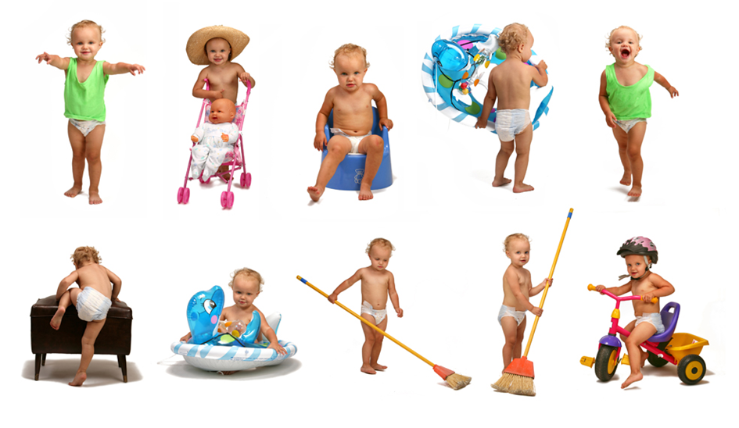
One to Two Years Olds
Physical Development
  Rapid increasing movement
  Refer to table in Learner Guide for expected milestones (Pg49)
Notes:
Discuss table in learner guide

Slide 71
One to Two Years Olds
Emotional Development
  Understands that they are a separate person from you
  This causes them to worry about the possibility of you leaving
  Causes the much-repeated words "me" and "mine"
  The whole notion of owning something needs first to have a self to own it
  They can understand many words, but cannot grasp abstract concepts
  They are strictly concrete thinkers
  They do not respond to spoken commands
  Need to be lifted down, moved away, distracted from and picked up very often indeed
  They are unable yet to control their impulses so they will still do the forbidden
  Refer to table in Learner Guide for expected milestones (Pg51)
Notes:
Discuss table in learner guide

Slide 72

One to Two Years Olds
Intellectual Development
  Are observant and imitate people
  Vocabulary improves
  Able to hold a pencil / crayon and scribble
  Refer to table in Learner Guide for expected milestones (Pg52)
Notes:
Discuss table in learner guide

Slide 73

3 – 5 Year Olds
Physical Development
  Eye–hand movements better co-ordinated
Emotional Development
  More sociable
  Accepts suggestions and follows simple directions
Intellectual Development
  Able to put words together to form sentences
  Enjoys singing
  Skills improve and develop
  Refer to table in Learner Guide for expected milestones
  (Pg54-59)
Notes:
Discuss table in learner guide

Slide 74
School Aged Children
Important for children to be accepted by the group
They compare their physical size and abilities with friends
They seek adult approval, need encouragement, recognition, praise, patience and adult support.
Boys play only with boys / Girls play only with girls
Begin to recognise the rights and desires of others
Have a need for privacy from parents and family
Learn best through active participation, sight, sound, and touch
Are curious, want to learn, and are usually interested in the here and now
Have an immediate need for success and rewards
Common issues and problems include lying, stealing, rudeness, irresponsibility, homework, television viewing, bedtime, use of allowance, and sex education.

Slide 75
School Aged Children
Social Development
  Social skills improve
  Enjoys group activities
  Boys and girls interests and personalities develop
Emotional Development
  More sensitive
Intellectual Development
  Understand and think more complicated thoughts
  Reading & writing skills develop
  Refer to table in Learner Guide for expected milestones
  (Pg61-66)
Notes:
Discuss table in learner guide

Slide 76
Factors that Influence Development
Gender
  Strongest influence on gender role development seems to occur within the family setting
Socio-Economic Background
  Children who come from families with adequate finances are more likely to grow and develop to optimal levels
Special Needs
  Develop differently
  Special care should be taken to spend more time with such children and to stimulate them in a specialised way
Environment
  Internal and external factors play a role in a child's growth and development

Slide 77
Environmental Factors
Nurture
  The way a child is treated by parents / caregivers impacts growth and development
  A loving and supportive environment helps children to focus on learning and growing instead of having to worry about being accepted and receiving praise
  Helping children to solve problems and learn new things and spending quality time together are effective ways to nurture children and help them develop

Slide 78

Environmental Factors
Stimulation
  The child must be exposed to new things
  Playing with open-ended toys, dramatic play, arts and crafts, reading and playing games as a way to promote healthy development in young children are excellent ways of stimulating a child.
  Encourage a love of reading, play games together and help the child to solve problems.

Slide 79

Environmental Factors
Nutrition
  Plays a vital role in a child's growth and development
  Lack of proper nutrition can interfere with the maturation of a child's brain and body.
  Good nutrition should start before a baby is even born and should continue throughout his/her life.
Notes:
Nutrition

Slide 80
Portfolio
Complete Formative Activity 1

Slide 81
Basic Child Knowledge
Study Unit 2:
Routines and Transitions

Slide 82

The Importance of Routines
Routines help babies and toddlers learn self-control
Routines can reduce power struggles
Routines guide positive behaviour and safety
Routines support children’s social skills
Routines help children cope with transitions
Routines are an important opportunity for learning

Slide 83
Routine in Care Centres
Children thrive in a well-ordered and predictable environment
Daily routines such as arrivals and departures, mealtimes, nap times and toileting should be dealt with consistently by all caregivers
Daily routines also offer children a sense of stability
The challenge is to develop appropriate daily routines for children
Notes:
, where

Slide 84
Routine in Care Centres
Daily Schedule
  Follow a basic daily schedule – allow flexibility
Transition times
  Creates flow during the day
Handling Nap Times
  Either conveys warmth and security, or stress and turmoil
  create a relaxed and quiet rest time
Separation Anxiety
  Daily routines create trust
  This special bond of trust is called "attachment”
Notes:
trust ….Lets look at some tips to establish attachment…

Slide 85
Tips to develop bond of attachment:
Listen and pay attention to what the baby or toddler is telling you---be sensitive to his/her cues
Pay attention to your own verbal cues and body language
Talk to the baby or toddler, even though he/she may not be speaking yet
Don't rush through daily tasks
Establish routines that are based on each individual baby or toddler's needs
Hold babies during bottle feeding in order to develop warm, nurturing relationships with them

Slide 86
Routine in Care Centres
Eating Routines
  Not everyone has the same diet
  Be sensitive to children who come from different cultures
  Important that snacks vary from day to day
Some considerations that help make mealtimes positive experiences
  Children eat at their own pace and some eat more than others do
  Do not tie food together with a reward or punishment
  Eating should be a shared and co-operative experience
  Mealtimes are opportunities for children to be independent
  Encourage children to taste everything but be careful not to force them to eat

Slide 87
Routine in Care Centres
The Process of Toileting
  A necessary social skill that most children develop around their second year
  Toilet training takes time, understanding and patience
  Do not rush children into using the toilet.
  Communication with families is essential
  There is no set age at which toilet learning should begin
  A child is ready to learn to use the toilet when
    he/she remains dry for at least two hours at a time
    dry after a nap
    he/she indicates beforehand that a bowel movement or urination is about to occur;
    he/she seems uncomfortable in a wet or soiled diaper;
    he/she asks to wear underwear.

Slide 88
Tips for encouraging toilet learning
Ask families to dress their child in clothing with elastic waistbands.
Make sure that there are enough extra clean clothes
Keep the toileting experience positive and relaxed
Praise the child if he/she is successful
Handle "accidents" in a calm matter-of-fact manner and reassure
Careful sanitation procedures are a must

Slide 89
Routine Examples
Refer to the routine examples for all ages in the learner guide
  3-6 months
  6-8 months
  8—14 months
  0-2 years
  2-5 years
Record information on the children in your care on a daily basis
Notes:
Work through examples and discuss

Slide 90
Transitions
Transitions in early childhood programmes happen whenever children switch caregivers,
Transitions require attention and planning
General principles that can be used to plan effective transitions
  Minimise the number of transitions as much as possible
  Plan ahead
  Teach children what is expected so that they learn self-regulation skills
  Constantly evaluate the effectiveness of transition plans and make adjustments

Slide 91
Portfolio
Complete Formative Activity 2

Slide 92
Basic Child Knowledge
Study Unit 3:
Providing a Safe Environment

Slide 93
Legal Implications of Providing Care
The Child Care Act 74 of 1983
Childrens Amendment Act, 2007
Both stipulate that anyone who intends caring for more than six children is required to register with the Department of Social Services

Slide 94
The Child Care Act 74 of 1983
Section 30 of the Child Care Act: Registration and Classification of Places of Care
  No child may be received in any place of care unless that place of care has been registered
  Application for the registration of a place of care shall be made to the Director-General
  After registration such a place must also be reviewed every 24 months
  Any person who contravenes or fails to comply with any provision of this section shall be guilty of an offence

Slide 95
The application documents
The constitution of the association of persons who will manage the place of care;
A certificate issued by the local authority that plans for the building or buildings have been approved by the local authority or that the building complies with all the structural and health requirements;
A certificate issued by the Director-General confirming that the applicant has performed a needs assessment which supports the need for this resource in the community.

Slide 96

Legal Implications of Providing Care
Public Liability
  All child care facilities must have Public Liability Insurance
  This protect them against claims for
    Personal Injury or
    Property Damage
    caused by an Occurrence in connection with their childcare service.

Slide 97
Forbidden Actions or Practices
The following disciplinary actions or practices are expressly forbidden in a place of child care:
  Group punishment for individual behaviour;
  Threats to remove a child from the school of from the programme;
  Humiliation or ridiculing of a child
  Any form of physical punishment
  Deprivation of basic rights and needs such as food and clothing
  Isolation of a child from other children other than for the immediate safety of such children, and only after all other possibilities have been exhausted
  Undue influence of children by care givers regarding their religious or personal beliefs including sexual orientation;
  Measures which demonstrate discrimination regarding language, gender, race or sexual orientation;
  Verbal, emotional or physical harm;
  Punishment by another child.
Notes:
Regular inspections can be done at child care facilities to ensure that the facility adheres to the Child Care Act

Slide 98
Registers and Records
Regulation 34 states that every place of care registered under Section 30 of the Act shall keep a register of children attending that place of care which must reflect the following details of each child:
  the full name, date of birth and gender of the child;
  the date of his/her admission;
  the names, addresses and telephone numbers of his/her parents;
  date on which care is terminated;
  any other information regarding the child which the place of care may deem necessary or
  expedient to enter.

Slide 99

Registers and Records
The facility must also complete the following documentation:
  A daily record of each child
  A medicine record
  A complete incident register
  Written Health and Safety Records

Slide 100
Closure of a Place of Care
Unsafe buildings or structures
Refusal to meet requirements as stipulated by the local authorities
Jeopardising the health of children
Physical abuse of children
Insufficient personnel
Incapable personnel
Chronic lack of or inappropriate stimulation programmes
Discrimination that leads to violation of the rights of children
A management committee that is not functioning, dysfunctional, has poor co-operation and/or is involved with corruption and maladministration
The community shows no interest, or there is no longer a need for the facility.
Notes:
Any of the following circumstances can lead to a place of care being closed:

Slide 101
General Safety
The outdoor playing space must be effectively and safely closed off,
Suitable gates must be installed so that the children cannot leave the premises on their own.
The facility must have controlled access to protect children
Swimming pools must be covered by a net and have a surrounding fence
All interior walls must have a durable finish – easy cleaning
Adequate storage space for the personal property of children and staff must be provided.
Adequate storage space accessible to children must be provided for indoor and outdoor equipment.
Waste bins with lids that fit tightly must be provided.
Notes:
The following general safety rules should be adhered to always:

Slide 102
General Safety
Action plans for specific emergency circumstances – must be known by all role players
Must also have an emergency exit plan in every room
Evacuation must be practised regularly
Measures must be taken for protection against and combating of fire, public violence and natural disasters.
No apparatus and equipment used, and no structures on the premises may at any stage endanger the children.
Provision should be made for the safe storage of medicines, cleaning materials, cooking fluids (paraffin) and other harmful agents

Slide 103
General Safety
Provision should be made for the safe-keeping of first aid kit equipment and universal precautions kit.
Personal toiletries such as a face cloth, soap, towels and toilet paper must be supplied and labelled
Where pets are kept on the premises they must be tame, clean, safe, healthy and cared for – children to be educated
Poisonous or noxious plants may not be grown on the premises.
The provisions of the Health Act 63 of 1977 states that children that have any form of infectious disease may not attend school – procedures to be in place

Slide 104
General Safety
All food, eating utensils and equipment used for the handling and serving of food must be free of dust, dust, dirt, insects and insecticides.
No poisonous substances may be used within the centre and/or near the children.
Insects and vermin must be effectively combated.
Alterations and additions, as well as new buildings, must comply with the National Building
Safety Regulations, and no children may be endangered if building or alterations are taking place.
The physical needs of children must be considered in the design and construction of buildings.
Especially the needs of physically disabled children must be catered for.

Slide 105
Indoor Safety
Keep emergency numbers by each phone in the care facility
All caregivers should know basic first aid
If the facility has stairs, use a hardware‑mounted swing gate at both the top and the bottom of stairs.
Full panel protective covers on all electrical outlets
No furniture in front of windows
Drawstrings on children’s outfits are very dangerous
Keep items such as toys, clothing, and any items with strings, cords, or ribbons that are longer than 15 cm (6 in.) out of the toddler’s reach
Cords on blinds and drapes must be removed or tied up where the baby or toddler cannot reach them

Slide 106
Bathroom Safety Tips
Always supervise a baby or toddler every moment that she or he is near water
Never leave babies or toddlers alone in a bathroom.
Keep all medications, cosmetics and cleansers out of reach and locked up
Keep sharp objects like scissors, and nail files out of reach and locked up
use a non‑skid bathmat on the bottom of the bathtub or shower.
Close the lid on the toilet seat and install a toilet seat lock
Keep baby powder, talc, corn starch, diaper pins, and other baby‑care objects well out of the baby or toddler’s reach.
Wipe up spills quickly

Slide 107
Kitchen Safety Tips
Safer not to allow children in the kitchen
Turn pot handles toward the back or middle of the stove
Keep a fire extinguisher in the kitchen
Use the back burners of the stove for hot temperatures
Front burners for lower temperatures
Keep hot oil out of reach and make sure it cannot splash or spill
Teach all children that the area in front of the stove is off limits as a play area.
Wipe up spills quickly.
Unplug and keep small appliances out of reach.
Keep small foods that could cause choking, such as beans or nuts, out of reach.
If the facility has a chest freezer, keep it locked

Slide 108
Top 8 Rules for Electric Safety
DON'T plug too many things into one outlet or extension cord
Make sure all electric cords are tucked away, neat and tidy
DON'T yank an electrical cord from the wall.
Fly a kite far away from power lines or substations
Teach children to ask a grown-up for help
Teach children to look up and look out for power lines before they climb a tree
Teach children to have a grown-up put safety caps on all unused electrical outlets
Keep electrical equipment far away from water

Slide 109

Health Hazards and the Environment
Children must, whenever weather permits, be allowed to play outdoors
Outdoor play has a set of risks,
  sun exposure,
  to poolside dangers,
  extra run-ins with insects
Never leave any baby, toddler or small child unattended while he/she is playing outside

Slide 110
Outdoor safety tips
Babies
  Babies under 6 months should avoid any significant sun exposure.
  Keep them in the shade, and out of the sun between the hours between 10am and 3pm
  Always use sunscreens specific to babies
  Choose an ultra-mild, baby-friendly insect repellent with a DEET concentration of less than 30 percent
  Keep water and snacks on hand

Slide 111
Outdoor safety tips
Toddlers
  Water safety with this age group is essential
  All water bodies in a care facility must be covered by a net and have a fence with a child-safe gate around it
  Apply insect repellent when necessary
  Sun protection - Cotton coveralls are cool and protective, and hats with chinstraps will generally stay put.
  Sunscreen wipes or spray-on sunscreens work well for quick, regular applications

Slide 112
Outdoor safety tips
Kids
  Have plenty of water, snacks, and even a small first-aid kit.
  Make sure the child is dressed for the occasion
  Use broad-spectrum sunscreens that block out ultraviolet A and B rays.
  Ensure not exposed to the sun for too long
  For lake or ocean activities always make sure the child wears a life vest with a buckle
  Sunscreen specific to the face is advisable for water activities
  Know which sunscreens the child is allergic to
  Use waterproof or water-resistant sunscreen and apply at least 30 minutes before going outside, then re-apply every hour
  Have child-friendly insect repellent
  Make sure kids wash their hands regularly or use hand sanitisers to kill bacteria.
  During excursions, take along snacks that won’t go bad in the heat
  Ensure appropriate padding and equipment is worn during sports and activities
  Do not allow children to play close to cell phone masts

Slide 113
Teaching Children Traffic Safety
Stop, Look and Listen
For the Very Young
Very young children have no real understanding of cars, streets or traffic.
  Start very simply by explaining how fast cars move,
  How difficult it is for drivers to see children
  Streets are off-limits.
Repetition is the key – make every trip outside a traffic lesson.
Never leave a young child alone near a street.
For the very young, make one simple but absolute rule – never go in the street without an adult.

Slide 114

Teaching Children Traffic Safety
As Children Get Older
Teach traffic safety through games and rhymes
Help a child learn to recognise and pay attention to corners

Slide 115
Teaching Children Traffic Safety
Traffic Signals
  Don’t make a child too dependent on traffic signals
  Explain that not all drivers follow the signals
  Everyone should look carefully in BOTH DIRECTIONS even when crossing with a signal
  “Look, Look and Look” (looking to the left, right and then the left again) is a good drill.
Safe Play
  Teach the child never to go into a street to retrieve a toy.
  Children should wait at the curb an adult comes and gets the toy.
  Make sure children play in safe places away from traffic.

Slide 116
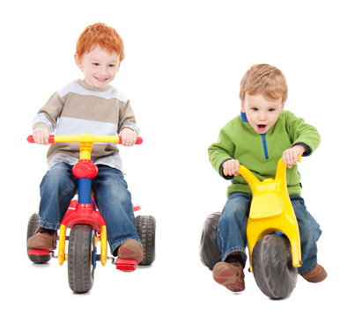
Teaching Children Traffic Safety
Bicycle Safety
  Children need to learn safe bicycle practices.
  They must wear helmets.
  Helmets reduce the risk of head injury and death in case of an accident.
  Be firm in laying down the “no-helmet-no-bike” rule.

Slide 117
Portfolio
Complete Formative Activity 3
Homework – Knowledge Questions

Slide 118
Basic Child Knowledge
Study Unit 4:
Illnesses and Injuries

Slide 119
Health care - Medical History Form
Information about the child’s general state of health;
Any communicable illnesses that the child has had and the dates when he/she had these illnesses;
Details regarding the child’s immunisation against polio, diphtheria, tetanus, whooping cough, measles, hepatitis B and tuberculosis;
Allergies and any other diseases such as diabetes and epilepsy that the place of care should have knowledge of;
The name, address and telephone number of the child’s family doctor, together with permission for him to be called out, if necessary;
The name, address and telephone number of the child’s dentist.
Notes:
The child in a place of care spends a significant part of the day away from home. For this reason the health care of the child is an important responsibility.
When a child is enrolled into the child care facility, the parents must complete a registration form. The medical history form is very important, and can form a part of the registration form

Slide 120
Health care –
Responsibilities of Caregivers
Watch out for possible illnesses and diseases in the children.
In case of any illness or problem, notify the parent immediately.
In urgent cases, with parent permission, call the family doctor or the appointed doctor.
If the child shows repeated bruising or injuries or if child may be subject to malnutrition, abuse and neglect - report to the social worker or welfare organisation and Child Protection Unit. The matter must be recorded at the centre.
Allow an ill child to rest away from the other children and inform the parent or guardian.
Keep a proper record of any medicine that is given to a child.

Slide 121
Health care –
Responsibilities of Caregivers
Place the names of children who are allergic to certain substances or products in prominent places and inform all staff.
Notify the medical health officer in cases of communicable diseases or diseases that must be reported.
If head or body lice and/or scabies are observed, notify parents and the child or children may not return until the condition has cleared up.
The provisions of the Health Act, 1977, regarding the barring of children that have infectious diseases from schools are applicable to all places of care.
Keep careful note and a record of any injury, trauma, biting, blood, knocks to head, or where treatment is applied and where the child fell ill while in the place of care, including the wounds and bruises with which the child was admitted.
Keep a record of each child’s immunisation programme.

Slide 122
Health care –
Responsibilities of Caregivers
Make sure that medicine is stored out of the reach of children.
Provide a safe place to keep first aid equipment.
Make sure that there are enough soap, towels or paper towels at the wash-basins at all times.
Make sure that caregivers are neat and clean at all times,
Caregivers must undergo regular health tests annually, particularly for tuberculosis.
Treat all illnesses in children in a confidential way.

Slide 123
Health care –
Universal Precautions
In the child care setting, blood is the most important source of spreading these viruses - protective measures are important.
Universal Precautions are the careful measures by which all blood as well as certain body fluids (e.g. breast milk) containing blood, are treated as if infected.
Universal Precautions usually do not apply in exposure situations to faeces, urine, vomitus, tears and nasal secretions, unless these are visibly blood stained.
Notes:
Child care providers are responsible to make sure that there is a safe environment for the normal healthy development of children in their care. To protect children, universal precautions need to be taken to ensure the well-being of the children

Slide 124
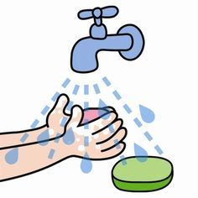
Health care –
Universal Precautions
Education.
Hand washing.
Use of protective barriers (Personal Protective Equipment (PPE))
Cleaning of contaminated surfaces.
Safe handling/disposal of contaminated material.

Slide 125
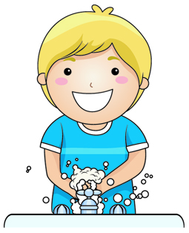
Health care –
Management Practices
Always practice Universal precautions.
Treat all blood or body fluids containing blood, as infected
Hand washing - should be practiced by caregivers and children.
Open sores, skin lesions and broken skin must be covered with waterproof dressings until they have healed.
Care givers must use latex gloves or plastics packets to cover their hands when they come in contact with blood

Slide 126
Health care –
Management Practices
Keep gloves, plastic packets and absorbent paper assessable
Children must be taught never to touch other people’s blood or body fluids
Attendance Registers and Incident Books must be accurately maintained.
Infection Control Measures are applied to prevent the spread of infections, diseases and conditions viz. diarrhoea, nits and lice.

Slide 127
Health care –
Administering Medicines
First make sure you have the correct bottle before giving medicine to children.
Don’t give medicines in the dark. Using the wrong bottle could have tragic results.
Read the label
Measure the dose carefully with a medicine spoon and give only the quantity prescribed
Don’t allow a child to take his/her own medicine.
Do not take medicines or tablets in a child’s presence
Always put containers away after use

Slide 128
Health care –
Storage of Medicine etc.
The golden rule is: Lock up all medicines and potentially dangerous household products
Replace the cap firmly - Put the container away immediately.
Never store potentially harmful products in soft drink bottles, containers or cups used for food or drink.
Keep medicines separate from other products.
Never store cleaning agents with food – keep them in a locked cupboard.
You must know which products in the centre are poisonous or dangerous.
Attractively packaged products that look harmless but can be dangerous when swallowed by a child.
These products are not labelled as poisonous and contain only the word “Caution” as warning.
Remember, small children cannot read warnings.

Slide 129

Health care –
Disposal of Medicine
Never throw bottles of medicine in the rubbish bin
Dispose of unwanted, left-over medicines and pills by returning them to the local pharmacist.
If this is not possible, flush them down the toilet or wash them down the drain
Wash out the empty bottle before putting it in the rubbish bin

Slide 130

Health care –
General Rules
Never allow children to play with medicine containers, empty or full
Teach the children not to eat or drink from bottles or cans left lying about
Keep an Emergency telephone numbers list near the telephone

Slide 131

Health care –
Medicine Administration Chart
Name of Child
Name of Medicine
Instruction of Parent: (Frequency, dosage/volume
Signature of Parent Signature of Caregiver
Dates

Slide 132

Childhood Illnesses - Signs
Is there a change in the baby’s behaviour?
  Is the baby crying more than usual?
  Has the tone of the cry changed?
  Is the crying at a different time of day than usual?
  Is the baby more irritable than usual?
  Is the baby sleeping more or less than usual?
  Does the baby seem lethargic or listless
Notes:
To find out whether the baby is ill, ask yourself the following questions

Slide 133
Childhood Illnesses - Signs
Has the baby’s appetite or digestion changed?
  Is the baby eating less than usual?
  Has the baby vomited more than once?
  If the baby is vomiting, is the vomiting forceful? (This is called projectile vomiting.)
  Are there signs of constipation? That is, are the stools hard or more solid than usual?
  Are there signs of diarrhea? That is, are the stools watery, or more runny than usual?
  Are they more frequent than usual?
  Is the baby urinating less frequently than usual? Has the colour of the urine changed?

Slide 134

Childhood Illnesses - Signs
Has there been a change in the baby’s breathing?
  Does the baby seem to have trouble breathing?
  Does the baby sound congested?
  Does the baby have a runny or stuffy nose?
  Is the baby coughing?
How does the baby look?
  Is the baby’s skin pale or flushed?
  Is there a rash anywhere on the baby’s body?
  Do the baby’s eyes look glassy or dull?
  Is there any discharge from the eyes?
Does the baby have a fever? A general rule is that a baby has a fever if his/her temperature is over 37.5.
Notes:
Any of these changes could indicate illness. If you notice any of them, or changes in the baby that concerns you, you should call the mother

Slide 135

If concerned – call the mother!
Describe:
The signs of illness about which you are concerned
How long the signs have been present
If the mother cannot leave her workplace,
  she might then ask you to take the baby to the doctor or
  call in the doctor that the facility usually uses.
  Be very precise when you describe to the doctor what you are worried about.

Slide 136
Acute Diseases
Acute diseases: A sudden onset of symptoms that are usually severe - usually heals fast
Examples of acute diseases are:
  Earache
  Sore throat
  Cough
  Croup
  Chicken pox
  Tonsillitis
  Bronchitis

Slide 137
Chronic Diseases
Chronic diseases: A chronic condition is a human health condition or disease that is persistent or otherwise long-lasting in its effects.
The term chronic is usually applied when the course of the disease lasts for more than three months.
Examples of chronic diseases in children are
  Diabetes
  Asthma
  Attention-deficit hyperactivity disorder (ADHD)
  Cerebral palsy
  Anaemia due to poor nutrition

Slide 138
Common Childhood Illnesses
- Fever
Elevated Temperature or Fever
  A fever is a temperature of over 37.5°C.
  Fevers are quite common in young children and are usually mild.
  If a child’s face feels hot to the touch and he/she looks red or flushed
  Check their temperature with a thermometer.
  Measured under the arm, normal temperature is about 36.4°C (97.4°F).
  Under the tongue or in the ear, normal temperature is slightly higher at about 37°C (98.4°F).
  Always contact the child’s parent or doctor if:
    The child has other signs of illness as well as a raised temperature
    The baby’s temperature is 38°C (101°F) or higher (if he/she is under three months), or
    The baby’s temperature is 39°C (102°F) or higher (if he/she is three to six months)
Notes:
It is also important to know which diseases are infectious, so that you can separate the child from others until the parents can fetch him/her.

Slide 139
Common Childhood Illnesses
- Fever
How to treat a fever
  Keep the child hydrated
  Don’t give the child food unless he/she wants it
  Treat discomfort and fever with paracetamol or ibuprofen (always follow the dosage instructions carefully), with parents’ permission only.
  The following may help the child feel more comfortable:
    Give the child plenty of cool clear fluids.
    Undress the child to the nappy or vest and pants.
    Cover him/her with a sheet if necessary.
    Keep the room well aired and at a comfortable temperature (about 18°C (65°F)) by adjusting the heating or opening a window.

Slide 140
Common Childhood Illnesses
- Rashes
Prickly Heat or Heat Rash
  Occurs when the child is overheated
  It is a faint red rash with tiny bumps or blisters found on
    the forehead,
    the trunk,
    in skin creases.
  Keep the child cool and dress him/her in lightweight, breathable fabrics.
  Let the skin air out and apply cool compresses and cornstarch to soothe the rash.

Slide 141
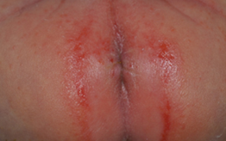
Common Childhood Illnesses
- Rashes
Diaper/Nappy Rash:
  Child's diaper area looks irritated and red,
  skin may be a little puffy and warm when you touch it.
  Diaper rash can be mild – a few prickly red spots in a small area
  Extensive rash will have tender red bumps that spread to tummy and thighs.
  The most likely causes are wetness, chafing or chemical sensitivity, new foods, infection and some antibiotics.

Slide 142
Common Childhood Illnesses
- Rashes
Diaper/Nappy Rash:
  Keep the child clean and dry by changing the diaper frequently.
  Rinse the diaper area well at each diaper change.
  Don't use wipes that contain alcohol or fragrance.
  Keep cotton balls and a squirt bottle or an insulated container of warm water at the changing table for easy, gentle cleanups.
  Pat the child's skin dry — don't rub!
  Use an ointment that forms a protective barrier on the skin after every diaper change to help protect the child's irritated skin
  Put the child's diaper on loosely or use a diaper that's a little big to allow for better air circulation.

Slide 143
Common Childhood Illnesses
- Rashes
Contact Dermatitis:
  A kind of skin inflammation that occurs when substances touching the child’s skin cause irritation or an allergic reaction.
  The red, itchy rash isn't infectious or life-threatening, but it can be very uncomfortable.
  Culprits in everyday life include soaps, cosmetics, fragrances, jewellery, or plants such as poison ivy or poison oak.
  Successful contact dermatitis treatment consists primarily of identifying what's causing the reaction.
  If the child can avoid that offending agent, the rash usually resolves in two to four weeks.
  Wet compresses and anti-itch creams can help soothe the child’s skin and reduce inflammation.
Notes:
Other rashes are associated with childhood illnesses like measles, chicken pox, scarlet fever and rubella, this we will discuss later.

Slide 144
Common Childhood Illnesses
- Ear Infection
Young children easily get ear infections because of their small Eustachian tubes.
These tubes connect the ears to the throat, and they may get blocked when a cold causes inflammation.
This traps fluid inside the middle ear, behind the eardrum, allowing germs to breed.
The symptoms include fever, fussiness, and ear-pulling.
Most ear infections are due to viruses and go away on their own.
Childhood vaccinations help prevent infections from certain bacteria that can cause ear infections.

Slide 145
Common Childhood Illnesses
- Glue Ear
A build-up of fluid in the middle ear (either with or without any pain) is called otitis media with effusion, or OME.
It often follows an acute ear infection or upper respiratory infection.
The fluid usually clears up on its own within a couple weeks.
However, if it lingers or is thick and glue-like ("Glue Ear"), it can interfere with a child's hearing.
Ear tubes may be recommended to help the fluid drain.

Slide 146
Common Childhood Illnesses
- Flu
Is it a cold or the flu?
These illnesses can have similar symptoms.
The flu more commonly causes high fever, chills, body aches, extreme fatigue, a sore throat, swollen glands and nausea or vomiting.
While most children get better on their own, the flu can lead to serious complications like pneumonia, especially in younger children.
An annual flu vaccination for children ages 6 months and older is recommended

Slide 147
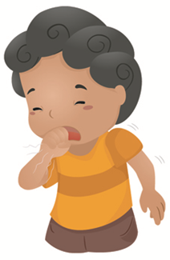
Common Childhood Illnesses
- Croup
The hallmark of croup is a tight cough that sounds like a barking seal.
The cause of the cough is inflammation in the upper airways, usually due to a virus.
If breathing becomes severely impaired, hospital treatment may be needed.
However, most kids get better on their own in about a week.
Croup is most common in children under five.

Slide 148
Common Childhood Illnesses
- Seasonal Allergies
Also called hay fever
Not an infection, but a reaction to microscopic particles like pollen.
Symptoms may include sneezing, watery eyes, and a runny or stuffy nose and may only occur in spring or fall.
Kids may constantly rub their nose with the palm of the hand, a gesture called the allergic salute.
There is no cure for hay fever, but there are ways to help control the symptoms.

Slide 149
Common Childhood Illnesses
- Sinusitis
If the child has a cough and a runny nose that has lasted for ten days or more with no signs of improvement – and the doctor has ruled out pneumonia – it may be sinusitis.
This bacterial infection of the sinus cavities causes a lingering cough because mucus is constantly draining down the back of the throat, triggering the cough reflex.
If the doctor determines that the child has sinusitis, she'll prescribe an antibiotic.
Once the sinuses are clear again, the cough should stop.

Slide 150
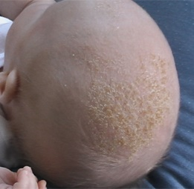
Common Childhood Illnesses
- Cradle Cap
Baby's scalp has flaky, dry skin that looks like dandruff, or thick, oily, yellowish or brown scaling or crusting patches
The cause of cradle cap is unknown
Not caused by poor hygiene or allergies
Not necessary to treat
  Gently massage the baby's scalp with your fingers or a soft brush to loosen the scales.
  Shampoo more frequently (up to once a day),
  Ensure to rinse out all the soap or shampoo.
  After shampooing, gently brush the baby's scalp with a soft brush or a terrycloth towel.
  Can try an oil remedy to help loosen dry flakes.

Slide 151
Common Childhood Illnesses
- Vomiting
Vomiting usually isn't serious
It is important to find out what is the cause
In most cases, vomiting will stop without specific medical treatment
Usually a virus and will get better on their own
Never use over-the-counter or prescription remedies
Keep child lying on their stomach or side as much as possible.
Make certain that dehydration doesn't occur
Notify parent as if it persists then a doctor must be consulted.

Slide 152
Infectious Diseases
- Lice
Spreads easily and very fast
Are tiny insects that live on the skin on the top of your head
Head lice can live up to 30 days on a human
Eggs can live for more than 2 weeks
Having head lice causes
  Intense itching
  Small, red bumps on the scalp, neck, and shoulders
  Tiny white specks (eggs, or nits) on the bottom of each hair that are hard to get off
Lotions and shampoos containing 1% permethrin (Nix) often work well
Notes:
Child must be isolated, should not be at school

Slide 153
Infectious Diseases
- Pink eye
Tearing, redness, itching, and crusty eyelashes are all signs of conjunctivitis, commonly called pinkeye.
It is often caused by the same viruses as the common cold
Pinkeye spreads rapidly in schools and day care centers.
The mother should consult the paediatrician to determine whether the child needs treatment.
Most cases clear up in four to seven days.
It is infectious
  Wash your hand very well after having touched the baby,
  Wipe the baby’s eyes, and use a clean cotton ball for each eye.

Slide 154
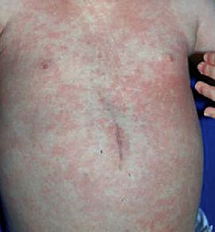
Infectious Diseases
- Roseola
A mild viral illness of childhood
Characterised by a sudden high fever
Lasts for three to five days
Symptoms: mild nasal congestion, eye redness, and a rash that appears after the fever has resolved.
  The rash may last for days or only hours.
  Rash is pink and may have small flat spots or raised bumps. These spots may have a lighter "halo" around them and turn white if you press on them. The rash isn't itchy or uncomfortable, and contact with the rash doesn't spread
  Rash shows up on the trunk and neck but can extend to the arms, legs, and face.
No specific treatment
Ensure child’s fever is kept under control, the child rests and gets plenty of liquids to avoid dehydration.

Slide 155
Infectious Diseases
- Rotavirus
Was the top cause of diarrhea-related deaths
Symptoms: vomiting and watery diarrhea causing dehydration
There are now two rotavirus vaccines for infants
Treatment involves the following:
  Offer the child plenty of fluids to avoid dehydration.
  Give acetaminophen or ibuprofen (but give ibuprofen only to children six months or older) to reduce fever.
  Serve bland foods (bananas, plain pasta, crackers, or toast) that won’t irritate the child’s digestive system any more than it already is — and avoid giving apple juice, dairy products, and sugary foods, which can make the little one’s diarrhea worse.
  Let the child rest.

Slide 156
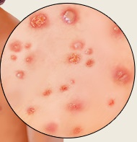
Infectious Diseases
- Chickenpox
Chickenpox is now preventable through the varicella vaccine
Can cause dangerous complications in newborns, adults, and pregnant women
Identified by a red rash, which turns into little blisters after a few days.
Rash is very itchy – no scratching as it will result in ugly permanent marks.

Slide 157
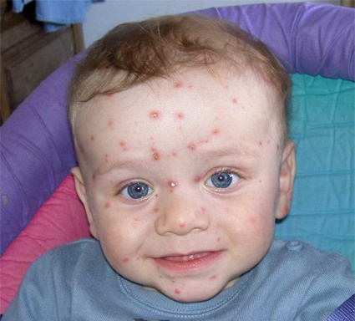
Infectious Diseases
- Chickenpox
Treatment involves keeping the person as comfortable as possible
  Avoid scratching or rubbing the itchy areas.
  Wear cool, light, loose bedclothes.
  Take lukewarm baths - oatmeal or cornstarch bath.
  Apply a soothing moisturizer after
  Avoid prolonged exposure to excessive heat and humidity.
  Try over-the-counter oral antihistamines
  Try over-the-counter hydrocortisone cream on itchy areas.
  Medications that fight the chickenpox virus are available but not given to everyone -medicine must be started within the first 24 hours.

Slide 158
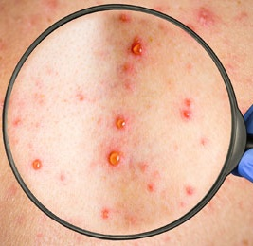
Infectious Diseases
- Measles
Children are vaccinated
The infection starts with a fever, runny nose, and cough
As these symptoms fade, a full-body rash appears.
Most kids get better in two weeks, but some develop pneumonia or other problems
The eyes of a child with measles can be very sensitive to light

Slide 159
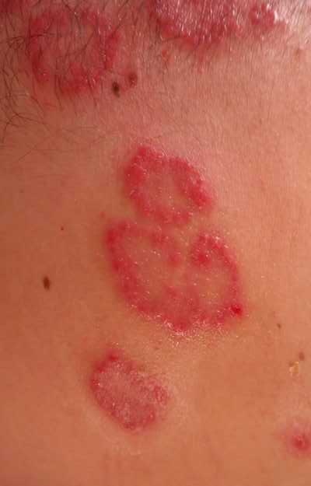
Infectious Diseases
- German Measles
Rubella, also called German measles
Mild virus that usually causes no serious problems
Can harm the fetus if a pregnant woman becomes infected
Symptoms are a low fever and rash that spreads from the face to the rest of the body
A standard childhood vaccine called MMR protects against measles, mumps, and rubella.

Slide 160
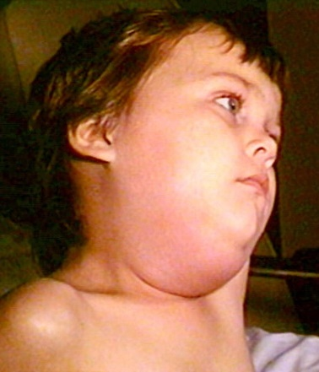
Infectious Diseases
- Mumps
Very common before a vaccine was developed
Infection often causes no symptoms,
  Classic sign is swollen glands between the ear and jaw
  Creates the appearance of "chipmunk cheeks."

Slide 161
Infectious Diseases
- Whooping Cough
The medical term for the disease is pertussis
The "P" in the DTaP vaccine
Makes children cough so hard, they run out of breath and inhale with a "whoop."
The infection is most severe in infants and may require hospital treatment.
Antibiotics are not especially helpful in treatment, so vaccination is essential
Adults may need a booster shot, especially if they are a caregiver for a young infant.

Slide 162
Infectious Diseases
- Meningitis
Meningitis is an inflammation or infection of the tissue around the brain and spinal cord.
In teens and adults, the main symptoms are headache, fever, and stiff neck.
Young children may have flu-like symptoms or extreme irritability.
Viral meningitis is usually mild, but bacterial meningitis is more severe with serious consequences if it isn't treated quickly.
Vaccines are available to prevent certain bacterial causes of meningitis.

Slide 163

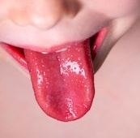
Infectious Diseases
- Scarlet Fever
Sometimes a rough, red rash accompanies strep throat.
The rash begins on the chest and abdomen and spreads all over the body, accompanied by a strawberry-looking tongue and high fever.
Without treatment, it can lead to rheumatic fever and, in rare cases, heart damage.
Scarlet fever was once a dreaded childhood illness.
Today, it is easily cured with antibiotics.

Slide 164
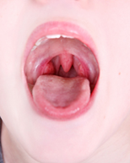
Infectious Diseases
- Strep Throat
Signs of strep include
  A sore throat that lasts more than a week,
  Painful or difficult swallowing,
  Excessive drooling,
  A rash, pus in the back of the throat,
  Fever over 100.4 degrees, or
  Contact with someone with strep throat.
Treatment - antibiotics.
Notes:
Most kids get a sore throat now and then, usually due to a cold virus.
Sneezing or a runny nose point to a cold.

Slide 165
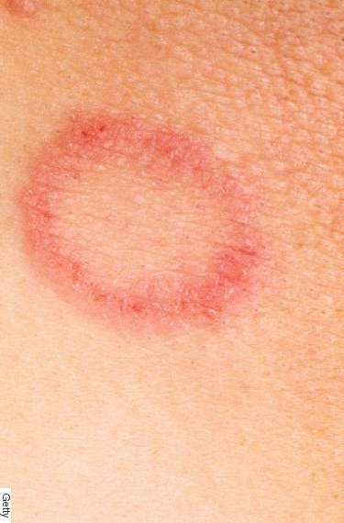
Infectious Diseases
- Ringworm
Ringworm is skin infection caused by a fungus -- no worms involved.
It causes a red, scaly ring on the skin or a round patch of hair loss on the scalp.
The fungus spreads easily from child to child, so sharing combs, brushes, towels, and clothes should be avoided.
Ringworm is treated with antifungal medication.

Slide 166
Notifiable Diseases
South Africa has a routine notification system for reporting notifiable medical conditions
The South African Disease Notification System is a passive surveillance system that collects information on Notifiable Medical Conditions
The notification of certain medical conditions in South Africa is based on the government’s Health Act, Act No. 61 Of 2003
In South Africa all the childhood diseases, for which vaccines are routinely given, are notifiable
This helps to monitor the number of cases still occurring and also enables the health authorities to control any outbreaks

Slide 167
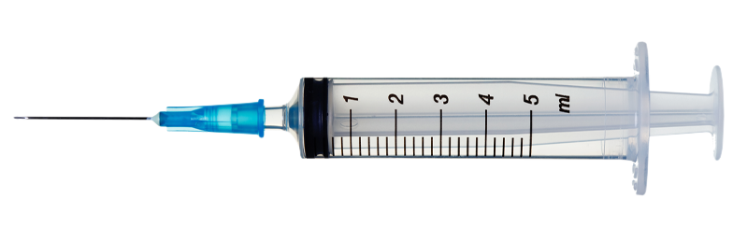
Vaccinations/Immunisations
Vaccination is strongly recommended, in some countries, law enforces certain vaccinations.
Vaccines on the EPI programme are provided free of charge
  Poliomyelitis
  Diphtheria
  Hepatitis A and B
  Mumps
  Varicella (Chickenpox)
  Rotavirus (Gastro)
  Pneumococcal infection (meningitis, infection of the lung, blood infections and infection of the middle ear)
  Tuberculosis
  Tetanus
  Pertussis (Whooping Cough)
  Haemophilus Influenza type B (Hib)
  Measles
  Rubella (German measles)

Slide 168
Vaccinations/Immunisations
How do Vaccines Work?
  Vaccines “teach” the immune system to recognise and fight certain germs, bacteria and viruses
  By giving the body a small “sample” of the germ, it can develop resistance, without actually contracting the disease.
Why Give Babies and Children Vaccines?
  Certain vaccine-preventable diseases can infect babies within the first few months of life.
  Vaccinating these babies helps provide them with protection when it is needed.
  Some of these immunisations have to be repeated to make sure the baby/child remains protected.

Slide 169
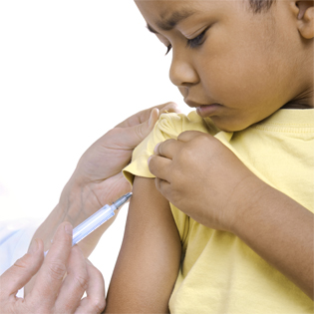
Vaccinations/Immunisations
Side Effects of Vaccines
  The most typical side-effects include a slight fever, drowsiness and soreness at the injection site.
  In rare cases, vaccines can cause other side-effects, e.g. very high temperatures.
  If the child develops a high fever (more than 39º C), or appears to be in severe pain, seek medical attention immediately.

Slide 170
Vaccinations/Immunisations
The Road to Health Chart
  Received when baby was born in a hospital maternity ward.
  These charts vary.
  Charts can be obtained from the nearest clinic when the baby’s birth certificate is presented.
  All the details about the baby’s health will be entered on the chart by the doctor or clinic sister.
  Vaccination information also has to be filled in on the chart.
  The chart must be kept in a safe place, because the parents will need it when the child goes to school.
  When further immunisations must be done, it is important that the chart is taken with to the clinic, doctor or hospital
  Refer to the schedule in the learner guide pg113
Notes:
Discuss the immunisation schedule with the class.

Slide 171
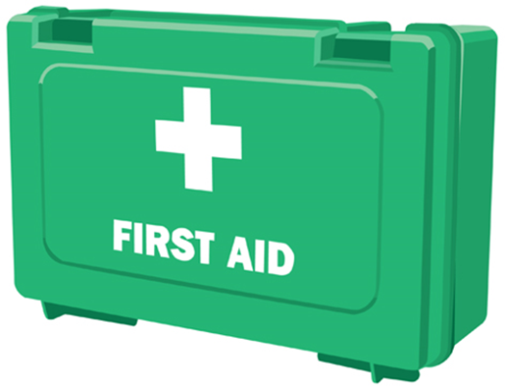
Emergencies
- First Aid Box
Child care facility must have a well-stocked first aid box
Supplies:
  Medicine spoons for rehydration drink
  Scissors
  Jik (or some kind of disinfectant)
  Soap
  Scrap cotton for bandages and dressings
  Plastic bags to substitute for rubber gloves
  Litre container to make rehydration drink
  Box to keep supplies in

Slide 172
Emergencies
- First Aid Box
Equipment:
  Syringe for removing mucus
  Oral or ear thermometer and instruction card
  Cotton wool
  Triangular bandages
  Medicine spoons
  Gauze squares
  Gauze rolls
  Surgical tape
  Kidney dish
  Safety pins
  Scissors
  Rubber gloves

Slide 173
Emergencies
- First Aid Box
Medicines:
  Potassium Permanganate and colour card
  Dettol/Eusol
  Betadine/Podine
  Vaseline
  Zinc Ointment
  Whitfield Ointment
  Gentian Violet
  Benzyl Benzoate (Ascabasol) and instruction card for (a) Scabies (b) Lice
Medicines:
  Mercurochrome
  Calamine Lotion
  Vitamin B Complex
  Benylin Expectorant and instruction card
  Panado (Dolorol) and instruction card
  Savlon
  Lemon juice/honey/liquor instruction card
  Gargling instruction card
  Oral or ear thermometer instruction card

Slide 174
Emergencies
- First Aid Box
Improvised:
  2 litre ice-cream container
  Scrap cotton for dressings
  Scrap cotton for bandages
  Scrap cotton triangular bandages
  Scrap small pieces of material for nose wipes
  Scrap material for face cloths
  Plastic bags to substitute for rubber gloves
  Litre container (to make re-hydration drink)
  Cardboard and padding for rigid splints
  First-aid box (with lock)

Slide 175
Emergencies
- Swallowing or Inhaling an Object
A cough that has hung on for a week or more without any associated signs of illness (runny nose, fever, lethargy) or the clear discharge from the nose that signals allergies may mean that the baby has something stuck in his/her throat or lungs.
If the child's doctor suspects that a foreign body is the cause of the cough, he/she'll order a chest X-ray.
If the X-ray shows something trapped in the lungs, it will have to be removed surgically.
If the child has developed pneumonia as a result, he/she'll also be treated with antibiotics.

Slide 176
Emergencies
- Poisoning
If the baby has diarrhoea and is vomiting, and you think he/she may have swallowed some kind of non-food item like a medication, chemical, or plant, call the Poison Control Center right away
Call the nearest ambulance service if the child becomes unconscious or is having trouble breathing.
The poison control centre will tell you what to do until the ambulance arrives,
If you are not be able to reach them you will have to make a judgement call whether you should induce vomiting or not.
Do not induce vomiting if:
  The child has swallowed a cleaning product containing acids or alkalis.
  The child has swallowed a petroleum-based product.
  The child is groggy or confused.
  He or she is too young to understand and follow directions (such as a baby less than two years old).

Slide 177
Emergencies
- Poisoning Trouble Spots
Kitchen:
  Polishes, bleaching powder, detergents, ammonia, washing powder, insecticides and cleaning agents for drain-pipes.
Toilet:
  Disinfectants, deodorant blocks and toilet cleaners.
Other:
  Moth balls and insect repellents in strips, sticks, aerosol cans and fluids. All batteries.
Poison out of doors:
  Some plants, berries and mushrooms are poisonous.

Slide 178
Emergencies
- Wasp or Bee Stings
A bee's stinger works like an automatic pump — the longer it stays in, the more venom it releases
Remove quickly.
Look for a little black dot in the center of a reddened area and scrape it off with a fingernail or credit card.
Do not squeeze the stinger with your fingers or tweezers, because that could release more venom.
Wash the area with soap and water.
Apply an ice pack for 15 minutes or so to minimise swelling and relieve pain.
Wrap icepack in a washcloth of towel so it doesn't touch the baby's skin directly.
Can help to apply a paste of baking soda and water to the area, to soothe it and draw out some of the venom
The pain will go away after a few hours, although the swelling may increase for another day or two.

Slide 179
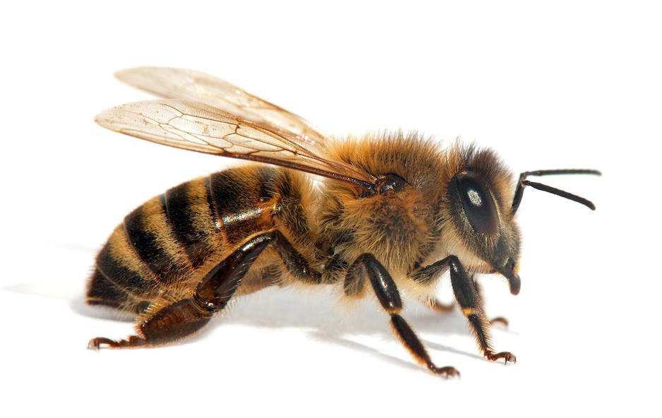
Emergencies
- Wasp or Bee Stings
On rare occasions, a child will have a severe allergic reaction to an insect sting
Symptoms within a few minutes or hours of the sting:
  Rash over many parts of his body
  Shortness of breath
  Swollen tongue, hands, or face
  Weakness
  Unconsciousness
Call an ambulance immediately for emergency

Slide 180

Emergencies
- Fractures
Babies' bones are so pliable they rarely break
If the baby's injury only swells a little bit and he doesn't seem to be in much pain, it's all right to treat the injury with ice and wait a day or two before calling the doctor
If the injury doesn't improve or gets worse, take the baby to the doctor for an exam.
If the baby is in a lot of pain, or you don't know the extent of the injury you should rather take the baby to the doctor immediately.
Notes:
To determine on your own whether a child has broken a bone can be difficult, but chances are usually good that the bone is not broken, just sprained

Slide 181
Emergencies
- Fractures
Some other warning signs of a broken bone:
  A snapping sound
  Bruising
  Tenderness to touch
  Severe pain, especially in one spot
  Increased pain with any movement (don't assume that if the baby can move his limb or digit it's not broken — that's an old wives' tale)
  Stiffness
  Limping or the inability to stand or walk (for a child who can walk)
  Refusing to stand or walk
  A limb that seems bent or out of position

Slide 182
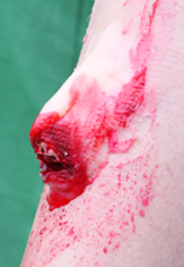
Emergencies
- Open Fractures
If the accident has caused the bone to pierce through his skin, call an ambulance or get him to an ER right away.
This type of break is called an open fracture;
Because of bleeding and the risk of infection, it is the most dangerous type of break.
Don't touch it for any reason, do not even try to wash it.
To lower the risk of infection, drape the open wound with a clean cloth diaper or sterile gauze.
Either call an ambulance or take the child to the nearest hospital immediately.

Slide 183

Emergencies
- Skull, Neck, Back or Pelvic Fracture
Don't move the baby.
Call and ambulance immediately

Slide 184
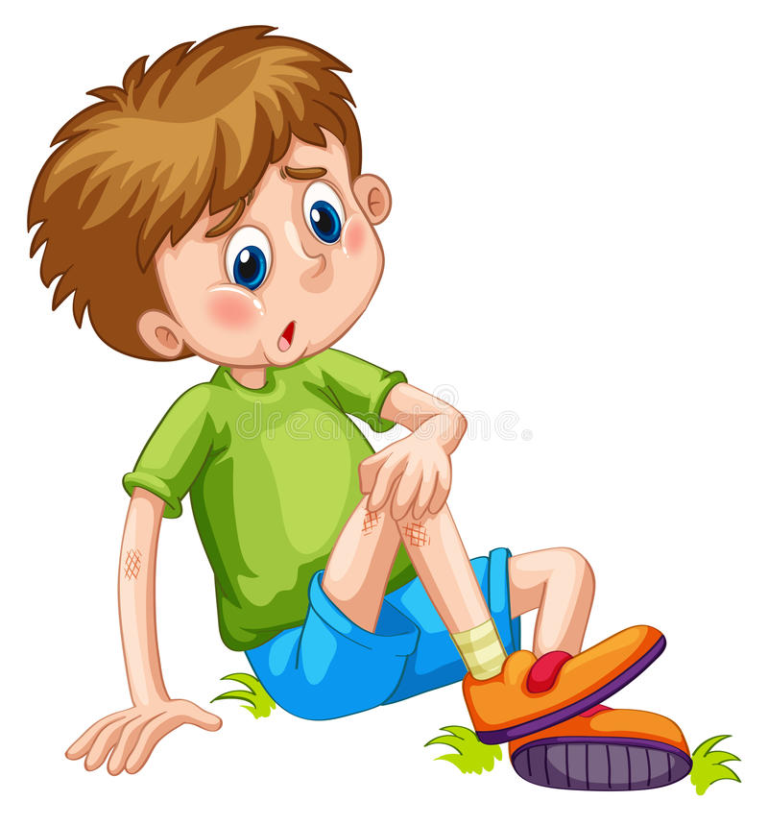
Emergencies
- Bruises
Bruises heal very quickly on their own.
If a baby is very active, they are prone to banging into things or taking an occasional tumble.
Minor injuries routinely happen while babies explore the world.
Almost all babies, especially those who are learning to crawl or walk, wind up with a few bruises now and then.

Slide 185
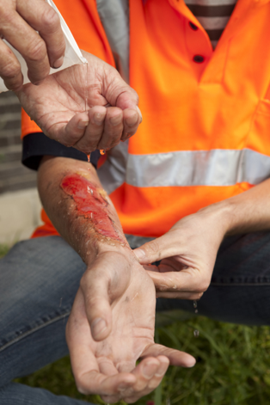
Emergencies
- Serious Burns
Remove child from the source of the burn and out of danger.
If clothing is on fire, smother the flames with a towel, blanket, or whatever else is available.
If the child has stopped breathing, administer CPR and have someone call an ambulance.
If the child is breathing, call an ambulance or rush him/her to the emergency room.
Place a clean sterile cloth over the area if possible, but don't try to treat a serious burn yourself.
Do not to touch the child's burns directly or breathe on them, as they're very susceptible to infection.

Slide 186
Emergencies
- Concussion
Early symptoms for concussion are:
  loss of consciousness
  drowsiness
  dizziness
  confusion
  vomiting
  irritability
  drainage, clear or bloody, from his nose, mouth, or ears
If the child hits his/her head and starts breathing irregularly, has convulsions, or is unconscious, call for immediate help.
Don't move the child unless they are in danger of being hurt further.
Perform CPR if they are not breathing
If child is bleeding, cover the wound with a clean cloth and apply pressure.
Notes:
When a closed-head injury — meaning one in which no object penetrates the skull — causes a change in the normal functioning of the brain, it's called a concussion. The injury might be from a hitting his/her head very hard, a fall, or a severe shaking.

Slide 187
Emergencies
- Concussion
If the baby suffers from any of the following symptoms after a day or two you must take them to a doctor immediately:
  Persistent vomiting.
  Unusually sleepy during the day or can't be awakened at night.
  Seems weak or confused,
  Has problems with co-ordination, vision, or verbal communication.

Slide 188
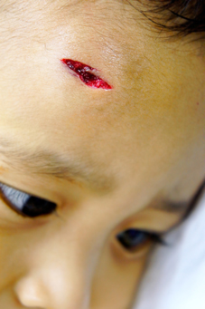
Emergencies
- Cuts and Scrapes
Wash your hands well, and look.
If the wound is bleeding, apply direct pressure with a clean bandage or towel until the bleeding stops.
If the bleeding doesn't stop after ten minutes of direct pressure, take the child to the emergency room.
If the bleeding has stopped, check for glass, dirt, or other foreign materials in the wound.
Flush object out with cool running water.
Or use tweezers to carefully lift out the debris.
Gently wash the wound well with soap and warm water, and carefully pat it dry.
Antibiotic ointment after washing and drying the area can help reduce the risk of infection.

Slide 189
Emergencies
- Cuts and Scrapes
Stitches
  Cuts that look deep and open, especially if they have jagged edges, probably need stitches
  Candidates for stitches are cuts on the face and on areas that are taut or that stretch with movement, like the palm side of the hands and fingers.
  For the best results, the child should have the stitches within eight hours of receiving the cut — preferably sooner
  This will avoid the risk of serious infection and to help prevent scarring.

Slide 190
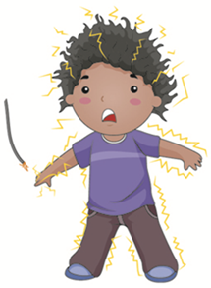
Emergencies
- Electric Shock
Depending on the strength and type of current and how long the child holds on, it can cause
  a split-second sensation,
  a burn, or
  a serious injury.
If the child suffers an electric shock,
  They may have skin burns;
  numbness or tingling;
  muscle contractions,
  pain,
  weakness;
  a headache;
  or hearing impairment.

Slide 191
Emergencies
- Electric Shock
A big enough shock can make a child unconscious, stop his/her breathing, or cause seizures, cardiac arrest, damage to his/her brain, heart, or other organs, or even death
Shut off the source of the electricity immediately
Don't touch the child with your bare hands while they are in contact with the electric current
Don't reach into water in which there's an electric current,
If you need to break the child's connection with the current, use an object that's not metallic and won't conduct electricity, like a wooden broom or a rolled-up magazine.

Slide 192
Emergencies
- Electric Shock
Check the child’s breathing
If they not breathing, have someone call an ambulance while you give CPR
If the child's breathing is fine, check their skin colour
Call for emergency help if they seems pale
Monitor the child's breathing and begin CPR if they stop.
Look for burned skin.
Electric shock can cause a serious burn – internal & external
If the child has a burn, don't put ice, ointment, or anything else on it, but take the child to the emergency room right away.

Slide 193
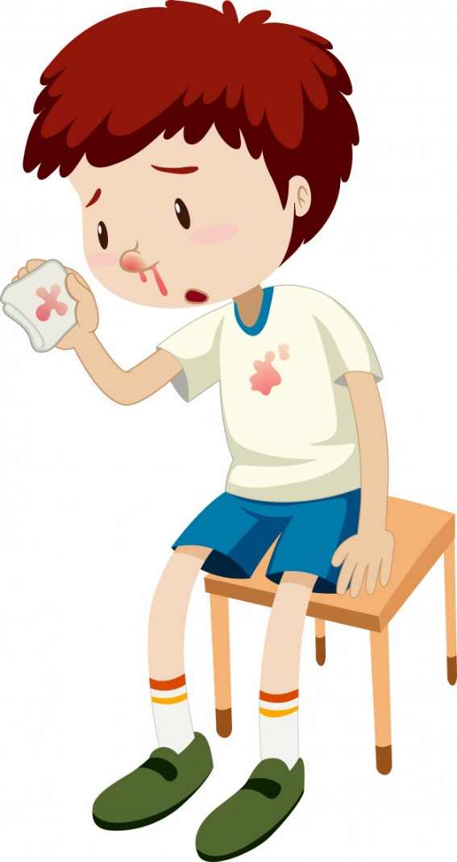
Emergencies
- Nosebleed
Seat the child in your lap and lean him/her forward slightly.
Using a tissue or a clean, soft washcloth, gently pinch the soft part of his nose shut.
Apply gentle, constant pressure for a full ten minutes.
Resist the temptation to peek earlier to see if the bleeding has stopped.
After ten minutes, release the pressure and see if the bleeding has stopped.
You can also apply a cold compress to the bridge of his/her nose.
Notes:
Nosebleeds are very common and are rarely a cause for concern
Distract the child by singing, looking at a book together, or watching a video.
After ten minutes, release the pressure and see if the bleeding has stopped.

Slide 194
Emergencies
- Severe Bleeding
Act quickly if a child is bleeding severely.
If the child has lost consciousness or appears to be in shock, have someone call the ambulance immediately
Begin first aid.
Lay the child down with his/her feet elevated about 6 inches.
If possible, elevate the part of his/her body that's bleeding in order to reduce blood flow to that area.
Apply firm pressure directly to the wound using a sterile bandage or cloth
Keep the pressure on to minimise the bleeding until you can get help.
If blood soaks through the bandage you're using, don't remove it. Instead, just add another layer on top.
Keep calm and to calm the child
Once the bleeding stops, leave the bandage or cloth in place. To maintain pressure, tie another bandage
Firmly around the bandages and the injured area

Slide 195

Emergencies
- Severe Bleeding
Blood Spill
  Children must be separated from the person bleeding and from blood spills.
  Gloves or plastic packets must be worn when cleaning up the blood spills to prevent skin/blood contact.
  Spilt blood must be soaked up with absorbent material e.g. paper/dry soil/sawdust.
  Used paper/dry soil/sawdust and used gloves must be carefully placed in double plastic bags, tied securely and discarded into the refuse bin.
  Wash hands immediately thereafter.
  The blood stained area must be sprayed with a disinfectant solution (household bleach 1 part to 9 parts of water which is made up daily) and followed with the normal cleansing procedure.

Slide 196
Emergencies
- Severe Bleeding
Blood Stained Items
  Gloves or plastic packets must be worn when handling blood stained items such as clothing/linen/carpets etc.
  Remove as much of the blood as possible using absorbent paper/tissues.
  Rinse or mop with cold water to remove the bloodstain.
  Place clothing/linen into a plastic bag and return to child’s home for complete laundering.
  Carpets can be sponged with hot soapy water, rinsed and allowed to dry in the sun if possible.
  All disposable cleaning material (e.g. paper, tissue) and gloves to be placed in double plastic bag, tied securely and discarded into the bin. Wash hands immediately thereafter.
  Used sanitary towels must be placed in double plastic bags, tied securely and disposed into a lidded refuse bin for collection.

Slide 197
Emergencies
- Seizures
Help the child to lie down.
Remove glasses or other harmful objects in the area.
Do not try to put anything in the child's mouth. In doing so, you may injure the child or yourself.
Immediately check if the child is breathing. Call the emergency number to obtain medical assistance if the child is not breathing.
After the seizure ends, place the child on one side and stay with the child until he or she is fully awake.
Observe the child for breathing.
If he or she is not breathing within 1 minute after the seizure stops, then start mouth-to-mouth rescue breathing (CPR).
Do not try to do rescue breathing for the child during a convulsive seizure, because you may injure the child or yourself.
Notes:
When a child has a seizure, your initial efforts should be directed first at protecting the child from additionally injuring himself or herself.

Slide 198
Emergencies
- Seizures
If the child has a fever, acetaminophen (such as Tylenol) may be given rectally.
Do not try to give food, liquid, or medications by mouth to a child who has just had a seizure.
Children with known epilepsy (a history of seizures) should also be prevented from further injury by moving away solid objects in the area of the child.
If the child is in a boat or near the water, restrain the child to prevent drowning.
If you have discussed use of rectal medication (for example, Valium) with the child's parents or doctor, give the child the correct dose.

Slide 199
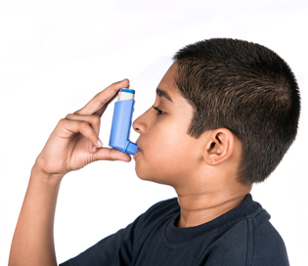
Emergencies
- Asthmatic Attacks
Occasionally a child can have an asthma attack no matter how careful you are
Asthma attacks are the result of a gradual worsening of symptoms over a few days.
If the child's symptoms are getting worse, do not ignore them.
Asthma attacks can be frightening so it is important to stay calm

Slide 200
Emergencies
- Asthmatic Attacks: Five step rule
Let the child:
1. Take two puffs of reliever inhaler immediately
2. Sit upright and stay calm
3. Take slow steady breaths
4. If there is no immediate improvement,
      let the child take one puff of reliever inhaler every minute
      A child can take up to 10 puffs in ten minutes
      Children under 6 years can take up to 6 puffs in ten minutes)
5. Call the emergency number if symptoms do not improve
OR if you are worried
If an ambulance does not arrive within 10 minutes repeat Step 4.
Don't put your arm around the child or lie him/her down
Don't worry about giving the child too much reliever - during an asthma attack extra puffs of reliever medication are safe.

Slide 201
Emergencies
- Choking: 12 months or Younger
If the child is coughing and gagging but can breathe and talk, don't do anything
If the child can't breathe, you must act quickly to stop a life-threatening situation.
Call for an ambulance, then
If the child is unconscious:
  Start CPR
  Take the object out of his mouth only if you can see it.
Notes:
Young children are prone to choking..
But if he/she can't breathe, you must act quickly to stop a life-threatening situation.

Slide 202
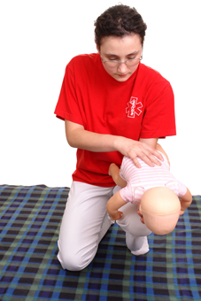
Emergencies
- Choking: 12 months or Younger
For a child younger than 1 year who is conscious but not breathing:
1. Get the child into position
Hold the child face down on your forearm, supported by your thigh.
Keep the child's torso higher than the head.

Slide 203
Emergencies
- Choking: 12 months or Younger
2. Give Forceful blows
Use the heel of your free hand to thump the child in between the shoulder blades up to five times.
3. Turn the child over
Turn the child face up, and keep supporting the head and neck. If the object is not out yet, go to step 4.
4. Press the chest
Place the child on a firm surface, which may still be your forearm.
Put two or three fingers in the center of the child's breastbone and push quickly up to five times.
Repeat the back thumping and chest pushes until the object comes out or the child loses consciousness.

Slide 204
Emergencies
- Choking: 12 months or Younger
If the child is still not breathing, open the airway by putting your thumb in the child's mouth and grasping the lower incisors or gums. The jaw should lift up so you can look for the object.
Do not try to pull the object out unless you see it clearly. You could accidentally push the object deeper in the child's throat.
5. Start CPR, if needed
If the child loses consciousness, perform CPR and take the object out of his/her mouth only if you can see it. Never do a finger sweep unless you can see the object in the child's mouth.

Slide 205
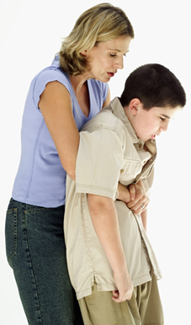
Emergencies
- Choking: Older than 1 Year
For a child older than 1 year who is conscious:
1. Get the child into position
Stand behind the child and wrap your arms around his/her waist.
Place a fist just above the child's belly button
2. Try to dislodge the object
Hold the fist with your free hand and quickly push in and up.
Repeat until the object comes out or the child loses consciousness.

Slide 206
Emergencies
- Choking: Older than 1 Year
3. Start CPR, if needed
If the child loses consciousness, move the child to the floor and start CPR.
Take the object out of his/her mouth only if you can see it.
Never do a finger sweep unless you can see the object in the child's mouth.

Slide 207
Emergencies
- Bite Wounds
If the skin isn't broken and the wound will not be serious.
  Simply wash the area with mild soap and water
If the skin is broken, it is serious.
  The human mouth is full of bacteria,
  The risk of infection is 10 to 15 percent.
  Serious bites to the face, hands, or genitals can be especially dangerous.
  Wash — but don't scrub — the wound with mild soap and running water for three to five minutes
  Cover with a clean bandage.
  If the wound is bleeding, apply pressure with a clean, dry cloth and elevate the area if possible.
  Take child to see a doctor
Notes:
It's not uncommon for a child to bite another child during play or in anger

Slide 208
Emergencies
- Bite Wounds
If an animal bites a child, follow these guidelines:
  For minor wounds. If the bite barely breaks the skin and there's no danger of rabies, treat it as a minor wound.
  Wash the wound thoroughly with soap and water.
  Apply an antibiotic cream to prevent infection and cover the bite with a clean bandage.
  For deep wounds. If the animal bite creates a deep puncture of the skin or the skin is badly torn and bleeding
  Apply pressure with a clean, dry cloth to stop the bleeding
  Take the child to a doctor.

Slide 209
Emergencies
- Bite Wounds
If an animal bites a child, follow these guidelines:
  For infection. If you notice signs of infection, such as swelling, redness, increased pain or oozing, see a doctor immediately.
  For suspected rabies. If you suspect the bite was caused by an animal that might carry rabies — including any wild or domestic animal of unknown immunisation status, particularly bats — see a doctor immediately.
Notes:
Domestic pets cause most animal bites. Dogs are more likely to bite than cats. Cat bites, however, are more likely to cause infection because they are usually puncture wounds and can't be thoroughly cleaned. Bites from nonimmunised domestic animals and wild animals carry the risk of rabies.

Slide 210
Dealing with an Emergency
Keep a list of emergency numbers close to a phone
Have all contact numbers of parents available where they can easily be located, like in a folder on a computer or in the child’s file.
See example of checklist in learner guide
When calling an emergency number...
  Try to stay calm.
  Make sure you have the following details ready:
1. The nature of the emergency.
2. Exact location of the incident (including nearby landmarks).
3. Caller details, for instance contact name and number.
4. Any injuries.
  Do not hang up until you are told to do so, even if you dialled the wrong number by mistake.
Notes:
Refer to checklist in LG

Slide 211
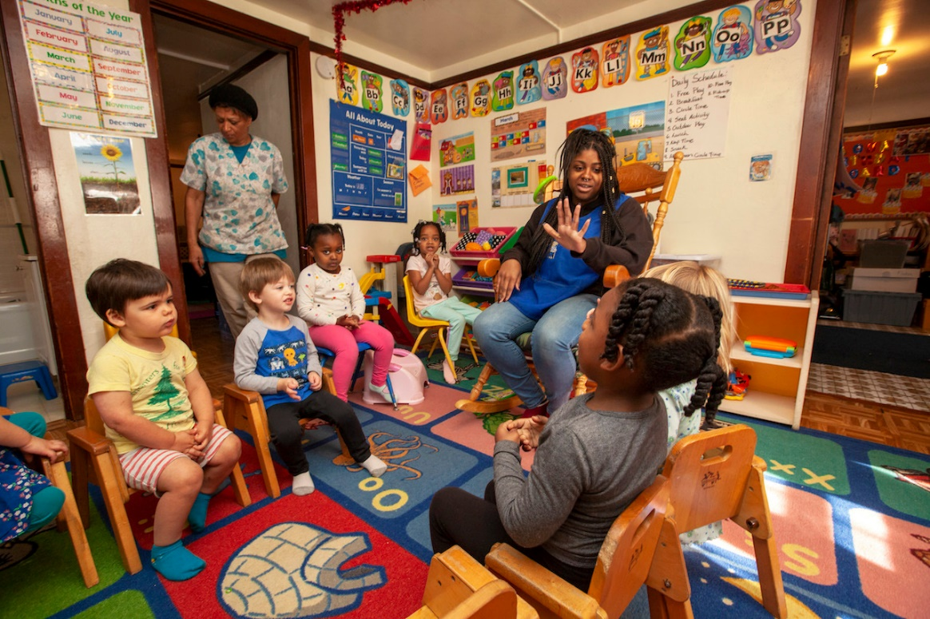
Maintaining Staff Health
ECD workers are at risk of contracting the diseases of the children.
They are prone to injuries due to the nature of their job
Monitoring health is important!

Slide 212

Staff Health
- Infectious Disease Prevention
All ECD staff should have a full medical before being appointed.
Immunisation: should receive annual influenza vaccines
Hygienic Procedures: practice good hygiene
Exclusion Criteria: monitoring for infectious diseases and practice isolation
Notes:
ECD professionals acquire infectious diseases at a higher rate than adults who have less contact with children The increased risk for ECD providers is attributed to the higher incidence of disease in the population they work with (young children) and to children’s greater propensity for transmitting diseases.
Some of the diseases providers may contract from children are more serious when acquired by adults

Slide 213
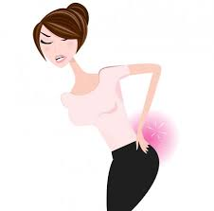
Staff Health
- Musculoskeletal Injuries
Musculoskeletal risk factors to ECD workers:
  heavy lifting and carrying (for example, lifting children),
  sitting on the floor or in child-size chairs with insufficient or no back support,
  kneeling,
  squatting, and
  reaching to a variety of heights.

Slide 214
Staff Health
- Musculoskeletal Injuries Prevention
Education in proper body mechanics to understand the importance of posture in preventing
  Strain on the lower back
Education in proper lifting and carrying techniques provision of furniture and fixtures at appropriate adult heights
Regular exercise and stretching for increased strength and flexibility
Maintenance of proper body weight to prevent straining back muscles
Use of proper shoes

Slide 215
Musculoskeletal Injuries Prevention
- Maintenance of Good Posture
Seating should support the lower back - Adult-size furniture should be used.
When rising from child-size chairs, assume a squat position keeping the back straight, pelvis level and abdomen tight while using the thigh muscles to raise the body to standing.
When floor sitting is necessary, sit with your back against a wall or some other firm base of support.
Avoid sitting or standing for long periods of time.
When standing for long periods, shift weight from side to side and change positions to avoid stress on certain muscles.
Adjust the height of changing tables to waist level.
Use stepping stools for reaching high places.
To get down to child level, assume a squatting or kneeling position
Store most commonly used items where they are accessible from a normal standing position.

Slide 216
Musculoskeletal Injuries Prevention
- Lifting of Children
Prepare first. Plan ahead and do not rush.
Make sure there is enough room to lift safely.
Give yourself a firm base of support.
  Stand close to the child with your feet about shoulder width apart and with one foot alongside child and the other slightly back.
  Squat down, bending at the knees, not the waist.
  Try to keep your chin parallel to the floor, and your back as straight as possible.
Have a firm grasp of the child before beginning to lift.
Begin slowly lifting with your legs. Never twist the body during this step.
Use slow and smooth movements.
To put the child down again follow the same steps in reverse order.

Slide 217
Portfolio
Complete Formative Activity 4
Homework – Knowledge Questions

Slide 218
Basic Child Knowledge
Study Unit 5:
Nutrition and Food

Slide 219

Basic Rules of Nutrition
Let children eat every 2-3 hours
Include complete, lean protein each time the child eats
Choose complex carbohydrates and foods that have a low Glycemic Index (GI)
Eat vegetables with every meal, and at least three fruit portions per day
Let the child drink at least 8 glasses of water per day
Teach the child to love healthy fats
Focus on whole foods
Balance daily food choices with variety
Never Allow Children to Skip Breakfast
Beware of Portion Distortion
Notes:
Understanding a child’s eating habits helps a childcare provider avoid frustration

Slide 220
Get Them to Eat
Children can be very adamant of what they like or dislike
They will eat different amounts of food on different days
Tips
  Present new foods along with well-liked foods
  Meals should be served in a pleasant and comfortable setting
  Allow children to make choices from the variety of healthful foods available
  Allow children to decide how much to eat
  Children naturally stop eating when they have had enough
  Children eat food because it tastes good and because of their mood

Slide 221
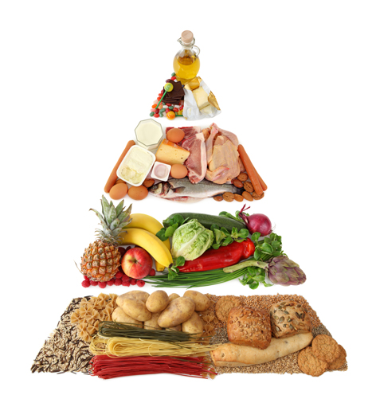
The Food Pyramid
Notes:
The food pyramid is designed to make healthy eating easier. Healthy eating is about getting the correct amount of nutrients – protein, fat, carbohydrates, vitamins and minerals you need to maintain good health
Foods that have the same type of nutrients are grouped together on each of the layers of the Food Pyramid
the Food Pyramid as a guide will help you get the right balance of nutritious foods within your calorie range

Slide 222
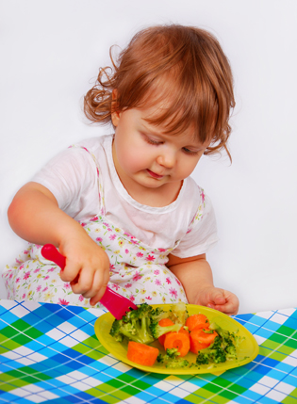
Healthy eating
Lots of bread, rice, potatoes, pasta and cereals – going for the wholegrain varieties whenever you can
Lots of fruit and vegetables
Some milk, cheese and yoghurt
Some meat, poultry, eggs, beans and nuts
A very small amount of fats and oils
And a very small amount or no food and drinks high in fat, sugar and salt

Slide 223
Food Pyramid for Kids
Children aged two to nine should eat per day:
  85 to 140 grams of grain and cereal foods, which include bread, pasta and rice
  Two cups of dairy foods, including cheese, milk and yogurt
  50 to 100 grams of protein foods, like lean meat, chicken and other poultry meats, fish, eggs and nuts
  One and a half cups of fruit or 3 – 4 medium-sized fruits
  One to one and a half cups of vegetables
  Three to four teaspoons of fats and oils.

Slide 224

Foods Suitable for Children
Milk: is a good source of calcium, vitamin D and protein for kids and should be a part of every child's diet
Fruit: Apples are a great snack food, other fruits include:
  Kiwi
  Melon
  Oranges
  Blueberries and strawberries
  Dried fruits are another option
Peanut butter is relatively high in fat, but it is mostly mono- and- poly-unsaturated fat. Be careful of allergies
Yogurt with "live active cultures" that is low-fat and without a lot of added sugar.

Slide 225
Foods Suitable for Children
Tuna fish is a great source of protein and provides omega-3 essential fatty acids and many vitamins and minerals
Whole grain cereal that is calcium fortified and has added fibre
Eggs are a good source of protein and contain some iron and many other vitamins and minerals
Vegetables: raw and cooked
Oatmeal is a high fibre food that is good for kids
Nuts and Sunflower Seeds: be careful of allergies and choking hazard
Low-fat cheese is another great source of calcium

Slide 226
Planning a Menu
Offer children a wide variety of foods
Plan healthy meals and snacks with good variety in advance
Use the Food Pyramid to ensure that they receive the recommended number of servings from all food groups each day and that suitable portion sizes are offered
Offer children healthy snacks between meals to meet their higher energy requirements
Offer tooth-friendly drinks regularly.
Prepare food in a clean and safe way
Use healthy cooking methods
Notes:
Key Points in Planning a Menu

Slide 227
Planning a Menu
Avoid adding salt or using very salty foods frequently
Accommodate any specific dietary requirements of the children
Remember, food is a wonderful source of learning for children
Use mealtimes and snacks to give children the opportunity to explore new foods
The use of different colours, tastes and textures makes mealtimes exciting for children.
It allows for a variety of food related activities to be introduced. This can lay the foundations of simple health promoting links between food and health at an early age.
Notes:
Key Points in Planning a Menu

Slide 228
Mealtime Safety
Never leave a child unattended while they are eating due to the risk of choking
Be especially careful when foods with different textures are being eaten
For younger children, take care to remove pips and seeds from fruit
Whole nuts and popcorn are not recommended for children under the age of 5 years because of the risk of choking
Encourage food to be eaten slowly and carefully to reduce the risk of choking and to prolong the taste sensation from food
Make sure that children sit quietly while eating, as young children who run, play, laugh or cry while eating are more likely to choke on their food

Slide 229
Portion Sizes
 | Food Group | Age 1 - 2 – Daily servings | Age 3 - 5 | Age 6 - 10
Breakfast | Milk | ½ cup | ¾ cup | 1 Cup
 | Vegetables and fruits | ¼ cup each | ½ cup each | ½ cup each
 | Grains and Breads: Bread Cereal Pasta | ½ slice ¼ cup ¼ cup | ½ slice ⅓ cup ¼ cup | 1 slice ¾ cup ½ cup
Notes:
Refer to table in LG

Slide 230
Portion Sizes
 | Food Group | Age 1 - 2 – Daily servings | Age 3 - 5 | Age 6 - 10
Lunch | Milk | ½ cup | ¾ cup | 1 cup
 | Vegetables and fruits | ¼ cup total | ½ cup total | ¼ cup total
 | Grains and Breads: Bread Cereal Pasta | ½ slice ¼ cup ¼ cup | ½ slice ⅓ cup ¼ cup | 1 slice ¾ cup ½ cup
 | Meat and meat alternatives: Meat, poultry, fish Cheese Eggs Peanut butter Nuts Yoghurt | 30 gram 30 gram ½ egg 2 Tbsp 15 gram ½ cup | 45 gram 45 gram ¾ egg 3 Tbsp 20 gram ¾ cup | 60 gram 60 gram 1 egg 4 Tbsp 30 gram 1 cup

Slide 231
Portion Sizes
 | Food Group | Age 1 - 2 – Daily servings | Age 3 - 5 | Age 6 - 10
Snacks | Milk | ½ cup | ¾ cup | 1 cup
 | Vegetables and fruits | ¼ cup each | ½ cup each | ½ cup each
 | Grains and Breads: Bread Cereal Pasta | ½ slice ¼ cup ¼ cup | ½ slice ⅓ cup ¼ cup | 1 slice ¾ cup ½ cup
 | Meat and meat alternatives: Meat, poultry, fish Cheese Eggs Peanut butter Nuts Yoghurt | 30 gram 30 gram ½ egg 2 Tbsp 15 gram ½ cup | 45 gram 45 gram ¾ egg 3 Tbsp 20 gram ¾ cup | 60 gram 60 gram 1 egg 4 Tbsp 30 gram 1 cup
Notes:
Refer to LG for examples of menu’s for one week

Slide 232
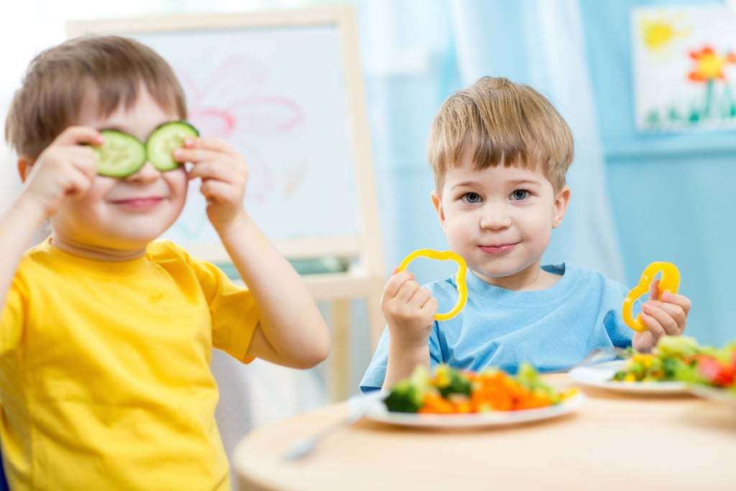
Introducing Solids
Introducing solid foods to a baby is a really big milestone.
This milestone is a lot of fun and a lot of worry as well.
Current recommendations indicate that breast milk or formula should be baby’s main source of nutrition until at least 6 months of age.
Many paediatricians recommend starting solid foods sometime between four and six months,

Slide 233
Introducing Solids - Signs
He/she can sit up (with support) and can hold her head and neck up well
His/her birth weight has doubled
He/she’s interested in what you’re eating and may even try to grab food from your plate
He/she can keep food in her mouth rather than letting it dribble out
He/she shows signs of being hungry for more than he/she’s getting by clamouring for more when her bottle is empty or wanting to nurse more often.

Slide 234
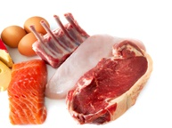
Beginning Solid Foods
Give the baby one new food at a time
Wait a minimum of two to three days before starting another
After each new food, watch for any allergic reactions such as diarrhoea, rash, or vomiting
Within a few months of starting solid foods, you should offer the baby a variety of foods
  Breast milk and/or formula
  Meats
  Cereal
  Vegetables
  Fruits
  Eggs and fish

Slide 235
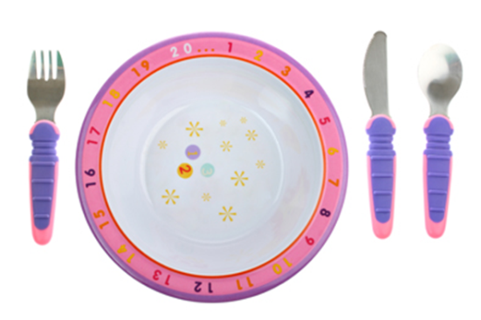
Baby Feeding Gear
Small, soft-tipped spoons
A high chair or other secure seat that holds the baby upright to eat
Plastic or other waterproof bibs
Unbreakable plates and bowls

Slide 236
Feeding Baby Solid Foods:
When to Move On
As babies develop more teeth and chewing skills, you can offer them foods with more texture:
Instead of pureeing veggies and fruits, try giving them in mashed-up form.
There’s no hard and fast age rule
Each time you introduce a new solid food, wait about three days to see if it causes an allergic reaction
If the baby has moved past purees, he/she can also begin to try other table foods, such as meats and poultry, eggs, dairy products, and beans
Just cut or mash the food into a size and consistency that he/she can chew or gum.

Slide 237

Introducing Allergenic Foods to Babies and Food Allergies
Changes to how to introduce allergenic foods to the baby are slowly taking place.
The advice of many paediatricians is not to give eggs and fish in the first year of life because of allergic reactions,
There is no evidence that introducing these nutrient-dense foods after 4 to 6 months of age determines whether the baby will be allergic to them.

Slide 238
Portfolio
Complete Formative Activity 5
Homework – Knowledge Questions

Slide 239
Basic Child Knowledge
Study Unit 6
Basic Rights of Children

Slide 240
The Needs of Children
Most important purpose of a place of care is to provide care to children in the temporary absence of their parents.
It is the responsibility of a place of care to enhance the development of the child physically, mentally, psychologically, emotionally, morally, culturally and socially.
The nature and standard of the care and education that a child receives during the first seven years of life is of crucial importance for his/her later development.
For this reason it is of vital importance that the child should receive good quality care that meets all his/her needs.

Slide 241
The Needs of Children
An holistic approach to early childhood development is required
The Department of Social Development has a responsibility to ensure that conditions are created for the optimum development of all children and their families
Programmes should be in place to accommodate disadvantaged children and children with special needs
Responsibility of places of care is to educate children about their rights and responsibilities

Slide 242

The Needs of Children
Children have the right to be
  listened to,
  respected,
  protected,
  educated and
  cared for.
Children also have responsibilities towards others.
They have to be educated on this responsibility, which includes to listen to others, care for and respect their peers, siblings, care-givers, parents and other members of the community.
Notes:
The place of care forms part of the community. Parents, families and communities have the responsibility to complement the services provided at care facilities. In order to address the child’s needs holistically it is important that there should be close collaboration between the parent/s and
the caregiver.

Slide 243

The United Nations Convention on the Rights of the Child
Children need special protection and care
All children deserve equal treatment and opportunities in life.
All children deserve good education, health care and protection against abuse and neglect.
Notes:
In 1989, many nations came together and adopted the United Nations Convention on the Rights of the Child

Slide 244
Constitution of South Africa
Child Care Act
  To a name and a nationality from birth;
  To family care or parental care, or to appropriate alternative care when removed from the family environment;
  To basic nutrition, shelter, basic health care services and social services;
  To be protected from maltreatment, neglect, abuse or degradation;
  To be protected from exploitative labour practices;
  Not to be required or permitted to perform work or provide services that ­
    are inappropriate for a person of that child's age; or
    place at risk the child's well-being, education, physical or mental health or spiritual, moral or social development;
  Not to be detained except as a measure of last resort, in which case, in addition to the rights a child enjoys under sections 12 and 35, the child may be detained only for the shortest appropriate period of time, and has the right to be ­
    kept separately from detained persons over the age of 18 years; and
    treated in a manner, and kept in conditions, that take account of the child's age;
  To have a legal practitioner assigned to the child by the state, and at state expense, in civil proceedings affecting the child, if substantial injustice would otherwise result; and
  Not to be used directly in armed conflict, and to be protected in times of armed conflict.
Notes:
Each child has a right to_

Slide 245

General Rights of Children
The Right to Life
The Right to Health and Health Care
The Right to Social Security
The Right to Family Life
The Right to Identity, Nationality and Refuge
The Right to Protection against Abuse and Neglect
Protection Against Degrading Punishment
Protection against Sexual Exploitation and Sexual Abuse
Protection against Harmful Substances and Exploitation
The Right to Education
The right to Recreation
The Rights of Children with Disabilities / Special Needs
The Right to Privacy
The Right to Freedom of Expression, Thought, Conscience and Religion
The Right for Association and Peaceful Assembly
Notes:
Discuss each aspect and give examples, refer to LG

Slide 246
Suspected Violation of a Child’s Rights
Legal responsibility care centres to report such violation, or suspected violation.
Warning signs of possible abuse are:
  Physical signs such as bruising, head injuries, broken bones or malnutrition.
  Change in behaviour such as not going to school, withdrawal, poor concentration, fear, anxiety, suicidal or self-harming behaviour.
  Other signs such as obsessions, inappropriate sexual behaviour, inappropriate anger, bed-wetting and difficultly sleeping, or changes in eating.

Slide 247
Suspected Violation of a Child’s Rights
If a child reports child abuse to a carer in a centre, he/she should respond in the following way:
  Believe the child.
  Thank the child for having courage to talk to you.
  Tell the child that it was not his or her fault.
  Explain confidentiality – that although the child has disclosed in confidence, you as the adult need to report to the right authority
  Reassure them you will find support for them

Slide 248

The Procedures to Report Abuse or Suspected Abuse
The following information will be required:
  Name, surname and age of the child.
  Physical address or contact details of the child.
  Information on parents or care giver details.
  The type of abuse you suspect has occurred, and any other details you have (without investigating the abuse).
  The details of the person reporting the abuse, anonymous reports will be accepted and investigated.

Slide 249
The Procedures to Report Abuse or Suspected Abuse
Who to report to:
  Social worker (Social Development) - 0800 60 10 11
  Childline - 08000 55 555
  Police station - 10111 / 08600 10 111
  For human trafficking - 0800 555 999

Slide 250
Portfolio
Complete Formative Activity 6

Slide 251
Summative Assessment
Complete Knowledge Questions
Complete workplace activities

