Slide 1
Conflict Management Training Programme
Interpret and Manage Conflicts within the Workplace
Unit Standard ID 114226 | NQF Level 5 | Credits 8

Slide 2
Ground Rules
3 Days Training
Portfolio building
Breaks
Cell Phones
Participation
Portfolio Submission

Slide 3

Section 1 Overview
What Is a Portfolio?
Collection of Evidence that
Lists criteria for proving competence
Provides evidence that you meet criteria
Is organised to enable assessor to evaluate evidence against criteria.

Slide 4
Overview
The Portfolio of Evidence (PoE)
Section 1 – Administrative detail
Section 2 – Assessment planning
Section 3 – Assessment design matrix
Section 4 – Formative assessment activities
Section 5 – Summative assessment
Knowledge questionnaires

Slide 5
Overview
Section 6 – Summative assessment – Workplace assignments
Section 7 – Feedback
Section 8 - Additional Evidence

Slide 6
Categories Of Evidence
Practical Competence
Foundational Competence
Reflective Competence

Slide 7
Overview
Competency
  Against Outcomes in Unit Standard
Interpret
  Outcomes in relation to workplace

Slide 8
Good Evidence
Valid
  Should relate to what is being assessed
Authentic
  Own evidence
Reliable
  Consistency
  Another assessor makes same judgment
Current
  As recent as possible
Sufficient
  Enough evidence

Slide 9
Assessment Brief
Purpose of Unit Standard
Identify and manage the resolution of personal conflict between persons or parties..
The qualifying learner is capable of:
Describing the main sources of conflict
Describing appropriate techniques to manage conflict
Implementing a strategy to resolve conflict
Developing the attributes of a good conflict manager

Slide 10

Assessment Brief
Entry Level Requirements
Communication at NQF Level 4 or equivalent
Mathematical Literacy at NQF Level 4.

Slide 11
Assessment Brief
Credit Value
8 credits = 80 notional hours
Theoretical + Practical + Workplace experience
Submission of Portfolio of Evidence (PoE) - based on Specific Outcomes (SOs) and Assessment Criteria (ACs).

Slide 12
Types of Assessment
Integrated Assessment
Diagnostic
Formative
Summative

Slide 13
Assessment Methods
Assessment Methods
Questioning
Product Evaluation
Observation

Slide 14
Assessment
Assessment
Formative
Summative
Evidence during
facilitation
Self Assessment
Knowledge Assessment
Summative Workplace
Assignments
Formative + Summative = Competent

Slide 15
Competence
Competent
Ability to perform task, action or function successfully
Certificate issued and credits awarded
Not Yet Competent
Not successful yet
Opportunities to remediate to address gaps

Slide 16

Re-Assessment
Specific feedback - focus on not yet competent areas
Re-assessment - same context and same conditions
Only Not Yet Competent specific outcomes - to be re-assessed
ENJO’s policy: - Two (2) re-assessments

Slide 17
Assessment Brief
Credit Accumulation
Credits will be awarded on successful completion of unit standards.
NB: - Quality Assurance Process
Assessment
Moderation
Verification

Slide 18
Assessment Brief
Assessment Tools and Matrix:
  All the specific outcomes
  Associated assessment criteria
  Range statements
  Critical cross-field, development outcomes
  Essential embedded knowledge.

Slide 19
Assessment Brief
ENJO Assessment Process:
  Integrated assessment against current SAQA registered unit standards and qualifications in a fair, valid, reliable and practicable manner.
  Moderation and verification procedures carried as per SAQA requirements.
  Learner competence demonstrated through formative and summative assessments.

Slide 20
Assessment Brief
Learners have the right to:
  Be informed when and how assessments are conducted
  Appeal against an assessment conducted.
  Get interpretation to the numeracy and literacy level of the skills programme, unit standard or qualification.

Slide 21
Assessment Brief
Facilitation and assessments will be conducted in English.
Learners may have an observer present; however observer may not partake, comment or interrupt the assessment process.
Assessment results will be available within 20 working days after submission
Final results are dependent on SETA
Learners may have access to results within normal working hours.

Slide 22
Assessment Brief
Additional Notes:
  Assessor will maintain telephonic and electronic contact until sufficient evidence has been submitted.
  Additional evidence may be submitted after initial submission.
  If you have a problem which might affect the outcome of assessment(s) you should notify the assessor. Where practicable such needs will be accommodated. (special needs)

Slide 23
Appeals and Disputes
Learner has right to appeal against:
Unfair assessment
Invalid assessment
Unreliable assessment
Unethical practices
Inadequate expertise and experience of the assessor
Appeals have to be submitted in writing to ENJO.

Slide 24
Section 1
Portfolio of Evidence
Section 1 – Administrative Detail

Slide 25

Section 1 Administrative Detail
Learner Information
ID
CV
Qualifications
Special Instructions
Declaration of Authenticity
Unit Standard
Sign all required documents

Slide 26
Special Instruction
No Tippex
Initial each page
Comments in full
ENJO or own templates to be used to complete portfolio
Use assigned colour unless instructed differently

Slide 27
Unit Standard
SAQA US ID
Unit Standard Title
NQF Level
Credits
Purpose of the Unit Standard
Learning assumed to be in place

Slide 28
Unit Standard
Unit Standard Range
Specific Outcomes
Assessment Criteria
Essential Embedded Knowledge (EEK)
Critical Cross-field Outcomes (CCFOs)
Notes

Slide 29

Conflict Management Training Programme
Study Unit 1:
Demonstrate understanding of outcomes-based assessment.

Slide 30

Study Unit 1 – Assessment Criteria
1. A list of possible sources of conflict, including perceptions and assumptions, is drawn up with examples of where they are most likely to occur.
2. Positive and negative characteristics of conflict in the workplace are discussed with examples.
3. Organisational conflict modes are explained with examples.
4. Conflict, which may arise in personality types, can be described, using transactional analysis.

Slide 31
1. Main Sources of Conflict
The Difference between Conflict and Dispute
Disputes: A by-product of conflict.
Typical disputes: Formal court cases, grievances, arguments, threats and counter threats.
Conflict can exist without disputes, but disputes do not exist without conflict.
Conflict might not be noticed easily, disputes are always out in the open.
Conflicts can exist in the workplace without turning into disputes.

Slide 32

1. Main Sources of Conflict
Types of Conflict
Interpersonal
Organisational
Change related
External factors

Slide 33
1.2 Positive and Negative Characteristics of Conflict
Negative Characteristics of Conflict
Mental health concerns
Decrease in productivity
Employees leave organisation
Violence

Slide 34
1.2 Positive and Negative Characteristics of Conflict
Positive Characteristics of Conflict
Inspire creativity
Share and respect opinions
Improve future communication
Identify members for new functions

Slide 35
1.2 Positive and Negative Characteristics of Conflict
Transactional Analysis
Our brains have three distinct ego states:
The parent
Child
Adult
In the workplace, you can see examples of transactional analysis at all levels

Slide 36

1.2 Positive and Negative Characteristics of Conflict
Transactional Analysis
Complementary transactions
Crossed transactions
Stroking
Transactional games
Why don't you/yes but

Slide 37
1.3 Organisational Conflict Modes
Examples of Organisational Conflict:
Labour/management and supervisor/employee tensions heightened by power differences
Differences in supervisory styles between departments
Work style clashes
Seniority/junior clashes
Pay equity conflict

Slide 38

1.3 Organisational Conflict Modes
Examples of Organisational Conflict:
Conflict over resource allocation
Distribution of duties
Workload and benefits
Different levels of tolerance for risk taking
Varying views on accountability

Slide 39
1.4 Conflict between Personality Types
Commanding drivers
Enthusiastic adventurers
High energisers
Supporting cheerleaders
Dependable stabilisers
Analysing perfectionists

Slide 40

Formative Assessment
Do Activity 1 in your PoE.

Slide 41
Conflict Management Training Programme
Study Unit 2:
Conflict Management Techniques

Slide 42
Study Unit 2 – Assessment Criteria
1. The various business conflict modes are discussed with examples
2. Useful steps to be taken to manage conflict are explained with examples
3. The route, which conflicts normally follow toward resolution can be described with examples.

Slide 43

2.1 Business Conflict Modes
Accommodating
Avoiding
Collaborating
Competing
Compromising

Slide 44
2.2 Steps in Managing and Resolving Conflict
Take a step back
Understand the other person’s view
Reflect and assert your own needs
Find the benefits or value of the conflict
Share your “stories” with each other
Find a mutually agreeable solution

Slide 45
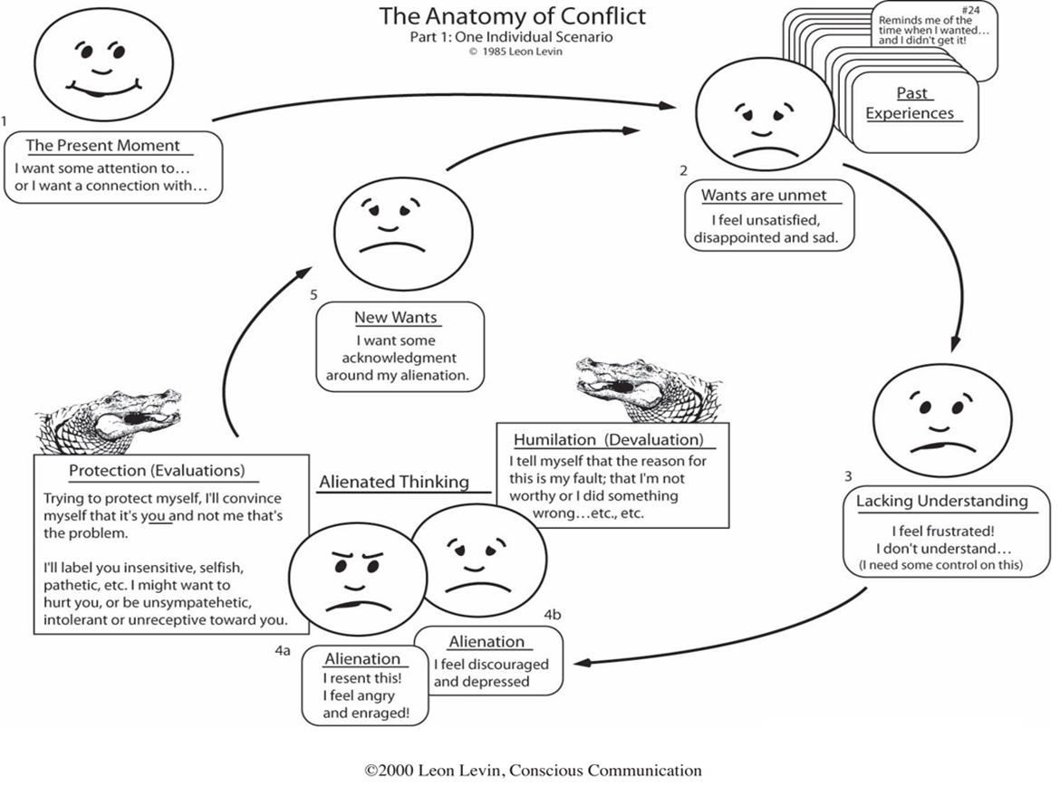
2.3 The Route that Conflict takes towards Resolution

Slide 46
2.3 The Route that Conflict takes towards Resolution
Stages of Conflict
Latent Stage: Participants are not yet aware that there is conflict
Perceived Stage: Participants are now aware that a conflict exists
Felt Stage: Stress and anxiety
Manifest: Conflict is open and can be observed
Aftermath: Outcome of conflict, resolution or dissolution

Slide 47
Formative Assessment
Do Activity 2 in your PoE.

Slide 48
Conflict Management Training Programme
Study Unit 3:
Action Plan and Strategies to Manage Conflict

Slide 49
Study Unit 3 – Assessment Criteria
1. Methods available to resolve conflict in terms of the Labour Relations Act are listed with examples.
2. The most appropriate strategy to resolve a particular conflict is chosen with a justification for the choice of strategy.
3. The need to adopt action plans and adapt them to a particular conflict is demonstrated with examples.
4. The role of policies and procedures in place in the organisation are explained in terms of their role in preventing and/or resolving conflicts.

Slide 50

3.1 Methods to Resolve Conflict
Labour Relations Act: Statutory Dispute-resolution Forums
The dispute-resolution arms of Bargaining Councils (BC):
The Commission for Conciliation,
Mediation and Arbitration (CCMA)
The Labour Court
The Labour Appeal Court

Slide 51
3.1 Methods to Resolve Conflict
The process to follow for unfair dismissal, or other unfair practices:
Complete a dispute-referral form and lodge it with BC or CCMA
A conciliation meeting is then set up where a mediator is appointed to try to settle the matter out of court

Slide 52
3.1 Methods to Resolve Conflict
If conciliation process is:
Successful: Employer and employee signs a contract setting out the terms of their settlement agreement and the matter is then regarded as closed.
Unsuccessful: Employee may refer it to the next level, either be an arbitration tribunal or labour court

Slide 53
3.1 Methods to Resolve Conflict
Multiple retrenchment, strike dismissals or automatically unfair dismissals - Labour Court instead of arbitration.
Alternatively, the CCMA may set the matter down as a con/arb
Any decision of the Labour Court may be referred to the Labour Appeal Court, the Supreme Court of Appeal and to the Constitutional Court.

Slide 54
3.1 Methods to Resolve Conflict
Arbitration or Labour Court
Employee only has to prove that he/she was dismissed, or was treated unfairly
Employer has to prove that the dismissal was both procedurally and substantively fair
Employer is assumed guilty until he/she can prove his/her innocence

Slide 55
3.1 Methods to Resolve Conflict
At arbitration lawyers may be allowed if:
The dispute is not a matter of misconduct or incapacity
The arbitrator allows lawyers due to the legal complexity of the matter or to "uneven playing fields"

Slide 56
3.2 Strategies to Resolve Conflict
The following are eight strategies to handle conflict and restore the workplace:
Understand the situation
Acknowledge the problem
Be patient and take your time
Avoid using coercion and intimidation

Slide 57

3.2 Strategies to Resolve Conflict
Focus on the problem, not the person
Establish guidelines
Keep the communication open
Act decisively

Slide 58

3.3 Action Plans to Resolve Conflict
Tools to manage conflict:
Active listening
Constructive dialogue
Negotiation
Mediation
Reconciliation

Slide 59
3.3 Action Plans to Resolve Conflict
Conflict Management Process:
Hold preliminary conversations to build trust and understanding
Deepen conversations to identify and define the issues
Turn the issues inside-out, upside-down to reflect reality from different perspectives
Engage in mutual problem solving
Agree on actions that help all parties meet their needs and preserve their dignity
Follow-up to assure that expected results have been achieved

Slide 60
3.3 Action Plans to Resolve Conflict
Ground Rules
Set ground rules to protect everyone
Create a framework for resolution
Communication, compromise and respect are vital
Wait until tempers have cooled for each side to present its arguments calmly
Approach conflict resolution with a common goal in mind

Slide 61
3.3 Action Plans to Resolve Conflict
Individual
With interpersonal issues, individual conflict resolution is often best
Help team members to communicate and resolve conflict before it escalates
Direct communication saves valuable time
Set up a process: email a request, reserve a room and meet for 15 minutes, for example.

Slide 62
3.3 Action Plans to Resolve Conflict
Manager Involvement
When employees cannot solve their own issues, ask a direct supervisor to step in
The manager is not overly involved but must have first-hand knowledge of the situation
A manager could clear up misconceptions
The involvement of a supervisor helps to keep emotions in check

Slide 63
3.3 Action Plans to Resolve Conflict
Moderator
Some problems are impossible to solve from the inside
Bring in an outside party to act as a moderator
During a moderated session, each side should present its argument; the moderator then works with them to see problems and create solutions

Slide 64
3.3 Action Plans to Resolve Conflict
Action Plan
Timing:
When will new interventions be introduced?
How often will you meet?
When will you report to senior management?
Which interventions are priorities?

Slide 65
3.3 Action Plans to Resolve Conflict
Action Plan
Cost:
Do you have estimated budget, for instance for training, workshops, team building sessions, etc.?
Consultation:
Who needs to be consulted before you start?
Objectives:
Do these match your original project objectives? If not, why not?

Slide 66
3.3 Action Plans to Resolve Conflict
Action Plan
Who:
Who will carry out the implementation?
Will you need external experts?
Who will you need to report to?

Slide 67
3.3 Action Plans to Resolve Conflict
Action Plan
Evaluate:
How will you measure progress?
How will you measure success?
How will you learn from you mistakes?

Slide 68
3.3 Action Plans to Resolve Conflict
Action Plan
Points to consider:
Are the people being asked to change Involved in planning?
Have people’s concerns with change been articulated and addressed?

Slide 69
3.4 Policies and Procedures
Each organisation must have policies and procedures in place to resolve conflict in the workplace
They should be adhered to at all times
They should be communicated to all employees

Slide 70
Formative Assessment
Do Activity 3 in your PoE.

Slide 71
Conflict Management Training Programme
Study Unit 4:
Attributes of an Effective Conflict Manager

Slide 72
Study Unit 3 – Assessment Criteria
1. Personal attributes of a good conflict manager can be listed with examples of how each characteristic contributes to conflict resolution.
2. A skills audit is done by the learner to identify the skills he/she needs to develop to be an effective conflict manager are identified.
3. The negative attributes which should be avoided or controlled by an effective conflict manager are listed with an explanation of the negative effect each has on the resolution of conflict.

Slide 73

4.1 Personal Attributes of a Good Conflict Manager
He/she must be a follower of ethics
He/she must be a wise leader
He/she must be calm and rational
He/she should focus on issues not
on people and personal grudges
He/she must be respectful to all
parties

Slide 74
4.1 Personal Attributes of a Good Conflict Manager
He/she must control costs and closely monitor expenditures
He/she must be understanding and adaptable.
He/she must manage urgent tasks properly in limited time and with limited resources.
He/she must have self-motivation, optimism and calmness.
He/she must have integrity so that people can trust him/her.

Slide 75
4.1 Personal Attributes of a Good Conflict Manager
He/she must be dependable, reliable, responsive, confident and flexible.
He/she must have proper knowledge of the industry, and all aspects of the organisation
He/she must have good communication and listening skills
He/she must have good relationship qualities

Slide 76
4.2 Skills to Develop to be an Effective Conflict Manager

Slide 77
4.3 What a Conflict Manager Should and Should not do
Resolving Conflict in the Workplace: The “Do’s”
Understand that there will always be conflicts
Try to address conflict quickly and appropriately
Focus on the problem
Keep an open mind and be open to new solutions
Acknowledge how the different parties are feeling during the process

Slide 78
4.3 What a Conflict Manager Should and Should not do
Resolving Conflict in the Workplace: The “Do’s”
Listen actively
Use HR to mediate conflicts that occur between supervisors and employees
Encourage open communication
Treat all employees and co-workers with respect and dignity

Slide 79
4.3 What a Conflict Manager Should and Should not do
Resolving Conflict in the Workplace: The “Don’ts”
Focus on personality traits that cannot be changed
Interrupt others when they are speaking
Attack individuals
Disregard the feelings of others

Slide 80
4.3 What a Conflict Manager Should and Should not do
Resolving Conflict in the Workplace: The “Don’ts”
Avoid the conflict
Allow emotions to take over the conversation
Impose your own personal values or beliefs on the situation
Always try to fix it yourself instead of evaluating the best method of resolution

Slide 81
Formative Assessment
Do Activity 4 in your PoE.

